Slide 1
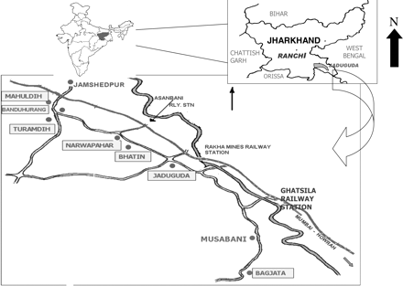
Figure 1. Environmental map of Jaduguda area showing uranium mines, Jharkhand, India.
Notes:
Figure 1. Environmental map of Jaduguda area showing uranium mines, Jharkhand, India.
Unless provided in the caption above, the following copyright applies to the content of this slide: © The Author 2010. Published by Oxford University Press. All rights reserved. For Permissions, please email: journals.permissions@oup.com

Slide 2
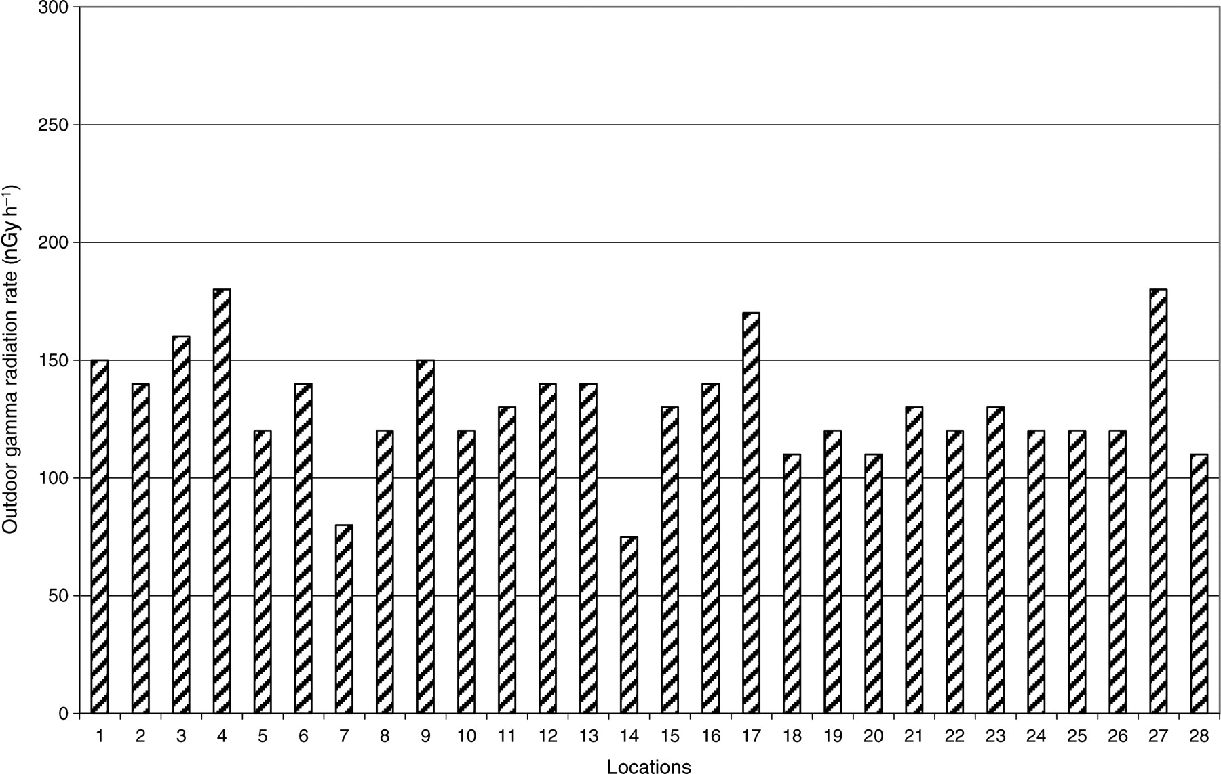
Figure 2. Natural outdoor gamma radiation levels around uranium mining complex, Jaduguda.
Notes:
Figure 2. Natural outdoor gamma radiation levels around uranium mining complex, Jaduguda.
Unless provided in the caption above, the following copyright applies to the content of this slide: © The Author 2010. Published by Oxford University Press. All rights reserved. For Permissions, please email: journals.permissions@oup.com

Slide 3
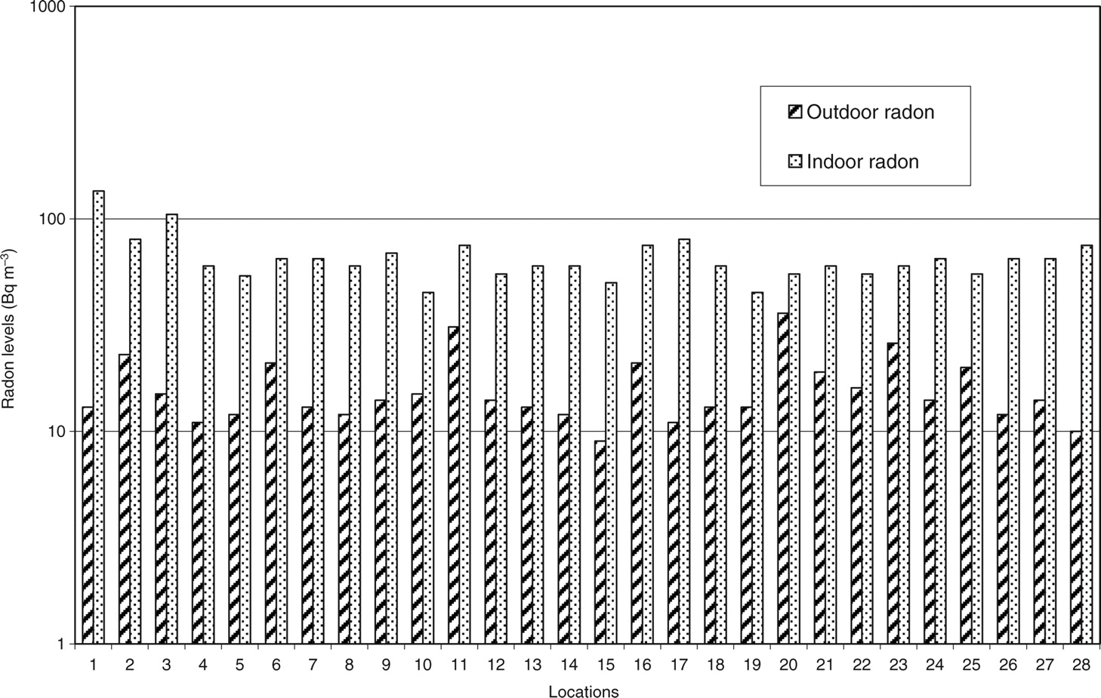
Figure 3. Natural outdoor and indoor radon levels around uranium mining complex, Jaduguda.
Notes:
Figure 3. Natural outdoor and indoor radon levels around uranium mining complex, Jaduguda.
Unless provided in the caption above, the following copyright applies to the content of this slide: © The Author 2010. Published by Oxford University Press. All rights reserved. For Permissions, please email: journals.permissions@oup.com

