Slide 1
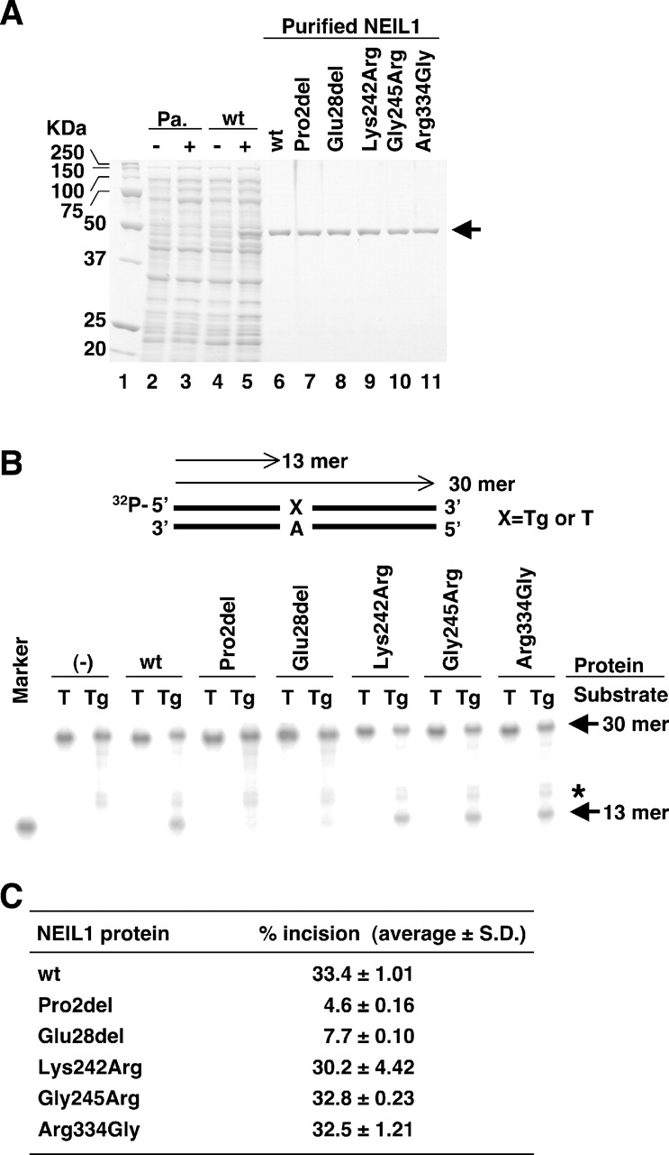
Fig. 1. Comparison of the cleavage activity toward double-stranded DNA containing a Tg:A mispair among NEIL1 variant ...
Notes:
Fig. 1. Comparison of the cleavage activity toward double-stranded DNA containing a Tg:A mispair among NEIL1 variant proteins. ( A ) Purification of recombinant NEIL1 proteins resolved by PAGE and stained with Coomassie Brilliant Blue. NEIL1 protein tagged with His 6 at its C-terminus was prepared according to the pET System protocol. Lysates of E.coli culture with/without expression of wild-type (wt) NEIL1 protein (lanes 2–5) and purified various NEIL1 proteins (lanes 6–11) are shown. Pa. (lanes 2 and 3) and wt (lanes 4 and 5) indicate the transformation of the host cells with parental pET25b(+) and NEIL1 cDNA-containing pET25b(+) vector, respectively. − and + mean the absence and presence of IPTG induction, respectively. The NEIL1-His 6 protein band is indicated. ( B ) Cleavage activity of NEIL1 variant proteins toward double-stranded DNA containing a Tg:A mispair. Various types of NEIL1 proteins and a 32 P-labeled double-stranded oligonucleotide containing or not containing a single 5 R ,6 S -Tg:A mispair were incubated and subjected to 20% PAGE. A 32 P-labeled 13mer oligonucleotide was used as a size marker for the cleaved products. A representative result is shown in the panel. (−) at the top of the panel indicates no addition of NEIL1 protein. The intact 30mer and cleaved 13mer oligonucleotides are indicated by the arrows. The band with an asterisk in the lane of the Tg substrate is an oligonucleotide impurity. ( C ) The percentage of cleaved products per total under conditions of 37°C for 15 min was calculated as % incision and listed.
Unless provided in the caption above, the following copyright applies to the content of this slide: Carcinogenesis vol.25 no.12 © Oxford University Press 2004; all rights reserved.

Slide 2
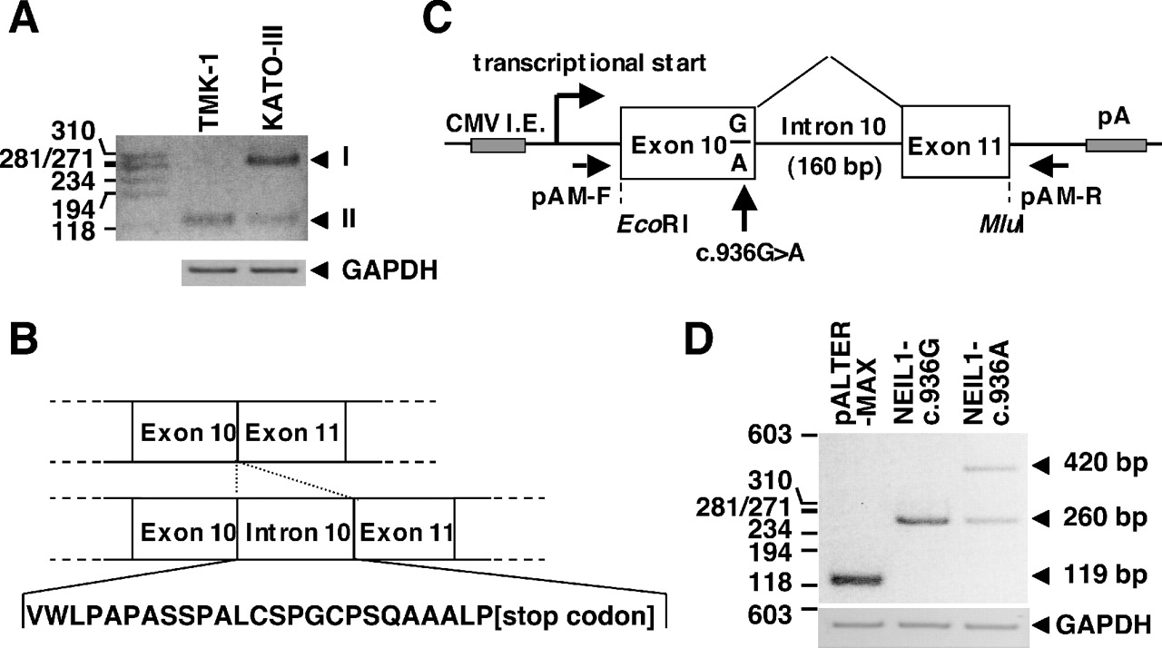
Fig. 2. Detection of the NEIL1 splicing abnormality due to the c.936G > A change by in vivo splicing assay. ( A ) ...
Notes:
Fig. 2. Detection of the NEIL1 splicing abnormality due to the c.936G > A change by in vivo splicing assay. ( A ) Detection of the abnormally spliced product from KATO-III cell line by RT–PCR analysis. The genotypes of TMK-1 and KATO-III cells are homozygous for the c.936G allele and heterozygous for the c.936G and c.936A alleles, respectively. Expression of the NEIL1 mRNA transcript was examined using the primers located in exons 10 and 11. GAPDH expression was also examined. The band detected by electrophoresis was excised from the gel and directly sequenced. Bands indicated by arrowheads I and II are PCR products retaining or not retaining intron 10, respectively. ( B ) Diagram showing the polypeptide sequence translated from the read-through transcript of intron 10. ( C ) Schema of a part of pALTER-MAX expression vectors containing exon 10, intron 10 and exon 11 of the NEIL1 gene. ( D ) In vivo splicing assay. The NEIL1-c.936G and -c.936A type expression vectors were transiently transfected into the NCI-H1299 cell line. At 24 h post-transfection, the cells were harvested, and RT–PCR was performed using the set of primers pAM-F/pAM-R, as indicated in (C), or a set of primers for GAPDH. PCR products were fractionated by agarose gel electrophoresis, and each band was directly sequenced. The 119-, 260- and 420-bp products correspond to a vector sequence without NEIL1 , a NEIL1 sequence without intron 10, and a NEIL1 sequence with intron 10, respectively.
Unless provided in the caption above, the following copyright applies to the content of this slide: Carcinogenesis vol.25 no.12 © Oxford University Press 2004; all rights reserved.

Slide 3
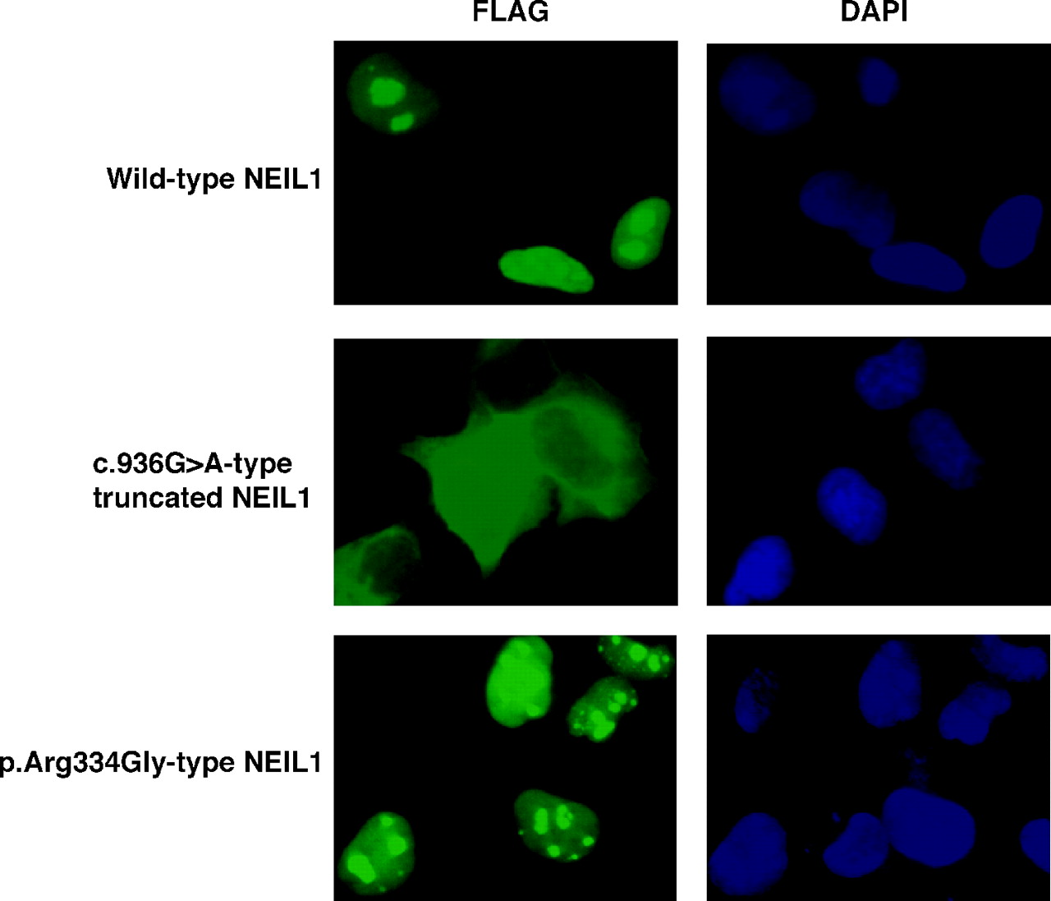
Fig. 3. The distinct subcellular localization of the wild- and mutant-type of NEIL1 protein. The wild-type and ...
Notes:
Fig. 3. The distinct subcellular localization of the wild- and mutant-type of NEIL1 protein. The wild-type and mutant-type NEIL1 with the FLAG epitope tag at the C-terminus were expressed in NCI-H1299 cells and stained with anti-FLAG M2 as the first antibody and FITC-conjugated anti-mouse IgG as the second antibody. The immunofluorescence microscopic image of FITC (green)-stained cells showed the localization of exogenous NEIL1 protein. The nuclei were counterstained with DAPI (blue).
Unless provided in the caption above, the following copyright applies to the content of this slide: Carcinogenesis vol.25 no.12 © Oxford University Press 2004; all rights reserved.

Slide 4
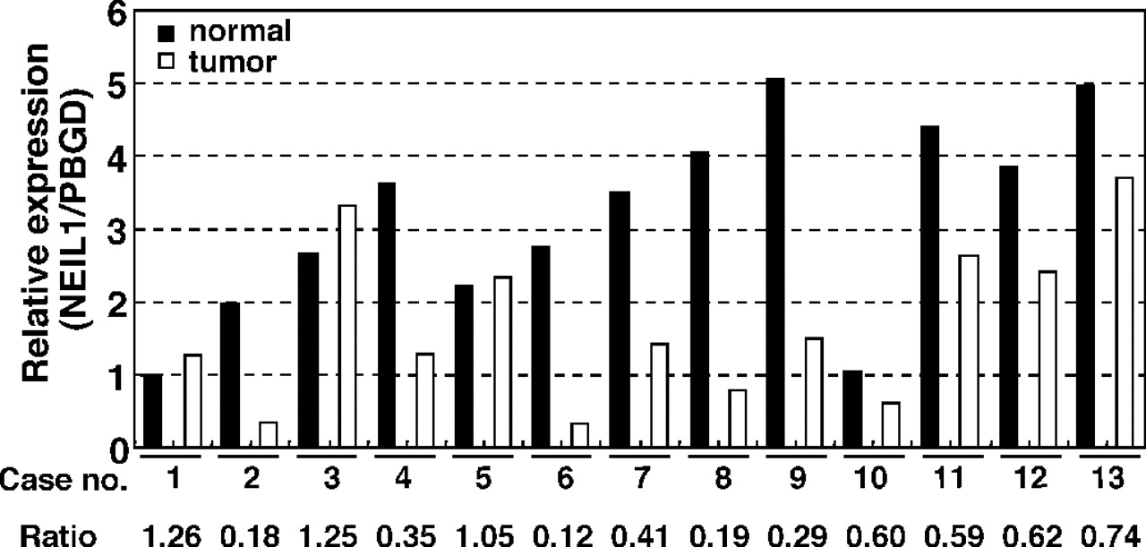
Fig. 4. NEIL1 expression in gastric cancer and corresponding non-cancerous tissue. Expression of the NEIL1 mRNA ...
Notes:
Fig. 4. NEIL1 expression in gastric cancer and corresponding non-cancerous tissue. Expression of the NEIL1 mRNA transcript was measured by QRT–PCR. The relative amounts of NEIL1 transcript were standardized according to those of the PBGD transcript. The relative expression of each sample was calculated by comparing the expression of non-cancerous gastric tissue in a primary gastric cancer patient (case no. 1). The T/N ratio is shown below the case number.
Unless provided in the caption above, the following copyright applies to the content of this slide: Carcinogenesis vol.25 no.12 © Oxford University Press 2004; all rights reserved.

