Slide 1
Figure 1 Fluid-attenuated inversion recovery images for a patient with West Nile encephalitis on day 10 of ...
Notes:
Figure 1 Fluid-attenuated inversion recovery images for a patient with West Nile encephalitis on day 10 of hospitalization showing increased signal intensity in the periventricular gray matter of the fourth ventricle at the vermis of the cerebellum (A and B) and increased signal intensity in both thalami and the right caudate nucleus (C and D).
Unless provided in the caption above, the following copyright applies to the content of this slide: © 2003 by the Infectious Diseases Society of America

Slide 2
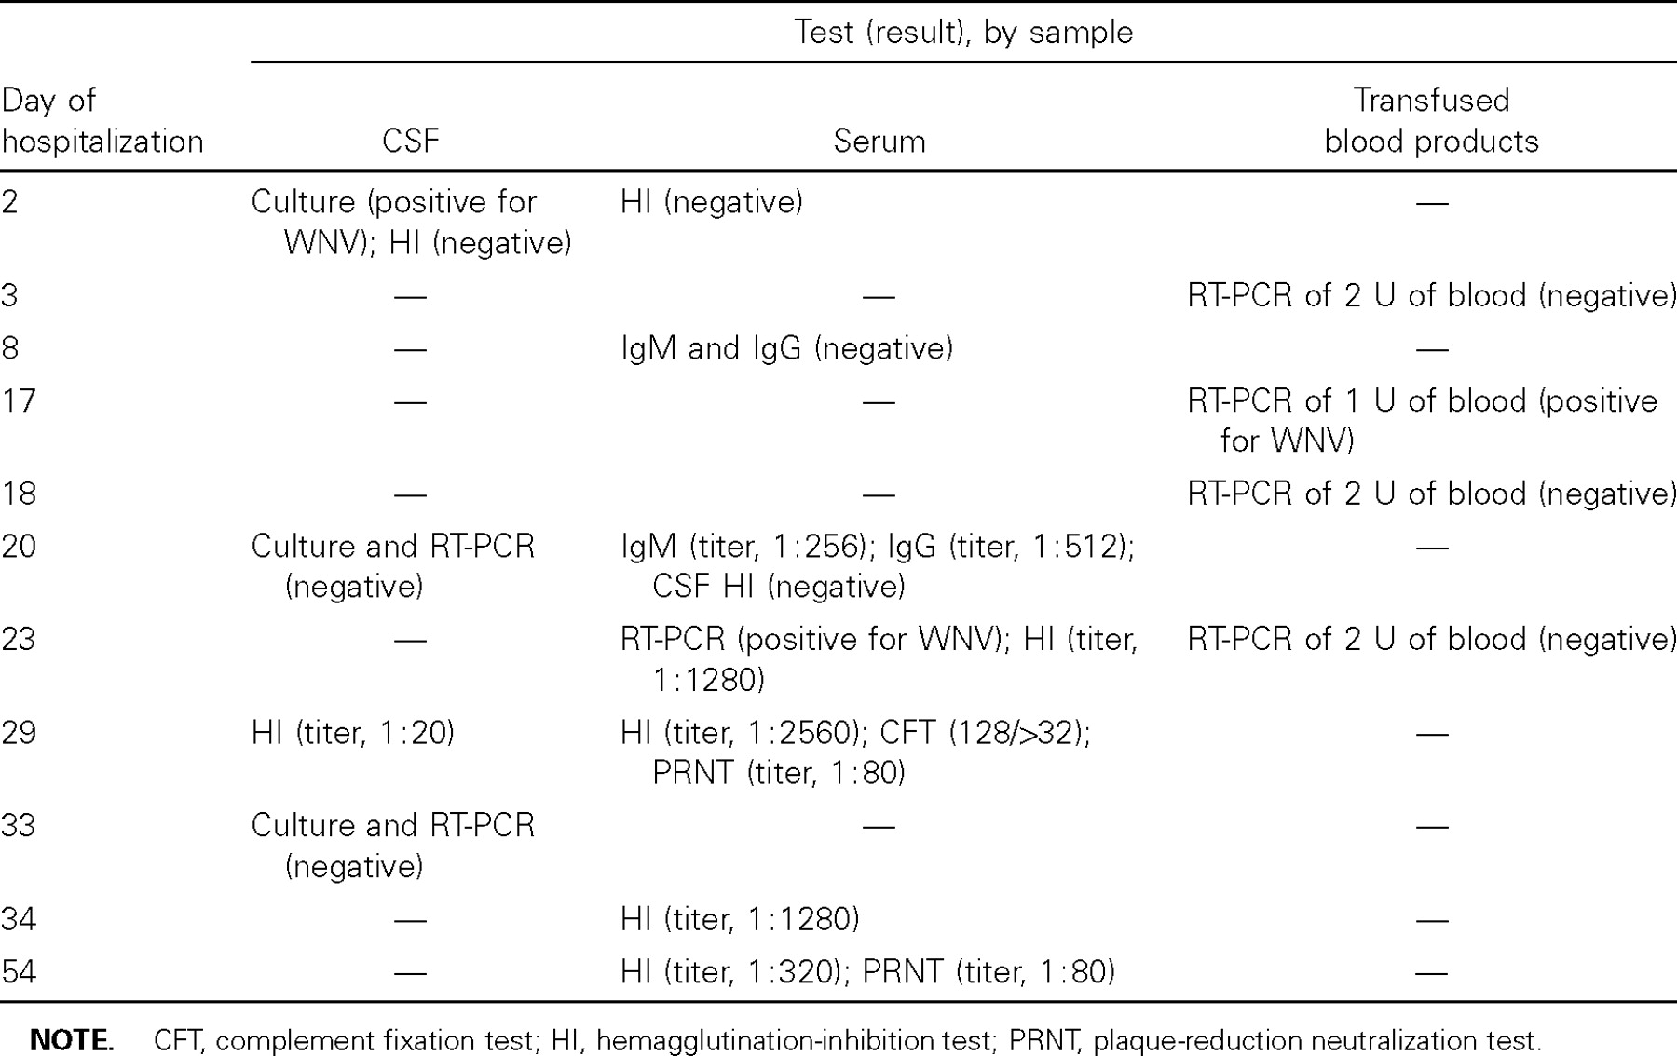
Table 1 Results of investigations for West Nile virus (WNV) infection.
Notes:
Table 1 Results of investigations for West Nile virus (WNV) infection.
Unless provided in the caption above, the following copyright applies to the content of this slide: © 2003 by the Infectious Diseases Society of America

Slide 3
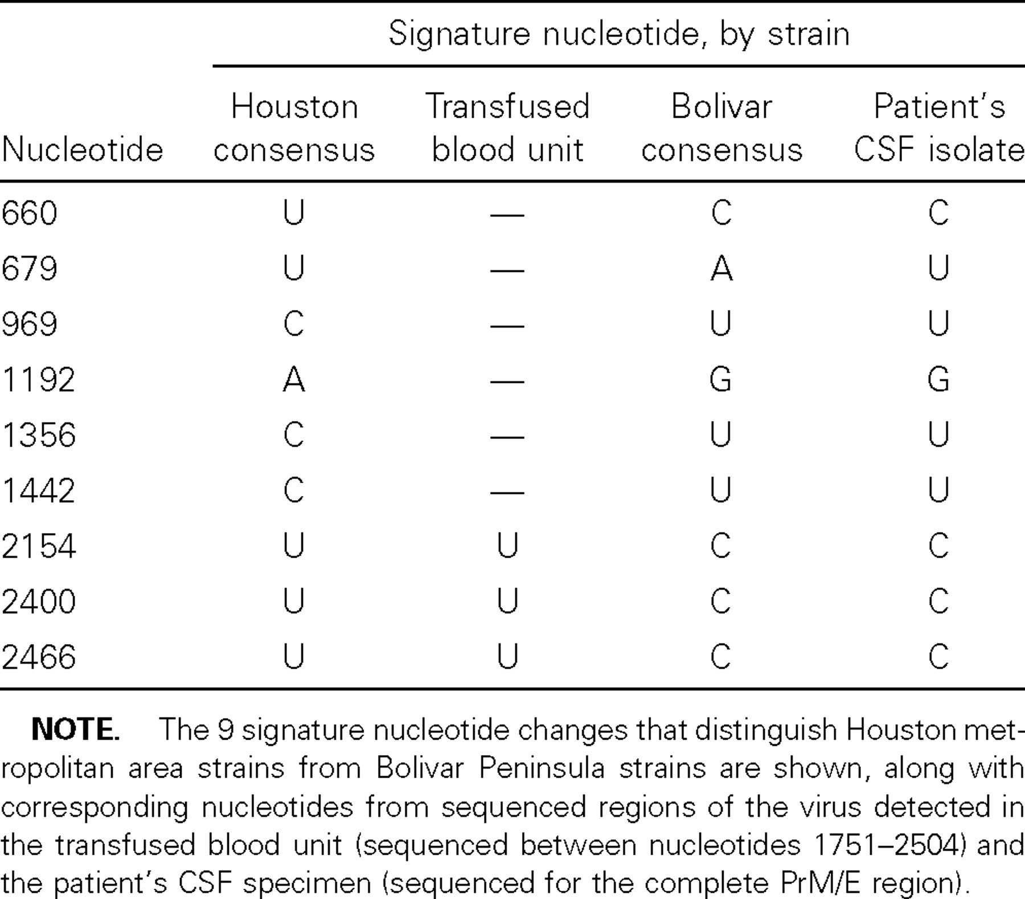
Table 2 Molecular comparison of West Nile virus strains.
Notes:
Table 2 Molecular comparison of West Nile virus strains.
Unless provided in the caption above, the following copyright applies to the content of this slide: © 2003 by the Infectious Diseases Society of America

