Slide 1
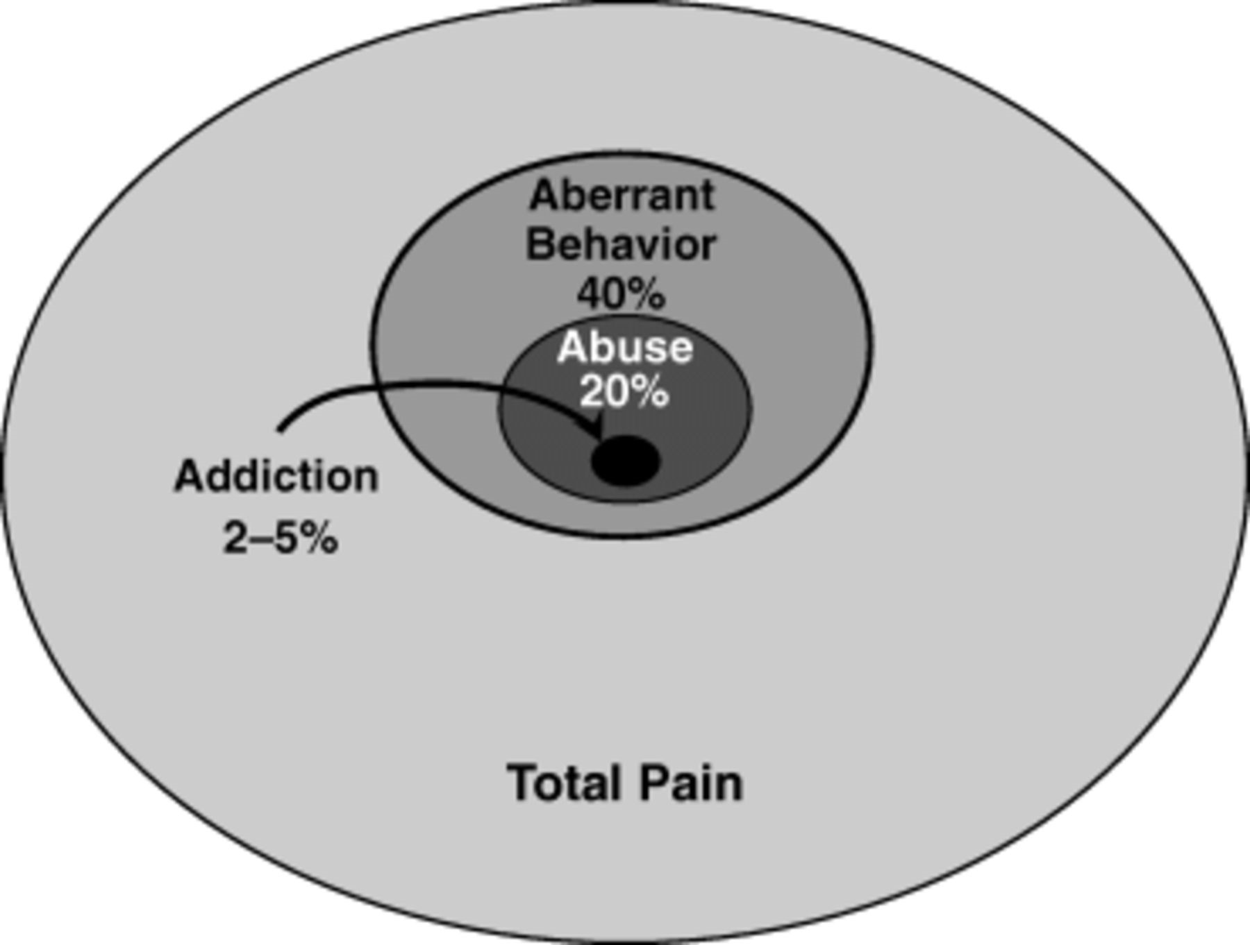
Figure 1 Relationships among aberrant behavior, abuse, and addiction in total pain population.
Notes:
Figure 1 Relationships among aberrant behavior, abuse, and addiction in total pain population.
Unless provided in the caption above, the following copyright applies to the content of this slide:

