Slide 1
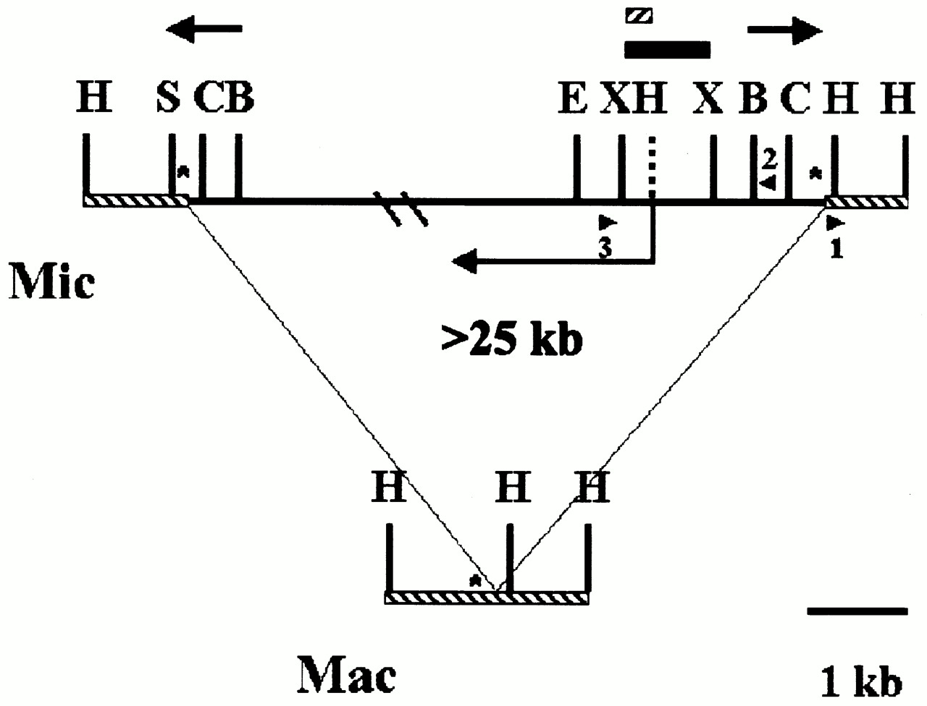
Figure 1. Restriction maps of the Tlr1 regions of micronuclear and macronuclear DNA. The cross-hatched line ...
Notes:
Figure 1. Restriction maps of the Tlr1 regions of micronuclear and macronuclear DNA. The cross-hatched line represents macronucleus-destined sequence. The thick solid line represents the micronuclear-limited sequence. The bold arrows represent the 825 bp Tlr1 inverted repeat. The symbol * marks the location of 19mer tandem repeats. The angled arrow depicts the location of the 2 kb open reading frame identified in this study. Arrowheads represent PCR primers. Restriction sites: B, BglII; C, ClaI; E, EcoRI; H, HindIII; S, Sau3A; X, XbaI. The HindIII restriction site indicated by the dashed line is not present in Tlr1, but is present in other family members. The boxes represent fragments used in hybridization for isolation of Tlr Int clones.
Unless provided in the caption above, the following copyright applies to the content of this slide:

Slide 2
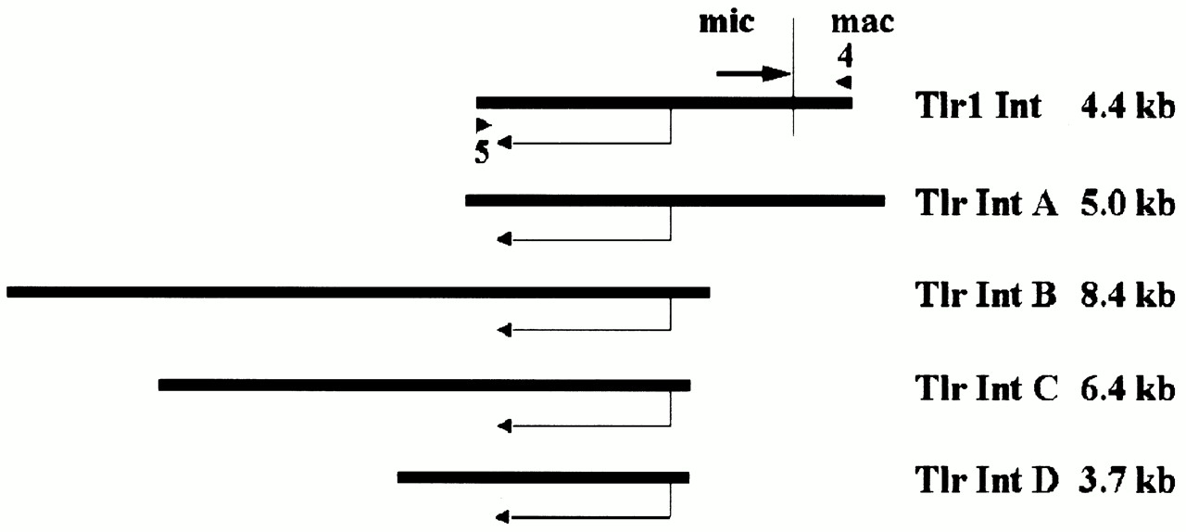
Figure 2. Alignment of Tlr clones according to shared sequence. The vertical line in clone Tlr1 Int indicates ...
Notes:
Figure 2. Alignment of Tlr clones according to shared sequence. The vertical line in clone Tlr1 Int indicates the location of the right Tlr1 boundary and the arrow the inverted repeat. Mic, micronuclear-limited sequence; mac, macronucleus-destined sequence; angled arrow, the 2 kb open reading frame; triangles, the primers used to PCR amplify clone Tlr1 Int from micronuclear DNA.
Unless provided in the caption above, the following copyright applies to the content of this slide:

Slide 3
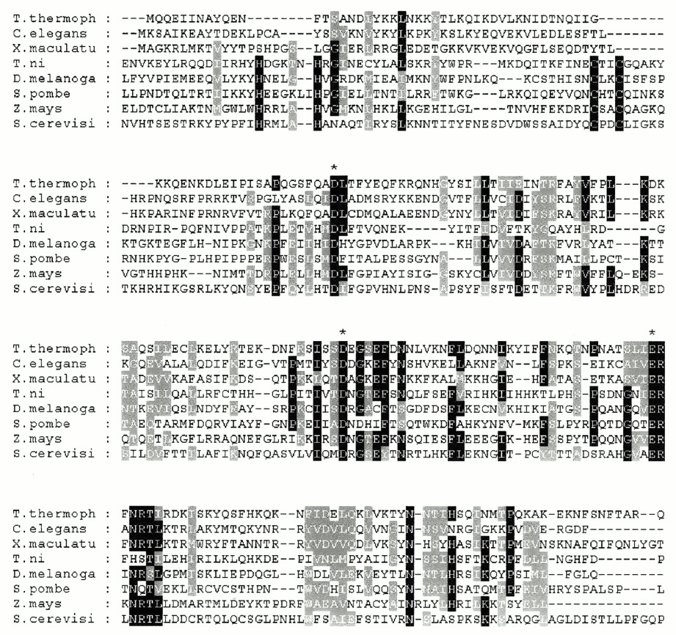
Figure 3. Alignment of the first 227 amino acid residues in the Tlr Int consensus sequence with proteins or ...
Notes:
Figure 3. Alignment of the first 227 amino acid residues in the Tlr Int consensus sequence with proteins or putative proteins that have similarity according to NCBI BLAST. Amino acids that are identical in at least five sequences are shaded black. Amino acids that are similar in at least five sequences are shaded gray. The active site DDE residues are marked with an asterisk. The integrase HHCC domain residues are indicated by circles. E values and accession numbers of the sequences are: C.elegans cosmid Y57G11C, 1e–22, Z99281; X.maculatus HASI putative protein, 3e–22, U43331; Trichopulsia ni TED retrotransposon, 7e–11, B36329; Drosophila melanogaster mdg3 retrotransposon, 1e–7, X95908; Schizosaccharomyces pombe Tf1 retrotransposon 1e–7, M38526; Zea mays Opie-2 retrotransposon, 2e–7, AF105716; S.cerevisiae Ty1 retrotransposon, 4e–5, Z47746.
Unless provided in the caption above, the following copyright applies to the content of this slide:

Slide 4
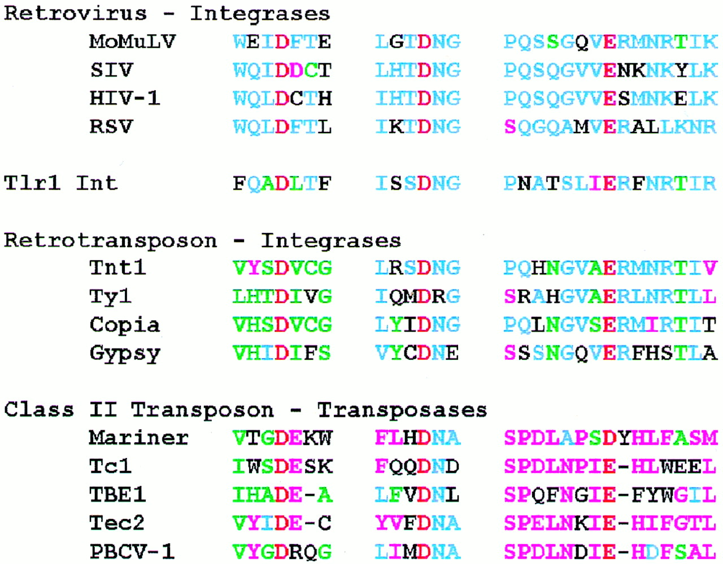
Figure 4. An alignment of the residues surrounding the DDE amino acids in integrases and transposases with ...
Notes:
Figure 4. An alignment of the residues surrounding the DDE amino acids in integrases and transposases with the corresponding Tlr1 Int amino acids. The amino acids common to all types of proteins are red. Blue letters correspond to the retroviral integrase consensus, green letters correspond to the retrotransposon integrase consensus and purple letters correspond to the class II element transposase consensus. Black letters show no consensus. Similar residues are included in the consensus and similarity for this analysis is defined as a score of 5 on the SG Matrix scoring system (38).
Unless provided in the caption above, the following copyright applies to the content of this slide:

Slide 5
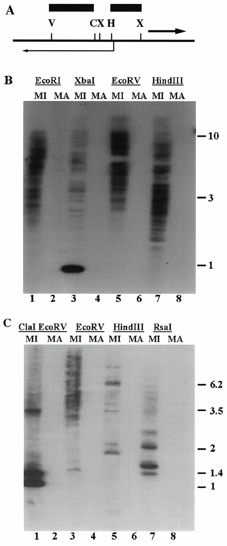
Figure 5. (A) Partial restriction map of restriction sites in the Tlr Int clones. Angled arrow, Int open ...
Notes:
Figure 5. (A) Partial restriction map of restriction sites in the Tlr Int clones. Angled arrow, Int open reading frame; heavy arrow, Tlr1 inverted repeat; bars, the HindIII–XbaI and EcoRV–ClaI fragments used to probe the blots in (B) and (C), respectively. Restriction sites C, ClaI; H, HindIII; V, EcoRV; X, XbaI. (B) Southern blot of micronuclear (MI) and macronuclear (MA) DNA digested with EcoRI, XbaI, EcoRV and HindIII. (C) Southern blot of micronuclear (MI) and macronuclear (MA) DNA digested with ClaI + EcoRV, EcoRV, HindIII and RsaI.
Unless provided in the caption above, the following copyright applies to the content of this slide:

