Slide 1
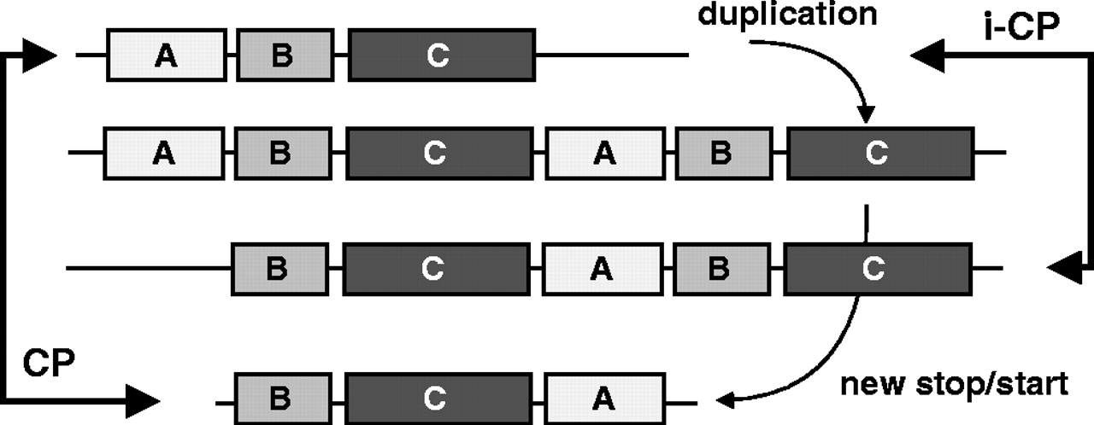
Fig. 1 Proposed mechanism of CPs (Ponting and Russell, 1995; Jeltsch, 1999). A gene sequence is first duplicated. ...
Notes:
Fig. 1 Proposed mechanism of CPs (Ponting and Russell, 1995; Jeltsch, 1999). A gene sequence is first duplicated. Domains may be lost or inserted and this gives rise to an iCP. Subsequently, new starts and stops are inserted in the reading frame. This shortens the duplicated protein and results in a true CP.
Unless provided in the caption above, the following copyright applies to the content of this slide: © The Author 2004. Published by Oxford University Press. All rights reserved. For Permissions, please email: journals.permissions@oupjournals.org

Slide 2
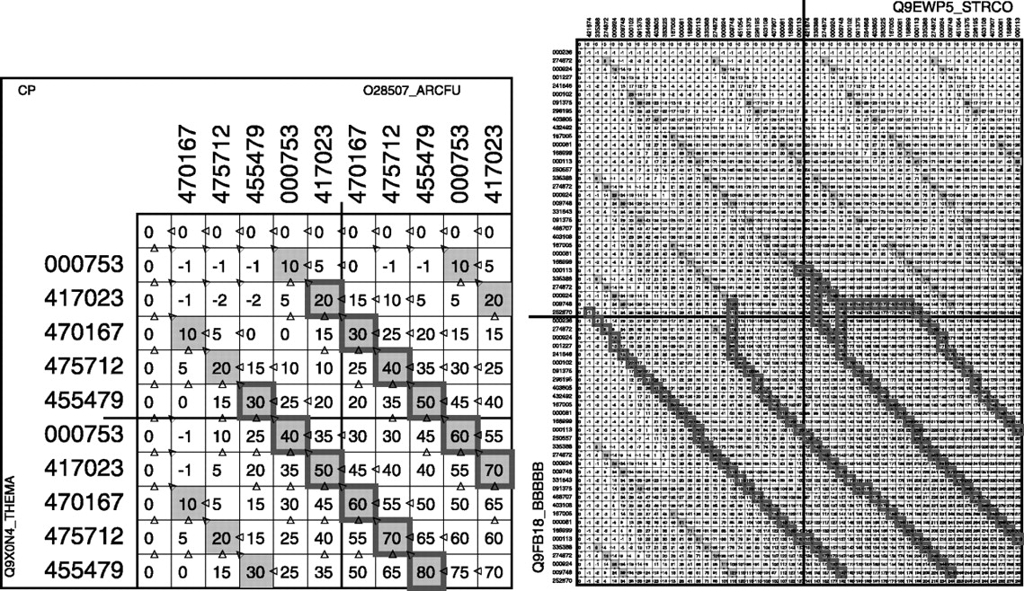
Fig. 2 The alignment lattice and traceback. Left: example of a true CP: the alignment between two oligopeptide ...
Notes:
Fig. 2 The alignment lattice and traceback. Left: example of a true CP: the alignment between two oligopeptide binding proteins from Thermatoga maritima (sp Q9X0N4) and Archaeoglobus fulgidus (sp O28507). Right: example of an intermediate CP: sp Q9EWP5 and sp Q9FB18. TR, TL, BR, BL—top right, top left, bottom right, bottom left quadrants, corresponding each to one alignment between the two sequences. Cells with dark background correspond to identical domains in both sequences. Borders of cells indicate the start and end of the tracebacks for the optimal and suboptimal paths (thick lines; a colour version of the picture can be found in Supplementary material).
Unless provided in the caption above, the following copyright applies to the content of this slide: © The Author 2004. Published by Oxford University Press. All rights reserved. For Permissions, please email: journals.permissions@oupjournals.org

Slide 3
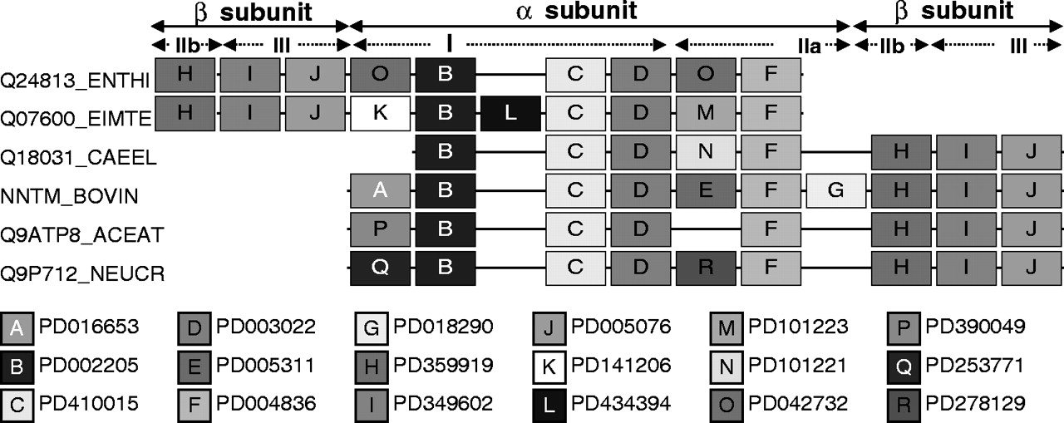
Fig. 3 Multiple alignment of different nicotinamide nucleotide transhydrogenase sequences related to the bovine ...
Notes:
Fig. 3 Multiple alignment of different nicotinamide nucleotide transhydrogenase sequences related to the bovine protein (NNTM). ENTHI, Entamoeba histolitica; EIMTE, Eimeria tenella; CAEEL, Caenorhabditis elegans; ACEAT, Acetabularia acetabulum; NEUCR, Neurospora crassa. The ancestor of the orthologs in the protozoan branch has obviously been subjected to a circular permutation. Letters are used for brevity, the corresponding ProDom IDs are shown under the alignment. For further explanations, see text. For sequence alignment, see Supplementary material.
Unless provided in the caption above, the following copyright applies to the content of this slide: © The Author 2004. Published by Oxford University Press. All rights reserved. For Permissions, please email: journals.permissions@oupjournals.org

Slide 4
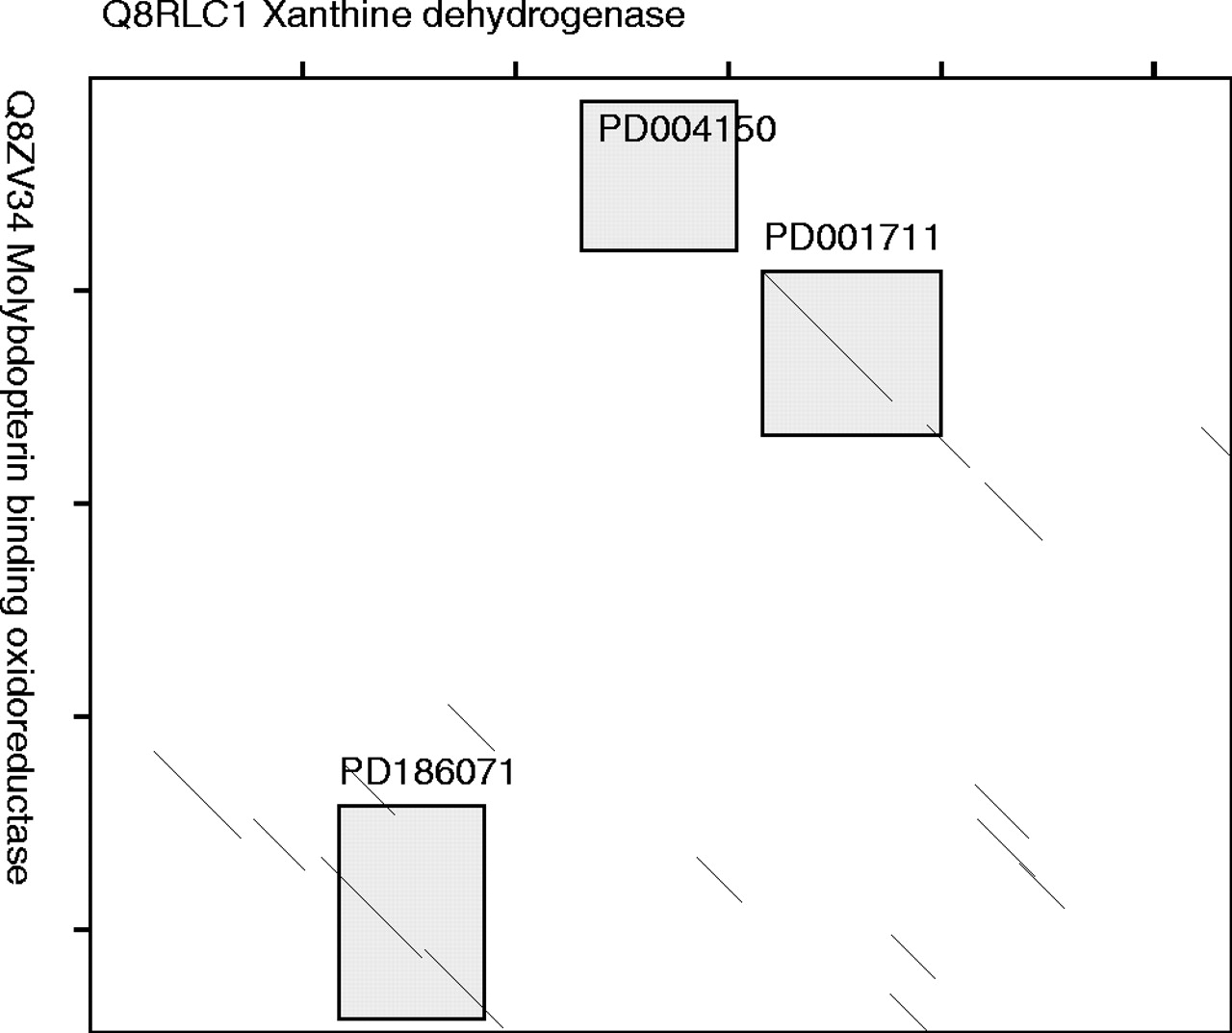
Fig. 4 Dot plot and domain-dot plot of two proteins, Q8RLC1 and Q8ZV34. Regions belonging to corresponding domains ...
Notes:
Fig. 4 Dot plot and domain-dot plot of two proteins, Q8RLC1 and Q8ZV34. Regions belonging to corresponding domains are shown by shaded boxes. HSPs do not correspond to protein domains. The overall sequence similarity is too small for the CP to be detected by the sequence-based algorithm with standard parameters.
Unless provided in the caption above, the following copyright applies to the content of this slide: © The Author 2004. Published by Oxford University Press. All rights reserved. For Permissions, please email: journals.permissions@oupjournals.org

