Slide 1
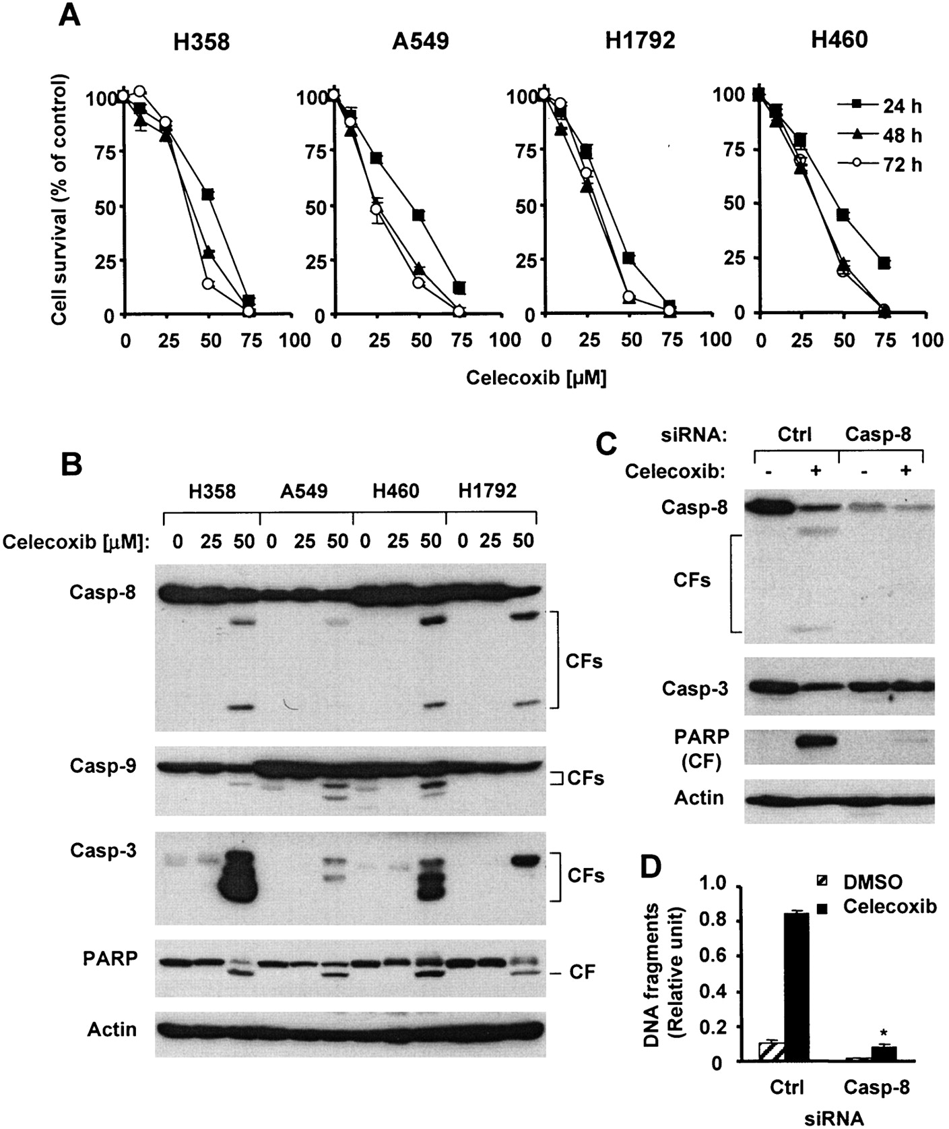
Fig. 1. Celecoxib and caspase 8-mediated apoptosis in human non-small-cell lung carcinoma (NSCLC) cell lines. A ) ...
Notes:
Fig. 1. Celecoxib and caspase 8-mediated apoptosis in human non-small-cell lung carcinoma (NSCLC) cell lines. A ) Celecoxib and cell survival. NSCLC cell lines, as indicated, were cultured in 96-well cell culture plates and treated on the second day with celecoxib as indicated. After 24, 48, or 72 hours, cell numbers were estimated by use of the sulforhodamine B assay, as described ( 39 ) . Cell survival is expressed as the percent of control (dimethyl sulfoxide [DMSO]-treated) cells (0 μ M celecoxib). Each point is the mean value from four identical wells. Error bars = 95% confidence intervals [CIs]. B ) Celecoxib and caspase activation. NSCLC cell lines were treated with celecoxib, as indicated, for 31 hours, whole cell protein lysates were prepared, and cleavage of caspase 8 (Casp-8), caspase 9 (Casp-9), caspase 3 (Casp-3), and poly(ADP-ribose) polymerase (PARP) was detected by western blot analysis. (Cleaved forms of caspase 9 appeared with longer exposure in the H1792 cell line, as did the smaller cleaved form of caspase 8 in the A549 cell line; data not shown.) Actin expression was used as a loading control. CF = cleaved form. C and D ) Silencing of caspase 8 expression and celecoxib-induced caspase activation and DNA fragmentation. H1792 cells were cultured in a 24-well cell culture plate and transfected with control (Ctrl) or caspase 8 small interfering RNA (siRNA) twice with a 48-hour interval between transfections. Forty hours after the second transfection, cells were treated with DMSO (0.05%) or 50 μ M celecoxib. Twenty-four hours later, caspase activation was assessed by western blot analysis ( C ), and DNA fragmentation was assessed with the Cell Death Detection enzyme-linked immunosorbent assay (ELISA) kit (Roche Molecular Biochemicals) ( D ). Data are the mean value of three identical wells, and error bars are the upper 95% CIs. *, P <.001 compared with that of control siRNA-transfected cells treated with celecoxib. All statistical tests were two-sided.
Unless provided in the caption above, the following copyright applies to the content of this slide: © Oxford University Press

Slide 2
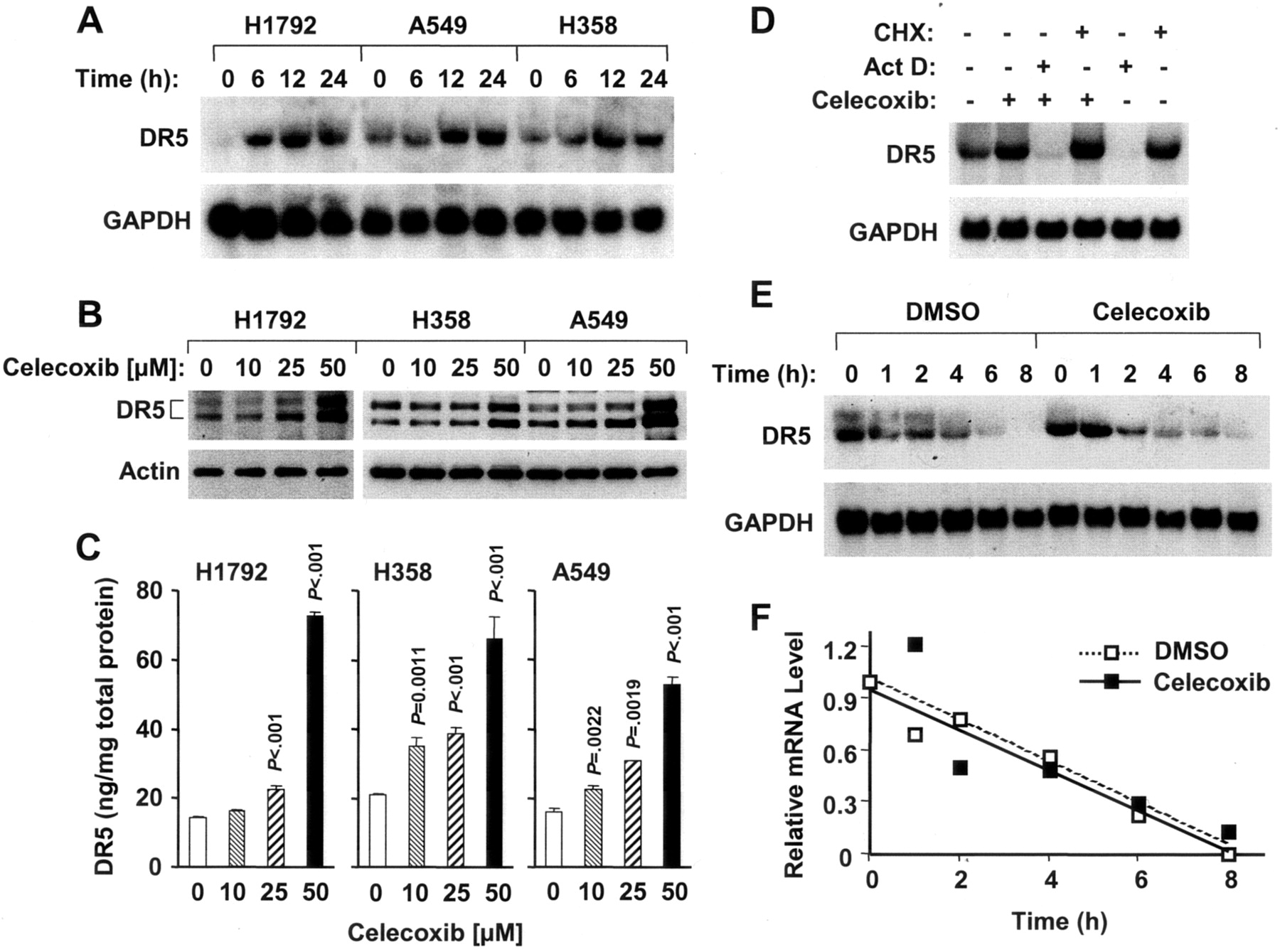
Fig. 2. Celecoxib and DR5 expression in human non-small-cell lung carcinoma (NSCLC) cells. A – C ) Celecoxib and DR5 ...
Notes:
Fig. 2. Celecoxib and DR5 expression in human non-small-cell lung carcinoma (NSCLC) cells. A – C ) Celecoxib and DR5 mRNA ( A ) and protein ( B and C ) expression. NSCLC cell lines were treated with 50 μ M celecoxib for the times indicated ( A ) or concentrations of celecoxib indicated for 24 hours ( B and C ). Total cellular RNA and whole cell protein lysates were then prepared, DR5 mRNA was detected by northern blot analysis ( A ), and DR5 protein was detected by western blot analysis ( B ) and by enzyme-linked immunosorbent assay (ELISA) ( C ). Data in panel C are the mean value of three identical treatments, and error bars are the upper 95% confidence intervals [CIs]. All P values were compared with control cells (0 μ M celecoxib) for all cells treated with the indicated concentrations of celecoxib compared with control cells. All statistical tests were two-sided. D ) Celecoxib induction of DR5 expression. H358 cells were pretreated with the transcription inhibitor actinomycin D at 5 μg/mL or with the translational inhibitor cycloheximide (CHX) at 10 μg/mL for 30 minutes and then treated with the combination of actinomycin D (Act D) or cycloheximide and 50 μ M celecoxib for 24 hours. Total cellular RNA was then prepared and the expression of DR5 mRNA was detected bynorthern blot anal- ysis. E and F ) Celecoxib and the stability of DR5 mRNA in H358 cells. E ) After a 24-hour treatment with 50 μ M celecoxib or dimethyl sulfoxide (DMSO), cells were exposed to actinomycin D at 5 μg/mL, and total cellular RNA was isolated and examined by northern blot analysis. F ) Hybridization signals were quantitated with a PhosphorImager using ImageQuant software and were normalized to glyceraldehyde-3-phosphate dehydrogenase (GAPDH). Data are the relative level of mRNA (ratio of the value at time 0 of actinomycin D treatment) at the indicated times. The result reflects one gel scanning.
Unless provided in the caption above, the following copyright applies to the content of this slide: © Oxford University Press

Slide 3
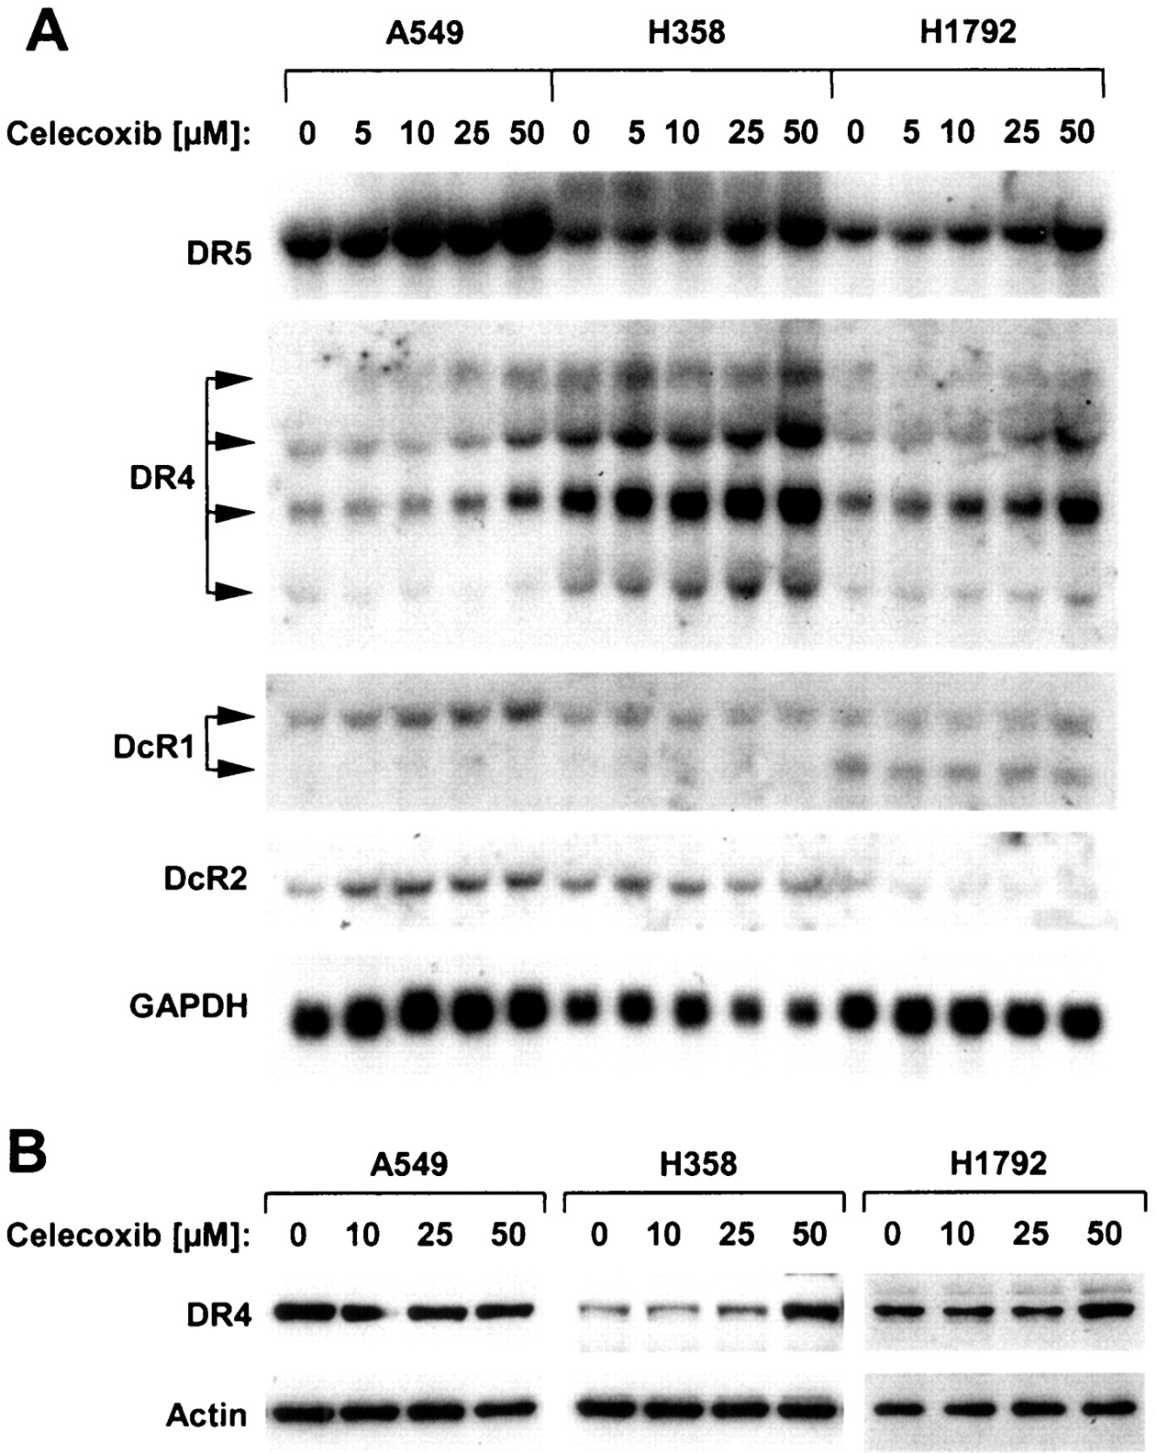
Fig. 3. Celecoxib and modulation of the expression of tumor necrosis factor-related apoptosis-inducing ligand ...
Notes:
Fig. 3. Celecoxib and modulation of the expression of tumor necrosis factor-related apoptosis-inducing ligand (TRAIL) receptors (DR4, DR5, DcR1, and DcR2) in human non-small-cell lung carcinoma (NSCLC) cells. A ) Celecoxib and the expression of TRAIL receptors. NSCLC cell lines as indicated were treated with celecoxib for 24 hours as indicated. Total cellular RNAs were prepared and subjected to northern blot analysis to detect TRAIL receptor expression. Glyceraldehyde-3-phosphate dehydrogenase (GAPDH) expression was used as a loading control. B ) Celecoxib and DR4 protein expression. The indicated NSCLC cell lines were treated with celecoxib as indicated. After 24 hours, whole cell protein lysates were prepared, and DR4 protein was detected by western blot analysis. Actin expression level was used as a loading comparison.
Unless provided in the caption above, the following copyright applies to the content of this slide: © Oxford University Press

Slide 4
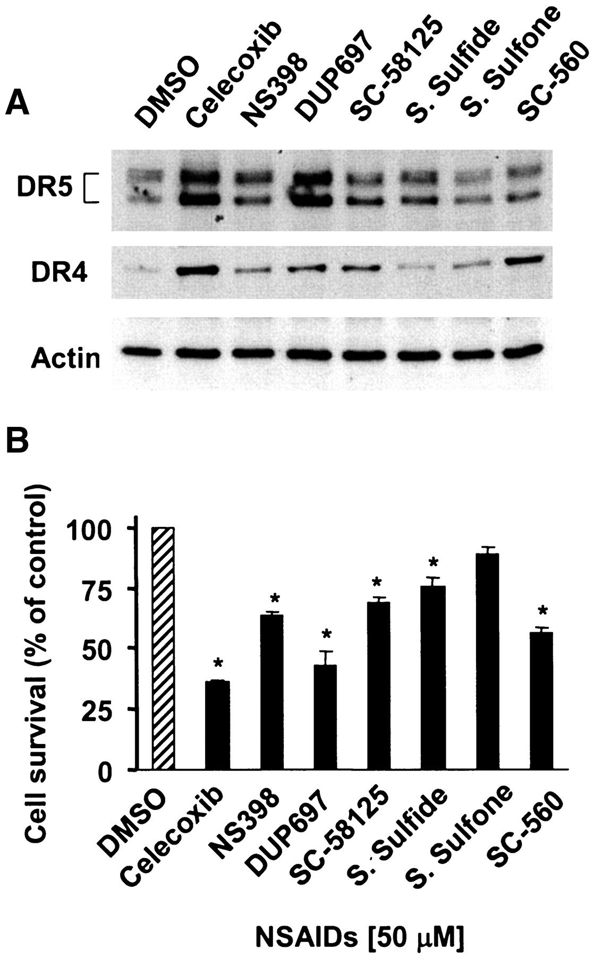
Fig. 4. Abilities of celecoxib and other nonsteroidal anti-inflammatory drugs (NSAIDs) to induce death receptor ...
Notes:
Fig. 4. Abilities of celecoxib and other nonsteroidal anti-inflammatory drugs (NSAIDs) to induce death receptor expression ( A ) and apoptosis ( B ). A ) H358 cells were treated for 24 hours with dimethyl sulfoxide (DMSO), 50 μ M celecoxib, or the indicated NSAIDs at 50 μ M. Whole cell protein lysates were prepared, and DR4 or DR5 protein was detected with western blot analysis. Actin expression was used as a loading control. B ) H358 cells were cultured in 96-well cell culture plates and treated with DMSO, 50 μ M celecoxib, or other NSAIDs at 50 μ M on the second day. After 48 hours, the cell number was estimated by use of the sulforhodamine B assay, as described ( 39 ) . Cell survival data are expressed as percent of control DMSO-treated cells and are the mean value of four identical wells. Error bars are the upper 95% confidence interval. *, P <.001 for survival cells treated with the indicated agent relative to control DMSO-treated cells. All statistical tests were two-sided. S. Sulfide = sulindac sulfide; S. Sulfone = sulindac sulfone.
Unless provided in the caption above, the following copyright applies to the content of this slide: © Oxford University Press

Slide 5
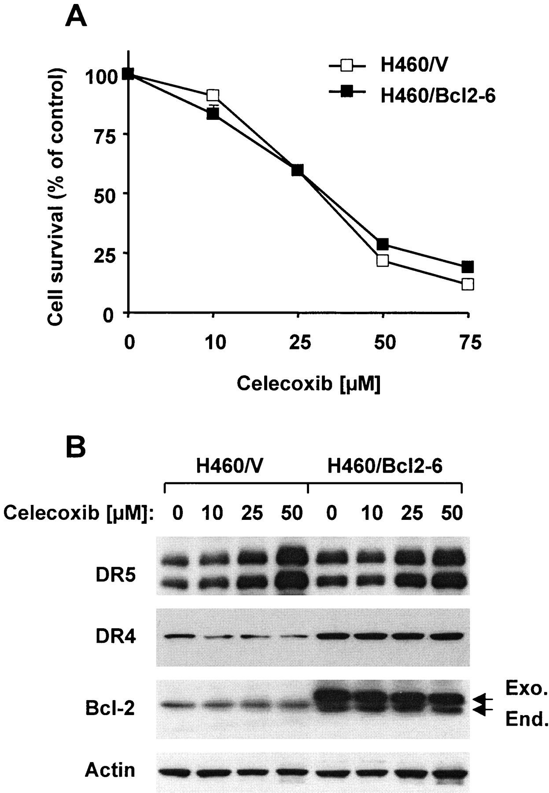
Fig. 5. BCL2 overexpression, celecoxib-induced apoptosis ( A ), and death receptor expression ( B ). A ) Control ...
Notes:
Fig. 5. BCL2 overexpression, celecoxib-induced apoptosis ( A ), and death receptor expression ( B ). A ) Control vector-transfected H460/V and BCL2 vector-transfected H460/Bcl2–6 cells were cultured in 96-well plates and treated on the second day with celecoxib as indicated. After 3 days, cell number was estimated with the sulforhodamine B assay, as described ( 39 ) . Cell survival data are expressed as percent of control dimethyl sulfoxide-treated cells (0 μ M celecoxib). Data are the mean value of four identical wells, and error bars are the 95% confidence intervals (some error bars are too small to be seen). B ) H460/V and H460/Bcl2–6 cells were cultured in 10-cm dishes and treated with celecoxib as indicated for 24 hours. Whole cell protein lysates were then prepared, and DR5, DR4, and BCL2 expression levels were detected by western blot analysis. Actin expression was used as a loading control. Positions of exogenous (Exo.) and endogenous (End.) BCL2, DR5, and DR4 are indicated.
Unless provided in the caption above, the following copyright applies to the content of this slide: © Oxford University Press

Slide 6
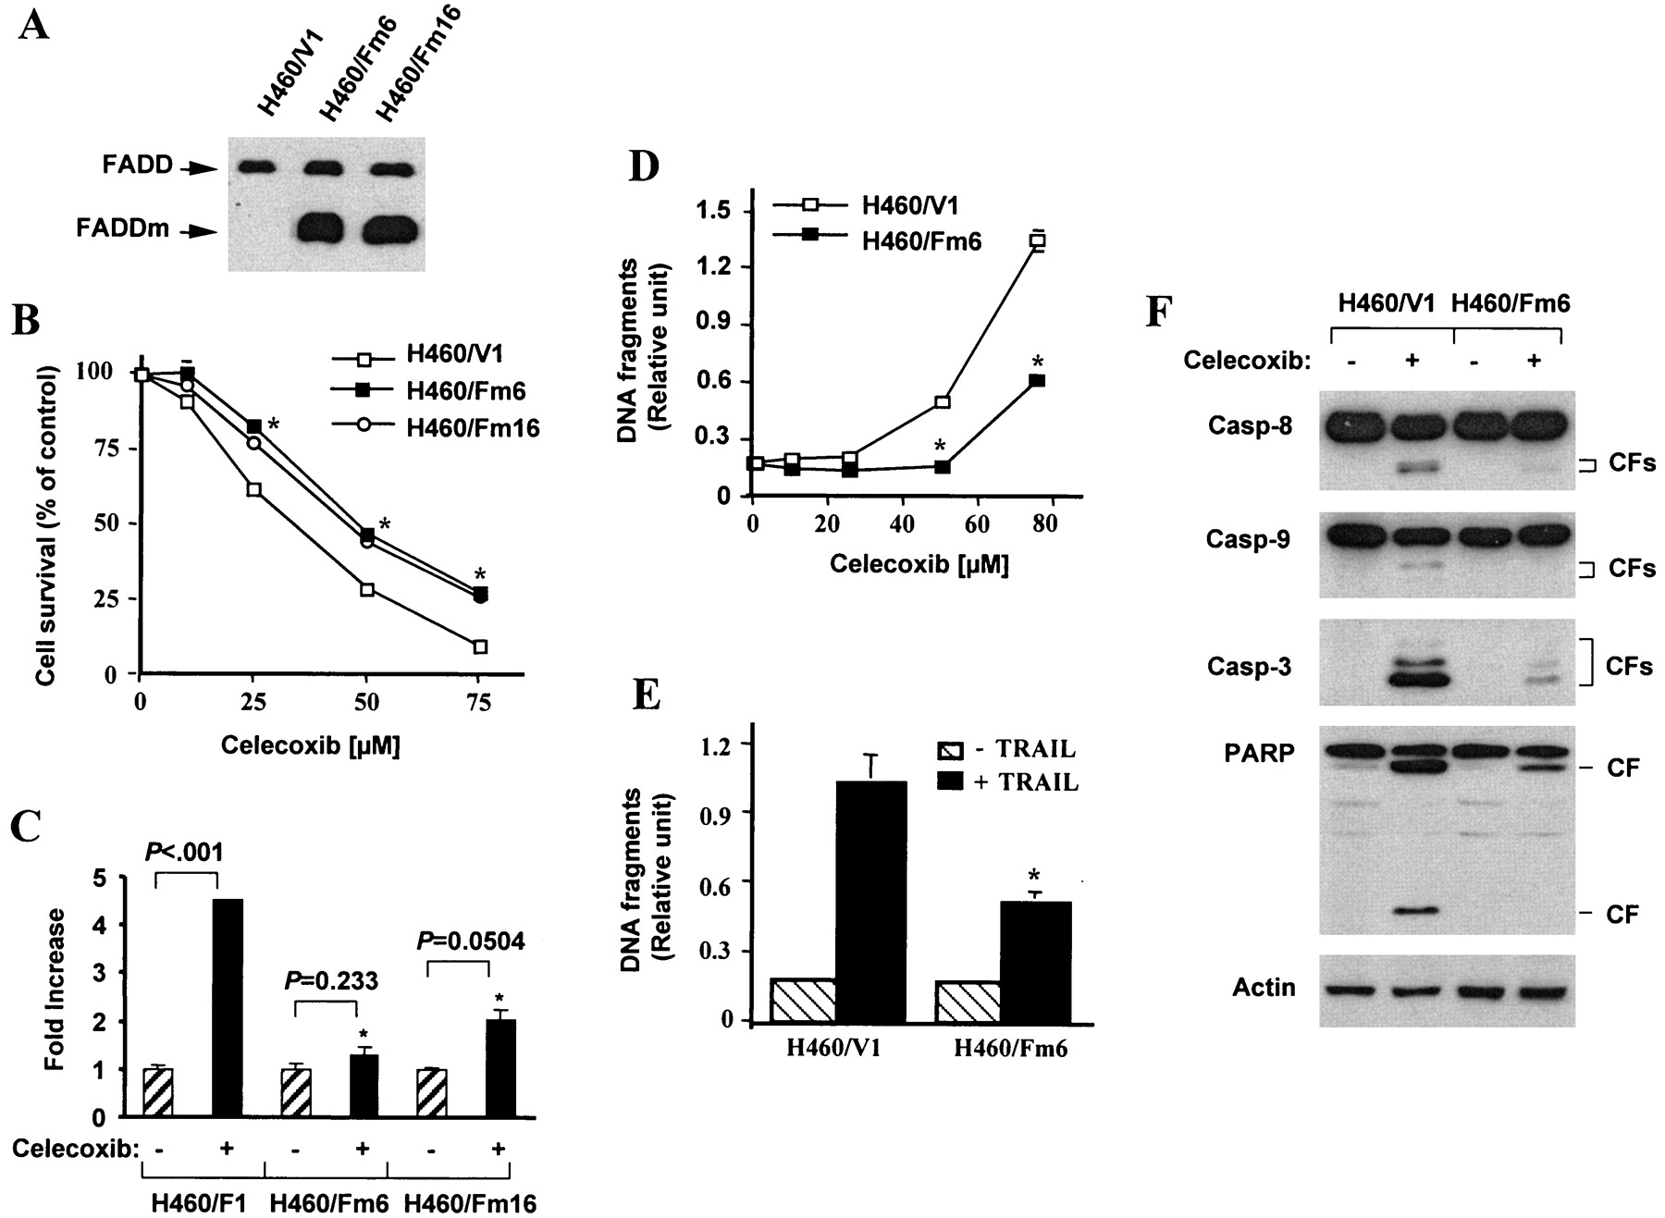
Fig. 6. Overexpression of a dominant negative Fas-associated death domain mutant (FADDm) and celecoxib-induced ...
Notes:
Fig. 6. Overexpression of a dominant negative Fas-associated death domain mutant (FADDm) and celecoxib-induced apoptosis. A ) Detection of FADDm by western blot analysis. Whole cell protein lysates prepared from H460 transfectants as indicated were subjected to detection of endogenous FADD and FADDm by western blot analysis. B ) Overexpression of FADDm and celecoxib-induced decrease of cell survival. H460 cells transfected with empty vector (H460/V1) or FADDm (H460/Fm6 and H460/Fm16) were cultured in 96-well plates and treated on the second day with celecoxib as indicated. After 24 hours, the cell number was estimated with the sulforhodamine B assay, as described ( 39 ) . Cell survival data are expressed as percent of dimethyl sulfoxide-treated cells (0 μ M celecoxib). Data are the mean value of four identical wells, and error bars are the 95% confidence intervals. *, P <.001 compared with celecoxib-treated H460/V1 cells. C ) Overexpression of FADDm and celecoxib-induced cell death. Cell lines, as indicated, were cultured in 10-cm diameter dishes and treated with 50 μ M celecoxib. After 24 hours, the floating or dead cells in the medium were counted directly with a hemacytometer. Data are the mean value of three identical dishes, and error bars are the upper 95% confidence intervals. *, P <.001, compared with the increase in H460/V1 cells. D ) Overexpression of FADDm and celecoxib-induced DNA fragmentation. Cell lines were cultured in 96-well plates and treated on the second day with celecoxib as indicated. After 24 hours, DNA fragmentation was measured with the Cell Death Detection enzyme-linked immunosorbent assay (ELISA) kit (Roche Molecular Biochemicals). Data are the mean value of three identical wells, and error bars are the upper 95% confidence intervals. *, P <.001 compared with the value in H460/V1 cells. E ) Overexpression of FADDm and tumor necrosis factor-related apoptosis-inducing ligand (TRAIL)-induced apoptosis. Cells were treated with TRAIL at 25 ng/mL for 24 hours, and then DNA fragmentation was measured by use of the Cell Death Detection ELISA kit. Data are the mean value of three identical wells, and error bars are the upper 95% confidence intervals. *, P = .002, compared with that of H460/V1 cell lines. F ) Overexpression of FADDm and celecoxib-induced caspase activation. Cells, as indicated, were treated with 50 μ M celecoxib for 20 hours, whole cell protein lysates were then prepared, and cleaved caspase 8 (Casp-8), caspase 9 (Casp-9), caspase 3 (Casp-3), and poly(ADP-ribose) polymerase (PARP) were detected by western blot analysis. Actin expression was used as a loading control. CF = cleaved form. All statistical tests were two sided.
Unless provided in the caption above, the following copyright applies to the content of this slide: © Oxford University Press

Slide 7
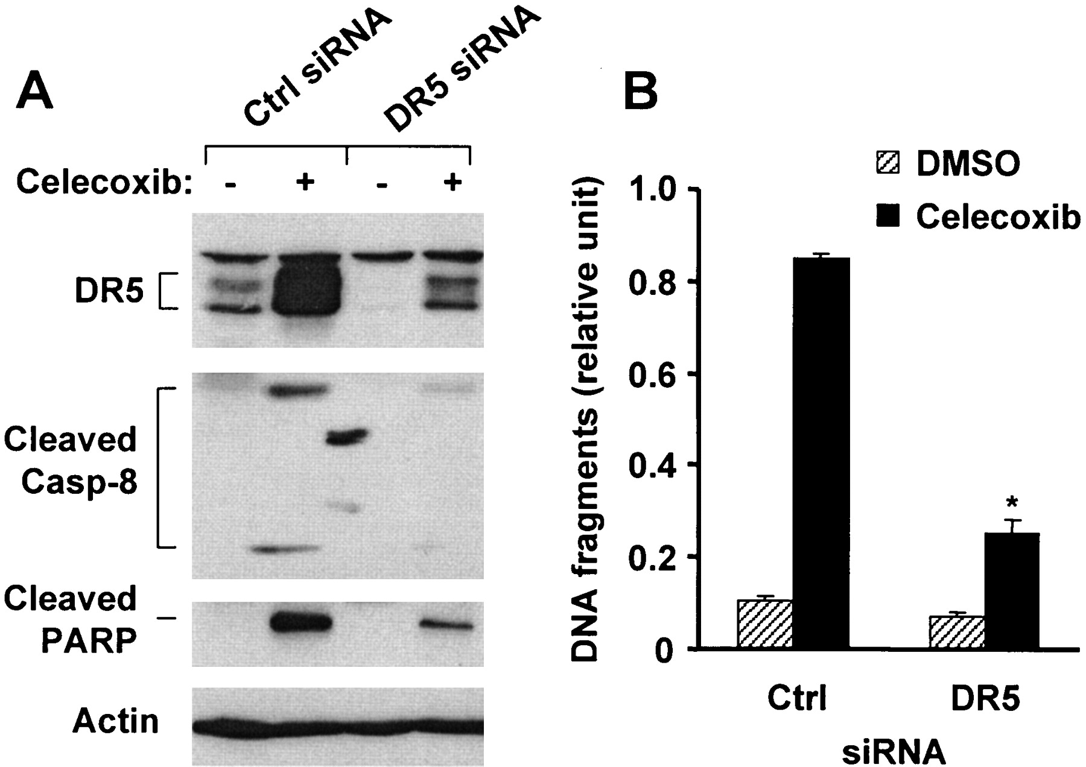
Fig. 7. Silencing of DR5 expression with small interfering RNA (siRNA) and celecoxib-induced caspase activation ( A ...
Notes:
Fig. 7. Silencing of DR5 expression with small interfering RNA (siRNA) and celecoxib-induced caspase activation ( A ) and DNA fragmentation ( B ). H1792 cells were cultured in a 24-well plate and on the second day transfected twice with control (Ctrl) or DR5 siRNA with a 48-hour interval in between transfections. Forty hours after the second transfection, cells were treated with dimethyl sulfoxide (DMSO) or 50 μ M celecoxib for 24 hours. A ) DR5 expression and cleavage of caspase 8 (Casp-8) and poly(ADP-ribose) polymerase (PARP) were assessed by western blot analysis. The two sports between lanes 2 and 3 are nonspecific background material. B ) DNA fragmentation was evaluated with the Cell Death Detection enzyme-linked immunosorbent assay (ELISA) kit (Roche Molecular Biochemicals). Data are the mean value of three identical wells or treatments, and error bars are the upper 95% confidence intervals. *, P <.001 compared with that of control (Ctrl) siRNA-transfected cells treated with celecoxib. All statistical tests were two-sided.
Unless provided in the caption above, the following copyright applies to the content of this slide: © Oxford University Press

Slide 8
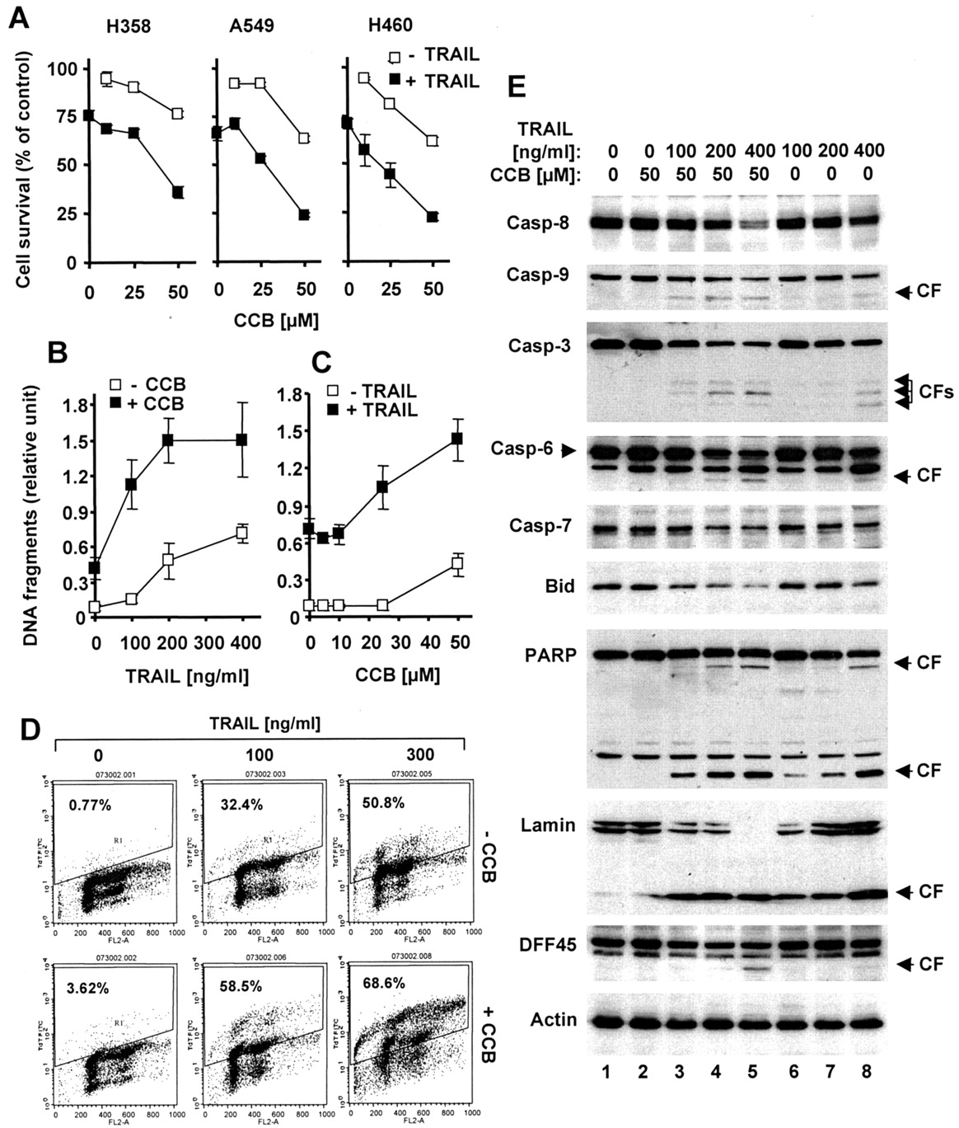
Fig. 8. Combination treatments with celecoxib and tumor necrosis factor-related apoptosis-inducing ligand (TRAIL) ...
Notes:
Fig. 8. Combination treatments with celecoxib and tumor necrosis factor-related apoptosis-inducing ligand (TRAIL) and human non-small-cell lung carcinoma (NSCLC) cells. A ) Cell survival. NSCLC cell lines, as indicated, were cultured in 96-well plates and treated on the second day with TRAIL alone at 400 ng/mL (H358), 300 ng/mL (A549), or 25 ng/mL (H460), celecoxib alone as indicated, or celecoxib plus TRAIL. After 20 hours, cell numbers were estimated by use of the sulforhodamine B assay, as described ( 39 ) . Cell survival data are expressed as percent control dimethyl sulfoxide-treated cells. Data are the mean value of four identical wells, and error bars are the 95% confidence intervals. B and C ) DNA fragmentation detected with an enzyme-linked immunosorbent assay (ELISA). H358 cells were cultured in 96-well plates and treated with 50 μ M celecoxib alone, TRAIL alone as indicated, or celecoxib plus TRAIL ( B ) or with celecoxib alone as indicated, TRAIL alone at 400 ng/mL, or celecoxib plus TRAIL ( C ). After 20 hours, cells were harvested, and DNA fragmentation was measured with the Cell Death Detection ELISA kit (Roche Molecular Biochemicals). Data are the mean value of three identical wells, and error bars are the 95% confidence intervals. D ) DNA fragmentation detected with the terminal deoxynucleotidyltransferase-mediated UTP nick-end-labeling (TUNEL) assay. H358 cells were cultured in 10-cm dishes and treated on the second day with 50 μ M celecoxib alone, TRAIL alone at 100 or 300 ng/mL, or celecoxib plus TRAIL. After 18 hours, cells were harvested, and DNA fragmentation was measured with an APO-DIRECT TUNEL kit (Phoenix Flow Systems) by the manufacturer's protocol. The percent of apoptotic cells with DNA fragmentation is shown. E ) Apoptosis detected by cleavage of caspases and their substrates. H358 cells were treated with 50 μ M celecoxib alone, TRAIL alone as indicated, or the combination of celecoxib and TRAIL for 16 hours. Whole cell protein lysates were then prepared from both detached (i.e., apoptotic death cells) and attached cells (i.e., cells that are undergoing apoptosis), and cleavage of caspases and their substrates was detected by western blot analysis. CCB = celecoxib; Casp = caspase; CF = cleaved form. Cleaved forms are indicated to the right. Caspase activation or cleavage of caspase substrates is indicated by a decreased level of the pro-form of the component and/or the appearance of cleaved forms.
Unless provided in the caption above, the following copyright applies to the content of this slide: © Oxford University Press

