Slide 1
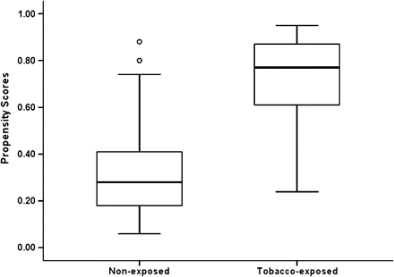
Figure 1. Propensity score distribution by tobacco exposure group status (the two dots indicated two nonexposed [NE] ...
Notes:
Figure 1. Propensity score distribution by tobacco exposure group status (the two dots indicated two nonexposed [NE] have relatively high propensity scores and the rest of NE neonates have propensity scores below .40).
Unless provided in the caption above, the following copyright applies to the content of this slide: © The Author 2010. Published by Oxford University Press on behalf of the Society for Research on Nicotine and Tobacco. All rights reserved. For permissions, please e-mail: journals.permissions@oxfordjournals.org

Slide 2
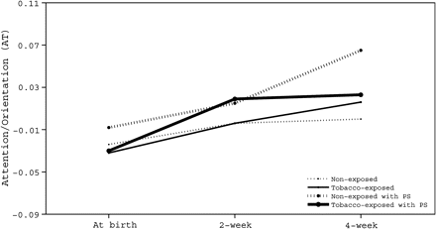
Figure 2. Exposure-related group differences in Attention/Orientation (AT) with and without propensity score ...
Notes:
Figure 2. Exposure-related group differences in Attention/Orientation (AT) with and without propensity score adjustment.
Unless provided in the caption above, the following copyright applies to the content of this slide: © The Author 2010. Published by Oxford University Press on behalf of the Society for Research on Nicotine and Tobacco. All rights reserved. For permissions, please e-mail: journals.permissions@oxfordjournals.org

