Slide 1
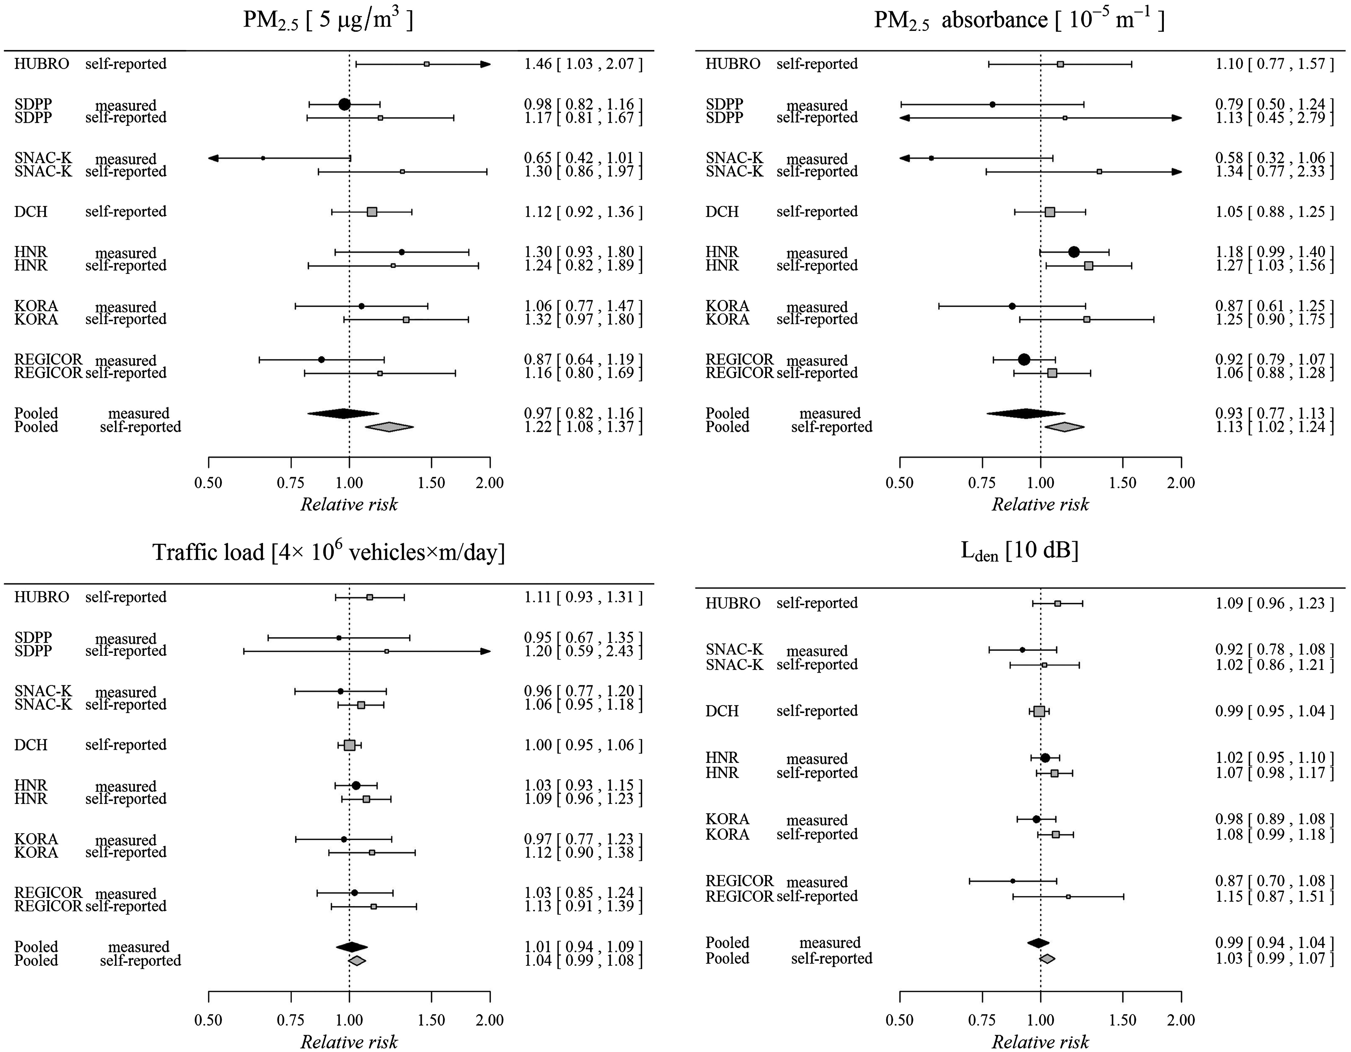
Figure 1 Random-effects meta-analysis of the associations of PM_{2.5}, PM_{2.5} absorbance, traffic ...
Notes:
Figure 1 Random-effects meta-analysis of the associations of PM2.5, PM2.5 absorbance, traffic load and Lden at baseline with measured and self-reported incidence of hypertension at follow-up. Filled marks = incident measured hypertension as outcome; open marks = incident self-reported hypertension. Relative risk (with 95% confidence interval) per given increase in exposure concentration is presented. Estimates were adjusted for age, sex, education, economic activity, body mass index, smoking status, pack-years of smoking, passive smoking, total alcohol consumption, wine consumption, physical activity, family history of hypertension, and area-level SES. Pooled estimates of the association of air pollution, traffic indicators and road traffic noise with incidence of measured and self-reported hypertension, and incident intake of blood pressure lowering medication (BPLM) ExposureIncident measured hypertensionIncident self-reported hypertensionIncident BPLM usenRR (95%-CI)I2phet.nRR (95%-CI)I2phet.nRR (95%-CI)I2phet.PM2.5 [5 µg/m³]5a0.97 (0.80, 1.17)42.240.147d1.22 (1.08, 1.37)0.000.895a1.15 (0.99, 1.34)0.000.71PMcoarse [5 µg/m³]50.97 (0.92, 1.03)0.000.5371.07 (0.98, 1.16)24.240.2451.03 (0.95, 1.13)16.910.31PM10 [10 µg/m³]50.99 (0.87, 1.12)34.190.1971.07 (0.97, 1.18)16.550.3051.01 (0.91, 1.12)0.000.84PM2.5 absorbance [10−5 m−1]50.93 (0.77, 1.13)57.260.0571.13 (1.02, 1.24)0.000.8051.08 (0.96, 1.22)0.000.64NO2 [10 µg/m³]50.97 (0.91, 1.03)0.000.8171.03 (0.99, 1.07)0.000.8151.02 (0.96, 1.09)0.000.58NOx [20 µg/m³]50.96 (0.91, 1.01)0.000.9871.03 (0.98, 1.08)18.900.2950.99 (0.93, 1.07)17.770.30Traffic load [4 × 106 vehicles × m/day]51.01 (0.94, 1.09)0.000.9671.04 (0.99, 1.08)0.000.6851.08 (1.01, 1.15)0.000.96Traffic intensity [5000 vehicles/day]4b0.95 (0.90, 1.00)0.000.716e1.01 (0.98, 1.03)16.540.314b0.98 (0.92, 1.04)29.370.24Lden [per 10 dB]4c0.99 (0.94, 1.04)0.150.396f1.03 (0.99, 1.07)6.080.384c1.05 (0.99, 1.10)0.000.97Results are presented per given exposure increment. Estimates were adjusted for age, sex, education, economic activity, body mass index, smoking status, pack-years of smoking, passive smoking, total alcohol consumption, wine consumption, physical activity, family history of hypertension, and area-level socio-economic status. RR, relative risk; CI, confidence interval; phet, P-value for test for heterogeneity. aSNAC-K, SDPP, HNR, KORA, REGICOR. bSNAC-K, SDPP, KORA, REGICOR. cSNAC-K, HNR, KORA, REGICOR. dDCH, HUBRO, SNAC-K, SDPP, HNR, KORA, REGICOR. eDCH, HUBRO, SNAC-K, SDPP, KORA, REGICOR. fDCH, HUBRO, SNAC-K, HNR, KORA, REGICOR.
Unless provided in the caption above, the following copyright applies to the content of this slide: Published on behalf of the European Society of Cardiology. All rights reserved. © The Author 2016. For Permissions, please email: journals.permissions@oup.com.

