Slide 1
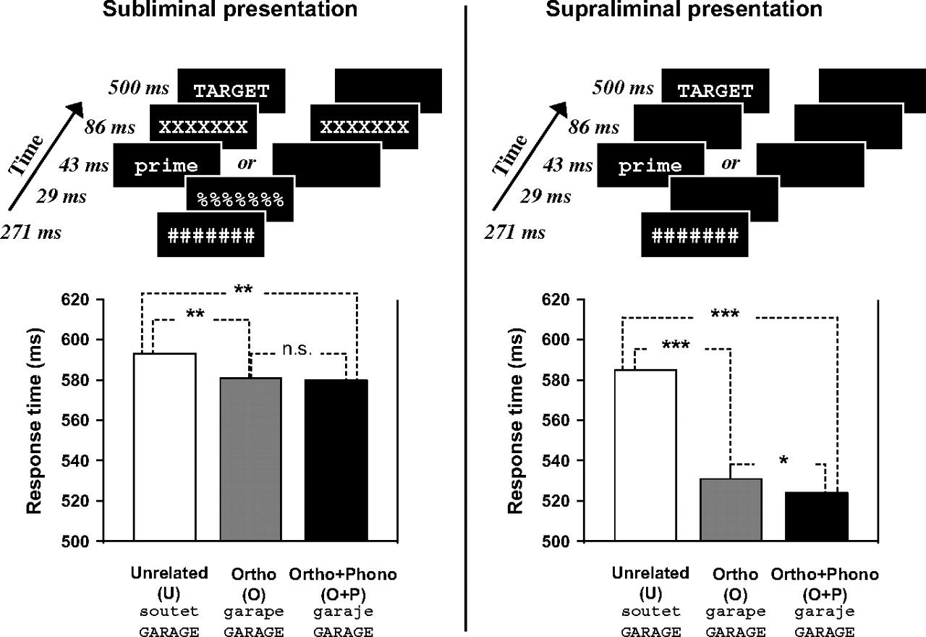
Figure 1. Experimental procedure and behavioral results for the subliminal (left part) and supraliminal presentation ...
Notes:
Figure 1. Experimental procedure and behavioral results for the subliminal (left part) and supraliminal presentation (right part) (n.s. = nonsignificant; *P < 0.02; **P < 0.002; ***P < 0.0002).
Unless provided in the caption above, the following copyright applies to the content of this slide: © The Author 2006. Published by Oxford University Press. All rights reserved. For permissions, please e-mail: journals.permissions@oxfordjournals.org

Slide 2
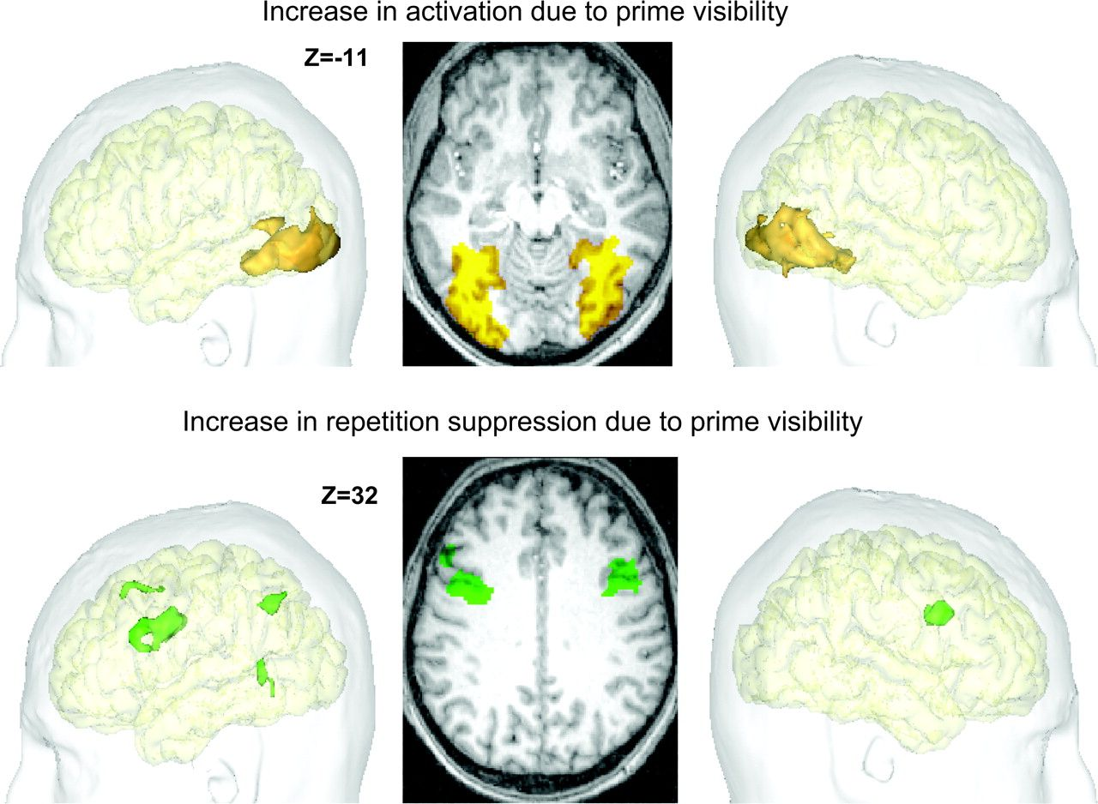
Figure 2. Neural correlates of prime visibility. The top images show the brain regions with more activity for visible ...
Notes:
Figure 2. Neural correlates of prime visibility. The top images show the brain regions with more activity for visible primes (supraliminal minus supraliminal trials). The bottom images show the brain regions where orthographic priming was significantly stronger under supraliminal than under subliminal conditions (i.e., an interaction between orthographic priming and the subliminal vs. supraliminal status of the primes).
Unless provided in the caption above, the following copyright applies to the content of this slide: © The Author 2006. Published by Oxford University Press. All rights reserved. For permissions, please e-mail: journals.permissions@oxfordjournals.org

Slide 3
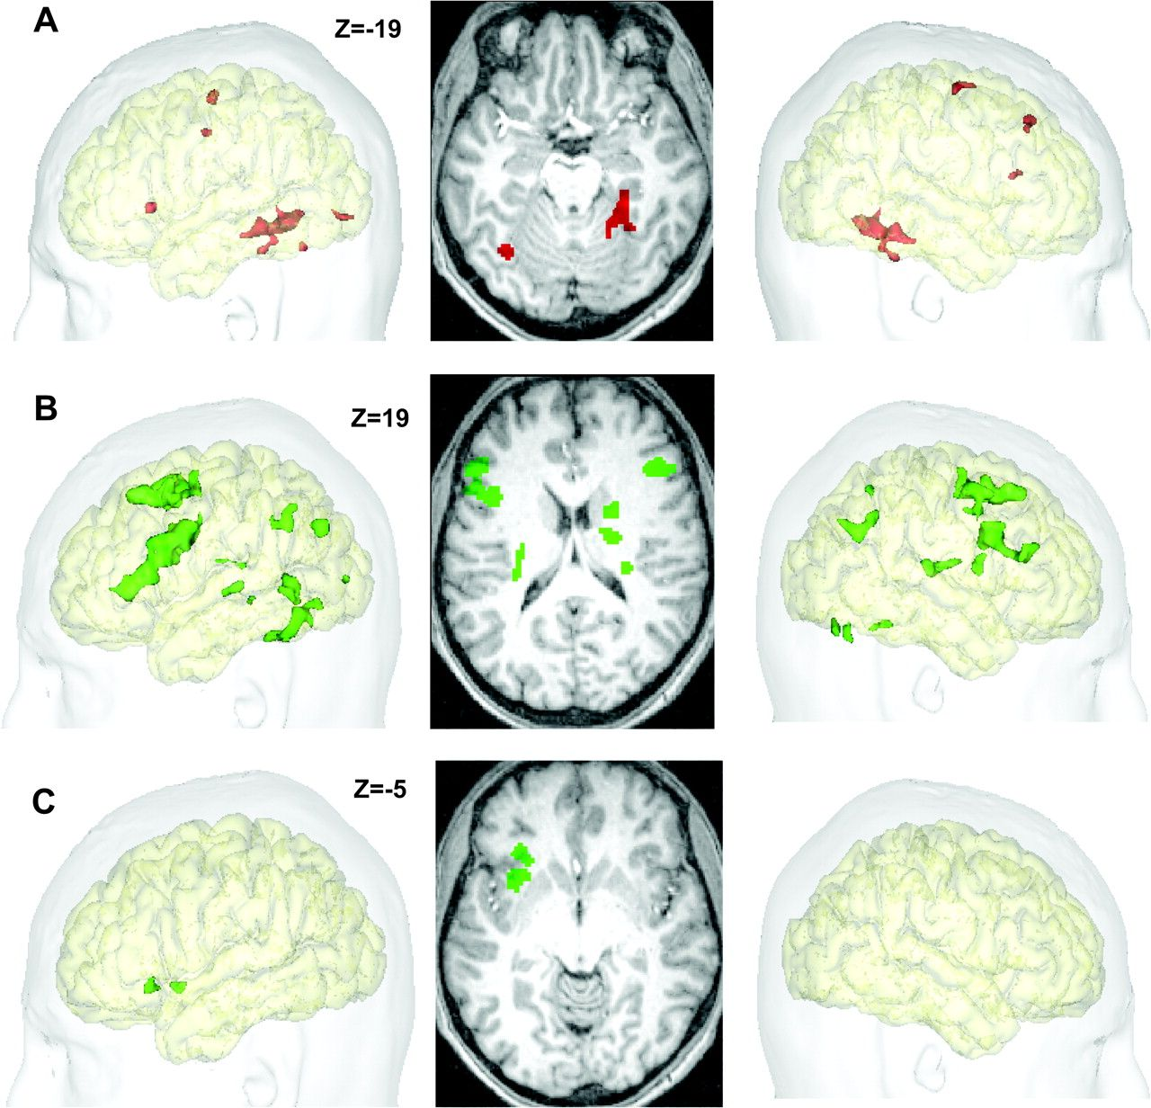
Figure 3. Effects of priming, projected onto left hemispheric, top, and right-hemispheric views of the standard MNI ...
Notes:
Figure 3. Effects of priming, projected onto left hemispheric, top, and right-hemispheric views of the standard MNI brain. (A) Regions showing subliminal repetition suppression. (B) Regions showing supraliminal repetition suppression. (C) Regions showing repetition enhancement in the supraliminal phonological condition. For illustration purposes, all contrasts are thresholded at P 23 voxels.
Unless provided in the caption above, the following copyright applies to the content of this slide: © The Author 2006. Published by Oxford University Press. All rights reserved. For permissions, please e-mail: journals.permissions@oxfordjournals.org

Slide 4
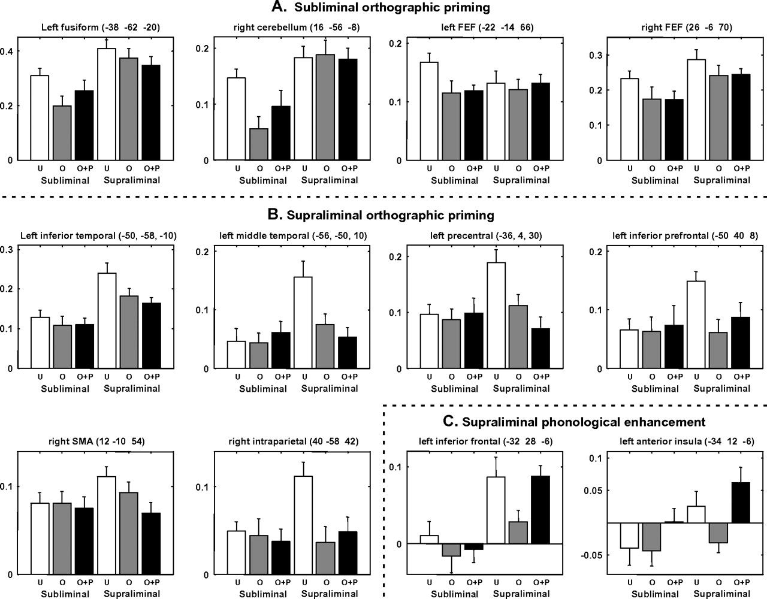
Figure 4. Histograms of percent BOLD signal change across the 6 conditions of the experimental design, for several ...
Notes:
Figure 4. Histograms of percent BOLD signal change across the 6 conditions of the experimental design, for several brain regions of interest showing orthographic repetition suppression from subliminal primes (A) and/or supraliminal primes (B), or phonological repetition enhancement from supraliminal primes (C).
Unless provided in the caption above, the following copyright applies to the content of this slide: © The Author 2006. Published by Oxford University Press. All rights reserved. For permissions, please e-mail: journals.permissions@oxfordjournals.org

