Slide 1
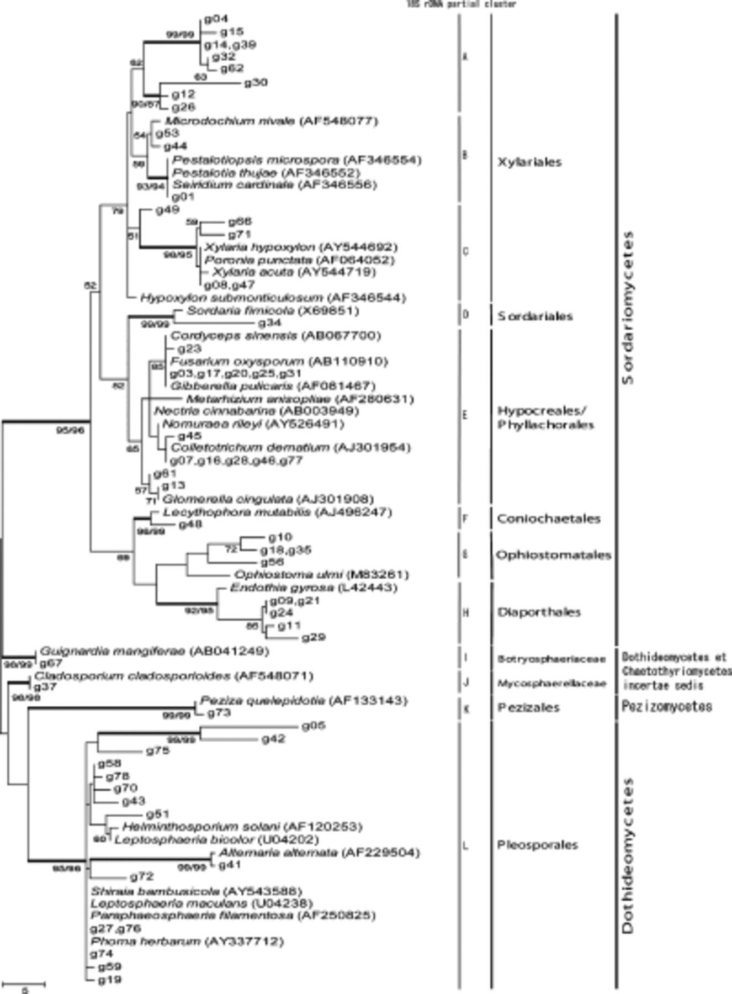
1 Maximum parsimony method tree of 60 groups of endophytic fungi isolated from bamboos based on Partial 610 bp ...
Notes:
1 Maximum parsimony method tree of 60 groups of endophytic fungi isolated from bamboos based on Partial 610 bp 18S rRNA gene sequences. Confidence values above 50 percent obtained from a 1000-replicate bootstrap analysis are indicated at the branch nodes. The bootstrap values that are higher than 90 are shown with bold lines. The scale bar indicates the number of steps.
Unless provided in the caption above, the following copyright applies to the content of this slide: © 2006 Federation of European Microbiological Societies

Slide 2
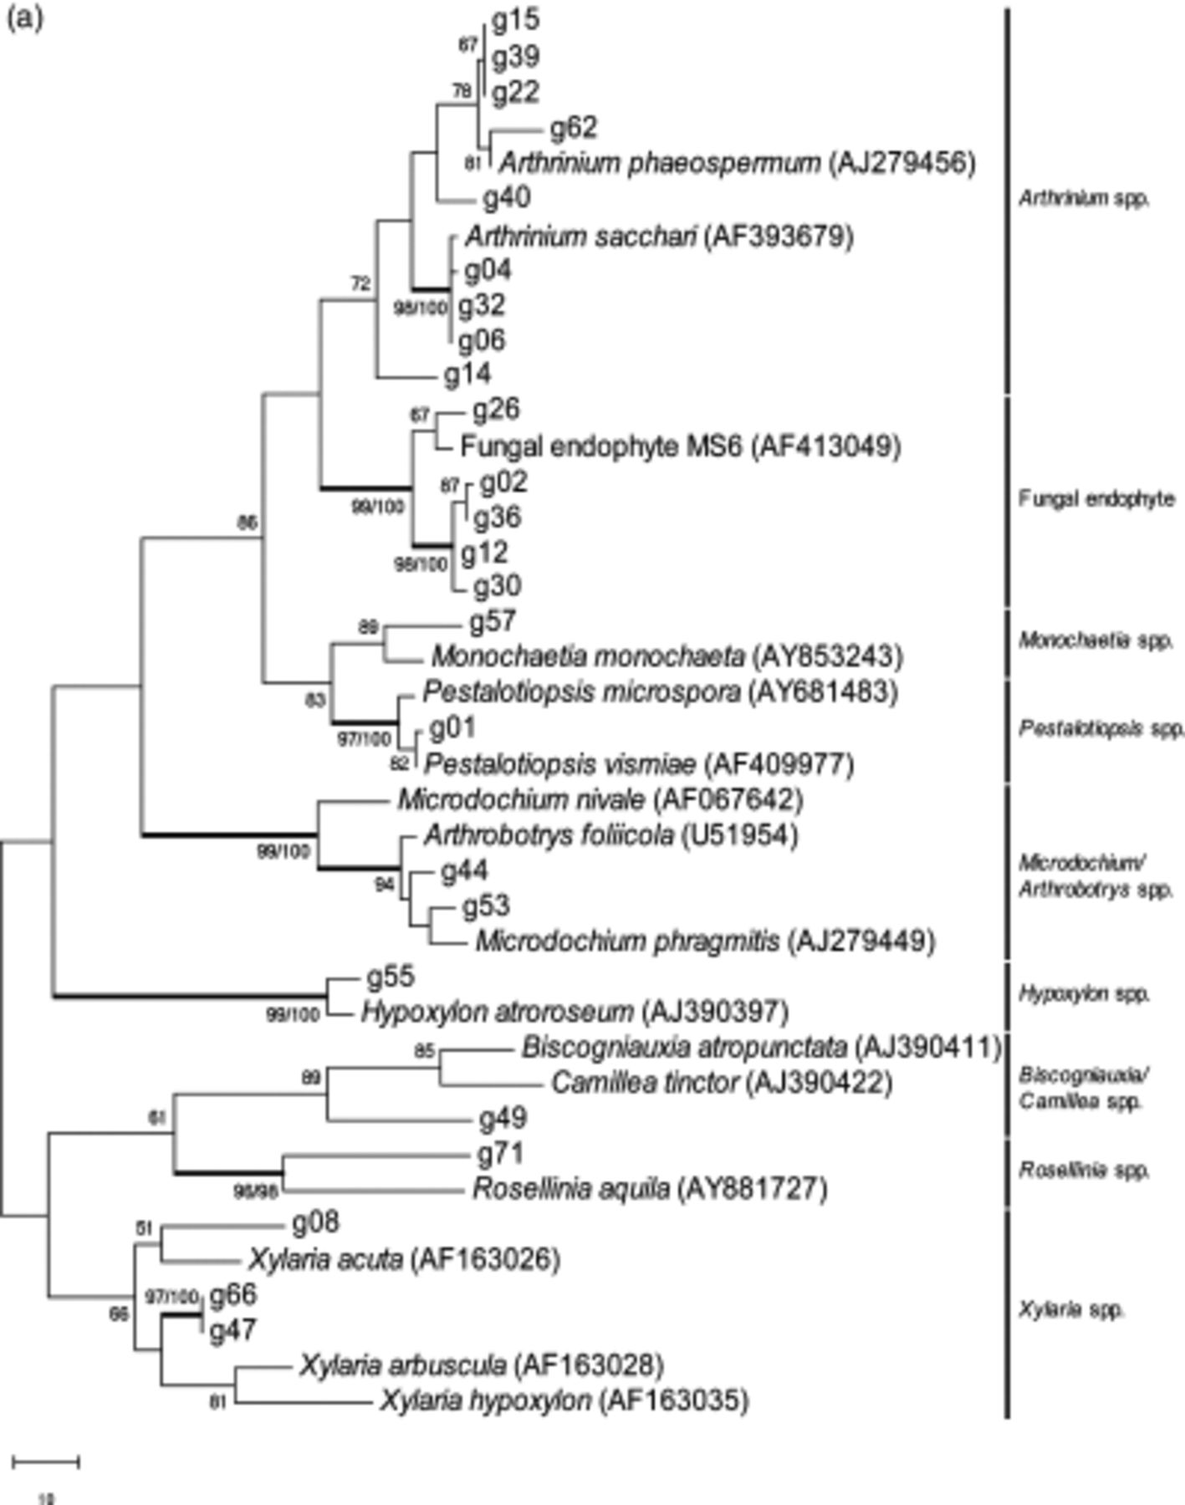
2 Maximum parsimony method tree of endophytes isolated from bamboos based on 300–500 bp of ITS1-5.8S-ITS2 rRNA ...
Notes:
2 Maximum parsimony method tree of endophytes isolated from bamboos based on 300–500 bp of ITS1-5.8S-ITS2 rRNA in different orders as given in the 18S rRNA gene tree as above, i.e. (a) Xylariales, 360 bp; (b) Hypocreales, 510 bp; (c) Phyllachorales, 446 bp; (d) Diaporthales, 360 bp; (e) Ophiostomatales and Coniochaetales, 385 bp; (f) Pleosporales, 393 bp. Confidence values above 50% obtained from a 1000-replicate bootstrap analysis are indicated at the branch nodes. The bootstrap values that are higher than 90 are shown with bold lines. The scale bar indicates the number of steps.
Unless provided in the caption above, the following copyright applies to the content of this slide: © 2006 Federation of European Microbiological Societies

Slide 3
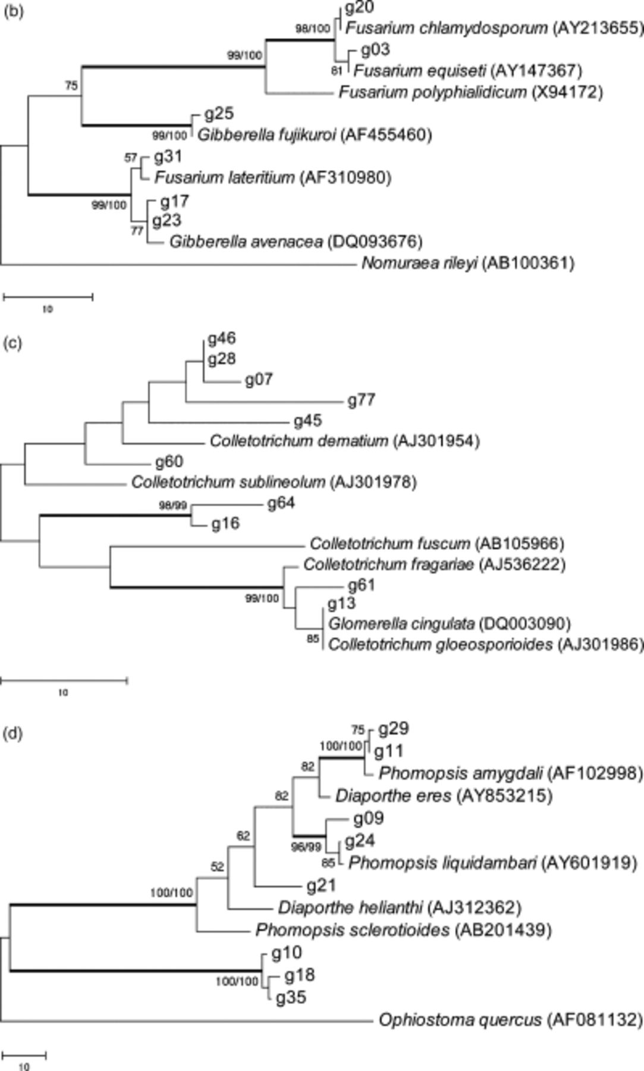
2 Maximum parsimony method tree of endophytes isolated from bamboos based on 300–500 bp of ITS1-5.8S-ITS2 rRNA ...
Notes:
2 Maximum parsimony method tree of endophytes isolated from bamboos based on 300–500 bp of ITS1-5.8S-ITS2 rRNA in different orders as given in the 18S rRNA gene tree as above, i.e. (a) Xylariales, 360 bp; (b) Hypocreales, 510 bp; (c) Phyllachorales, 446 bp; (d) Diaporthales, 360 bp; (e) Ophiostomatales and Coniochaetales, 385 bp; (f) Pleosporales, 393 bp. Confidence values above 50% obtained from a 1000-replicate bootstrap analysis are indicated at the branch nodes. The bootstrap values that are higher than 90 are shown with bold lines. The scale bar indicates the number of steps.
Unless provided in the caption above, the following copyright applies to the content of this slide: © 2006 Federation of European Microbiological Societies

Slide 4
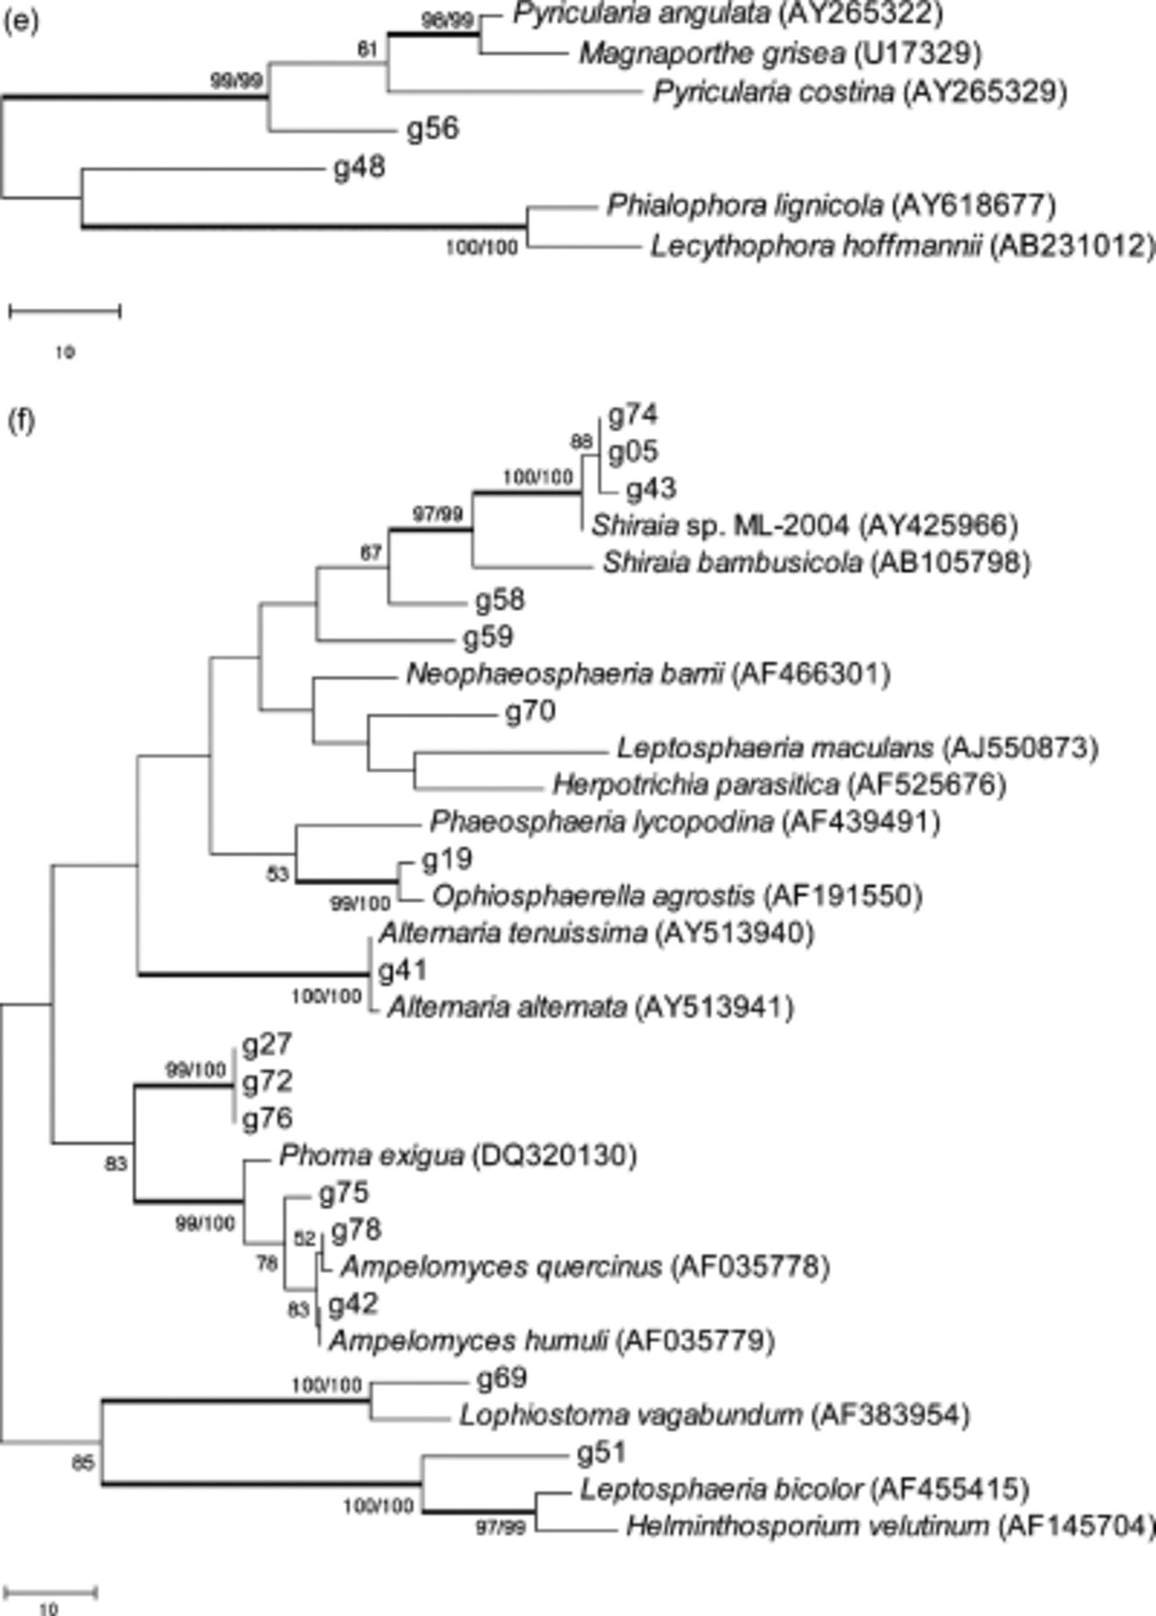
2 Maximum parsimony method tree of endophytes isolated from bamboos based on 300–500 bp of ITS1-5.8S-ITS2 rRNA ...
Notes:
2 Maximum parsimony method tree of endophytes isolated from bamboos based on 300–500 bp of ITS1-5.8S-ITS2 rRNA in different orders as given in the 18S rRNA gene tree as above, i.e. (a) Xylariales, 360 bp; (b) Hypocreales, 510 bp; (c) Phyllachorales, 446 bp; (d) Diaporthales, 360 bp; (e) Ophiostomatales and Coniochaetales, 385 bp; (f) Pleosporales, 393 bp. Confidence values above 50% obtained from a 1000-replicate bootstrap analysis are indicated at the branch nodes. The bootstrap values that are higher than 90 are shown with bold lines. The scale bar indicates the number of steps.
Unless provided in the caption above, the following copyright applies to the content of this slide: © 2006 Federation of European Microbiological Societies

