Slide 1
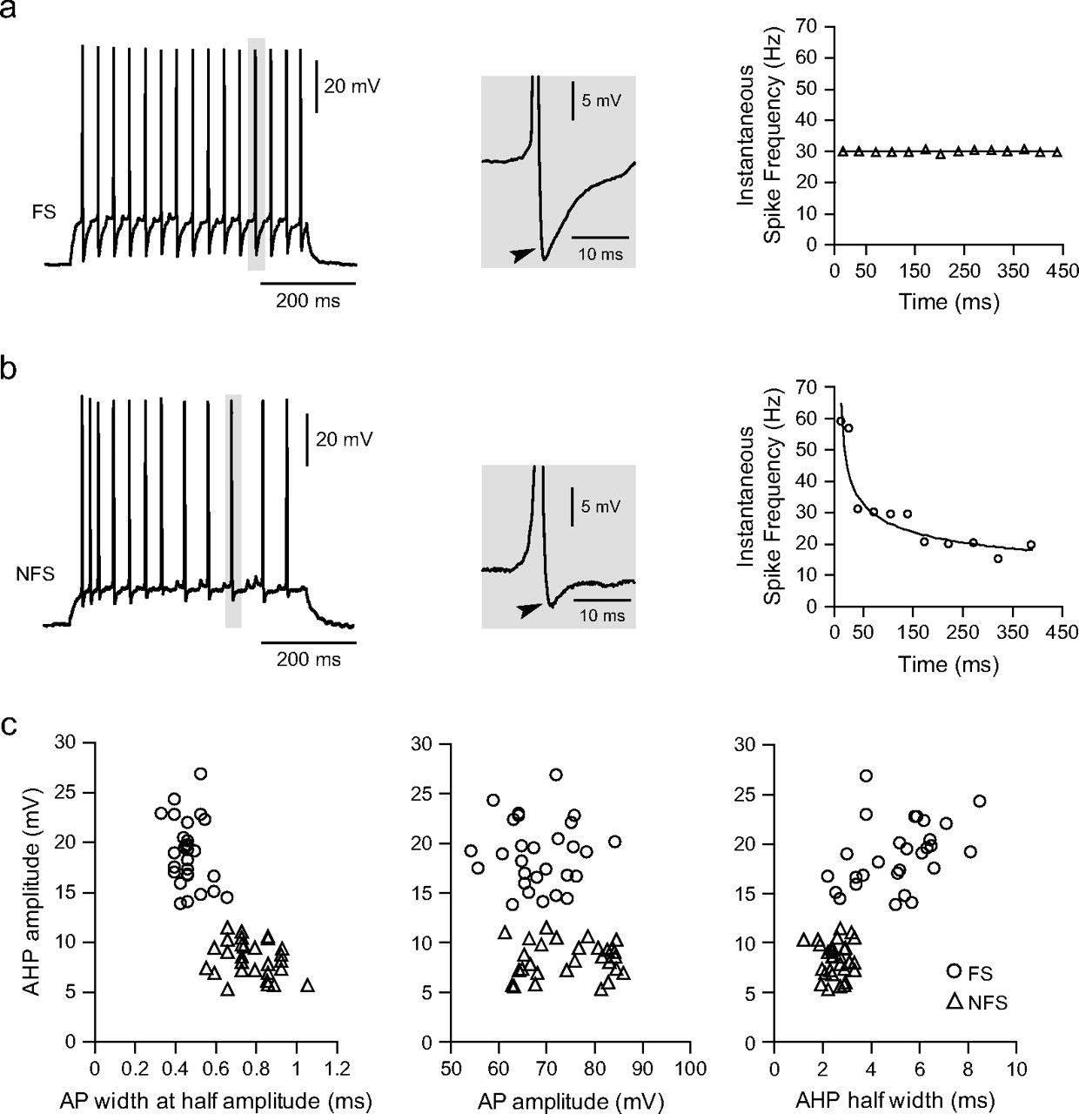
Figure 1. Interneurons could be classified as FS and NFS. Representative traces illustrating the firing pattern of FS ...
Notes:
Figure 1. Interneurons could be classified as FS and NFS. Representative traces illustrating the firing pattern of FS (a) and NFS (b) interneurons recorded in the PFC of developmentally mature animals (PD > 50). Depolarizing current steps induced repetitive action potential firing in both types of interneurons (left panel). FS interneurons exhibit a pronounced fast AHP (arrowhead), whereas AHP in NFS interneurons was less pronounced. The most distinctive difference was the lack of spike-frequency adaptation in FS interneurons, revealed as a constant instantaneous firing rate throughout the current pulse (right panel). NFS interneurons instead exhibited increasingly long interspike intervals. (c) FS and NFS interneurons exhibited different basic electrophysiological characteristics as indicated by AHP amplitude, AHP half width, action potential duration (measured at half width), and amplitude.
Unless provided in the caption above, the following copyright applies to the content of this slide: © The Author 2006. Published by Oxford University Press. All rights reserved. For permissions, please e-mail: journals.permissions@oxfordjournals.org

Slide 2
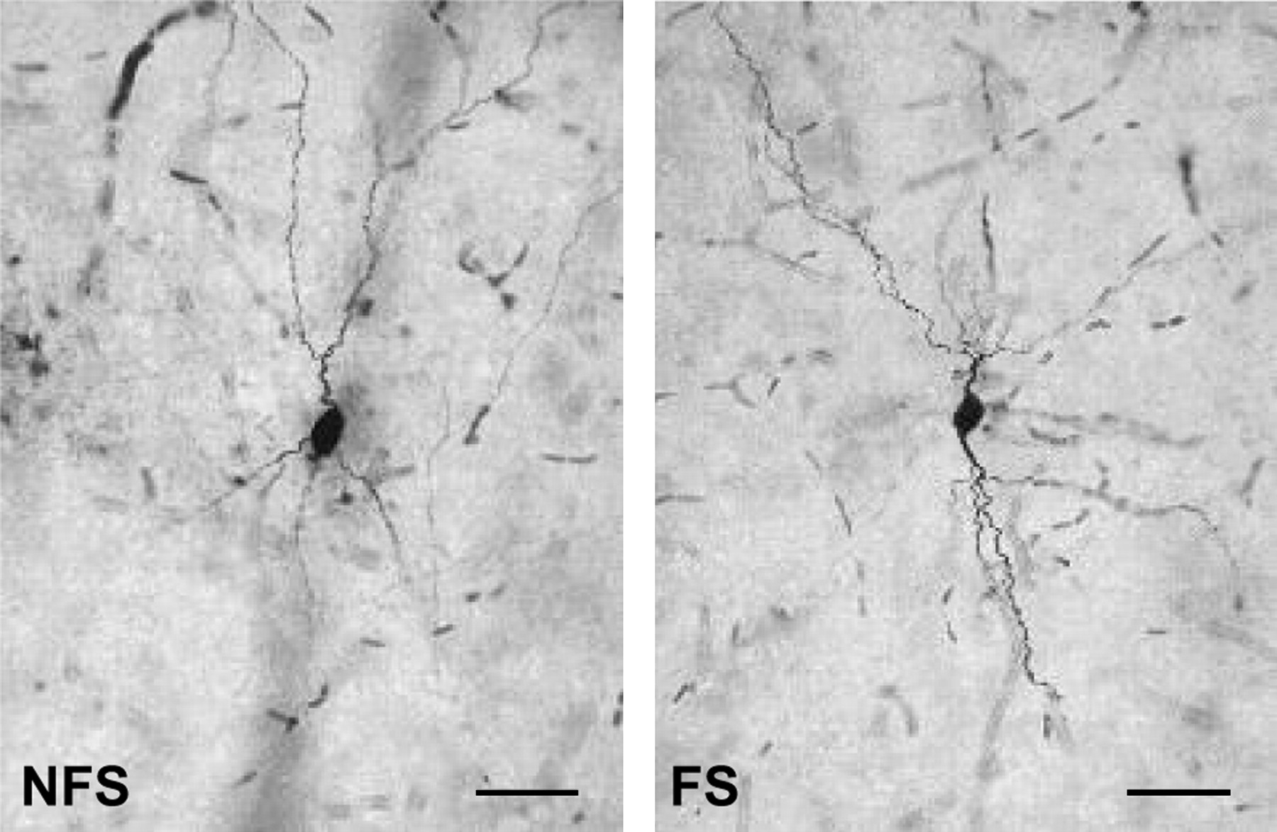
Figure 2. Neurobiotin staining of recorded GABAergic interneurons. Examples of layer V NFS and FS interneurons obtained ...
Notes:
Figure 2. Neurobiotin staining of recorded GABAergic interneurons. Examples of layer V NFS and FS interneurons obtained in the medial PFC from postpubertal rats. Scale bar: 50 μm
Unless provided in the caption above, the following copyright applies to the content of this slide: © The Author 2006. Published by Oxford University Press. All rights reserved. For permissions, please e-mail: journals.permissions@oxfordjournals.org

Slide 3
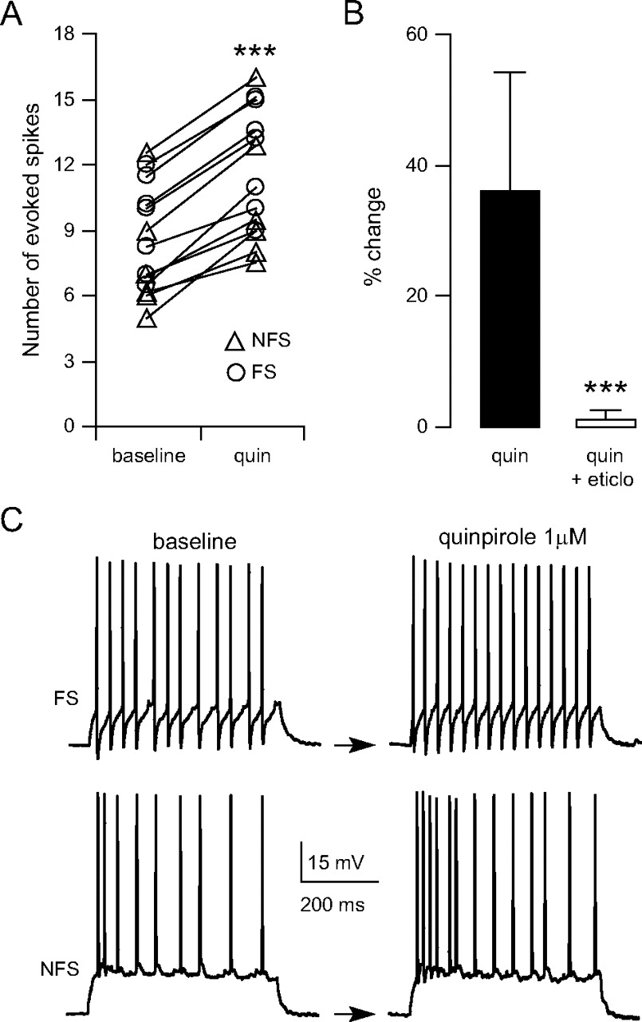
Figure 3. The D₂ agonist quinpirole increases interneuron excitability in adult animals. (A) Scatter plot ...
Notes:
Figure 3. The D2 agonist quinpirole increases interneuron excitability in adult animals. (A) Scatter plot showing the effect of 1 μM quinpirole on FS (open circles) and NFS (triangles) interneuron excitability. The data shown are the number of evoked spikes to intracellular current pulse injection and were obtained in the PFC of adult (PD > 50) animals. Quinpirole increased the number of evoked spikes in all PFC interneurons (***P < 0.0001, paired student's t-test). (B) Bar graph summarizing the effect of quinpirole and its blockade by 20 μM of the D2 antagonist eticlopride (indicated as percent change to baseline; ***P < 0.0001, repeated measures ANOVA). (C) Two representative traces of FS and NFS interneurons illustrating the number of evoked spikes before (baseline) and its increase after 5 min of bath application of quinpirole (1 μM) in both interneuron types.
Unless provided in the caption above, the following copyright applies to the content of this slide: © The Author 2006. Published by Oxford University Press. All rights reserved. For permissions, please e-mail: journals.permissions@oxfordjournals.org

Slide 4
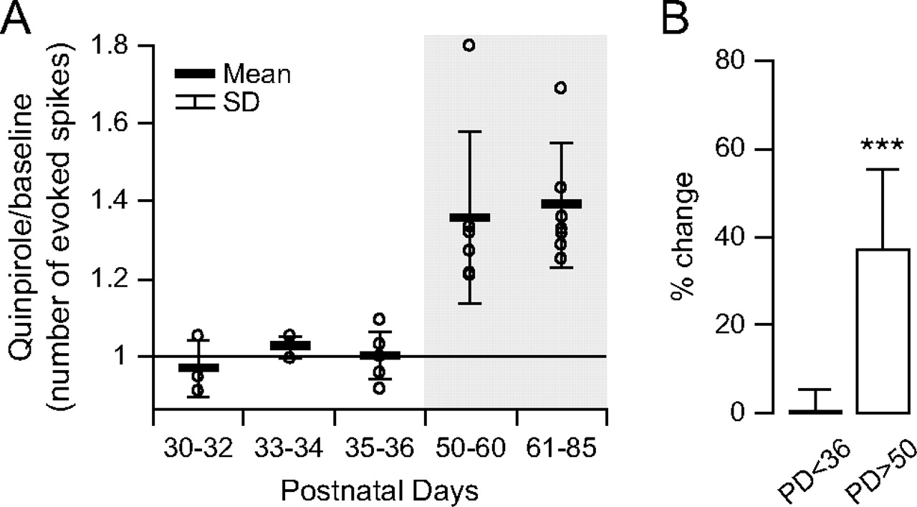
Figure 4. The excitatory effect of the D₂ agonist is observed only in slices from adult animals. (A) Scatter ...
Notes:
Figure 4. The excitatory effect of the D2 agonist is observed only in slices from adult animals. (A) Scatter plot showing the effect of quinpirole on PFC interneurons excitability from prepubertal to adult ages, expressed as the ratio between evoked firing after and before quinpirole administration. Open circles are individual neurons recorded from each group, and the data were grouped into age ranges. The excitatory effect of quinpirole (1 μM) was observed only in developmentally mature rats. (B) Bar graph (mean ± SD) summarizing the effect of quinpirole on prepubertal PFC interneurons (PD 50) animals (***P < 0.0001, repeated measures ANOVA).
Unless provided in the caption above, the following copyright applies to the content of this slide: © The Author 2006. Published by Oxford University Press. All rights reserved. For permissions, please e-mail: journals.permissions@oxfordjournals.org

Slide 5
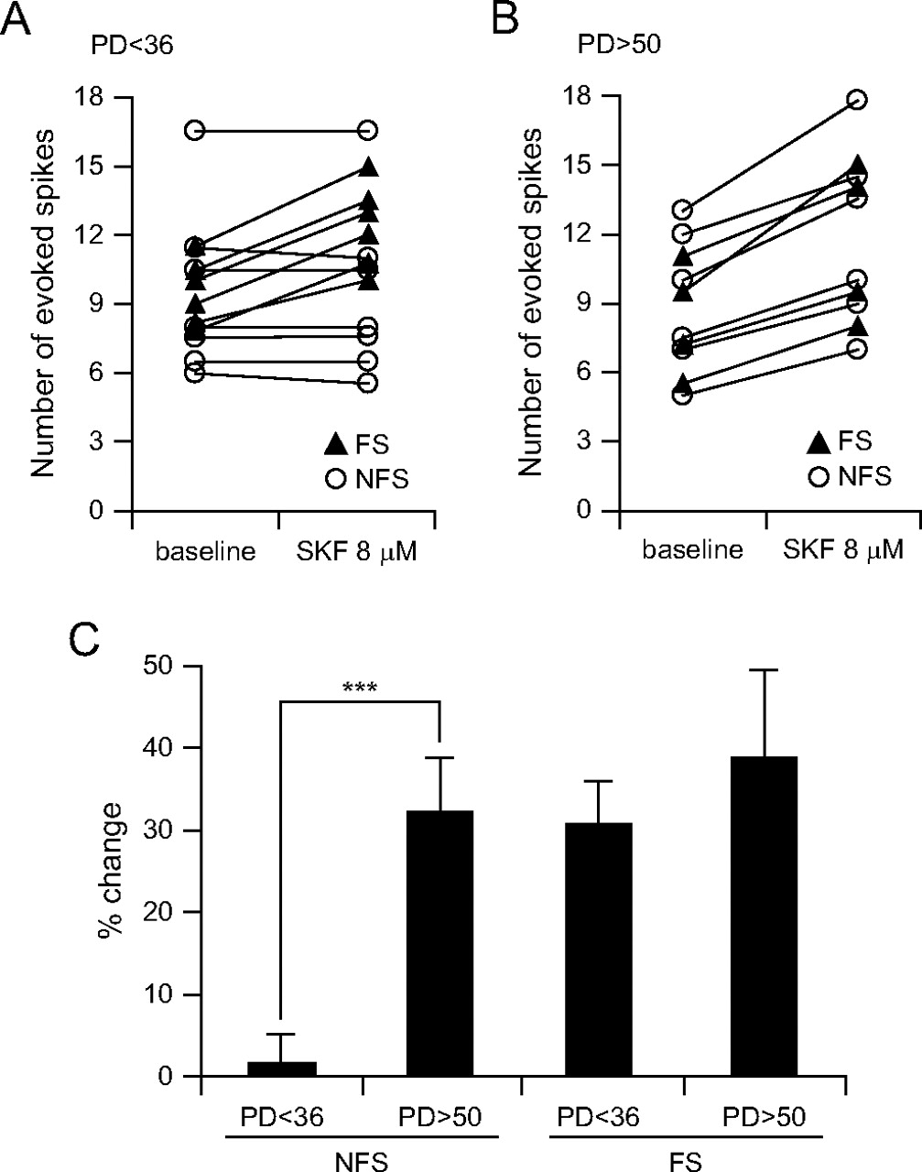
Figure 5. The D₁ agonist SKF38393 increases interneuron excitability in the adult PFC. (A) Scatter plot ...
Notes:
Figure 5. The D1 agonist SKF38393 increases interneuron excitability in the adult PFC. (A) Scatter plot showing the effect of 8 μM SKF38393 on FS (black triangles) and NFS (open circles) interneuron excitability, assessed with the number of spikes evoked by intracellular current pulse injection, in slices from prepubertal (PD < 36) animals. Bath application of 8 μM SKF38393 increased the number of evoked spikes in all FS (n = 6) interneurons, whereas not apparent changes were observed in NFS (n = 7). (B) Scatter plot illustrating changes in FS- and NFS-evoked spikes induced by the D1 agonist in slices from young adult animals (PD > 50). Both FS (n = 4) and NFS (n = 6) interneurons exhibited similar increases in neuronal excitability. (C) Bar graph (mean ± SD) summarizing the effect of SKF38393 on pre- and postpubertal PFC FS and NFS interneuron excitability, expressed as percent change from baseline. PFC NFS interneurons acquire a D1 modulation only after adolescence (***P < 0.0001, student's t-test).
Unless provided in the caption above, the following copyright applies to the content of this slide: © The Author 2006. Published by Oxford University Press. All rights reserved. For permissions, please e-mail: journals.permissions@oxfordjournals.org

