Slide 1
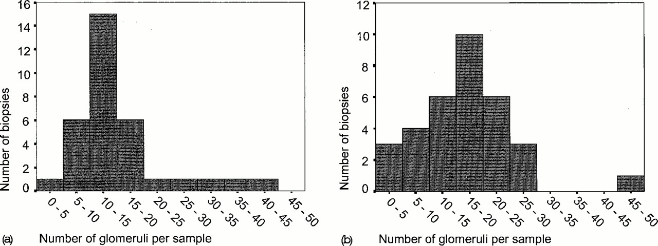
Fig. 1. Distribution of sample size in terms of the number of glomeruli per biopsy in the initial biopsies (a) and in ...
Notes:
Fig. 1. Distribution of sample size in terms of the number of glomeruli per biopsy in the initial biopsies (a) and in the follow‐up biopsies (b). The influence of a small number of glomeruli on the outcome of our results was tested, but it was found that both a minimum of five and 10 glomeruli per biopsy as inclusion criteria did not influence these results.
Unless provided in the caption above, the following copyright applies to the content of this slide: European Renal Association‐European Dialysis and Transplant Association

Slide 2
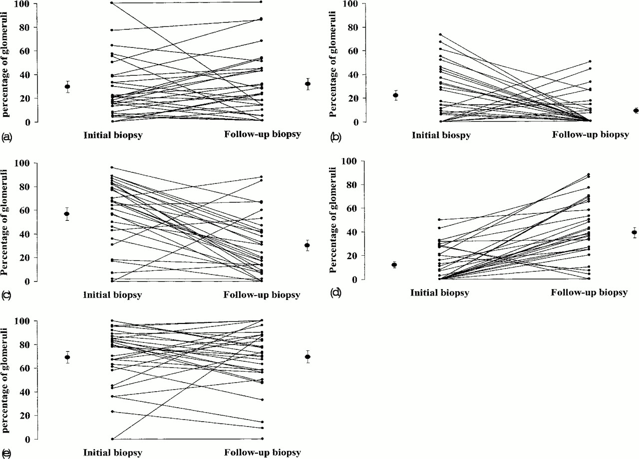
Fig. 2. The percentage of normal glomeruli (a), glomeruli with fibrinoid necrosis (b), extracapillary proliferation ...
Notes:
Fig. 2. The percentage of normal glomeruli (a), glomeruli with fibrinoid necrosis (b), extracapillary proliferation (c), global sclerosis (d), and the calculated diseased glomeruli (e) in initial and follow‐up biopsies paired for each individual. Each line counts for one patient. However, lines may overlap, in most cases between zero in the initial biopsy and zero in the follow‐up biopsy. The mean percentages of glomerular lesions per biopsy with standard errors are added for both initial and follow‐up biopsies.
Unless provided in the caption above, the following copyright applies to the content of this slide: European Renal Association‐European Dialysis and Transplant Association

Slide 3
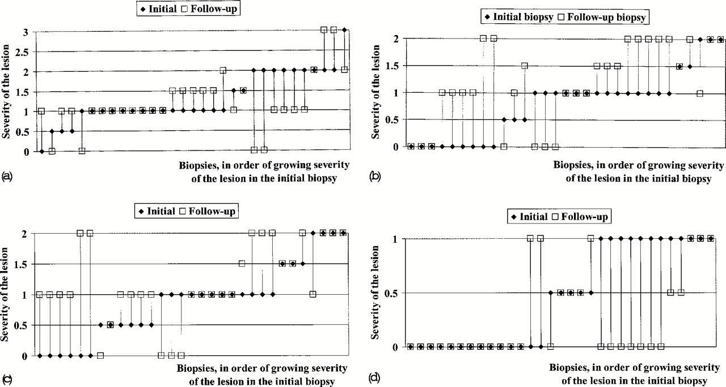
Fig. 3. The severity of interstitial infiltrates (a), interstitial fibrosis (b), tubular atrophy (c), and tubular ...
Notes:
Fig. 3. The severity of interstitial infiltrates (a), interstitial fibrosis (b), tubular atrophy (c), and tubular necrosis (d) in initial (diamond) and follow‐up (square) biopsies paired for each individual patient. The lesions were scored on a semi‐quantitative scale. Major differences of opinion were averaged.
Unless provided in the caption above, the following copyright applies to the content of this slide: European Renal Association‐European Dialysis and Transplant Association

Slide 4
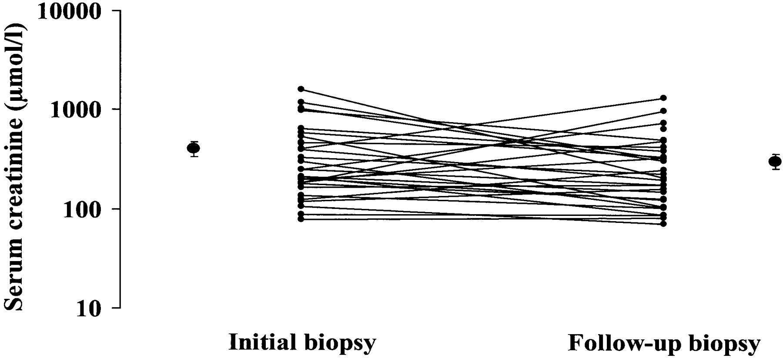
Fig. 4. Serum creatinine levels at the time points of initial and follow‐up biopsies. The mean levels of serum ...
Notes:
Fig. 4. Serum creatinine levels at the time points of initial and follow‐up biopsies. The mean levels of serum creatinine with standard errors are added for both time points.
Unless provided in the caption above, the following copyright applies to the content of this slide: European Renal Association‐European Dialysis and Transplant Association

Slide 5
Fig. 5. Correlations of the change in the percentage of normal glomeruli (a) and the change in the percentage of ...
Notes:
Fig. 5. Correlations of the change in the percentage of normal glomeruli (a) and the change in the percentage of diseased glomeruli (b) with the change in renal function (in terms of natural logarithm of serum creatinine) between the initial and the follow‐up biopsy. The changes were calculated as the value at the time of the initial biopsy minus the value at the time of the follow‐up biopsy.
Unless provided in the caption above, the following copyright applies to the content of this slide: European Renal Association‐European Dialysis and Transplant Association

Slide 6
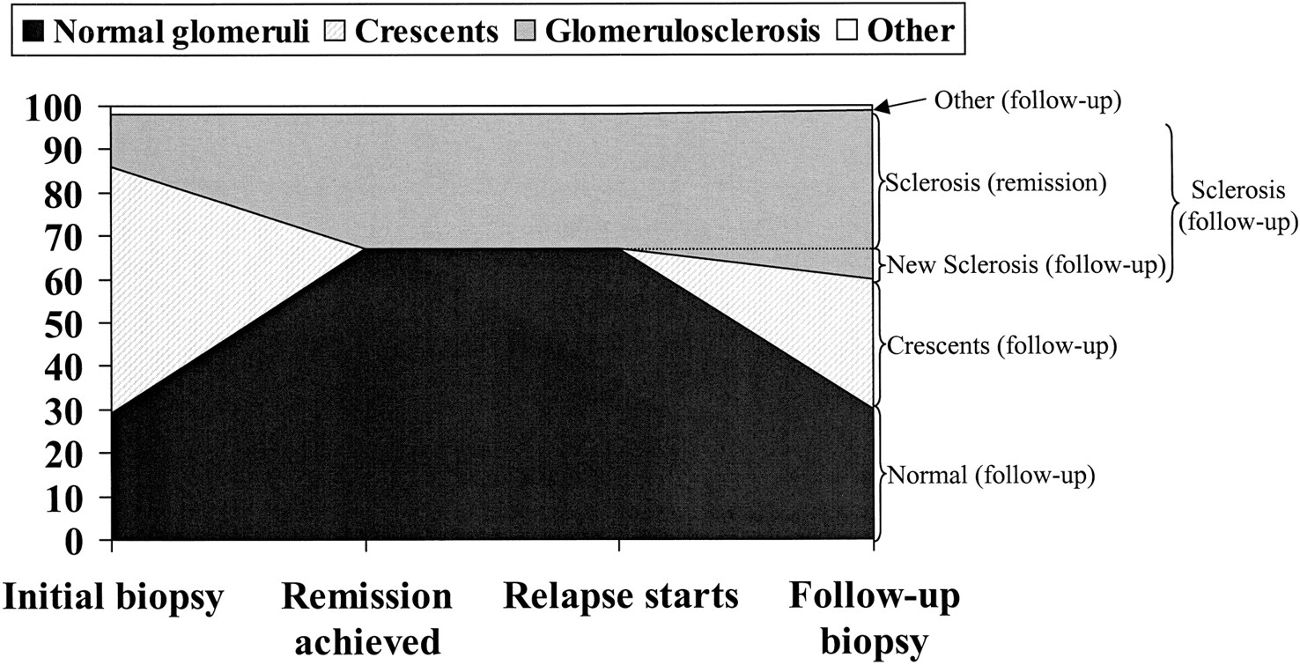
Fig. 6. Hypothesis on the evolvement of normal glomeruli, extracapillary proliferation, and glomerulosclerosis during ...
Notes:
Fig. 6. Hypothesis on the evolvement of normal glomeruli, extracapillary proliferation, and glomerulosclerosis during the time interval between the two biopsies. At presentation of the disease, 12% of glomeruli in the initial renal biopsy were globally sclerosed. Assuming an analogous course of events during relapse, 12% of glomeruli that were not sclerotic during remission will be sclerotic in the follow‐up biopsy. Subsequently, the percentage newly sclerosed glomeruli in the follow‐up biopsy (i.e. developed during relapse) can be calculated as follows: new sclerosis (follow‐up)=12/100 of the not sclerotic glomeruli during remission. The ‘not sclerotic glomeruli during remission’ can be substituted: new sclerosis (follow‐up)=12/100 (normal (follow‐up)+crescents (follow‐up)+new sclerosis (follow‐up)+other (follow‐up)). This formula can be converted to: new sclerosis (follow‐up)=12/88 (normal (follow‐up)+crescents (follow‐up)+other (follow‐up))=12/88 (30+30+1)=8%. For the percentage sclerosis, present on average during remission, we can subsequently calculate: sclerosis (remission)=sclerosis (follow‐up)−new sclerosis (follow‐up)=39−8=31%. Assuming that crescents will not persist during remission without consequence on renal function and that glomerular lesions stated as ‘other’ are not influenced by immunosuppressive treatment, we can calculate the percentage normal glomeruli during remission: normal (remission)=100−sclerosis (remission)−other (initial)=100−31−2=67%.
Unless provided in the caption above, the following copyright applies to the content of this slide: European Renal Association‐European Dialysis and Transplant Association

