Slide 1
Figure 1
Notes:
Figure 1
Unless provided in the caption above, the following copyright applies to the content of this slide: Published on behalf of the European Society of Cardiology. All rights reserved. © The Author 2011. For permissions please email: journals.permissions@oup.com

Slide 2
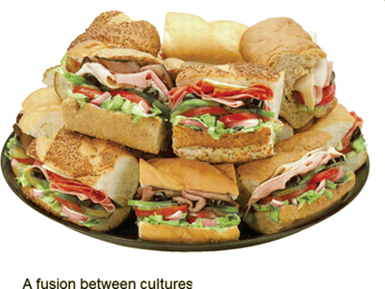
Figure 2
Notes:
Figure 2
Unless provided in the caption above, the following copyright applies to the content of this slide: Published on behalf of the European Society of Cardiology. All rights reserved. © The Author 2011. For permissions please email: journals.permissions@oup.com

Slide 3
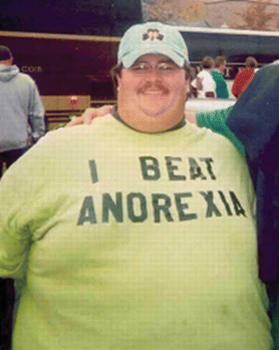
Figure 3
Notes:
Figure 3
Unless provided in the caption above, the following copyright applies to the content of this slide: Published on behalf of the European Society of Cardiology. All rights reserved. © The Author 2011. For permissions please email: journals.permissions@oup.com

