Slide 1
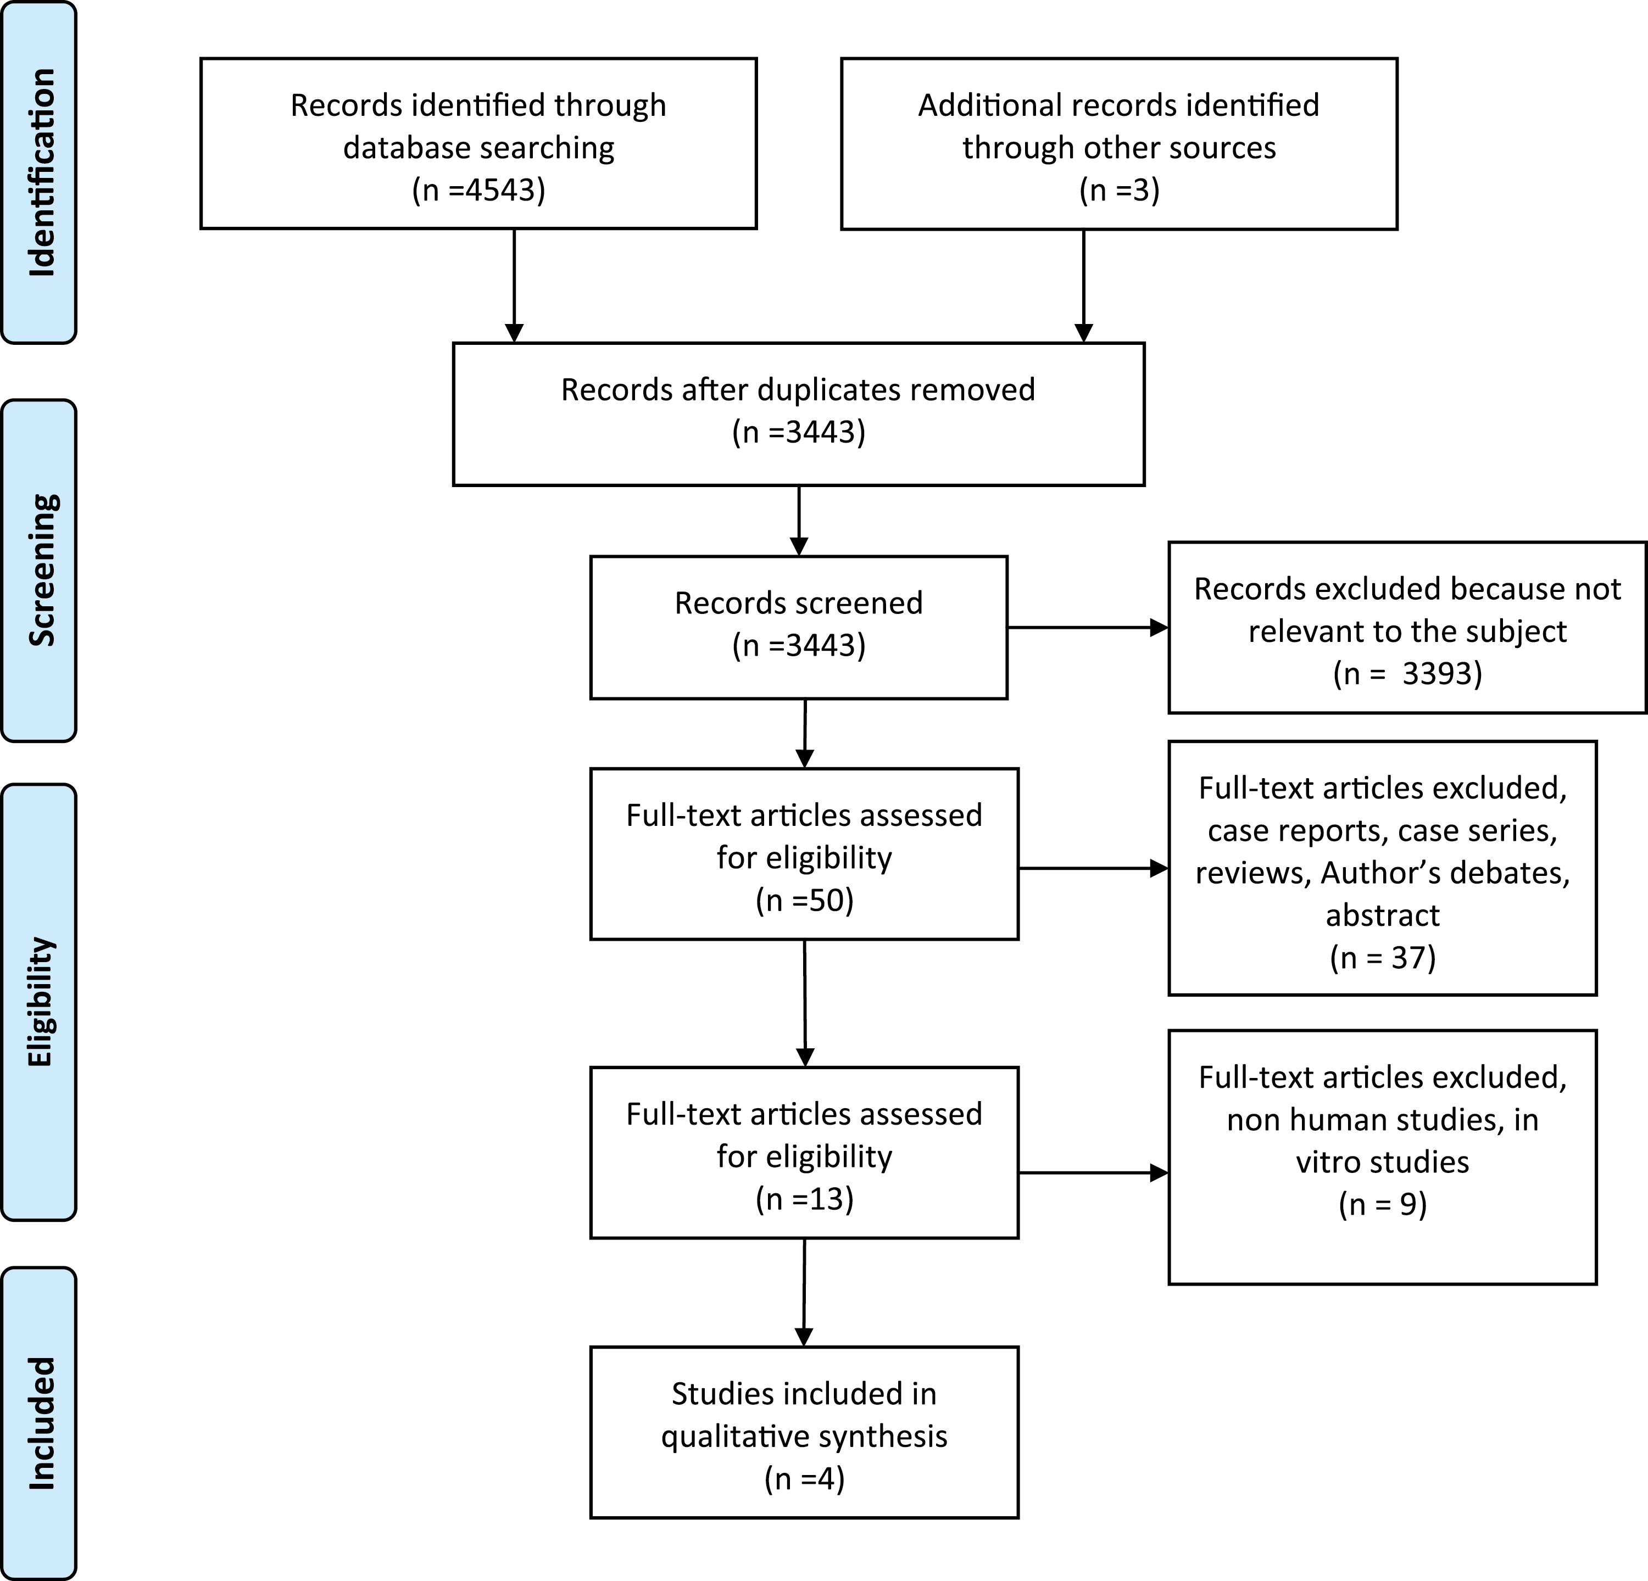
Figure 1. Flow diagram.
Notes:
Figure 1. Flow diagram.
Unless provided in the caption above, the following copyright applies to the content of this slide: © The Author 2016. Published by Oxford University Press on behalf of the European Orthodontic Society. All rights reserved. For permissions, please email: journals.permissions@oup.com

