Slide 1
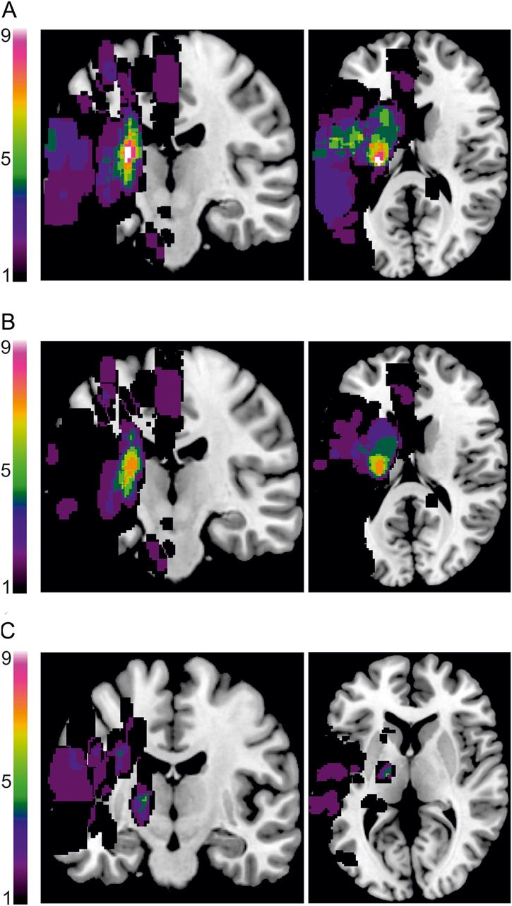
Table 1 Clinical data of stroke patients Note: *Note that the MI score for the upper limb was slightly reduced in 3 ...
Notes:
Table 1 Clinical data of stroke patients Note: *Note that the MI score for the upper limb was slightly reduced in 3 patients without hand motor impairment as they had difficulties to move the proximal muscles of elbow and shoulder against external resistance despite full grip force and hand motor performance. MI, Motricity Index; NIHSS, National Institutes of Health Stroke Scale. Table 2Clinical data of nonstroke neurological patients (control group) Patient numberage (years)gender (M, male; F, female)Mean MI (affected upper limb)Mean MI (affected lower limb)Trunk Control TestGrip force Index (% affected/unaffected)Modified Rankin ScaleClinical diagnosisControl 179M333325900TIAControl 272F333325930MeningitisControl 375F333325940TIAControl 446F333325950AIONControl 527M333325960TIAControl 650M333325990TIAControl 756M3333251000Peripheral facial nerve palsyControl 874M3333251040AIONControl 954M3333251040MigraineControl 1070M3333251040TIAControl 1172M3333251050TIAControl 1272F3333251050Amaurosis fugaxControl 1381F3333251050TIAControl 1457M3333251050TIAControl 1553F3333251050TIAControl 1638M3333251060TIAControl 1781M3333251160TIAControl 1867F3333251240TIAControl 1971F3333251270TIAControl 2092F3333251480TIAMEAN64.433.033.025.0106.30.0SD16.20.00.00.013.60.0AION, anterior ischemic optic neuropathy; TIA, transitory ischemic attack. Figure 1.Summary map of DWI lesions. (A) For the entire sample of stroke patients, the maximum overlap (n = 9/40) was at the posterior limb of the internal capsule of the CST. (B) Considering each stroke group separately, the maximum overlap in patients with hand motor deficits (n = 7/20) was also found at the posterior limb of the internal capsule. Thus, the overlap of lesion locations causing hand motor deficits was rather low. (C) Stroke patients without hand motor deficits also showed a maximum, albeit low lesion overlap at the internal capsule region (n = 5/20). This indicates that the lesion location within the internal capsule is not always associated with impairment of upper limb function. Lesion maps were normalized to an MNI reference brain. Lesion overlap was created using MRIcron (http://www.mccauslandcenter.sc.edu/mricro/mricron/index.html). For individual lesion maps, see Supplementary Data.
Unless provided in the caption above, the following copyright applies to the content of this slide: © The Author 2014. Published by Oxford University Press. All rights reserved. For Permissions, please e-mail: journals.permissions@oup.com

Slide 2
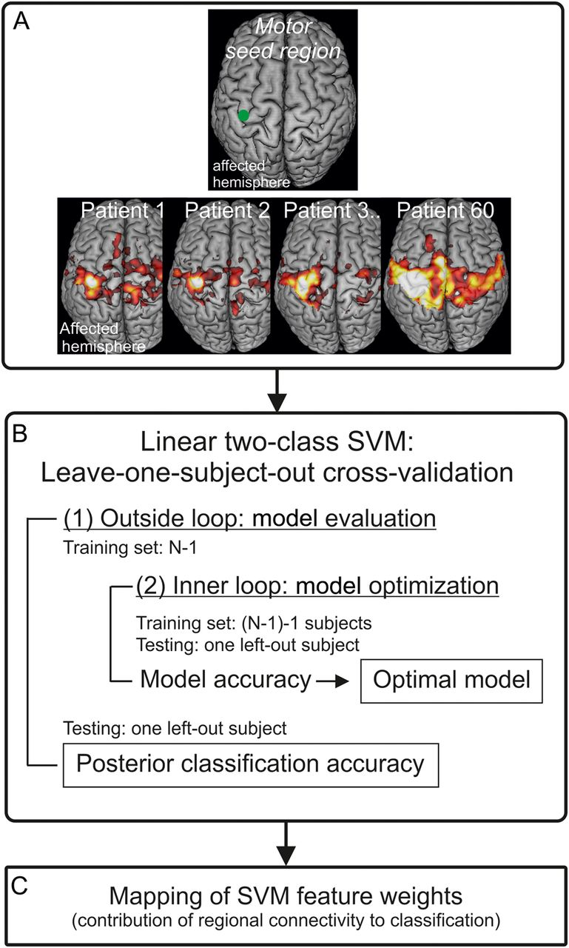
Figure 2. SVM design. (A) Preparing feature variables for the SVM analysis. The left panel shows the seed region at the ...
Notes:
Figure 2. SVM design. (A) Preparing feature variables for the SVM analysis. The left panel shows the seed region at the hand knob formation in primary motor cortex (M1) of the ipsilesional (affected) hemisphere, which was used to compute voxelwise correlation maps with every voxel within frontoparietal brain areas (cf. Methods). The right panel shows individual examples of resting-state functional connectivity maps. Each map consisted of 67 957 feature variables. Based on Fisher's criterion (cf. Methods), 5% of the most discriminative voxelwise features ( = connectivity values) for each training data set were entered into the SVM analyses. (B)Linear two-class SVM with a nested leave-one-subject-out cross-validation procedure. The outside loop was for model evaluation. Here, in a leave-one-subject-out cross-validation procedure, one subject was left out as a test sample and the rest of the sample constituted the training sample (N-1). The inner loop was for model optimization with a second leave-one-subject-out cross-validation procedure based on the training data. The model was optimized using different C-parameters of a linear decision function. The model with the highest accuracy and generalizability of the inner loop was used for classifying the left out, unknown subject of the outer loop. The posterior balanced accuracy was computed across all outer model evaluation loops. (C) The SVM weights of the linear separation function were reconstructed for all patients (cf. Methods). These weights show voxelwise connectivity values that contribute to SVM classification.
Unless provided in the caption above, the following copyright applies to the content of this slide: © The Author 2014. Published by Oxford University Press. All rights reserved. For Permissions, please e-mail: journals.permissions@oup.com

Slide 3
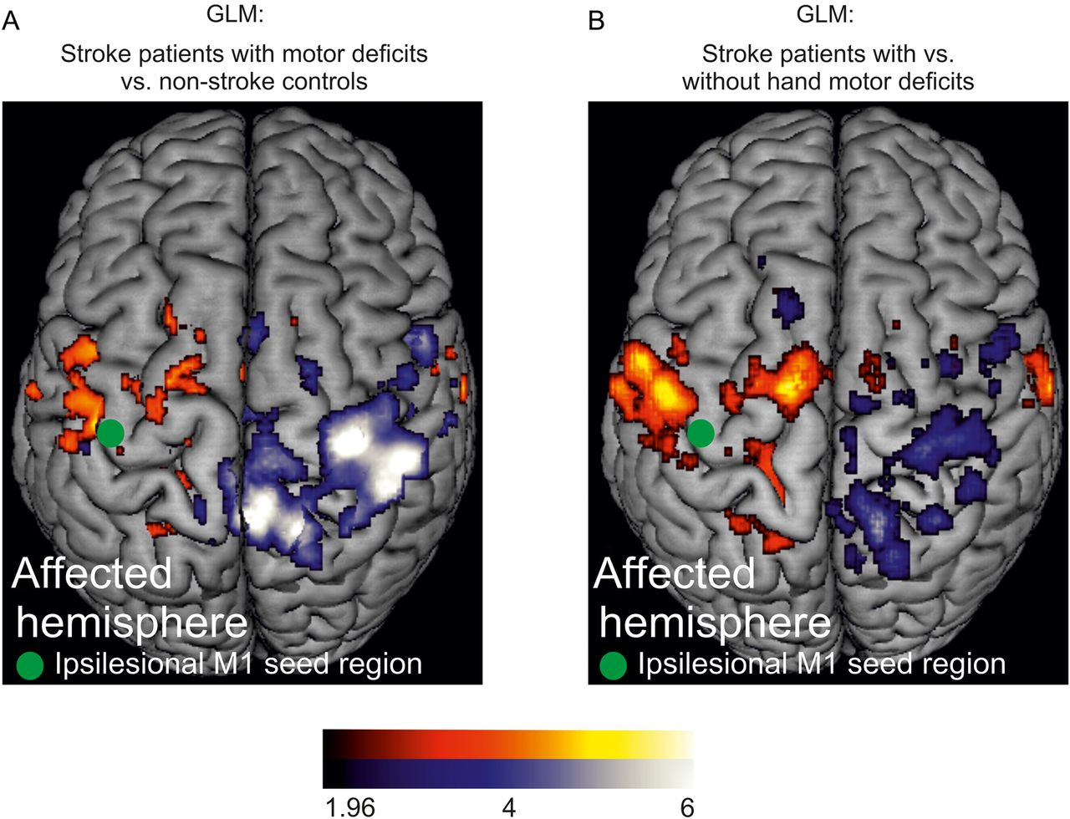
Figure 3. GLM results. (A) Group differences (independent samples t-test) between stroke patients with hand motor ...
Notes:
Figure 3. GLM results. (A) Group differences (independent samples t-test) between stroke patients with hand motor impairment and nonstroke control subjects. Blue: Areas of voxelwise resting-state connectivity for the SPM-T-contrast “controls > patients.” Red: Areas of voxelwise resting-state connectivity for the SPM-T-contrast “patients > controls.” (B) Group differences between stroke patients with and without hand motor impairment. Blue: Areas of voxelwise resting-state connectivity for the SPM-T-contrast “patients without impairment > patients with hand motor impairment.” Red: Areas of voxelwise resting-state connectivity for the SPM-T-contrast “patients with hand motor impairment > patients without hand motor impairment.” The green dot indicates the seed voxel coordinate in ipsilesional M1 (-38,-24,58). The color bar indicates the respective t-value (P < 0.05 uncorrected).
Unless provided in the caption above, the following copyright applies to the content of this slide: © The Author 2014. Published by Oxford University Press. All rights reserved. For Permissions, please e-mail: journals.permissions@oup.com

Slide 4
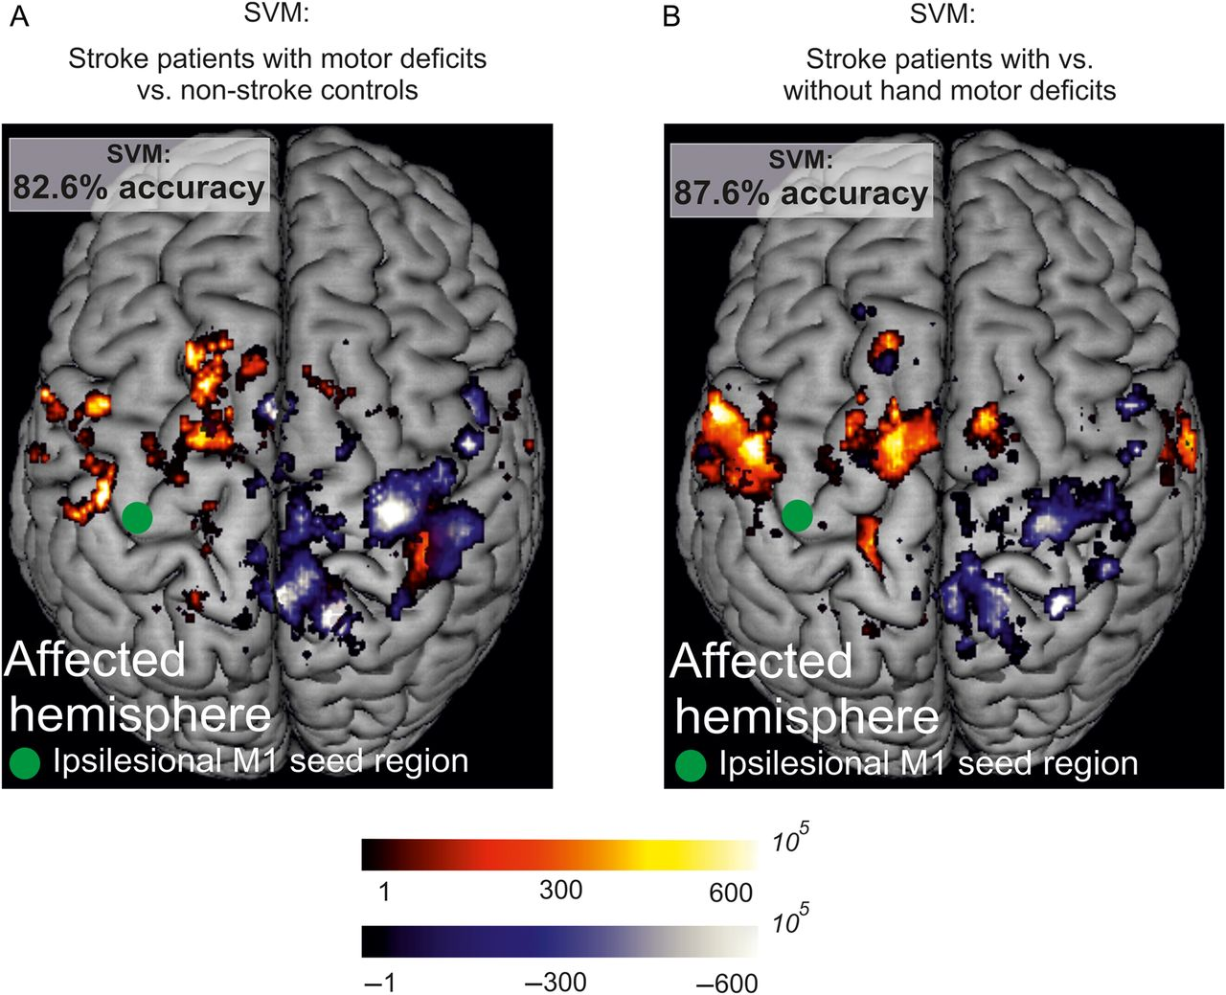
Figure 4. Multivariate SVM classification. (A) Results in stroke patients with hand motor impairment and nonstroke ...
Notes:
Figure 4. Multivariate SVM classification. (A) Results in stroke patients with hand motor impairment and nonstroke controls. Resting-state functional connectivity of ipsilesional M1 provided 82.6% mean accuracy for the classification of unknown patients. The SVM weight image shows the regional contribution of voxelwise resting-state connectivity to the classification of stroke patients with hand motor deficits and nonstroke controls. (B) SVM results in stroke patients. Resting-state functional connectivity of ipsilesional M1 provided 87.6% mean accuracy for the classification of stroke patients into hand motor impairment groups. Blue: Areas of voxelwise resting-state connectivity, which contribute to the classification of nonstroke controls (Fig. 4A) or stroke patients without hand motor deficit (Fig. 4B) (i.e., stroke patients with hand motor impairment were characterized by reduced connectivity with these areas). Red: Areas of voxelwise resting-state connectivity, which contribute to the classification of stroke patients with hand motor impairment. The scaling of the weights reflects the relative contribution of voxelwise resting-state connectivity with ipsilesional M1 to group classification. The green dot indicates the seed voxel coordinate in ipsilesional M1 (-38,-24,58).
Unless provided in the caption above, the following copyright applies to the content of this slide: © The Author 2014. Published by Oxford University Press. All rights reserved. For Permissions, please e-mail: journals.permissions@oup.com

