Slide 1
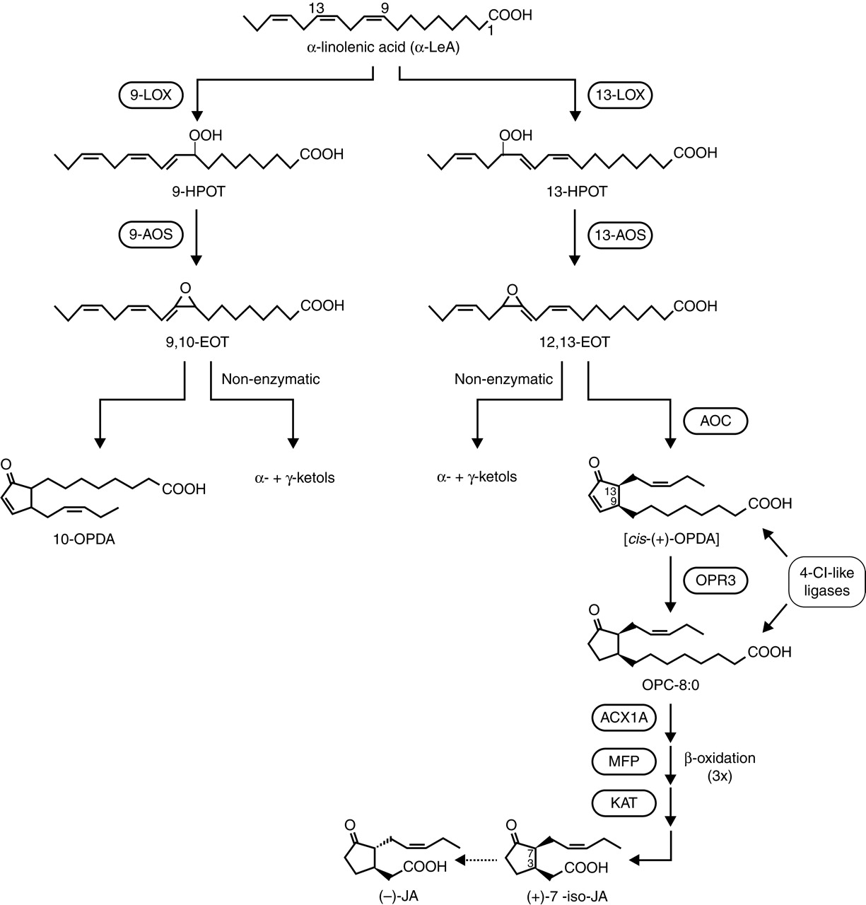
Fig. 1. The 9-LOX and 13-LOX pathways, and JA biosynthesis (modified after Schilmiller and Howe, 2005; Wasternack, ...
Notes:
Fig. 1. The 9-LOX and 13-LOX pathways, and JA biosynthesis (modified after Schilmiller and Howe, 2005; Wasternack, 2006).
Unless provided in the caption above, the following copyright applies to the content of this slide: © The Author 2007. Published by Oxford University Press on behalf of the Annals of Botany Company. All rights reserved. For Permissions, please email: journals.permissions@oxfordjournals.org

Slide 2
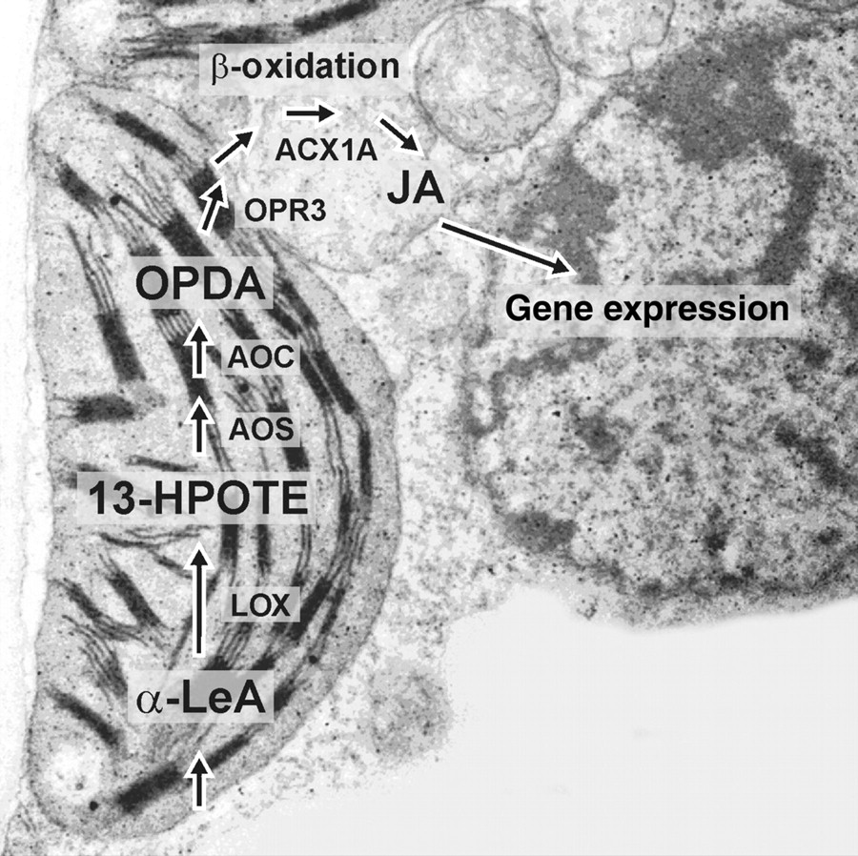
Fig. 2. Intracellular location of enzymes and intermediates in JA biosynthesis, illustrated on a SEM of a barley ...
Notes:
Fig. 2. Intracellular location of enzymes and intermediates in JA biosynthesis, illustrated on a SEM of a barley mesophyll cell showing the associated cellular compartments (photograph: B. Hause).
Unless provided in the caption above, the following copyright applies to the content of this slide: © The Author 2007. Published by Oxford University Press on behalf of the Annals of Botany Company. All rights reserved. For Permissions, please email: journals.permissions@oxfordjournals.org

Slide 3
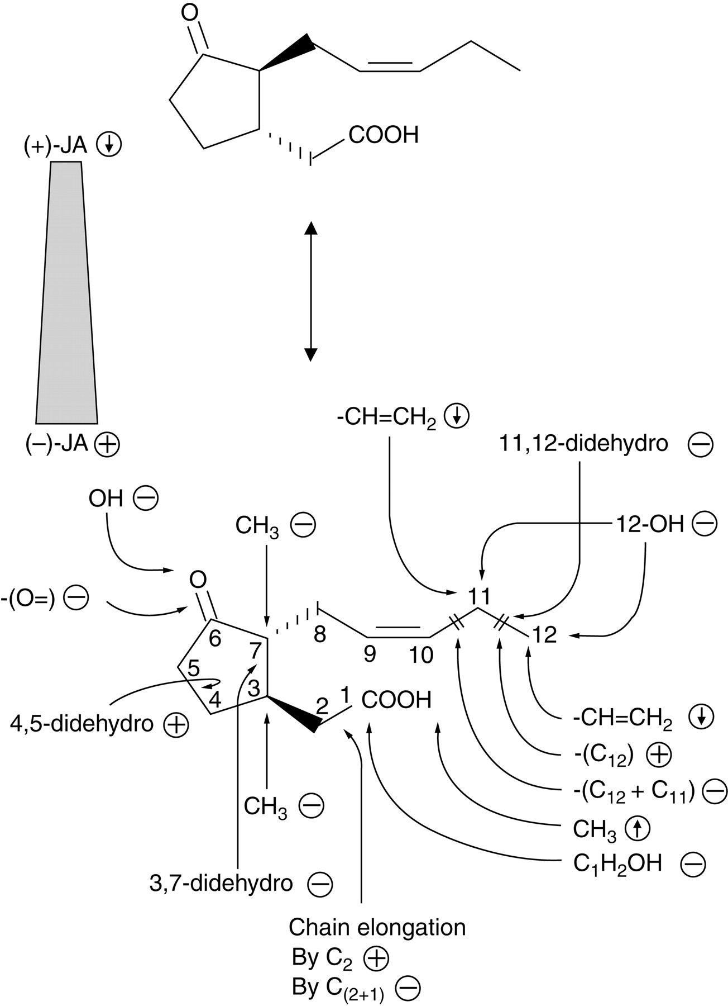
Fig. 3. Structure–activity relationships among jasmonates. The various structural analogs and enantiomers were tested ...
Notes:
Fig. 3. Structure–activity relationships among jasmonates. The various structural analogs and enantiomers were tested with respect to JA-induced gene expression in barley (data from Miersch et al., 1999b). ↓, decreased expression; ↑, increased expression; –, inactive; +, active in gene expression.
Unless provided in the caption above, the following copyright applies to the content of this slide: © The Author 2007. Published by Oxford University Press on behalf of the Annals of Botany Company. All rights reserved. For Permissions, please email: journals.permissions@oxfordjournals.org

Slide 4
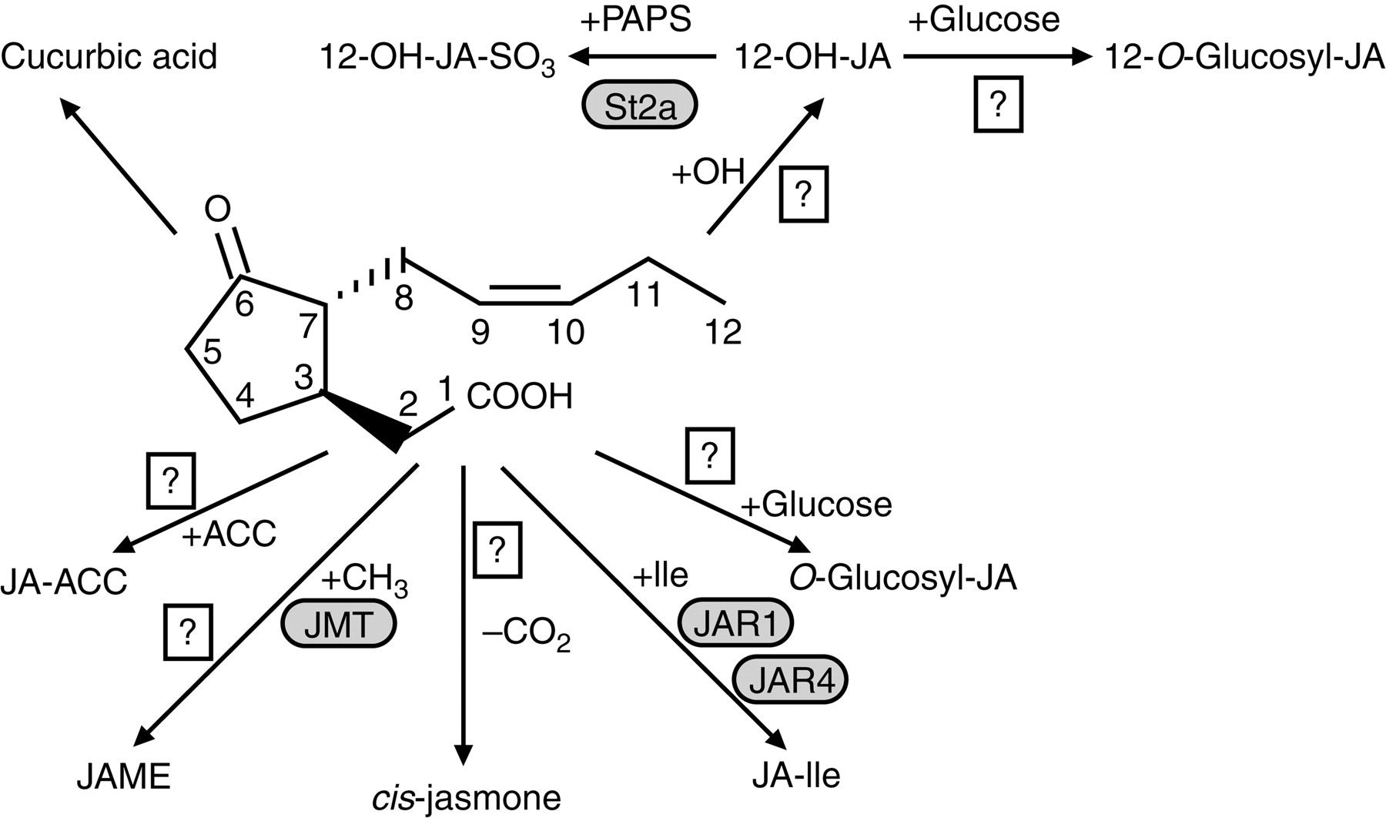
Fig. 4. Metabolic fate of jasmonic acid. The carboxylic acid side-chain can be conjugated to the ethylene precursor ...
Notes:
Fig. 4. Metabolic fate of jasmonic acid. The carboxylic acid side-chain can be conjugated to the ethylene precursor 1-amino cyclopropane-1-carboxylic acid (ACC), methylated by JA methyl transferase (JMT), decarboxylated to cis-jasmone, conjugated to amino acids such as Ile by JA amino acid synthase (Arabidopsis, JAR1; tobacco, JAR4) or glucosylated. The pentenyl side-chain can be hydroxylated in positions C-11 or C-12. In the case of 12-OH-JA, glucosylation or sulfation are subsequent reactions. Reduction of the keto group of the pentenone ring can lead to cucurbic acid.
Unless provided in the caption above, the following copyright applies to the content of this slide: © The Author 2007. Published by Oxford University Press on behalf of the Annals of Botany Company. All rights reserved. For Permissions, please email: journals.permissions@oxfordjournals.org

Slide 5
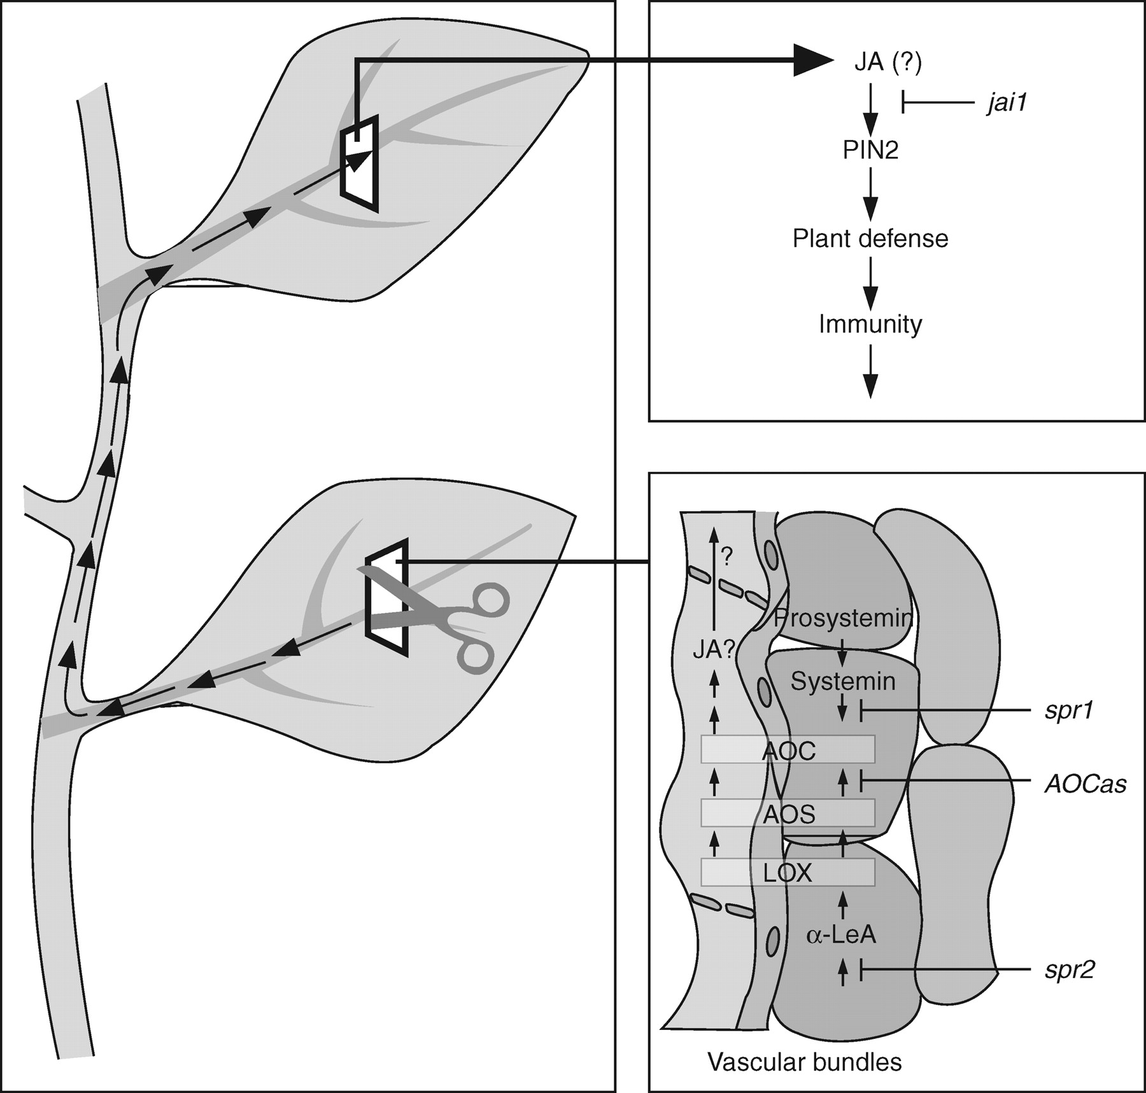
Fig. 5. Local and systemic wound response in tomato and cell-type-specific occurrence of AOC, AOS and LOX (after ...
Notes:
Fig. 5. Local and systemic wound response in tomato and cell-type-specific occurrence of AOC, AOS and LOX (after Hause et al., 2003; modified from Wasternack et al., 2006).
Unless provided in the caption above, the following copyright applies to the content of this slide: © The Author 2007. Published by Oxford University Press on behalf of the Annals of Botany Company. All rights reserved. For Permissions, please email: journals.permissions@oxfordjournals.org

Slide 6
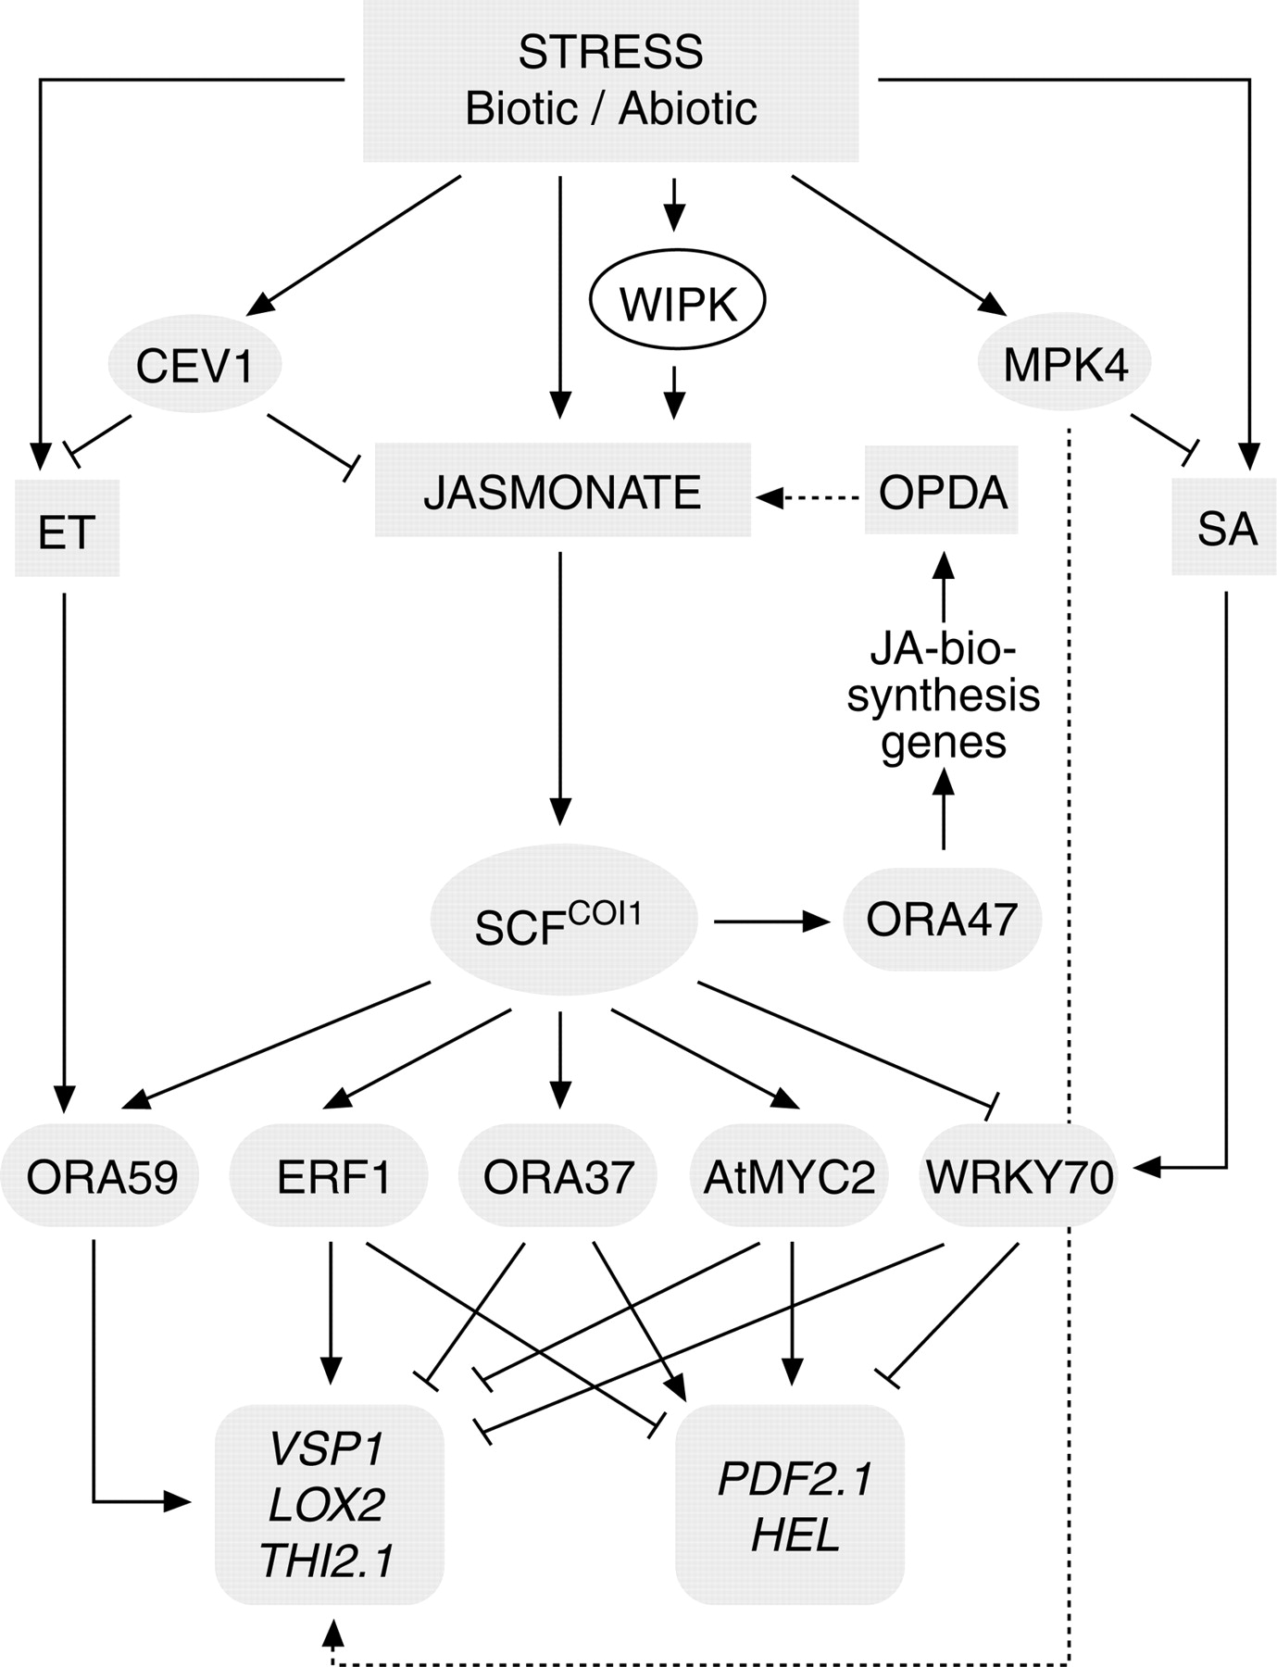
Fig. 6. Transcription factors involved in signalling pathways of JA and cross-talk to ethylene and SA (adapted from ...
Notes:
Fig. 6. Transcription factors involved in signalling pathways of JA and cross-talk to ethylene and SA (adapted from Pre, 2006, and Delker, 2007).
Unless provided in the caption above, the following copyright applies to the content of this slide: © The Author 2007. Published by Oxford University Press on behalf of the Annals of Botany Company. All rights reserved. For Permissions, please email: journals.permissions@oxfordjournals.org

Slide 7
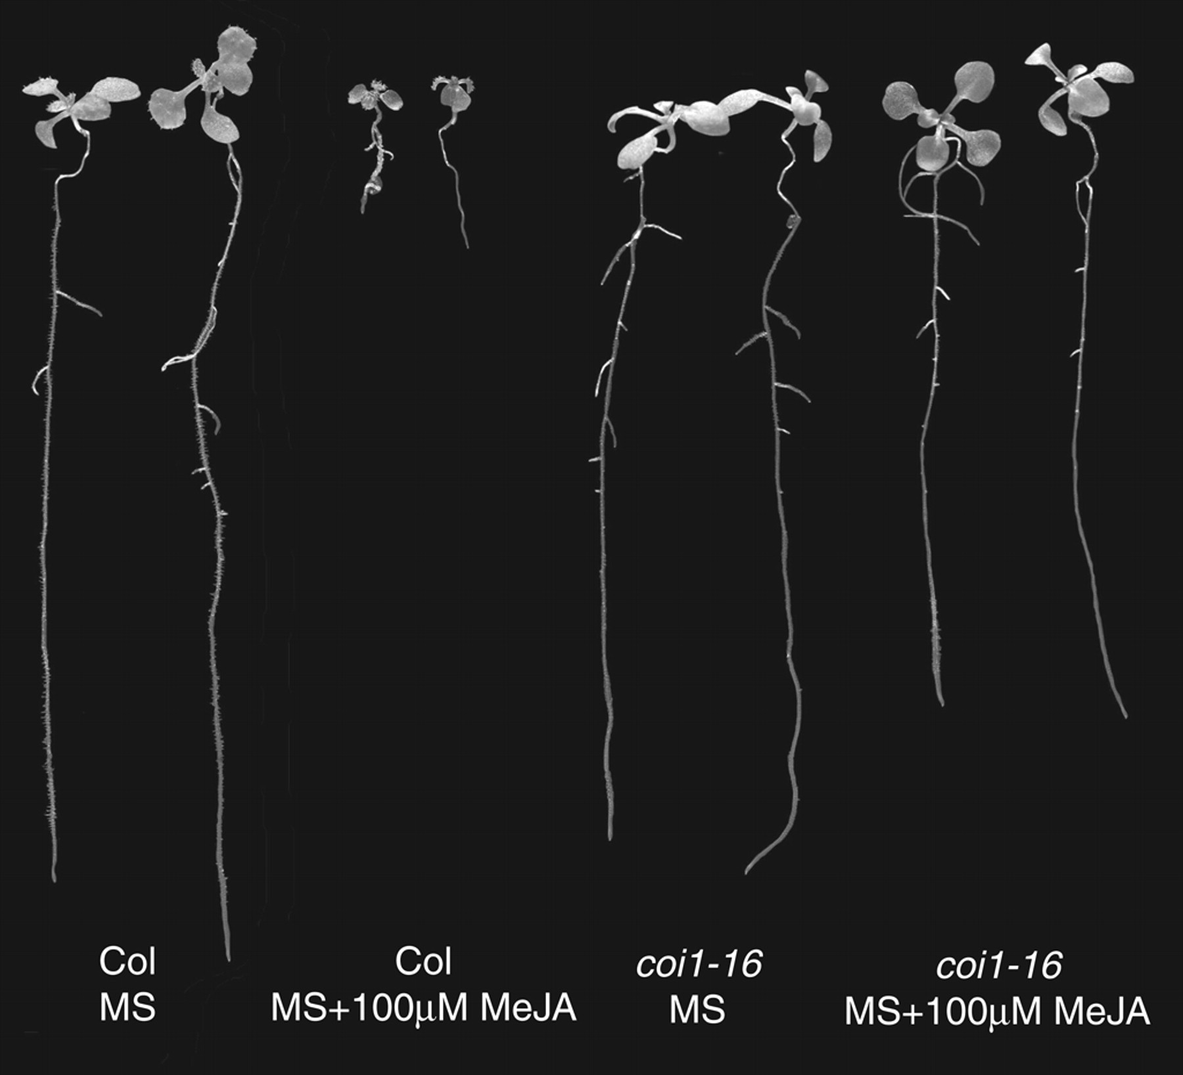
Fig. 7. Root growth inhibition by 100 µm methyl jasmonate in wild-type (Col) and the JA-insensitive mutant coi1-16 ...
Notes:
Fig. 7. Root growth inhibition by 100 µm methyl jasmonate in wild-type (Col) and the JA-insensitive mutant coi1-16 (photograph: C. Delker).
Unless provided in the caption above, the following copyright applies to the content of this slide: © The Author 2007. Published by Oxford University Press on behalf of the Annals of Botany Company. All rights reserved. For Permissions, please email: journals.permissions@oxfordjournals.org

Slide 8
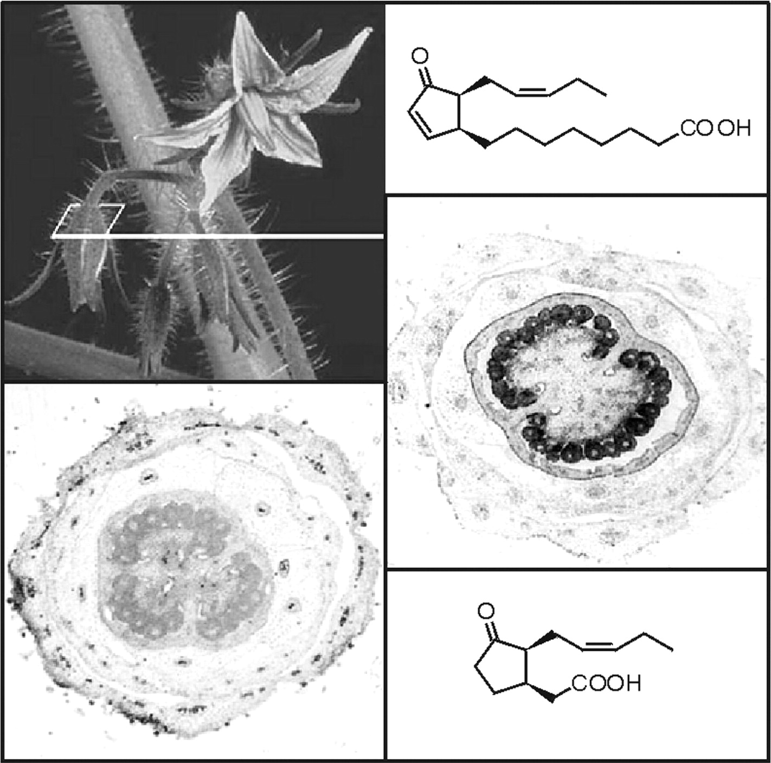
Fig. 8. The allene oxide cyclase (AOC) that establishes the correct enantiomeric structure of the cyclopentanone ring ...
Notes:
Fig. 8. The allene oxide cyclase (AOC) that establishes the correct enantiomeric structure of the cyclopentanone ring of jasmonate is encoded by a single copy gene in tomato, which is specifically expressed in ovules of young flower buds as revealed by AOC promoter activity tests (staining, left bottom) and immunocytological detection of AOC protein (black staining, right). The structure of jasmonic acid (bottom) and its precursor 12-oxophytodienoic acid (top) is shown.
Unless provided in the caption above, the following copyright applies to the content of this slide: © The Author 2007. Published by Oxford University Press on behalf of the Annals of Botany Company. All rights reserved. For Permissions, please email: journals.permissions@oxfordjournals.org

