Slide 1
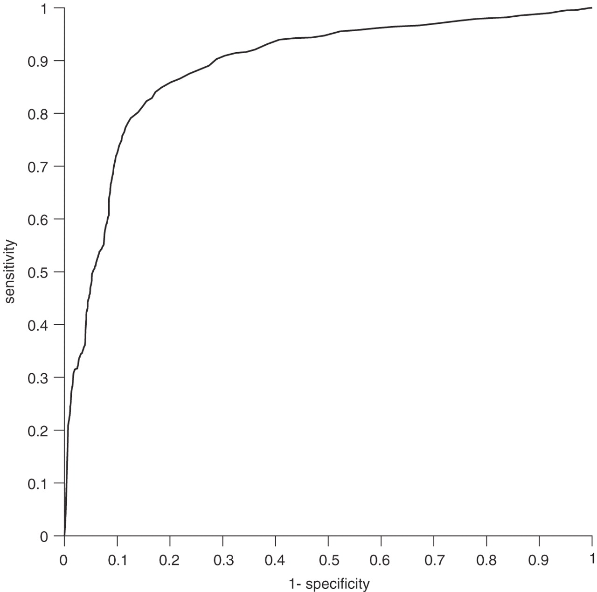
Fig. 1 Curve of receiver operating characteristics (ROC) at different cut-off points of scores. The area under the ...
Notes:
Fig. 1 Curve of receiver operating characteristics (ROC) at different cut-off points of scores. The area under the curve is 0.89.
Unless provided in the caption above, the following copyright applies to the content of this slide: © 2006 The Author(s)This is an Open Access article distributed under the terms of the Creative Commons Attribution Non-Commercial License () which permits unrestricted non-commercial use, distribution, and reproduction in any medium, provided the original work is properly cited.

Slide 2
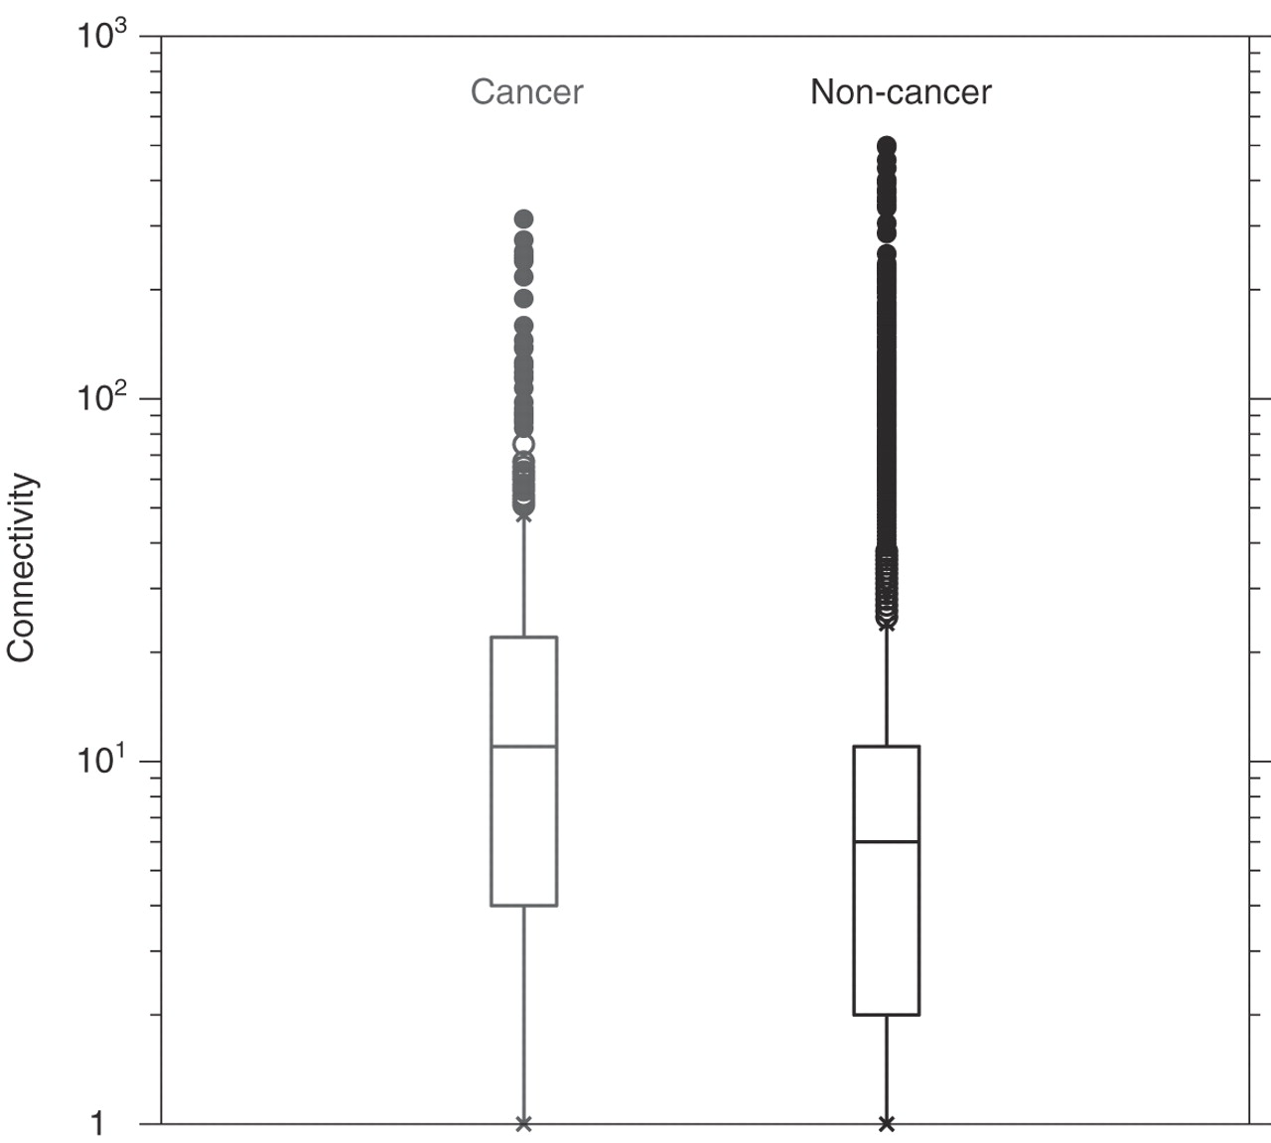
Fig. 2 The number of interactions, in which cancer proteins participate (left), compared with the number of ...
Notes:
Fig. 2 The number of interactions, in which cancer proteins participate (left), compared with the number of interactions of non-cancer proteins (right). Cancer proteins are, on average, involved in 23.4 interactions, whereas non-cancer proteins are involved in 11.4. The centre of the box is the median and the box spans from first to third quartiles (the inter-quartile range). The whiskers extend to the furthest point within 1.5 times the inter-quartile range. Beyond the whiskers, all outliers are shown, in open circles up to a distance of three times the inter-quartile range and closed beyond that.
Unless provided in the caption above, the following copyright applies to the content of this slide: © 2006 The Author(s)This is an Open Access article distributed under the terms of the Creative Commons Attribution Non-Commercial License () which permits unrestricted non-commercial use, distribution, and reproduction in any medium, provided the original work is properly cited.

Slide 3
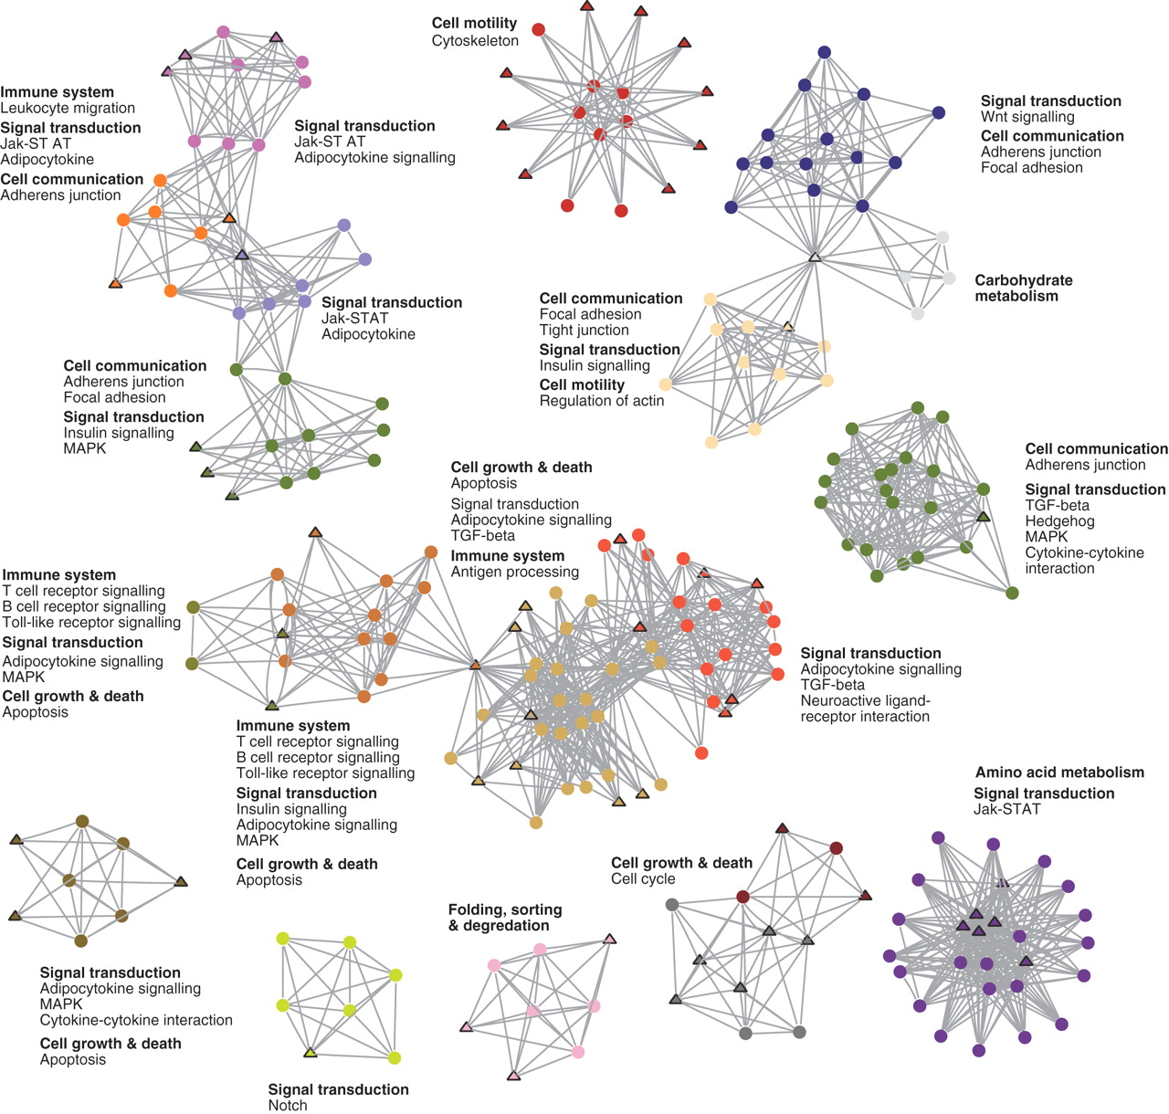
Fig. 3 A description of the protein communities identified by k-clique cluster analysis (k = 6). Each community is ...
Notes:
Fig. 3 A description of the protein communities identified by k-clique cluster analysis (k = 6). Each community is distinctly coloured, with cancer proteins shown as triangles. The main functional classes of each cluster (in bold) and individual pathways, as defined in the KEGG database, are listed alongside each community. Note that proteins can be members of more than one community, but the figure shows only one community assignment for each protein. A detailed version of this figure, including gene names for each protein, is available as supplementary material (see Supplementary Figure 2).
Unless provided in the caption above, the following copyright applies to the content of this slide: © 2006 The Author(s)This is an Open Access article distributed under the terms of the Creative Commons Attribution Non-Commercial License () which permits unrestricted non-commercial use, distribution, and reproduction in any medium, provided the original work is properly cited.

Slide 4
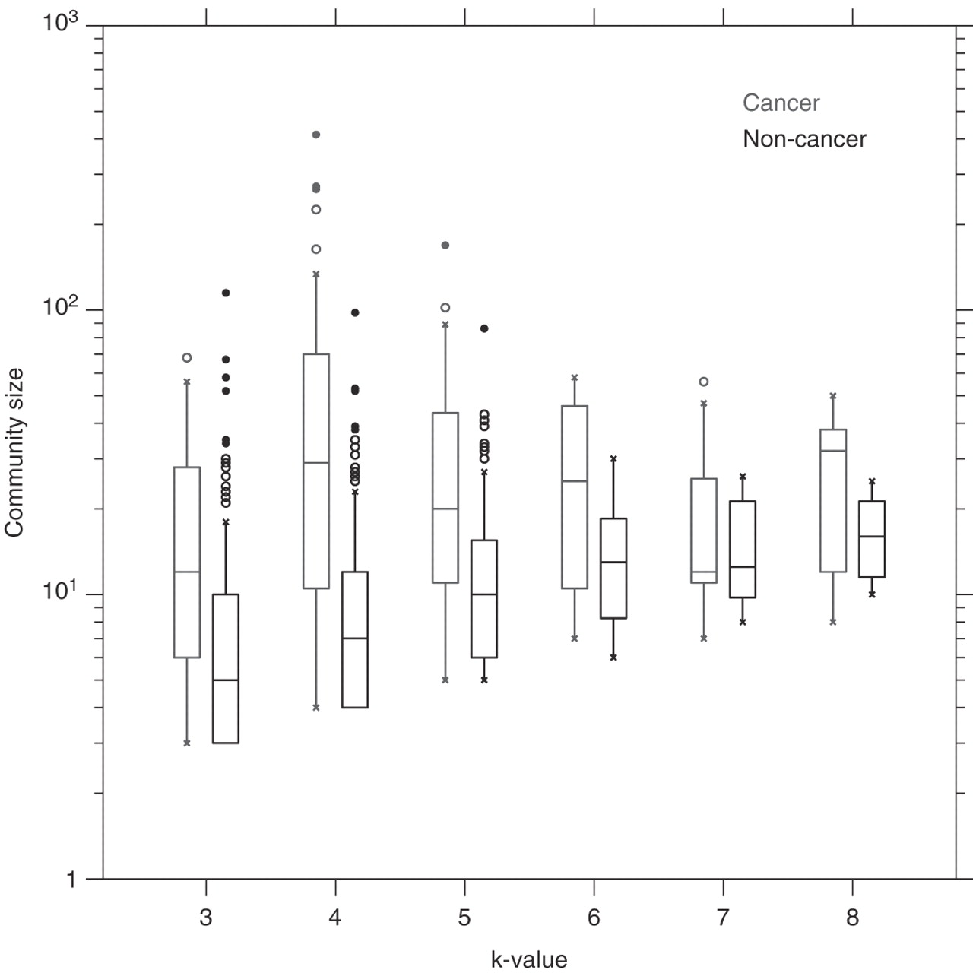
Fig. 4 Average size distribution of protein communities that contain cancer proteins compared to those containing ...
Notes:
Fig. 4 Average size distribution of protein communities that contain cancer proteins compared to those containing non-cancer proteins. Distributions are classified according to clustering k-value, with cancer communities on the left and non-cancer on the right. The difference between cancer and non-cancer groups is statistically significant, according to Wilcoxon rank sum tests, for k-values 3, 4, 5 (p < 0.005), and 6 (p < 0.05).
Unless provided in the caption above, the following copyright applies to the content of this slide: © 2006 The Author(s)This is an Open Access article distributed under the terms of the Creative Commons Attribution Non-Commercial License () which permits unrestricted non-commercial use, distribution, and reproduction in any medium, provided the original work is properly cited.

