Slide 1
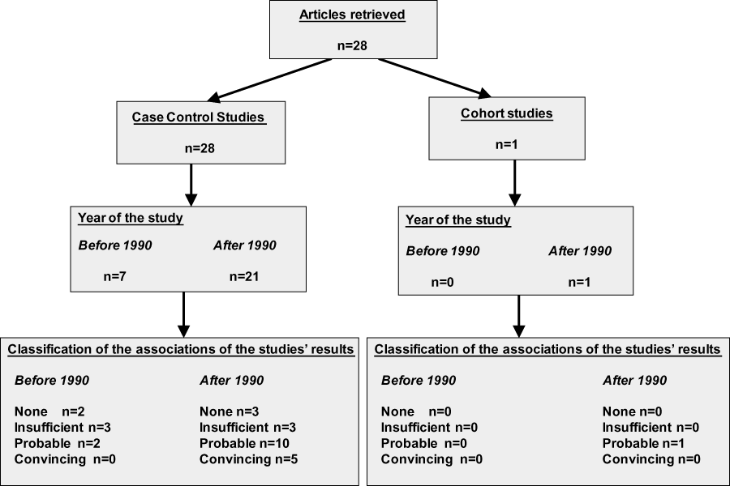
Figure 1 Flow chart of the literature review, selection, and categorization process .
Notes:
Figure 1 Flow chart of the literature review, selection, and categorization process .
Unless provided in the caption above, the following copyright applies to the content of this slide: © 2012 International Life Sciences Institute

