Slide 1
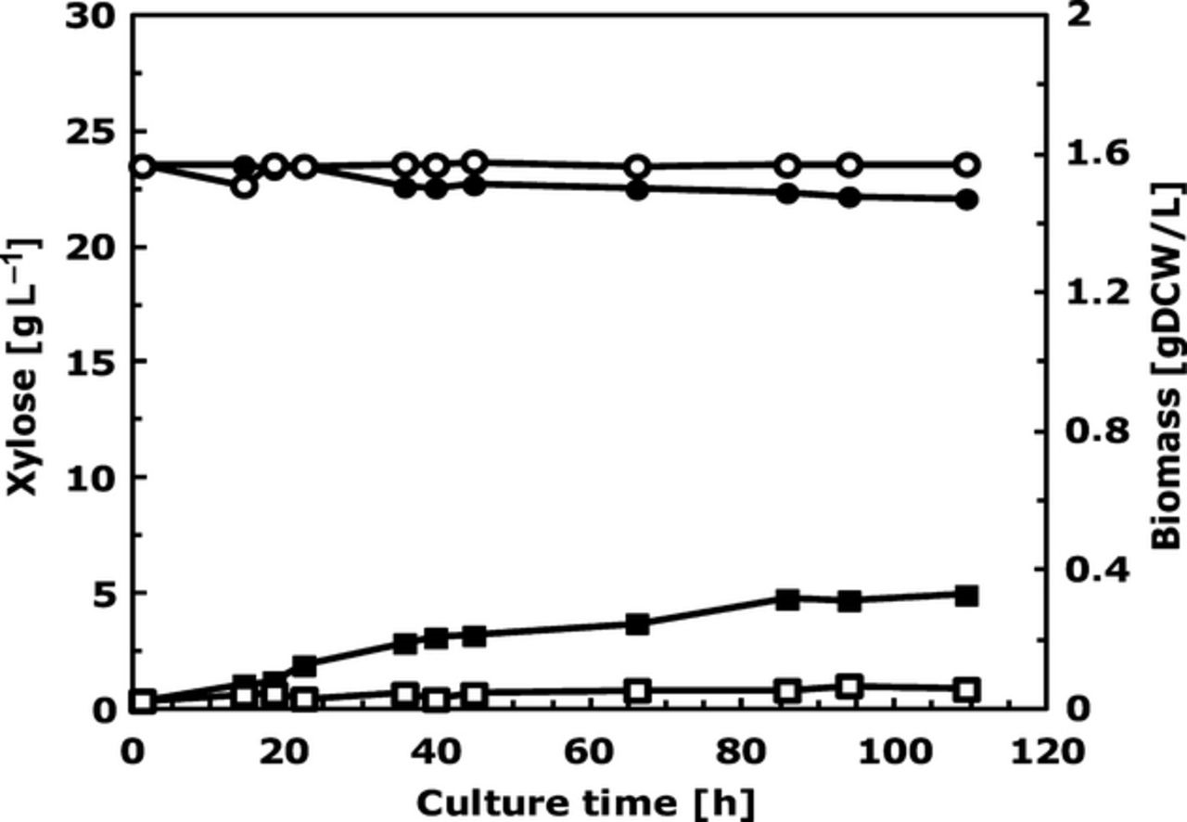
1 Time course of aerobic batch culture on defined minimal medium supplemented with 20 g L⁻¹ xylose ...
Notes:
1 Time course of aerobic batch culture on defined minimal medium supplemented with 20 g L−1 xylose of strain CEN.PK113-7D (empty symbols) and CMB.GS001 (filled symbols). Xylose, (circle) (g L−1) and biomass (square) (g DCW L−1) concentrations are presented as the functions of cultivation time. Data represent the average of three independent cultures.
Unless provided in the caption above, the following copyright applies to the content of this slide: © 2012 Federation of European Microbiological Societies Published by Blackwell Publishing Ltd. All rights reserved

Slide 2
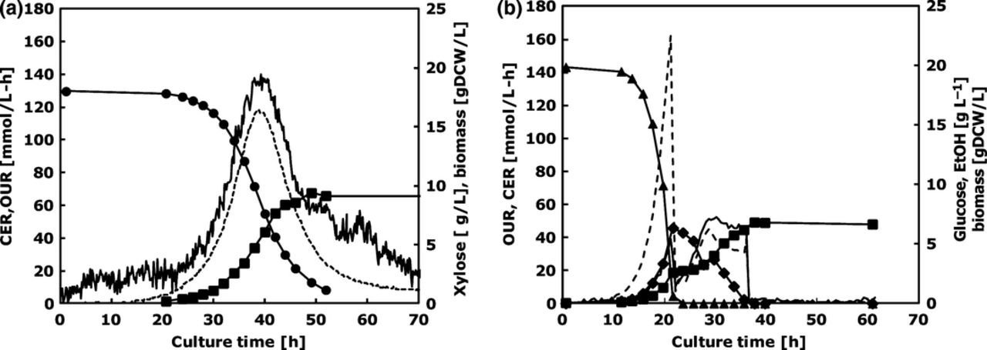
2 (a) Comparison in xylose consumption (bars) and biomass production (line) during repetitive growth of ...
Notes:
2 (a) Comparison in xylose consumption (bars) and biomass production (line) during repetitive growth of Saccharomyces cerevisiae CMB.GS001 in shake flask cultures on synthetic medium with 20 g L−1 xylose. Shake flask generation represents the number of specific shake flasks in the series of repetitive cultivations performed to select for mutants with higher specific growth rates and xylose utilization rates (for details, see Directed evolution and selection of strain CMB.GS010, Materials and methods). (b) Doubling time during the serial transfers of S. cerevisiae in shake flask cultures on synthetic medium with 20 g L−1 xylose as a function of the number of cell generations. Each data point represents the doubling time of a single shake flask culture estimated from OD 600 nm measurements. The small plot in the top right represents all 10 cycles, noting the initial doubling time of CMB.GS001 of 35 h, and the rapid decrease to 10 h within < 20 cell generations. For cell generations 50–74, there was no significant improvement in the specific growth rate.
Unless provided in the caption above, the following copyright applies to the content of this slide: © 2012 Federation of European Microbiological Societies Published by Blackwell Publishing Ltd. All rights reserved

Slide 3
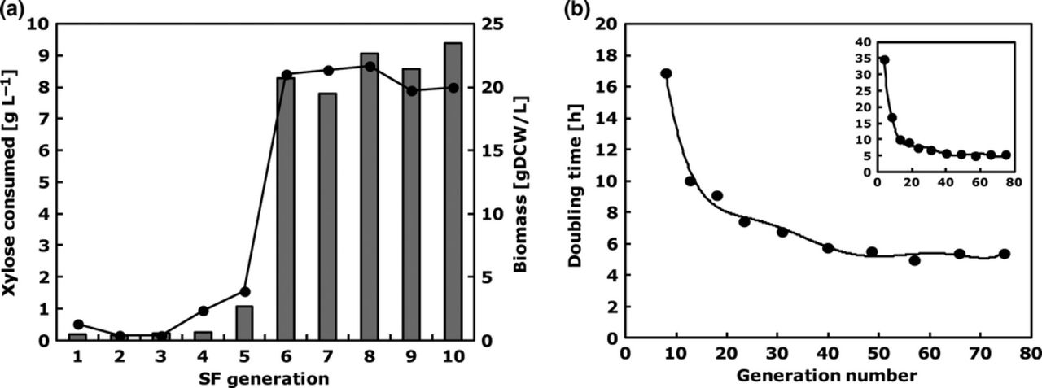
3 Time course of aerobic batch culture on defined minimal medium supplemented with 20 g L⁻¹ xylose ...
Notes:
3 Time course of aerobic batch culture on defined minimal medium supplemented with 20 g L−1 xylose (a) and 20 g L−1glucose (b) of strain CMB.GS010 (evolved strain). For all plots presented, carbon evolution rate (CER) (dashed line), oxygen uptake rate (OUR) (solid line) (mM h−1), and xylose (circle), glucose (triangle), ethanol (diamond) (g L−1); and biomass (square) (g DCW L−1) concentrations as the functions of cultivation time. Data represent the average of three independent cultures.
Unless provided in the caption above, the following copyright applies to the content of this slide: © 2012 Federation of European Microbiological Societies Published by Blackwell Publishing Ltd. All rights reserved

Slide 4
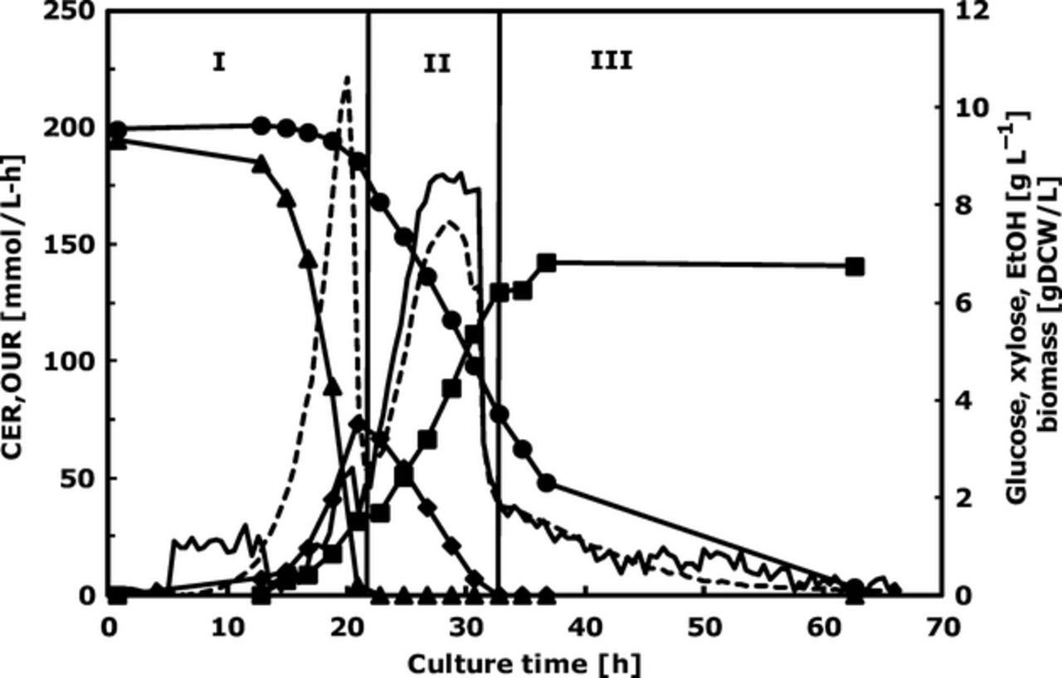
4 Time course of aerobic mixed substrate batch cultivation on defined minimal medium supplemented with 10 g ...
Notes:
4 Time course of aerobic mixed substrate batch cultivation on defined minimal medium supplemented with 10 g L−1 xylose and 10 g L−1 glucose of strain CMB.GS010 (evolved strain). Carbon evolution rate (CER) (dashed line), oxygen uptake rate (OUR) (solid line) (mM h−1), and xylose (circle), glucose (triangle), ethanol (diamond) (g L−1) and biomass (square) (g DCW L−1) concentrations as functions of cultivation time. Vertical line identifies the three different growth phase (I, II and II). Data represent the average of three independent cultures.
Unless provided in the caption above, the following copyright applies to the content of this slide: © 2012 Federation of European Microbiological Societies Published by Blackwell Publishing Ltd. All rights reserved

Slide 5
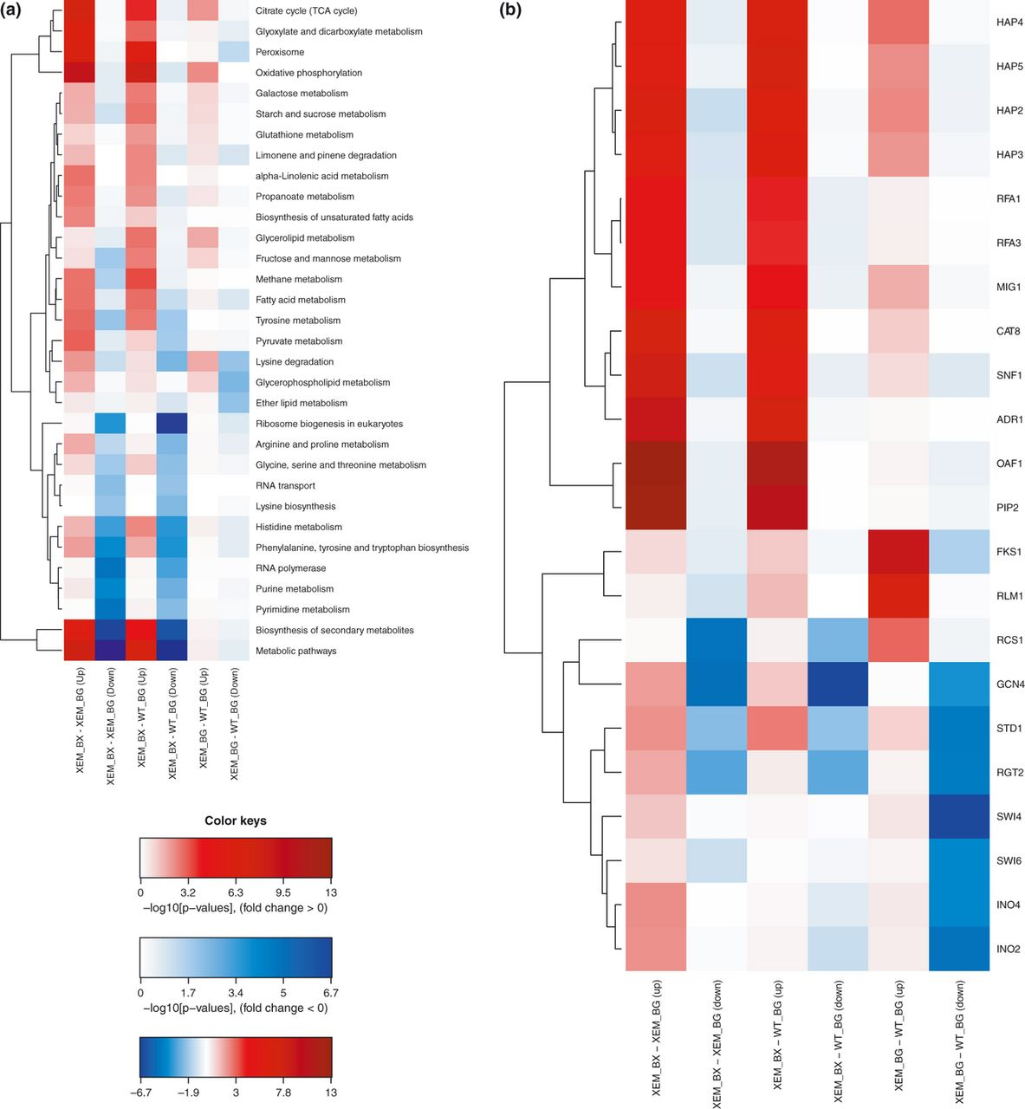
5 Integrated analysis of gene ontology (GO) process terms (a) and TFs analysis (b), the cluster frequency is ...
Notes:
5 Integrated analysis of gene ontology (GO) process terms (a) and TFs analysis (b), the cluster frequency is presented on the y-axis. Compared conditions are the evolved strain CMB.GS010 strain cultivated on batch xylose (XEM_BX), evolved strain CMB.GS010 cultivated in batch glucose (XEM_BG) and the un-evolved strain CMB.GS001 cultivated on batch glucose (WT_BG). Colour key indicates the different expression in log-fold change (Padjusted < 0.01).
Unless provided in the caption above, the following copyright applies to the content of this slide: © 2012 Federation of European Microbiological Societies Published by Blackwell Publishing Ltd. All rights reserved

Slide 6
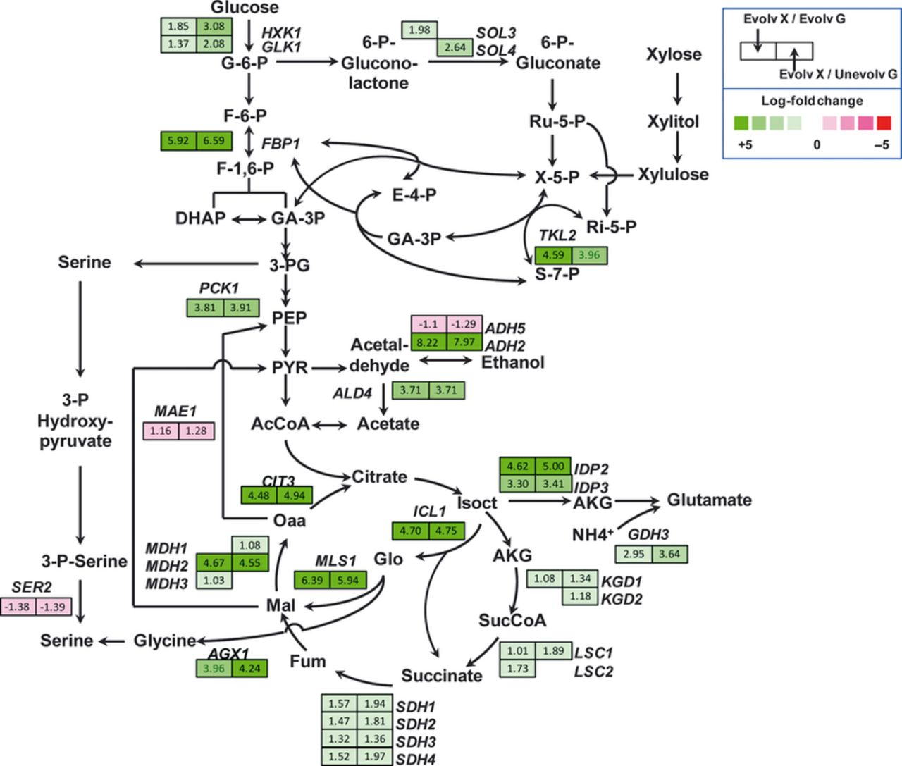
6 Gene expression levels of central carbon metabolic pathways: tricarboxylic acid (TCA) cycle, glyoxylate ...
Notes:
6 Gene expression levels of central carbon metabolic pathways: tricarboxylic acid (TCA) cycle, glyoxylate pathway, glutamine/glutamate synthesis and pentose phosphate (PP) pathway are presented. The comparative conditions evaluated include CMB.GS010 cultivated on batch xylose vs. CMB.GS010 cultivated on batch glucose (Evolv X/Evolv G), shown on the left side box; CMB.GS010 cultivated on batch xylose vs. CMB.GS001 cultivated on batch glucose (Evolv X/Unevolv G), shown on the right side box. The log-fold change of significantly differentially expressed genes (Padjusted 1) is indicated inside each box next to the gene name; boxes are coloured according to log-fold colour scale. If no gene is shown for a given comparative condition, then no significant differential expression changes were detected. The terms evolved and CMB.GS010, and un-evolved and CMB.GS001, are used interchangeably. The pathway intermediate abbreviations are the follows: G-6-P, glucose-6-phosphate; F-6-P, fructose-6-phosphate; F-1,6-P, fructose-1,6-biphosphate; GA-3P, glyceraldehyde-3-phosphate; DHAP, dihydroxyacetonephosphate; 3-PG, 3-phospho-glycerate; PEP, phosphoenol-pyruvate; PYR, pyruvate; AcCoA, acetyl-CoA; Isoct, isocitrate; AKG, alpha-keto-glutarate; SucCoA, succinyl-CoA; Fum, fumarate; Mal, malate; Oaa, oxaloacetate; Ru-5-P, ribulose-5-phosphate; X-5P, xylulose-5-phosphate; S-7-P, sedoheptulose-7-phosphate; E-4-P, erythrose-4-phosphate.
Unless provided in the caption above, the following copyright applies to the content of this slide: © 2012 Federation of European Microbiological Societies Published by Blackwell Publishing Ltd. All rights reserved

