Slide 1
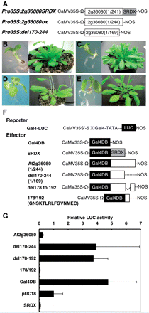
Fig. 1 The isolation of a novel transcriptional repressor and its repression domains. (A) Schematic representation ...
Notes:
Fig. 1 The isolation of a novel transcriptional repressor and its repression domains. (A) Schematic representation of the At2g36080 constructs and derivative. Ω, translation enhancer sequence derived from tobacco mosaic virus. (B–E) Seedlings and rosettes of Pro35S:2g36080SRDX (B), Pro35S:2g36080 (C), Pro35S:del170-244 (D) and the wild type (E). (F) Schematic representation of the Gal4-LUC reporter gene (Fujimoto et al., 2000) and Gal4DB effectors (Fujimoto et al. 2000). (G) Relative luciferase activities after co-bombardment of Arabidopsis leaves with Gal4DB-fused At2g36080 effectors and the Pro35S:Gal4:LUC reporter gene. The relative activity due to the pUC18 vector was set as 1. Error bars indicate the SD (n = 3).
Unless provided in the caption above, the following copyright applies to the content of this slide: © The Author 2009. Published by Oxford University Press on behalf of Japanese Society of Plant Physiologists. All rights reserved. For permissions, please email: journals.permissions@oxfordjournals.org

Slide 2
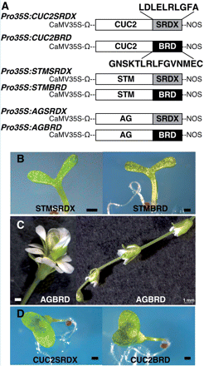
Fig. 2 Repressive activity of the repression domain of At2g36080 (BRD) in transgenic Arabidopsis. (A) Schematic ...
Notes:
Fig. 2 Repressive activity of the repression domain of At2g36080 (BRD) in transgenic Arabidopsis. (A) Schematic representation of the constructs. Ω indicates the Ω translation enhancer sequence. (B) Seedlings of Pro35S:STM2SRDX (left) and Pro35S:STMBRD (right) plants. (C) Flowers of Pro35S:AGBRD plants. (D) Seedlings of Pro35S:CUC2SRDX (left) and Pro35S:CUC2BRD (right) plants. Bars = 0.5 mm, except bar in right panel of C = 1 mm
Unless provided in the caption above, the following copyright applies to the content of this slide: © The Author 2009. Published by Oxford University Press on behalf of Japanese Society of Plant Physiologists. All rights reserved. For permissions, please email: journals.permissions@oxfordjournals.org

Slide 3
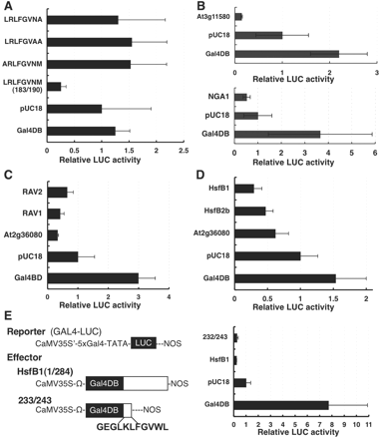
Fig. 3 Repressive activity of transcriptional repressors that contain a novel repression domain. (A–E) Relative ...
Notes:
Fig. 3 Repressive activity of transcriptional repressors that contain a novel repression domain. (A–E) Relative luciferase activities after co-bombardment of Arabidopsis leaves with the Pro35S:Gal4:LUC reporter gene and Gal4DB-fused effectors for the At2g36080 repression domain (LRLFGVNM: 183/190) or its derivatives (A), At3g11580 or NGA1 (B), RAV1 and RAV2 (C), HsfB1 and HsfB2b (D), and deletion of HsfB1 (E), respectively. The left panel of (E) shows schematic representations of the constructs used for transient expression analysis with effectors for HsfB1 and its deletion Error bars indicate the SD (n = 3). The relative activity due to the pUC18 vector was set as 1. Error bars indicate the SD (n = 3).
Unless provided in the caption above, the following copyright applies to the content of this slide: © The Author 2009. Published by Oxford University Press on behalf of Japanese Society of Plant Physiologists. All rights reserved. For permissions, please email: journals.permissions@oxfordjournals.org

