Slide 1
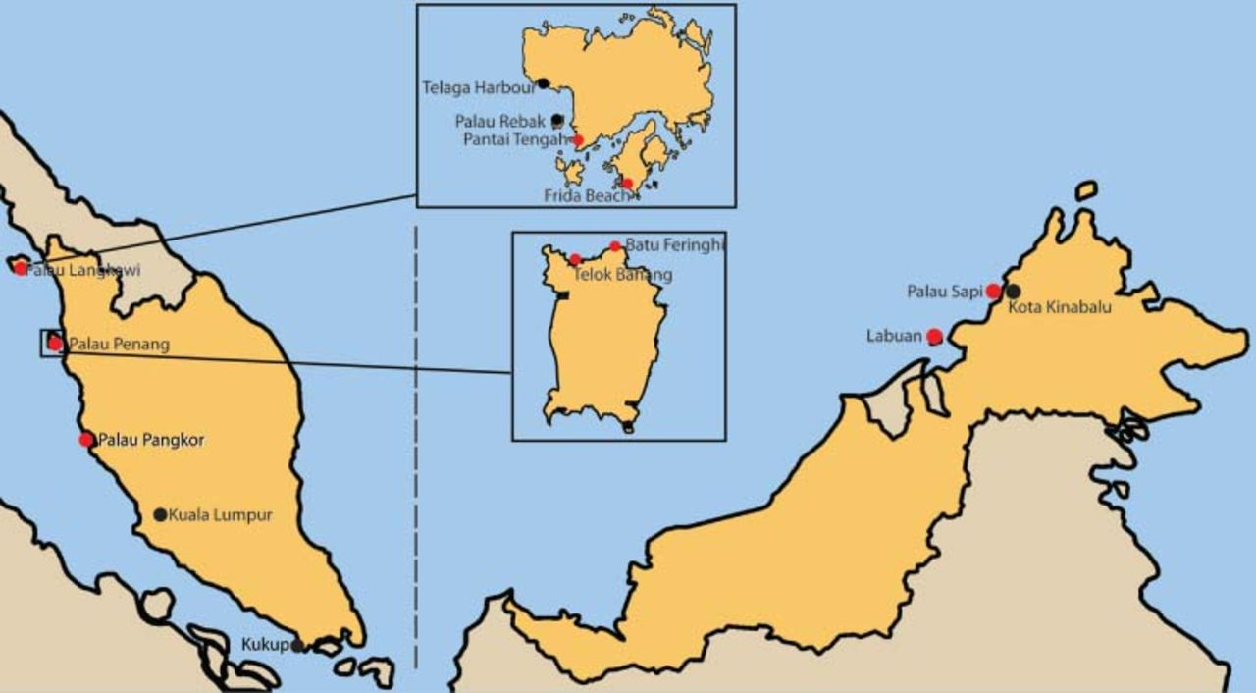
Figure 1 Locations in Malaysia where fatal or serious stings have been reported since 1945 (indicated by dots). In ...
Notes:
Figure 1 Locations in Malaysia where fatal or serious stings have been reported since 1945 (indicated by dots). In some locations there have been multiple fatalities and/or serious stings.
Unless provided in the caption above, the following copyright applies to the content of this slide: © 2011 International Society of Travel Medicine

Slide 2
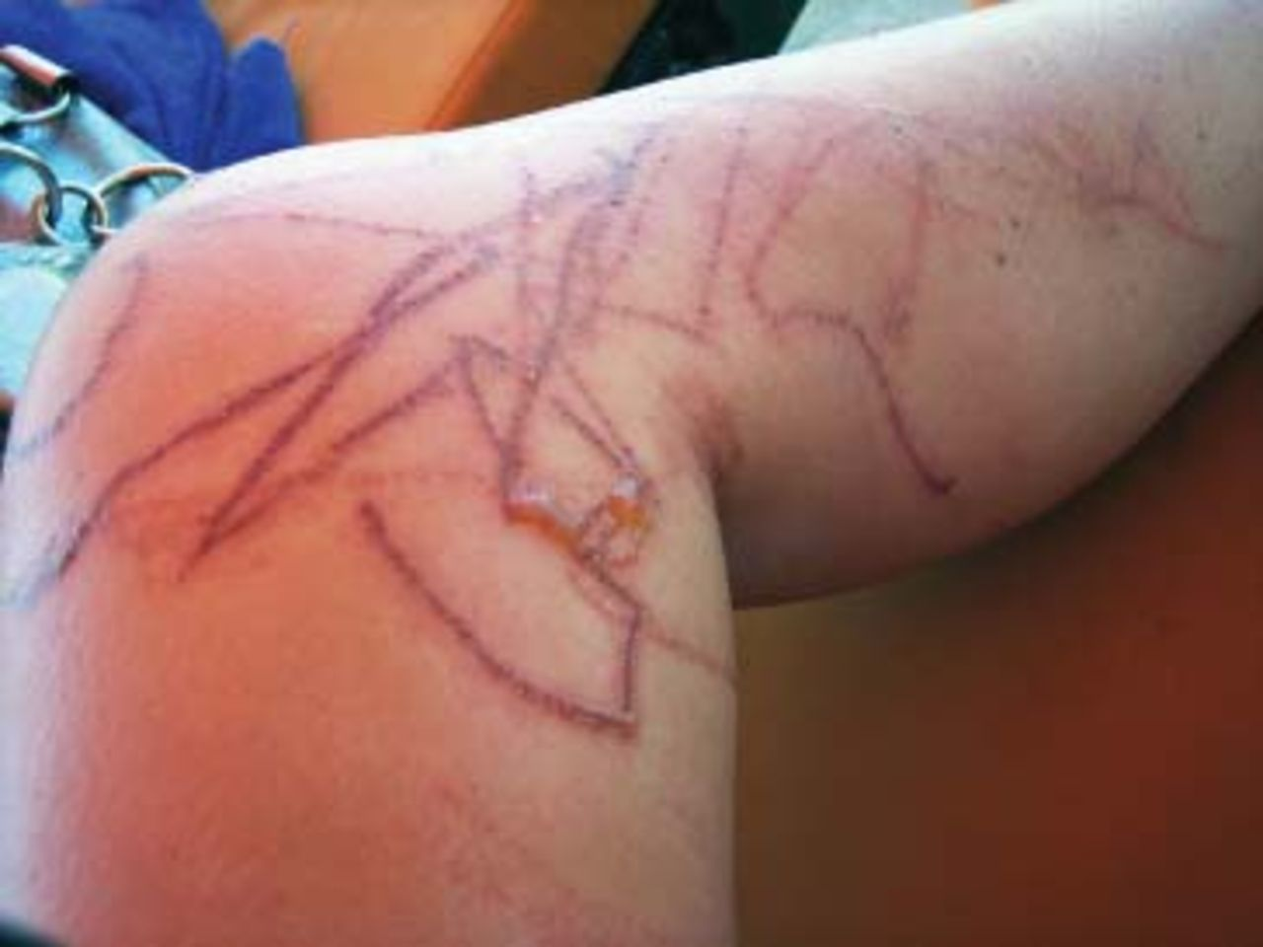
Figure 2 Chirodropic‐type lesions on the leg of a British tourist stung at Kota Kinabalu, July 2009.
Notes:
Figure 2 Chirodropic‐type lesions on the leg of a British tourist stung at Kota Kinabalu, July 2009.
Unless provided in the caption above, the following copyright applies to the content of this slide: © 2011 International Society of Travel Medicine

Slide 3
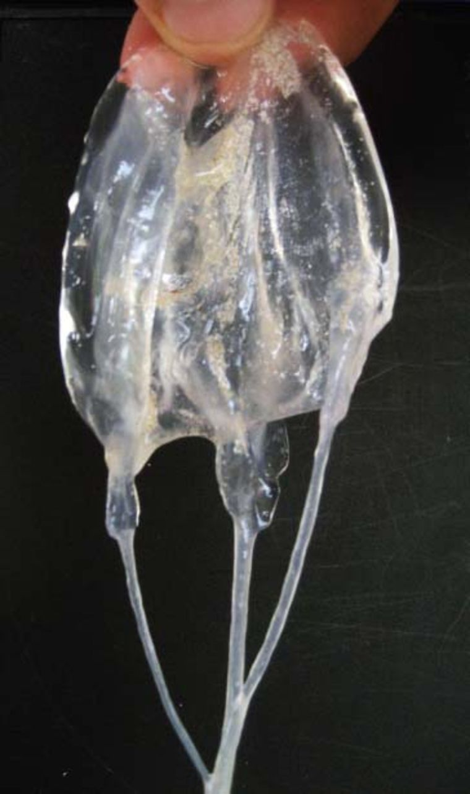
Figure 3 Carybdeid captured at Frida Beach, Langkawi, June 2010.
Notes:
Figure 3 Carybdeid captured at Frida Beach, Langkawi, June 2010.
Unless provided in the caption above, the following copyright applies to the content of this slide: © 2011 International Society of Travel Medicine

Slide 4
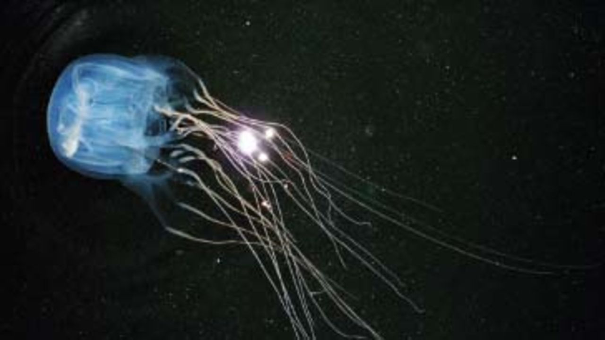
Figure 4 Chirodropid photographed at Telaga Harbour, Langkawi, May 12, 2010 (T. Marinis photo).
Notes:
Figure 4 Chirodropid photographed at Telaga Harbour, Langkawi, May 12, 2010 (T. Marinis photo).
Unless provided in the caption above, the following copyright applies to the content of this slide: © 2011 International Society of Travel Medicine

Slide 5
Figure 5 Carybdeid jellyfish species photographed at Rebak, Langkawi, May 15, 2010 (T. Marinis photo).
Notes:
Figure 5 Carybdeid jellyfish species photographed at Rebak, Langkawi, May 15, 2010 (T. Marinis photo).
Unless provided in the caption above, the following copyright applies to the content of this slide: © 2011 International Society of Travel Medicine

Slide 6
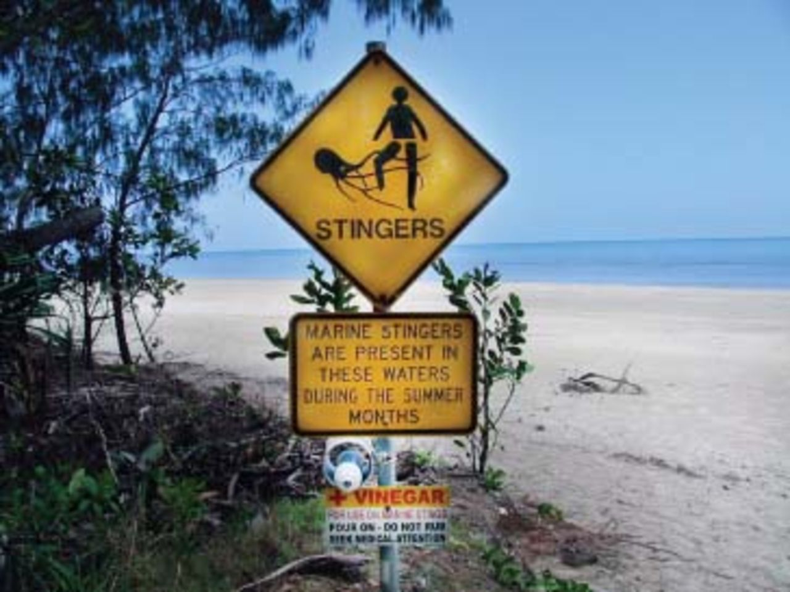
Figure 6 A suitable warning sign of dangerous jellyfish with an attached bottle of vinegar for dousing stings (Cape ...
Notes:
Figure 6 A suitable warning sign of dangerous jellyfish with an attached bottle of vinegar for dousing stings (Cape Tribulation, Queensland, Australia).
Unless provided in the caption above, the following copyright applies to the content of this slide: © 2011 International Society of Travel Medicine

