Slide 1
Fig. 1. Example for likelihood-based calculation.
Notes:
Fig. 1. Example for likelihood-based calculation.
Unless provided in the caption above, the following copyright applies to the content of this slide: © The authors 2016. Published by Oxford University Press. All rights reserved.

Slide 2
Fig. 2. Artificial network with degree power/doubleton model (left) and the PFP and triangle model (right) showing ...
Notes:
Fig. 2. Artificial network with degree power/doubleton model (left) and the PFP and triangle model (right) showing $c_0$.
Unless provided in the caption above, the following copyright applies to the content of this slide: © The authors 2016. Published by Oxford University Press. All rights reserved.

Slide 3
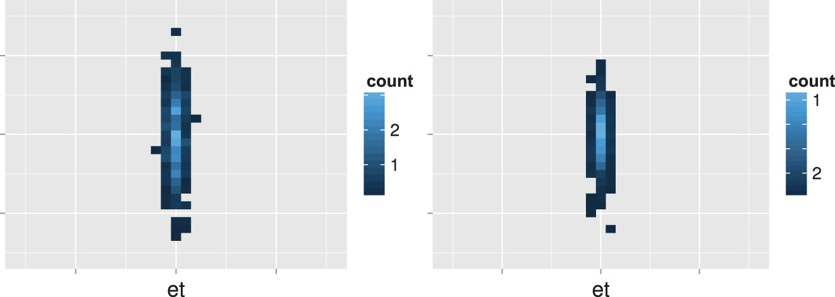
Fig. 3. Counts for best $c_0$ values for Model one, 5,000 links (left) 10,000 links (right).
Notes:
Fig. 3. Counts for best $c_0$ values for Model one, 5,000 links (left) 10,000 links (right).
Unless provided in the caption above, the following copyright applies to the content of this slide: © The authors 2016. Published by Oxford University Press. All rights reserved.

Slide 4
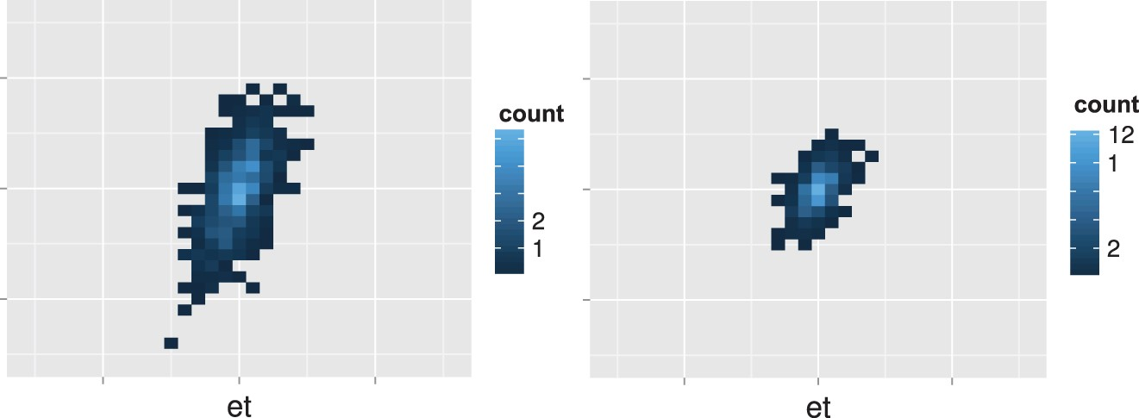
Fig. 4. Counts for best $c_0$ values for Model two, 5,000 links (left) 10,000 links (right).
Notes:
Fig. 4. Counts for best $c_0$ values for Model two, 5,000 links (left) 10,000 links (right).
Unless provided in the caption above, the following copyright applies to the content of this slide: © The authors 2016. Published by Oxford University Press. All rights reserved.

Slide 5
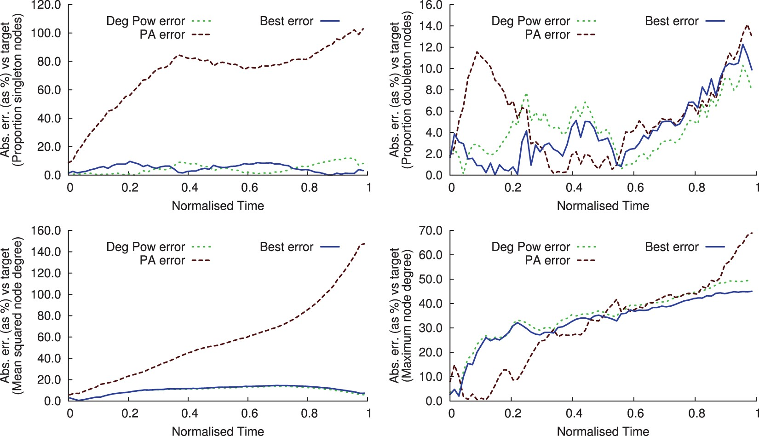
Fig. 5. Error in estimation for the facebook dataset: Number of singleton nodes (top left), doubleton nodes (top ...
Notes:
Fig. 5. Error in estimation for the facebook dataset: Number of singleton nodes (top left), doubleton nodes (top right), mean degree squared (bottom left), maximum node degree (bottom right).
Unless provided in the caption above, the following copyright applies to the content of this slide: © The authors 2016. Published by Oxford University Press. All rights reserved.

Slide 6
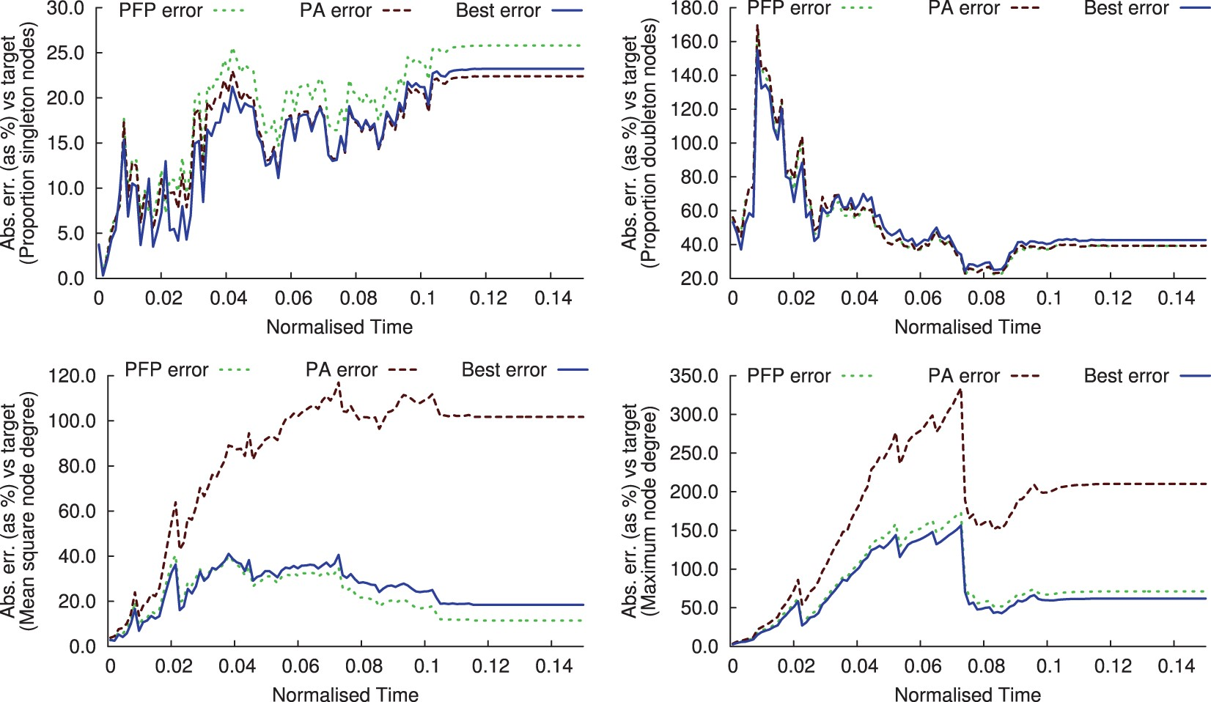
Fig. 6. Error in estimation for enron data: Number of singleton nodes (top left), doubleton nodes (top right), mean ...
Notes:
Fig. 6. Error in estimation for enron data: Number of singleton nodes (top left), doubleton nodes (top right), mean degree squared (bottom left), maximum node degree (bottom right).
Unless provided in the caption above, the following copyright applies to the content of this slide: © The authors 2016. Published by Oxford University Press. All rights reserved.

