Slide 1
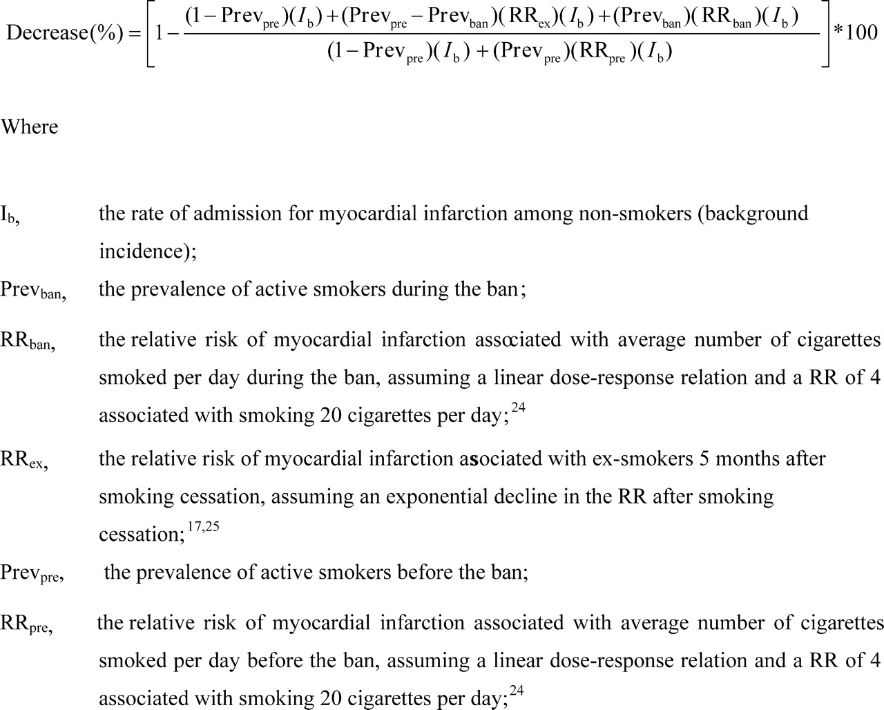
Figure 1 Estimate of decrease (%) in the rate of admission for AMI attributable to the effect of the ban on the ...
Notes:
Figure 1 Estimate of decrease (%) in the rate of admission for AMI attributable to the effect of the ban on the smoking habits of active smokers.
Unless provided in the caption above, the following copyright applies to the content of this slide: © The European Society of Cardiology 2006. All rights reserved. For Permissions, please e-mail: journals.permissions@oxfordjournals.org

