Slide 1
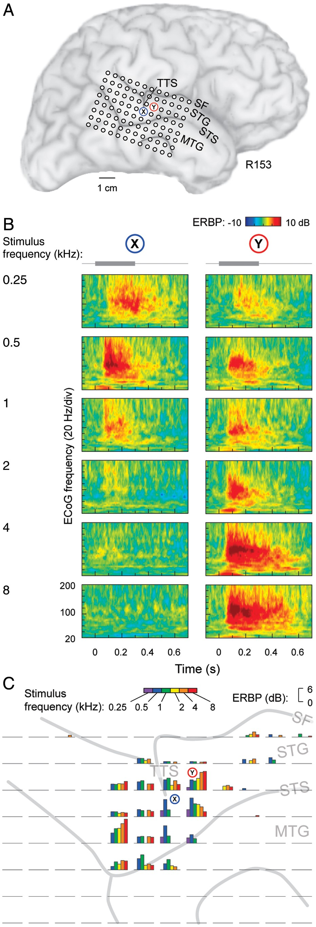
Figure 1. Tone-elicited responses recorded from the lateral STG in a representative subject (R153). (A) Location of the ...
Notes:
Figure 1. Tone-elicited responses recorded from the lateral STG in a representative subject (R153). (A) Location of the 96-contact subdural electrode grid (TTS: transverse temporal sulcus; SF: Sylvian fissure; STG: superior temporal gyrus; STS: superior temporal sulcus; MTG: middle temporal gyrus). X and Y denote the locations of 2 sites those detailed response properties are shown in panel B. (B) Time–frequency analysis of cortical activity elicited by pure-tone stimuli between 0.25 and 8 kHz (top to bottom), recorded from 2 sites on the STG (left and right panels). Stimulus schematic is shown on top. ERBP was calculated relative to baseline power measured in the reference period between 100 and 200 ms prior to stimulus onset. (C) High gamma ERBP in response to tone stimuli presented at different frequencies (color bars), simultaneously recorded from the 96-contact grid (individual plots). High gamma band (75–150 Hz) ERBP was averaged within the time window of 100–150 ms after stimulus onset.
Unless provided in the caption above, the following copyright applies to the content of this slide: © The Author 2012. Published by Oxford University Press. All rights reserved. For Permissions, please e-mail: journals.permissions@oup.com

Slide 2
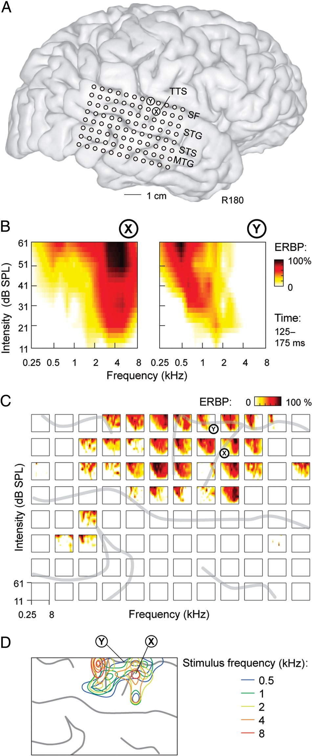
Figure 2. Frequency tuning properties of PLST in a representative subject (R180). (A) Location of the 96-contact ...
Notes:
Figure 2. Frequency tuning properties of PLST in a representative subject (R180). (A) Location of the 96-contact subdural electrode grid (TTS: transverse temporal sulcus; SF: Sylvian fissure; STG: superior temporal gyrus; STS: superior temporal sulcus; MTG: middle temporal gyrus). X and Y denote the locations of 2 sites those detailed response properties are shown in panel B. (B) Examples of frequency–intensity receptive fields for 2 sites in a representative subject. (C) Frequency–intensity receptive fields across the entire recording grid. Sulcal patterns are indicated by gray lines. (D) 50th, 75th, and 95th percentile contours of cortical responses to tones of 5 frequencies presented at 66 dB SPL. Sulcal patterns are shown by gray lines. Results shown in panels (B–D) are based on the analysis of ERBP averaged within 125–175 ms after stimulus onset.
Unless provided in the caption above, the following copyright applies to the content of this slide: © The Author 2012. Published by Oxford University Press. All rights reserved. For Permissions, please e-mail: journals.permissions@oup.com

Slide 3
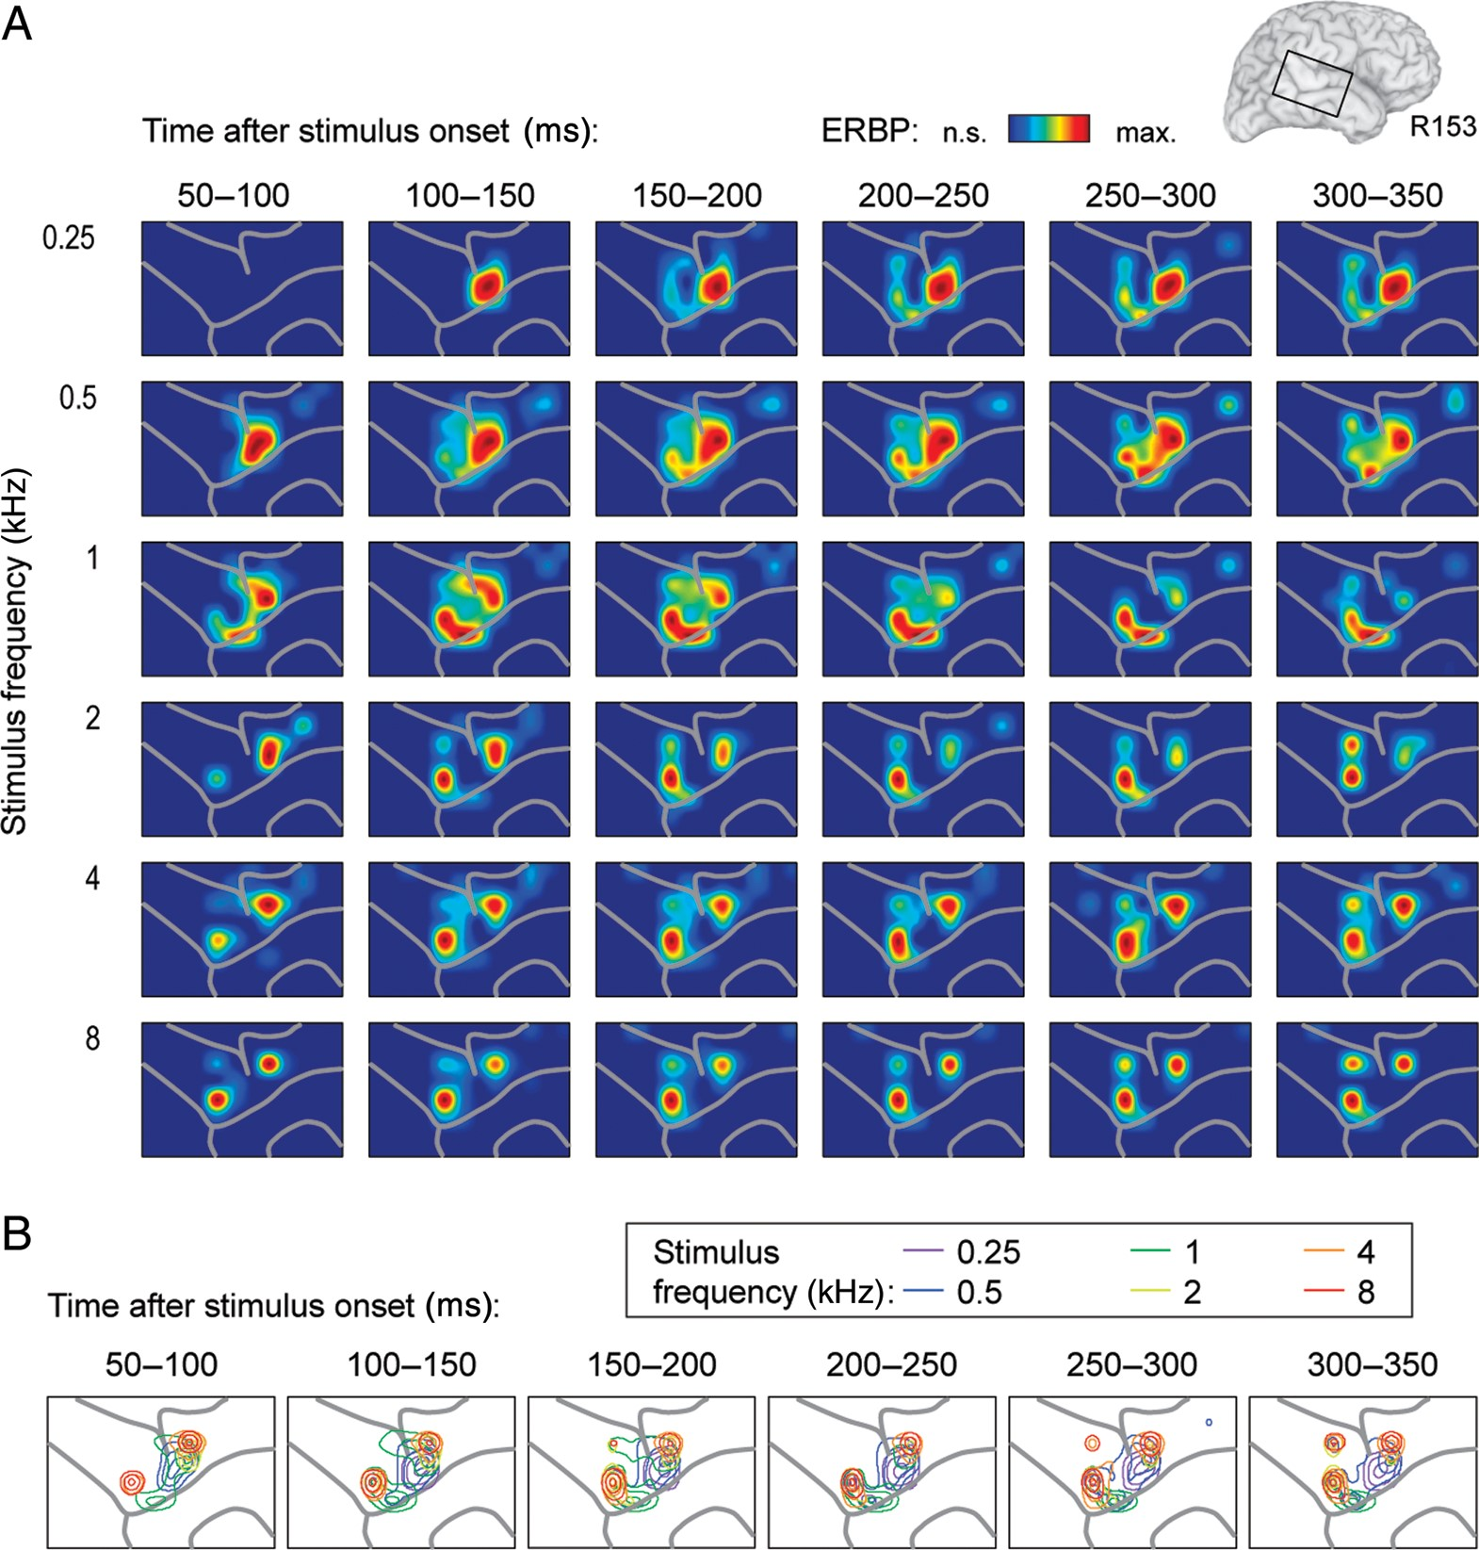
Figure 3. Spectral specificity of cortical high gamma responses with frequency gradients. Data recorded from the right ...
Notes:
Figure 3. Spectral specificity of cortical high gamma responses with frequency gradients. Data recorded from the right hemisphere in a representative subject (R153). (A) Cortical activation maps for the 6 stimulus frequencies (top to bottom). The values of average high gamma ERBP within 6 consecutive 50-ms time windows (left to right) obtained for each contact were normalized relative to the maximum response across contacts for a given frequency and time interval and smoothed using cubic interpolation. Only significant responses (paired t-tests with false discovery rate correction; q < 0.01) are plotted. (B) Maps depicting 50th, 75th, and 95th percentile contours of cortical responses to the 6 stimulus frequencies. Sulcal patterns are shown by gray lines.
Unless provided in the caption above, the following copyright applies to the content of this slide: © The Author 2012. Published by Oxford University Press. All rights reserved. For Permissions, please e-mail: journals.permissions@oup.com

Slide 4
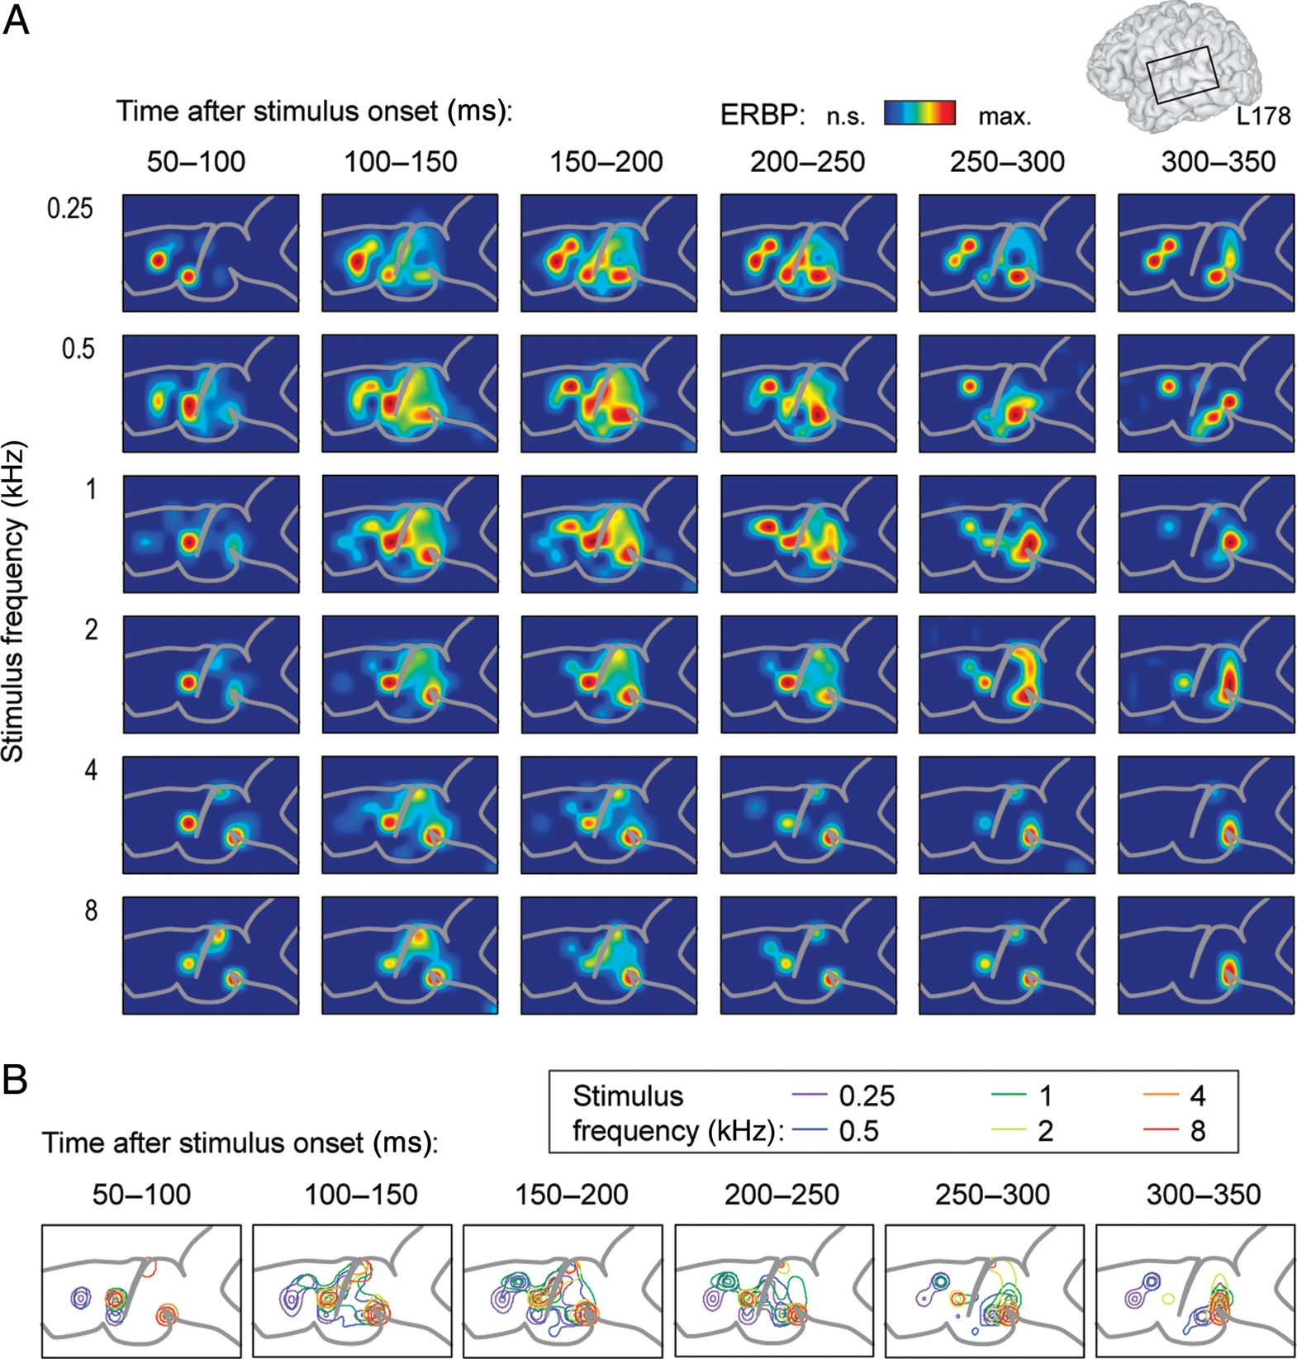
Figure 4. Spectral specificity of cortical high gamma responses without frequency gradients. Data recorded from the ...
Notes:
Figure 4. Spectral specificity of cortical high gamma responses without frequency gradients. Data recorded from the left hemisphere in a representative subject (L178). See legend of Figure 2 for details.
Unless provided in the caption above, the following copyright applies to the content of this slide: © The Author 2012. Published by Oxford University Press. All rights reserved. For Permissions, please e-mail: journals.permissions@oup.com

Slide 5
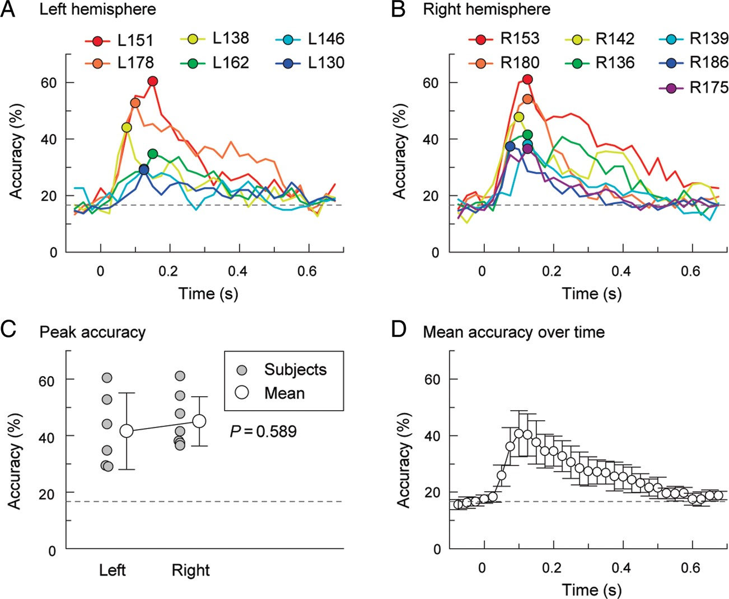
Figure 5. Tone classification analysis based on cortical high gamma ERBP. (A) Classification accuracy for the 6 ...
Notes:
Figure 5. Tone classification analysis based on cortical high gamma ERBP. (A) Classification accuracy for the 6 pure-tone stimuli (0.25, 0.5, 1, 2, 4, and 8 kHz) as a function of time window in the 6 subjects implanted in the left hemisphere. Circles indicate maximum classification accuracy in each subject. (B) Classification accuracy for the 6 pure-tone stimuli as a function of time window in the 7 subjects implanted in the right hemisphere. (C) Maximum classification accuracy for recordings from left- and right-hemisphere cases. Gray circles correspond to performance maxima in individual subjects; white circles are mean values, error bars correspond to 95% confidence intervals. (D) Classification accuracy over time. Circles indicate mean values; error bars represent 95% confidence intervals. Dashed lines indicate chance performance (16.7% for 6 frequencies).
Unless provided in the caption above, the following copyright applies to the content of this slide: © The Author 2012. Published by Oxford University Press. All rights reserved. For Permissions, please e-mail: journals.permissions@oup.com

Slide 6
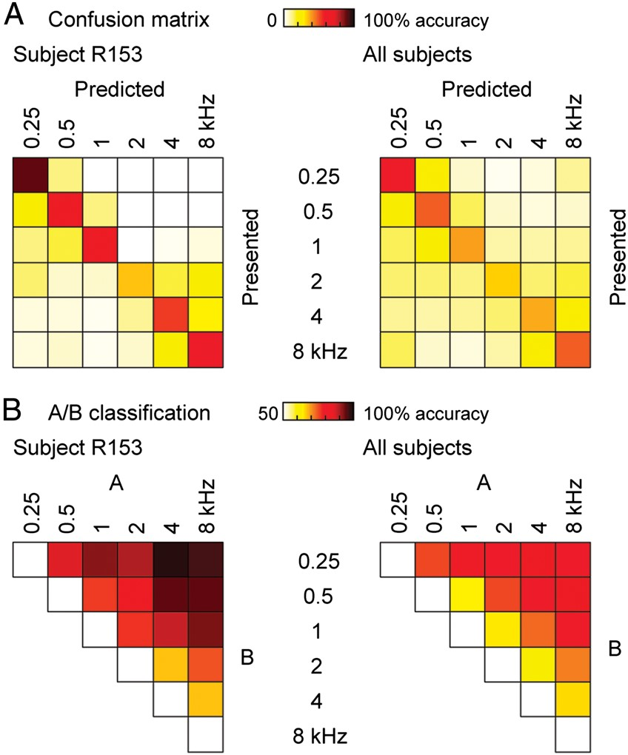
Figure 6. Classification accuracy based on the data from a representative subject (R153), and data averaged across the ...
Notes:
Figure 6. Classification accuracy based on the data from a representative subject (R153), and data averaged across the 13 subjects (left and right panels, respectively), measured in time intervals of the highest overall classification performance (indicated by circles in Fig. 4A,B). (A) Classification confusion matrices. (B) A/B pairwise classification.
Unless provided in the caption above, the following copyright applies to the content of this slide: © The Author 2012. Published by Oxford University Press. All rights reserved. For Permissions, please e-mail: journals.permissions@oup.com

Slide 7
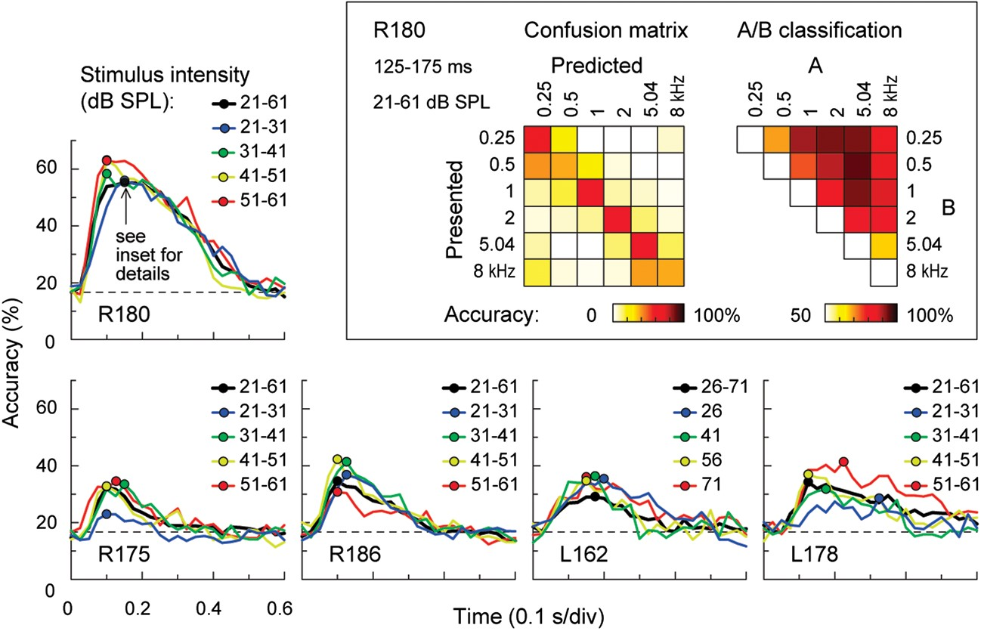
Figure 7. Frequency discrimination accuracy across stimulus intensities. Classification accuracy for the 6 pure-tone ...
Notes:
Figure 7. Frequency discrimination accuracy across stimulus intensities. Classification accuracy for the 6 pure-tone stimuli (0.25, 0.5, 1, 2, 5.04, and 8 kHz) is plotted as a function of time window for trials presented at different intensities. Circles indicate maximum classification accuracy for each intensity condition. Data from 5 subjects are shown. Inset: Classification confusion matrix (left) and pairwise classification accuracy (right) for stimulus intensities between 21 and 61 dB SPL in subject R180 for the time interval of peak classification performance (75–125 ms after stimulus onset).
Unless provided in the caption above, the following copyright applies to the content of this slide: © The Author 2012. Published by Oxford University Press. All rights reserved. For Permissions, please e-mail: journals.permissions@oup.com

