Slide 1
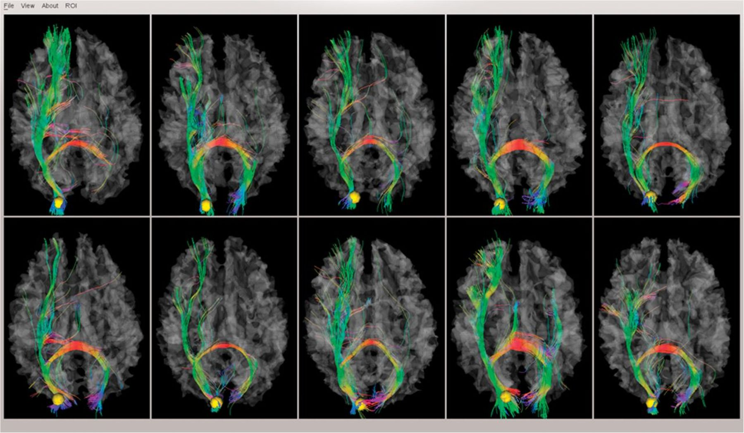
Figure 2. An example of the in-house batch visualization tool and its rendering of fiber shapes of one DICCCOL landmark ...
Notes:
Figure 2. An example of the in-house batch visualization tool and its rendering of fiber shapes of one DICCCOL landmark in 10 subjects.
Unless provided in the caption above, the following copyright applies to the content of this slide: © The Author 2012. Published by Oxford University Press. All rights reserved. For permissions, please e-mail: journals.permissions@oup.com

Slide 2
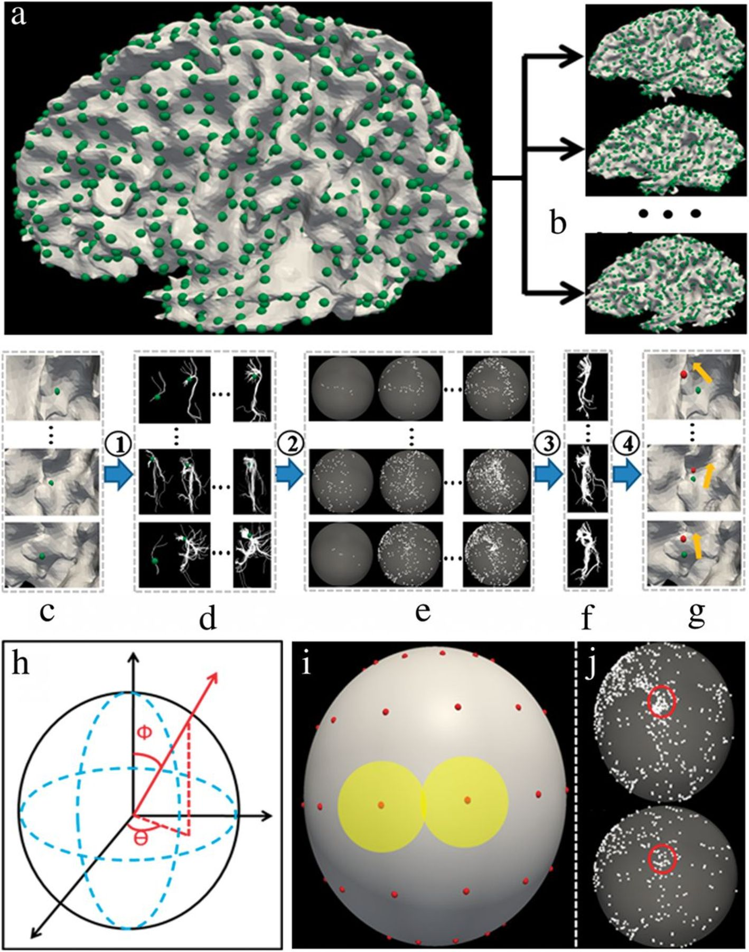
Figure 1. (a,b) Illustration of landmark initialization among a group of subjects. (a) We generated a dense regular ...
Notes:
Figure 1. (a,b) Illustration of landmark initialization among a group of subjects. (a) We generated a dense regular grid map on a randomly selected template. (b) We registered this grid map to other subjects using linear registration algorithm. The green bubbles are the landmarks. (c–g) The workflow of our DICCCOL landmark discovery framework. (c) The corresponding initialized landmarks (green bubbles) in a group of subjects. (d) A group of fiber bundles extracted from the neighborhood of the landmark. (e) Trace-maps corresponding to each fiber bundle. (f) The optimized fiber bundle of each subject. (g) The movements of the landmarks from initial locations (green) to the optimized locations (red). Step (1): Extracting fiber bundles from different locations close to the initial landmark. Step (2): Transforming the fiber bundles to trace-maps. Step (3): Finding the group of fiber bundles which make the group variance the least. Step (4): Finding the optimized location of initial landmark (red bubble). (h–j) Illustration of trace-map distance. (h) A sphere coordinate system for finding the sample points. We totally have 144 sample points by adjusting angle Φ and θ. 1) A sphere with 144 sample points. (j) Two trace-maps. The 2 red circles belong to the same sample point and will be compared based on the point density information within red circles.
Unless provided in the caption above, the following copyright applies to the content of this slide: © The Author 2012. Published by Oxford University Press. All rights reserved. For permissions, please e-mail: journals.permissions@oup.com

Slide 3
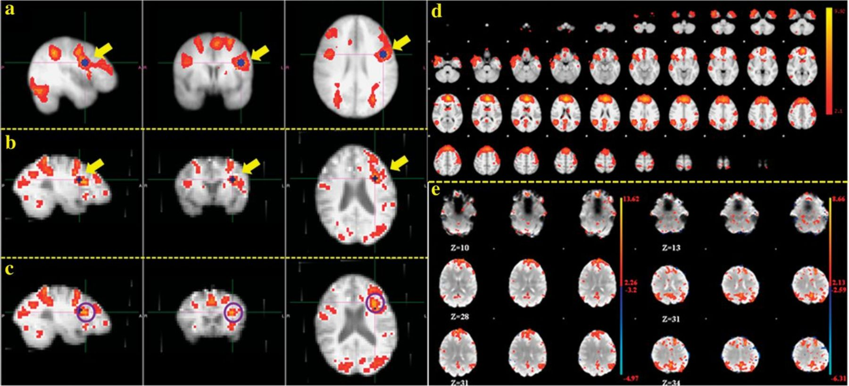
Figure 3. (a–c) Illustration of manual selection of working memory ROIs for an individual with the guidance of group ...
Notes:
Figure 3. (a–c) Illustration of manual selection of working memory ROIs for an individual with the guidance of group activation map. (a) Group-wise activation map. The ROI considered is shown in blue and highlighted by yellow arrow. (b) Individual activation map. The registered ROI peak from group activation map is shown in blue and highlighted by yellow arrow. (c) The manually chosen ROI peak for this individual. The ROI peak is the cross of 2 axes and the center of the highlighted purple circle. (d and e) Identification of DMN using ICA. (d) group-ICA result of DMN; (e): 2 individual samples of ICA maps for DMN.
Unless provided in the caption above, the following copyright applies to the content of this slide: © The Author 2012. Published by Oxford University Press. All rights reserved. For permissions, please e-mail: journals.permissions@oup.com

Slide 4
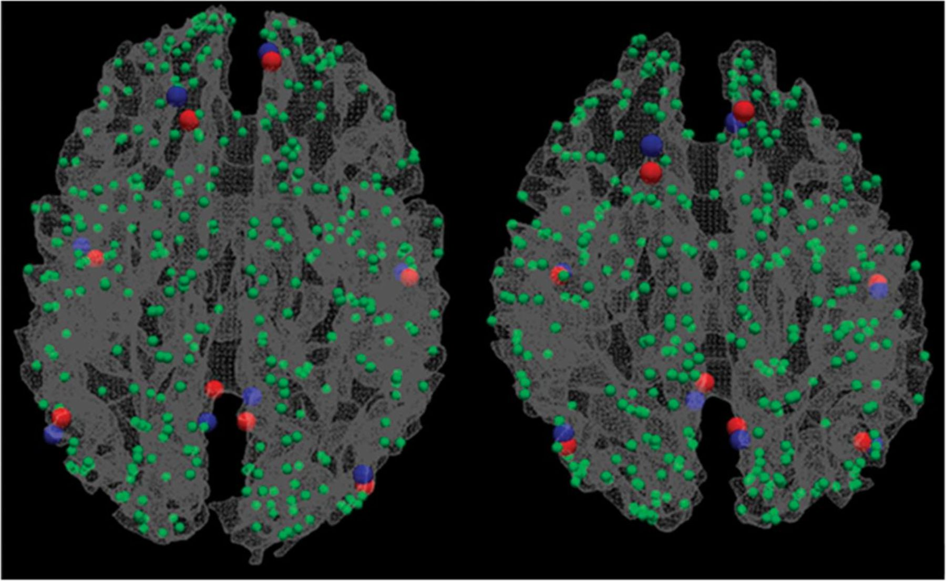
Figure 4. Two examples of mapping DICCCOL landmarks (blue) to fMRI benchmarks (red). The DMN is used here as an ...
Notes:
Figure 4. Two examples of mapping DICCCOL landmarks (blue) to fMRI benchmarks (red). The DMN is used here as an example.
Unless provided in the caption above, the following copyright applies to the content of this slide: © The Author 2012. Published by Oxford University Press. All rights reserved. For permissions, please e-mail: journals.permissions@oup.com

Slide 5
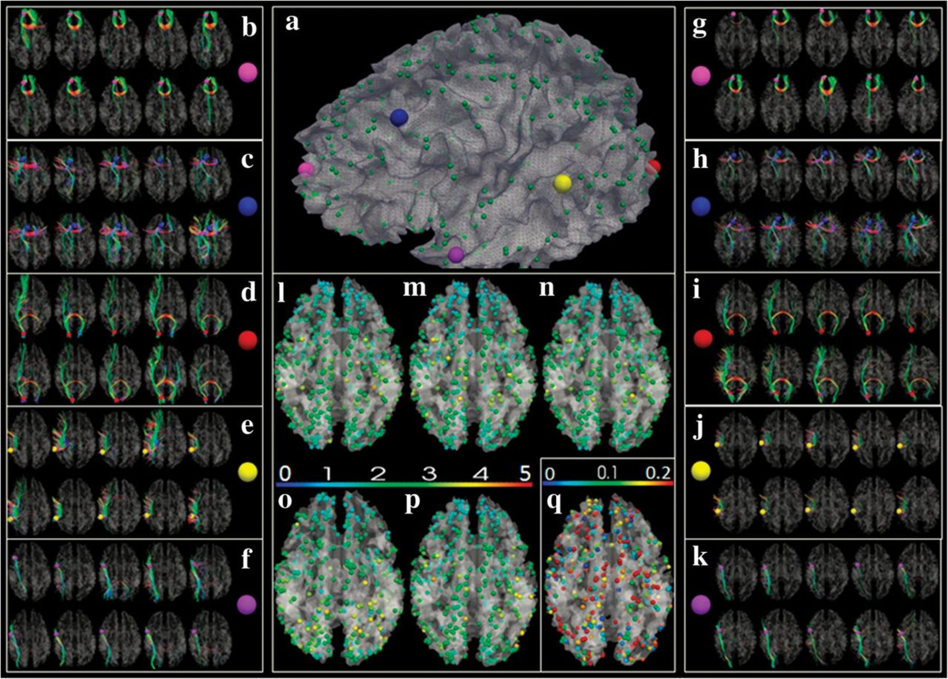
Figure 5. (a) The 358 DICCCOLs. (b–f) DTI-derived fibers emanating from 5 landmarks (enlarged color bubbles in a) in 2 ...
Notes:
Figure 5. (a) The 358 DICCCOLs. (b–f) DTI-derived fibers emanating from 5 landmarks (enlarged color bubbles in a) in 2 groups of 5 subjects (in 2 rows), respectively. (g–k) The predicted 5 landmarks in 2 groups of 5 subjects (in 2 rows) and their corresponding connection fibers. (l) Average trace-map distance for each landmark in the first group (rows in b–f); the color bar is on top of (o,p). (m) Average trace-map distance for each landmark in the second group (rows in b–f); (n) Average trace-map distance for each landmark across 2 groups in b–f; (o,p) Average trace-map distance for each landmark in the 2 predicted groups in g–k, respectively. (q) The decrease fraction of trace-map distance before and after optimization (the color bar on the top of q). The initialization was performed via a linear image warping algorithm.
Unless provided in the caption above, the following copyright applies to the content of this slide: © The Author 2012. Published by Oxford University Press. All rights reserved. For permissions, please e-mail: journals.permissions@oup.com

Slide 6
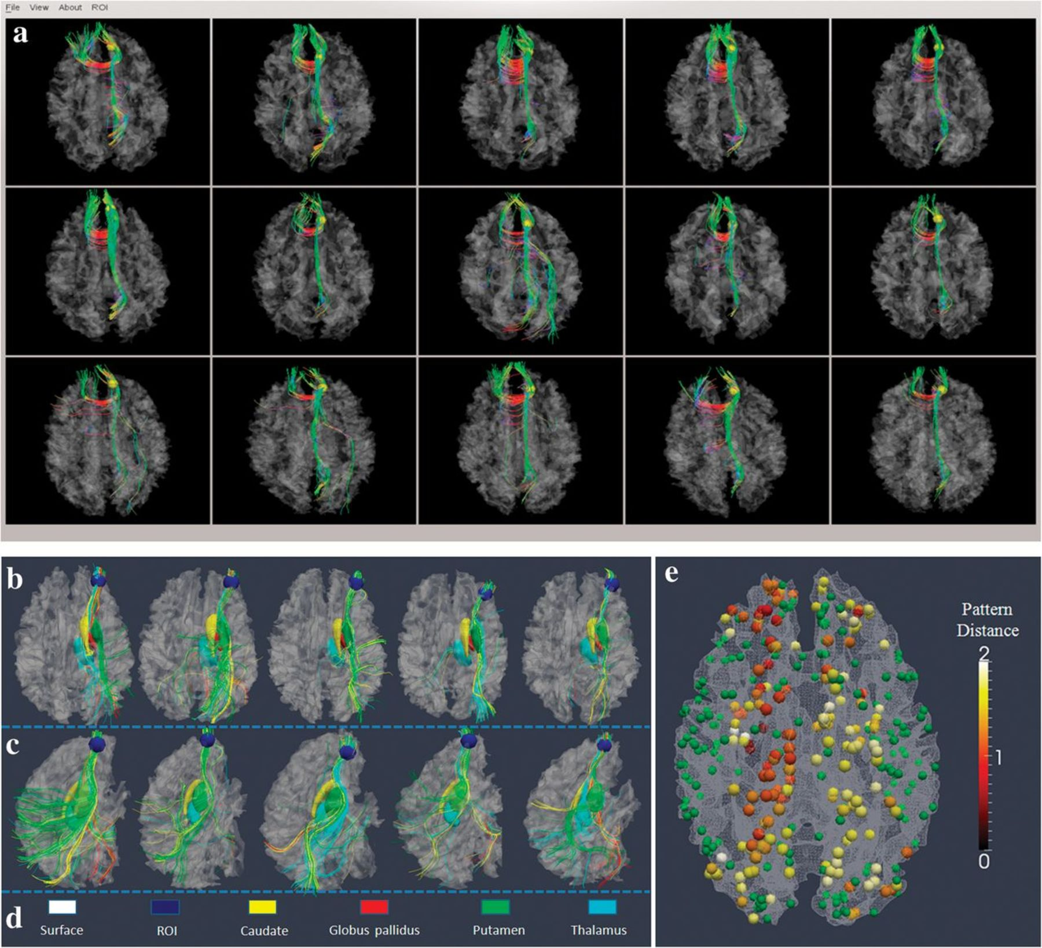
Figure 6. (a) An example of a predicted DICCCOL landmark (DICCCOL #311) in 5 separate subject brains. The first 2 rows ...
Notes:
Figure 6. (a) An example of a predicted DICCCOL landmark (DICCCOL #311) in 5 separate subject brains. The first 2 rows (n = 10) are models, and last row (n = 5) is the predicted result in 5 brains. (b–e) Demonstration that fiber shape pattern represents structural connectivity pattern using subcortical regions as benchmark landmarks. (b) One DICCCOL landmark (blue sphere) and its fiber connections in 5 different brains. The 4 subcortical regions are represented by yellow, red, green, and cyan colors in d. The fibers connected to these subcortical regions are in the same colors. It is evident that this DICCCOL landmark has the same pattern of structural connectivity to these subcortical regions. (c) Another lateral view of the fiber connection patterns. (d) Color codes for cortical surface, landmark ROI, and subcortical regions. (e) The average distances of structural connectivity patterns for 175 DICCCOL landmarks that have strong fiber connections (over 50 fibers) to subcortical regions. Other DICCCOL landmarks are shown in green.
Unless provided in the caption above, the following copyright applies to the content of this slide: © The Author 2012. Published by Oxford University Press. All rights reserved. For permissions, please e-mail: journals.permissions@oup.com

Slide 7
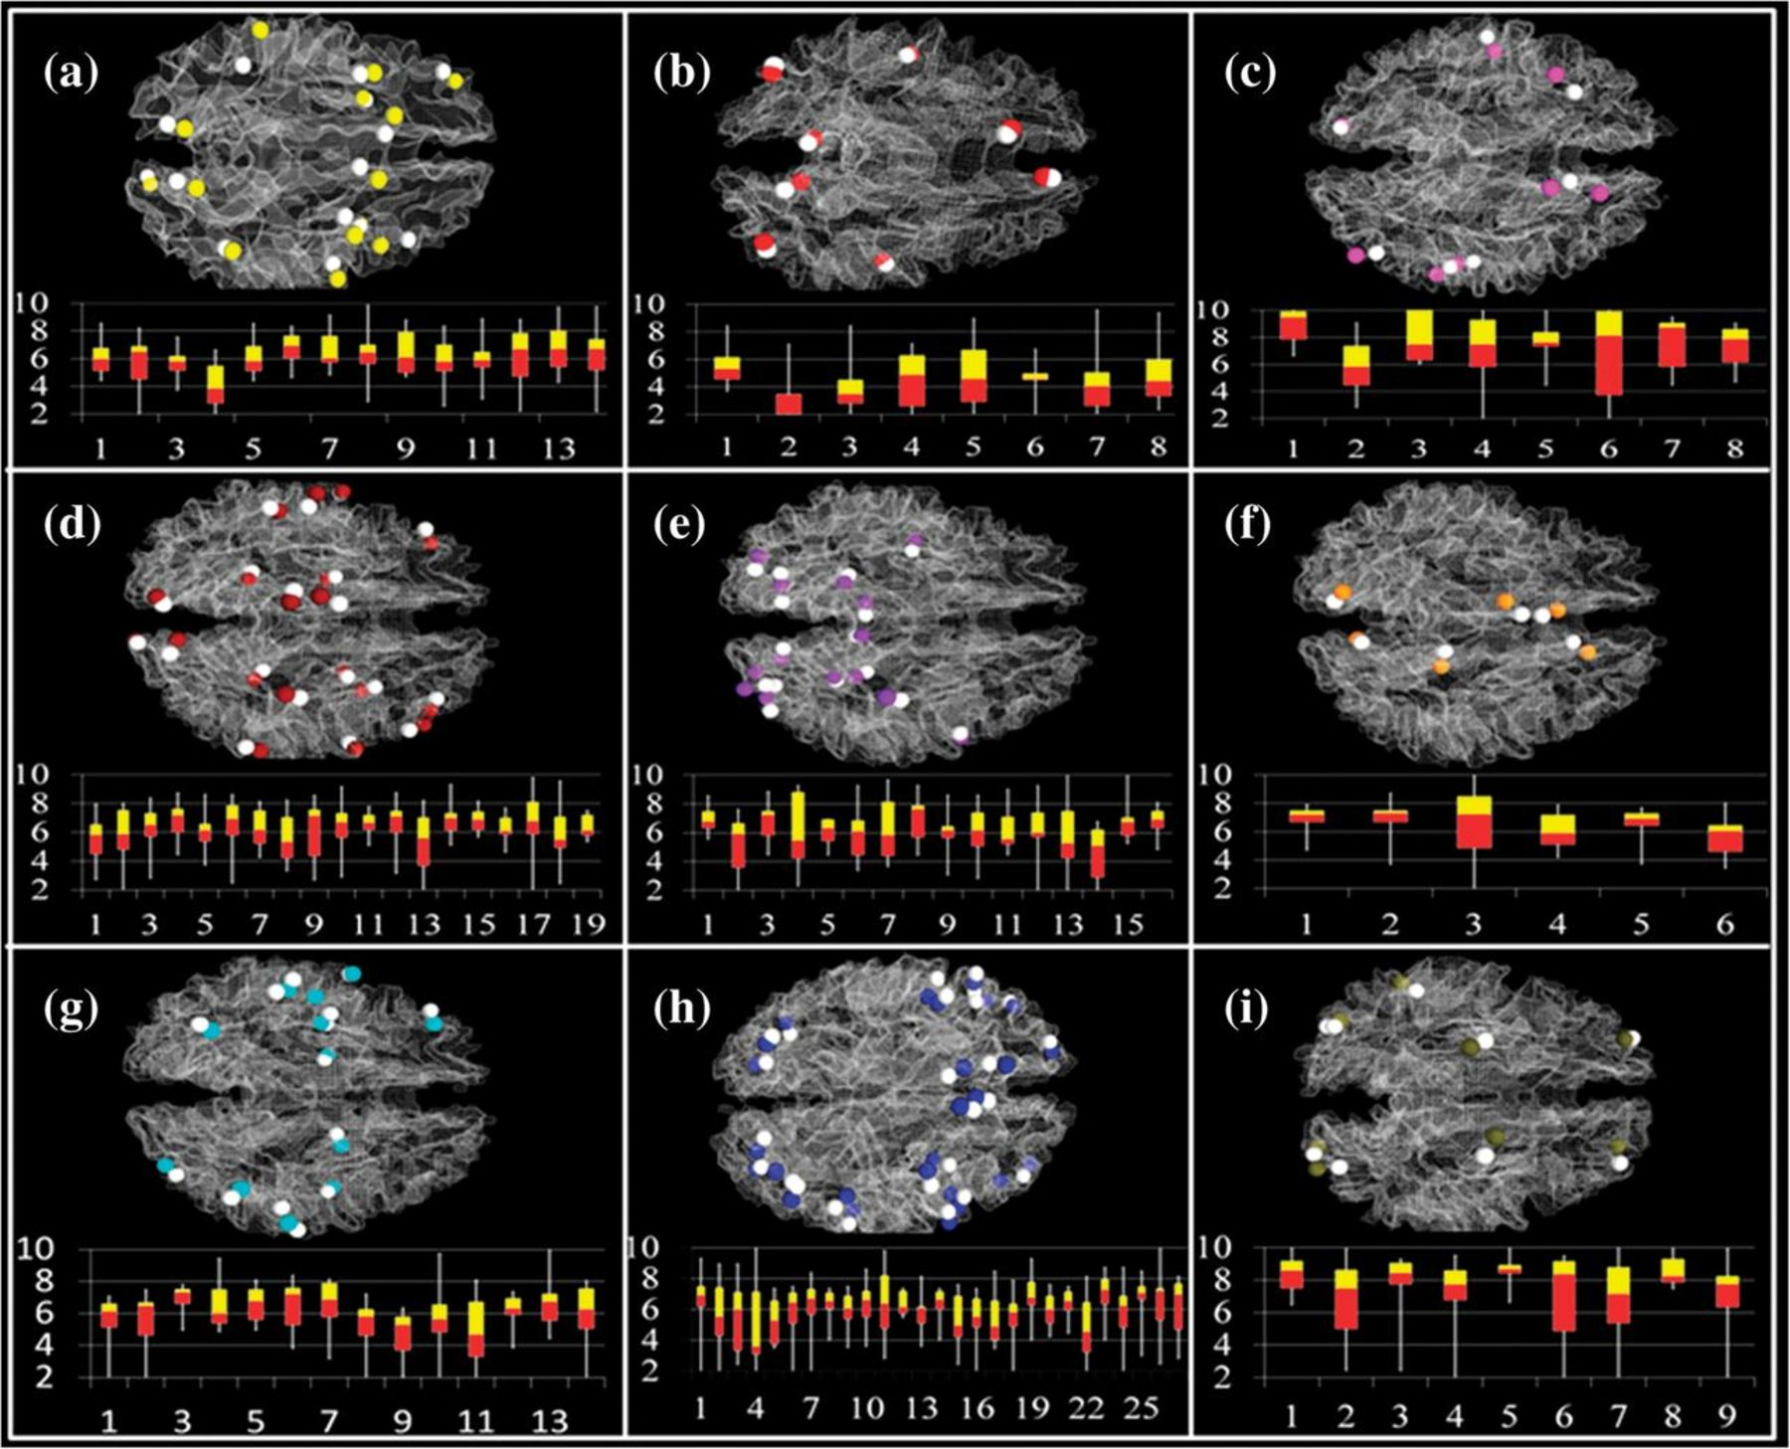
Figure 7. Functional localizations of 95 DICCCOLs determined by 121 fMRI-derived functional regions. Specifically, 76 ...
Notes:
Figure 7. Functional localizations of 95 DICCCOLs determined by 121 fMRI-derived functional regions. Specifically, 76 of them are located adjacently to one functional network, 16 of them are located within 2 functional networks, and 3 of them are located inside 3 functional networks. (a) Working memory network (data set 2). White spheres represent fMRI-derived benchmarks and yellow spheres represent corresponding DICCCOLs. The distances between centers of fMRI benchmarks and DICCCOLs are shown in the bottom panel, in which the horizontal axis indexes activations and the vertical axis is the distance in the unit of millimeter. Each bar represents the median (interface between the red and yellow bars), minimum and maximum value (2 ends of the white line), 25% (bottom of the red bar), and 75% (top of the yellow bar) of the distances for each fMRI activation peak. The average distance is 6.07 mm (b–i) results for default mode (data set 1), auditory (data set 4), semantic decision making (data set 1), emotion (data set 1), empathy (data set 1), fear (data set 1), attention (data set 3), visual networks (data set 4), respectively. In b–i, white spheres stand for fMRI benchmarks and other colors represent corresponding DICCCOLs. The average distances between centers of fMRI benchmarks and DICCCOLs in these networks are 5.50, 6.48, 6.25, 6.12, 6.41, 5.93, 5.94, and 7.59 mm, respectively.
Unless provided in the caption above, the following copyright applies to the content of this slide: © The Author 2012. Published by Oxford University Press. All rights reserved. For permissions, please e-mail: journals.permissions@oup.com

Slide 8
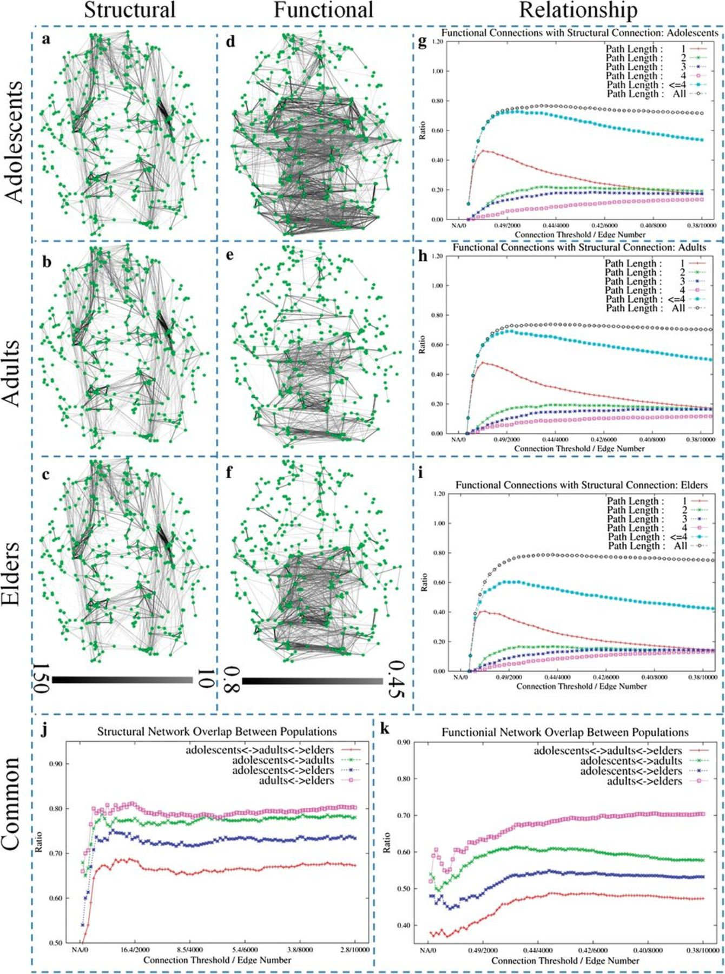
Figure 8. Structural and functional (resting-state) human brain connectomes. (a–c) Structural connectomes in adolescent ...
Notes:
Figure 8. Structural and functional (resting-state) human brain connectomes. (a–c) Structural connectomes in adolescent (n = 22), adult (n = 44), and elderly (n = 23) groups. Each structural connectome is obtained by the averaged structural connectivity between each pair of DICCCOLs in each age group. The color bar at the bottom of c encodes the number of streamline fibers (from 10 to 150). (d–f) Functional connectomes in the 3 age groups. Each functional connectome is obtained by the averaged functional connectivity between each pair of DICCCOLs in each age group. The color bar at the bottom of f encodes the average functional connectivity (from 0.45 to 0.8). (g–i) The percentages of functional connections in d–f that are coincident with direct and indirect (up to 4 path lengths) structural connections, for 3 age groups, respectively. The horizontal axis represents the threshold used to select the functional connection edges and the number of selected functional edges in the connectivity matrix, and the vertical axis is the ratio of structural connections that are coincident with functional connections. Path length 1 (red curve) means direct structural connection between 2 DICCCOLs, while path length 2 (green curve), 3 (blue curve), and 4 (pink curve) represent 2–4 structural connection edges between 2 DICOOOLs. In particular, the black dotted curves in g shows that around 80% of functional connections in d in the adolescent group have direct or indirect structural connections. We can see similar black dotted curves in h and i for the adult and elder groups. (j) Percentages of common structural connectome edges between 2 groups and across 3 groups. The horizontal axis stands for the thresholds used to select the structural connection edges and the numbers of selected edges in the connectivity matrix, and the vertical axis is the ratio of common structural edges between 2 or 3 structural connectivity matrices. (k) Percentages of common functional connectome edges between 2 groups and across 3 groups. The horizontal axis represents the thresholds used to select the functional connection edges and the numbers of totally selected edges in the functional connectivity matrix, and the vertical axis is the ratio of common functional edges between 2 or 3 functional connectivity matrices.
Unless provided in the caption above, the following copyright applies to the content of this slide: © The Author 2012. Published by Oxford University Press. All rights reserved. For permissions, please e-mail: journals.permissions@oup.com

Slide 9
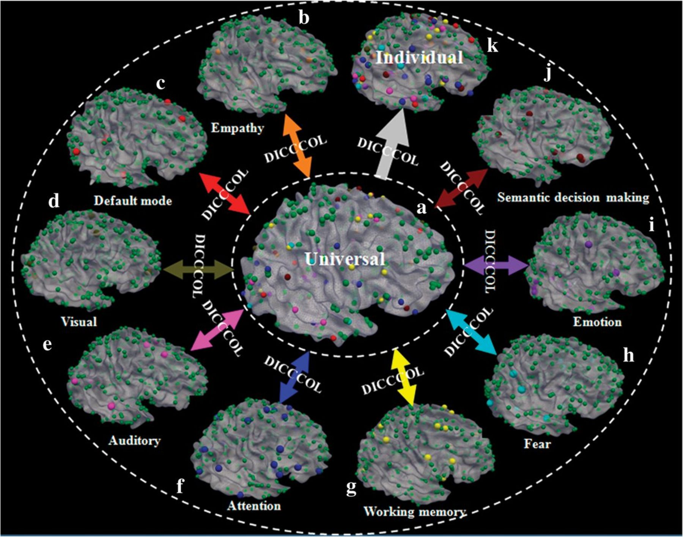
Figure 9. Summary of our approach and results. Spheres in orange (total 6), red (total 8), brown (total 9), pink (total ...
Notes:
Figure 9. Summary of our approach and results. Spheres in orange (total 6), red (total 8), brown (total 9), pink (total 8), blue (total 27), yellow (total 14), cyan (total 14), purple (total 16), and black-red (total 19) colors stand for landmarks in empathy, default mode, visual, auditory, attention, working memory, fear, emotion, and semantic decision making networks that are identified from fMRI data sets. The green spheres (totally 263) stand for landmarks that are not functionally labeled yet. The DICCCOLs serve as structural substrates to represent the common human brain architecture. For instance, 9 different functionally specialized brain networks (b–j) identified from different fMRI data sets are integrated into the same universal brain reference system (a) via DICCCOL. Then, the functionally labeled DICCCOLs in the universal space can be predicted in each individual brain with DTI data such that the DICCCOLs and their functional identities can be readily transferred to a local coordinate system (k).
Unless provided in the caption above, the following copyright applies to the content of this slide: © The Author 2012. Published by Oxford University Press. All rights reserved. For permissions, please e-mail: journals.permissions@oup.com

