Slide 1
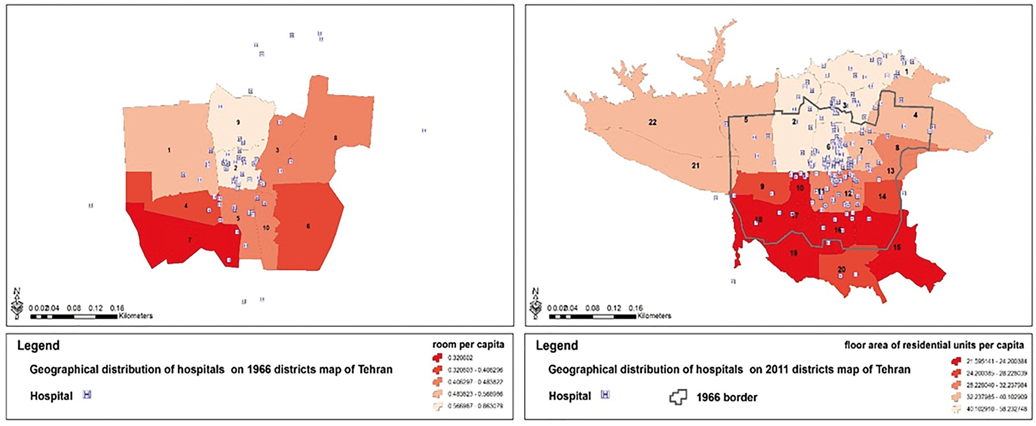
Figure 1. Geographical distribution of hospitals during 1966 and 2011 in districts of Tehran
Notes:
Figure 1. Geographical distribution of hospitals during 1966 and 2011 in districts of Tehran
Unless provided in the caption above, the following copyright applies to the content of this slide: © The Author 2017. Published by Oxford University Press in association with The London School of Hygiene and Tropical Medicine. All rights reserved. For permissions, please e-mail: journals.permissions@oup.com

Slide 2
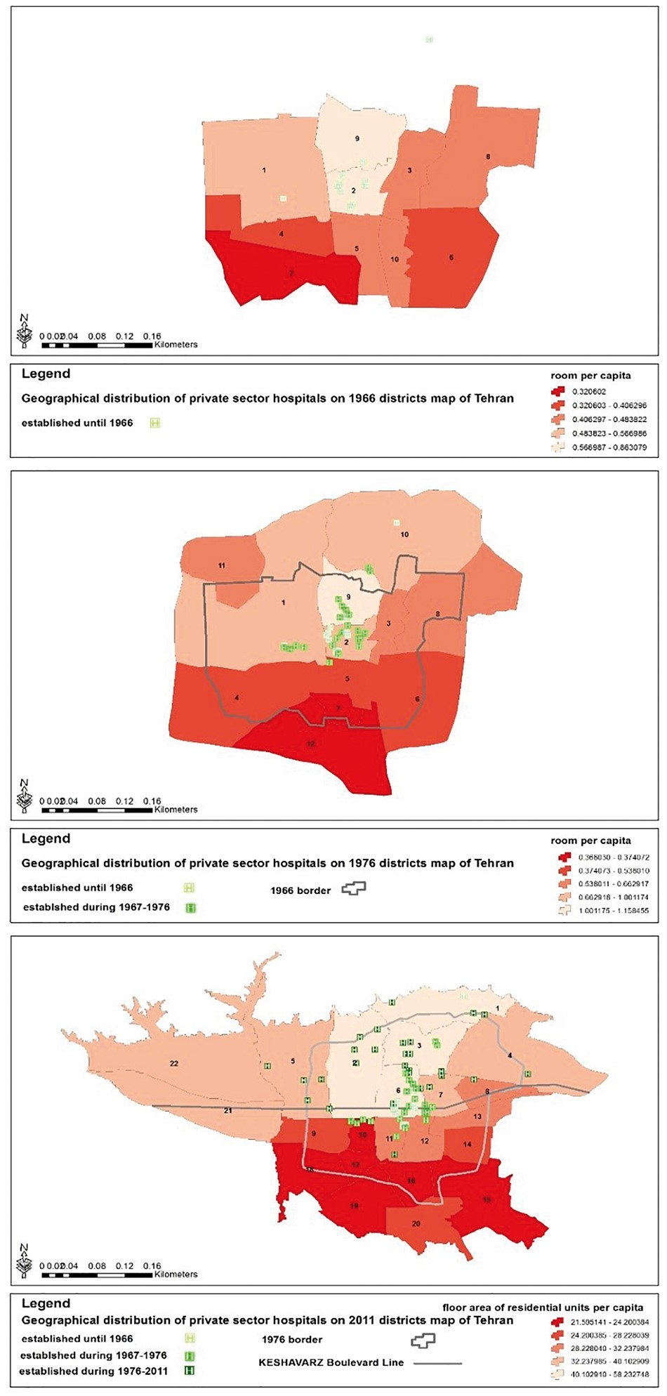
Figure 2. Geographical distribution of private hospitals during 1966, 1976 and 2011 in districts of Tehrann
Notes:
Figure 2. Geographical distribution of private hospitals during 1966, 1976 and 2011 in districts of Tehrann
Unless provided in the caption above, the following copyright applies to the content of this slide: © The Author 2017. Published by Oxford University Press in association with The London School of Hygiene and Tropical Medicine. All rights reserved. For permissions, please e-mail: journals.permissions@oup.com

