Slide 1
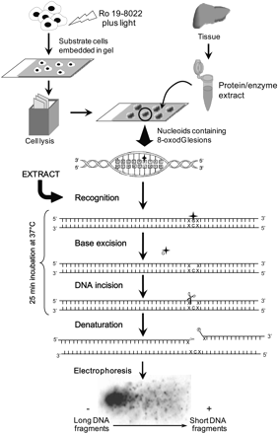
Fig. 1 Overview of comet-based in vitro repair assay to measure BER-related incision activity. Substrate cells are ...
Notes:
Fig. 1 Overview of comet-based in vitro repair assay to measure BER-related incision activity. Substrate cells are exposed to the photosensitiser Ro 19-8022 to induce 8-oxodG lesions (filled cross). After lysis, gel-embedded nucleoids are incubated with tissue extracts. Subsequent standard single-cell gel electrophoresis reveals the single-strand breaks introduced by the BER enzymes.
Unless provided in the caption above, the following copyright applies to the content of this slide: © The Author 2011. Published by Oxford University Press on behalf of the UK Environmental Mutagen Society. All rights reserved. For permissions, please e-mail: journals.permissions@oup.com.

Slide 2
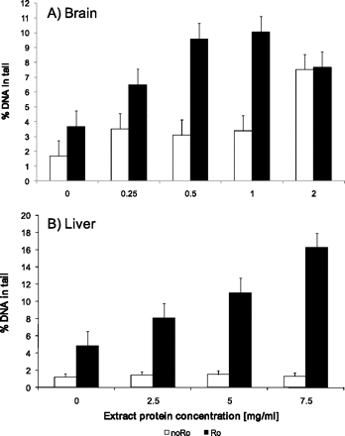
Fig. 2 Protein dilution curves of brain (A) and liver (B) extracts. The incision activity is related to the extract ...
Notes:
Fig. 2 Protein dilution curves of brain (A) and liver (B) extracts. The incision activity is related to the extract concentration and different for each tissue. Data from two biological replicates are presented as the mean of two independent experiments, calculated based on TI values. Bars indicate the pooled SEMs.
Unless provided in the caption above, the following copyright applies to the content of this slide: © The Author 2011. Published by Oxford University Press on behalf of the UK Environmental Mutagen Society. All rights reserved. For permissions, please e-mail: journals.permissions@oup.com.

Slide 3
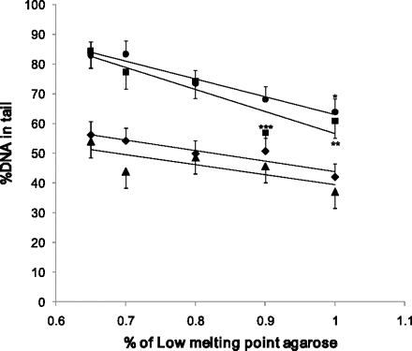
Fig. 3 The effect of the LMP agarose concentration on the DNA migration (P_{ANOVA} ≥ 1.131) and detection of ...
Notes:
Fig. 3 The effect of the LMP agarose concentration on the DNA migration (PANOVA ≥ 1.131) and detection of DNA repair incision activity (PANOVA ≤ 0.032). To study DNA migration, H2O2-induced DNA damage was detected via standard comet assay (filled diamonds, slope = 79.18) or after buffer incubation (filled triangles, slope = 73.42). DNA incisions were detected after incubation with liver extract (filled squares, slope = 130.7; ***PDunnett = 0.014 and **PDunnett = 0.026 versus 0.65%) or FPG enzyme (filled circles, slope = 122.83; *PDunnett = 0.044 versus 0.65%). The results are presented as the mean difference (n = 2) in DNA incisions between the unexposed and H2O2-exposed substrates. Bars indicate the pooled SEMs.
Unless provided in the caption above, the following copyright applies to the content of this slide: © The Author 2011. Published by Oxford University Press on behalf of the UK Environmental Mutagen Society. All rights reserved. For permissions, please e-mail: journals.permissions@oup.com.

Slide 4
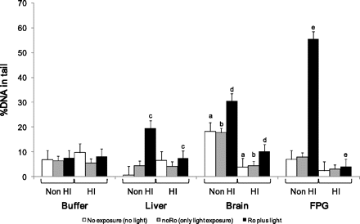
Fig. 4 DNA repair incision activity of HI and non-HI samples and controls. Data are presented as the mean (n = 2) of ...
Notes:
Fig. 4 DNA repair incision activity of HI and non-HI samples and controls. Data are presented as the mean (n = 2) of two independent experiments, calculated based on TI values. Bars indicate the pooled SEMs (aP = 0.047, bP = 0.001, cP = 0.016, dP = 0.002, eP < 0.001 non-HI versus HI, post hoc Tukey HSD).
Unless provided in the caption above, the following copyright applies to the content of this slide: © The Author 2011. Published by Oxford University Press on behalf of the UK Environmental Mutagen Society. All rights reserved. For permissions, please e-mail: journals.permissions@oup.com.

Slide 5
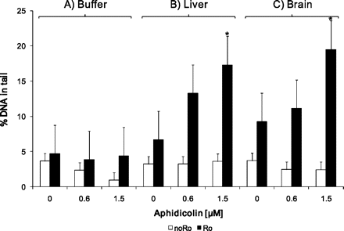
Fig. 5 The effect of APC on (A) the background DNA damage and on the BER-related incision activity detected in (B) ...
Notes:
Fig. 5 The effect of APC on (A) the background DNA damage and on the BER-related incision activity detected in (B) liver and (C) brain extracts. Data are shown as mean values (n = 2) of two independent experiments, and bars indicate the pooled SEMs. Addition of 1.5 μM APC significantly affected the sensitivity of the assay (*P = 0.018, brain and liver data combined, GLMUA post hoc Dunnett t-test).
Unless provided in the caption above, the following copyright applies to the content of this slide: © The Author 2011. Published by Oxford University Press on behalf of the UK Environmental Mutagen Society. All rights reserved. For permissions, please e-mail: journals.permissions@oup.com.

Slide 6
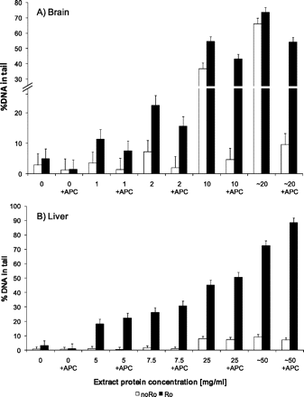
Fig. 6 Protein dilution curves showing the effect of 1.5 μM APC on the non-specific nuclease activity in (A) brain ...
Notes:
Fig. 6 Protein dilution curves showing the effect of 1.5 μM APC on the non-specific nuclease activity in (A) brain (PGLMUA = 0.002, white bars with versus without APC) and (B) liver extracts. Mean values (n = 2) of two independent experiments are shown. Bars indicate the pooled SEMs.
Unless provided in the caption above, the following copyright applies to the content of this slide: © The Author 2011. Published by Oxford University Press on behalf of the UK Environmental Mutagen Society. All rights reserved. For permissions, please e-mail: journals.permissions@oup.com.

Slide 7
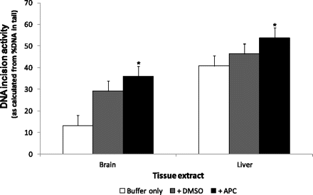
Fig. 7 The effect of DMSO on the non-specific cleavage activity, without or in combination with 1.5 μM APC (*P = ...
Notes:
Fig. 7 The effect of DMSO on the non-specific cleavage activity, without or in combination with 1.5 μM APC (*P = 0.002 versus buffer control, brain and liver data combined, GLMUA post hoc Dunnett t-test). Data are presented as the mean (n = 2) of two independent experiments, calculated based on TI values. Bars indicate pooled SEMs.
Unless provided in the caption above, the following copyright applies to the content of this slide: © The Author 2011. Published by Oxford University Press on behalf of the UK Environmental Mutagen Society. All rights reserved. For permissions, please e-mail: journals.permissions@oup.com.

Slide 8
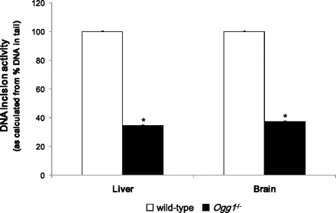
Fig. 8 DNA repair incision activity in Ogg1^{−/−} and corresponding wild-type mice liver and brain extracts. ...
Notes:
Fig. 8 DNA repair incision activity in Ogg1−/− and corresponding wild-type mice liver and brain extracts. Mean values (n = 2) of two independent experiments are presented as the percentage of the incision activity in wild-type tissues and were significantly lower in Ogg1−/− mouse tissues (*PGLMUA = 0.001). Bars indicate pooled SEMs.
Unless provided in the caption above, the following copyright applies to the content of this slide: © The Author 2011. Published by Oxford University Press on behalf of the UK Environmental Mutagen Society. All rights reserved. For permissions, please e-mail: journals.permissions@oup.com.

Slide 9
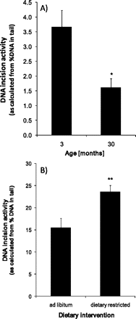
Fig. 9 The effect of age (A) and 26% DR (B) on the DNA repair incision activity in mice brain and liver tissue, ...
Notes:
Fig. 9 The effect of age (A) and 26% DR (B) on the DNA repair incision activity in mice brain and liver tissue, respectively. Mean repair activities of two independent experiments (n = 4/age group and n = 6–7/diet group) are presented. Bars represent SEMs (*P = 0.018 and **P = 0.008, t-test). Note: Incision activity of the different tissues should not be compared since tissues originated from different mice and different protein concentrations were used (i.e. 1 mg/ml for brain and 5 mg/ml for liver).
Unless provided in the caption above, the following copyright applies to the content of this slide: © The Author 2011. Published by Oxford University Press on behalf of the UK Environmental Mutagen Society. All rights reserved. For permissions, please e-mail: journals.permissions@oup.com.

