Slide 1
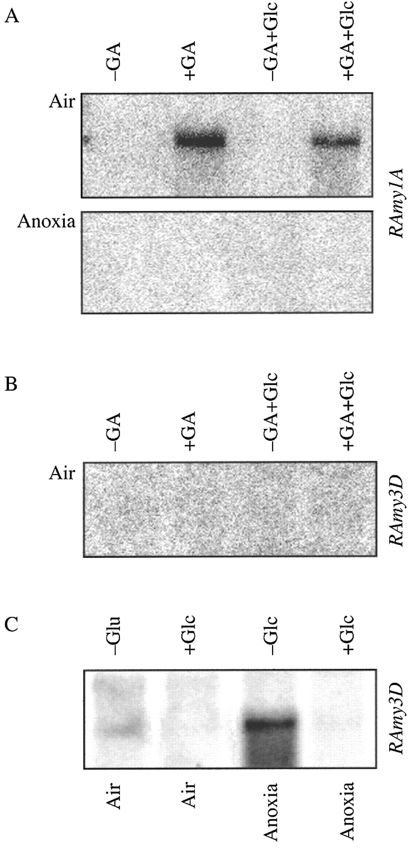
Fig. 1. Effects of anoxia, gibberellic acid and glucose on Ramy1A and Ramy3D mRNA accumulation in embryoless ...
Notes:
Fig. 1. Effects of anoxia, gibberellic acid and glucose on Ramy1A and Ramy3D mRNA accumulation in embryoless half‐grains. A, Northern blot analysis of Ramy1A mRNA accumulation in embryoless half‐grains incubated for 2 d in presence/absence of 1 µm GA and, when used, in presence of 100 mm glucose under aerobic/anaerobic conditions. B, Northern blot analysis of Ramy3D mRNA accumulation in embryoless half‐grains incubated for 2 d in presence/absence of GA in aerobic conditions and, when used, in presence of 100 mm glucose. C, Northern blot analysis of Ramy3D mRNA accumulation in embryoless half‐grains incubated for 2 d in air or anoxia in presence/absence of 100 mm glucose.
Unless provided in the caption above, the following copyright applies to the content of this slide:

Slide 2
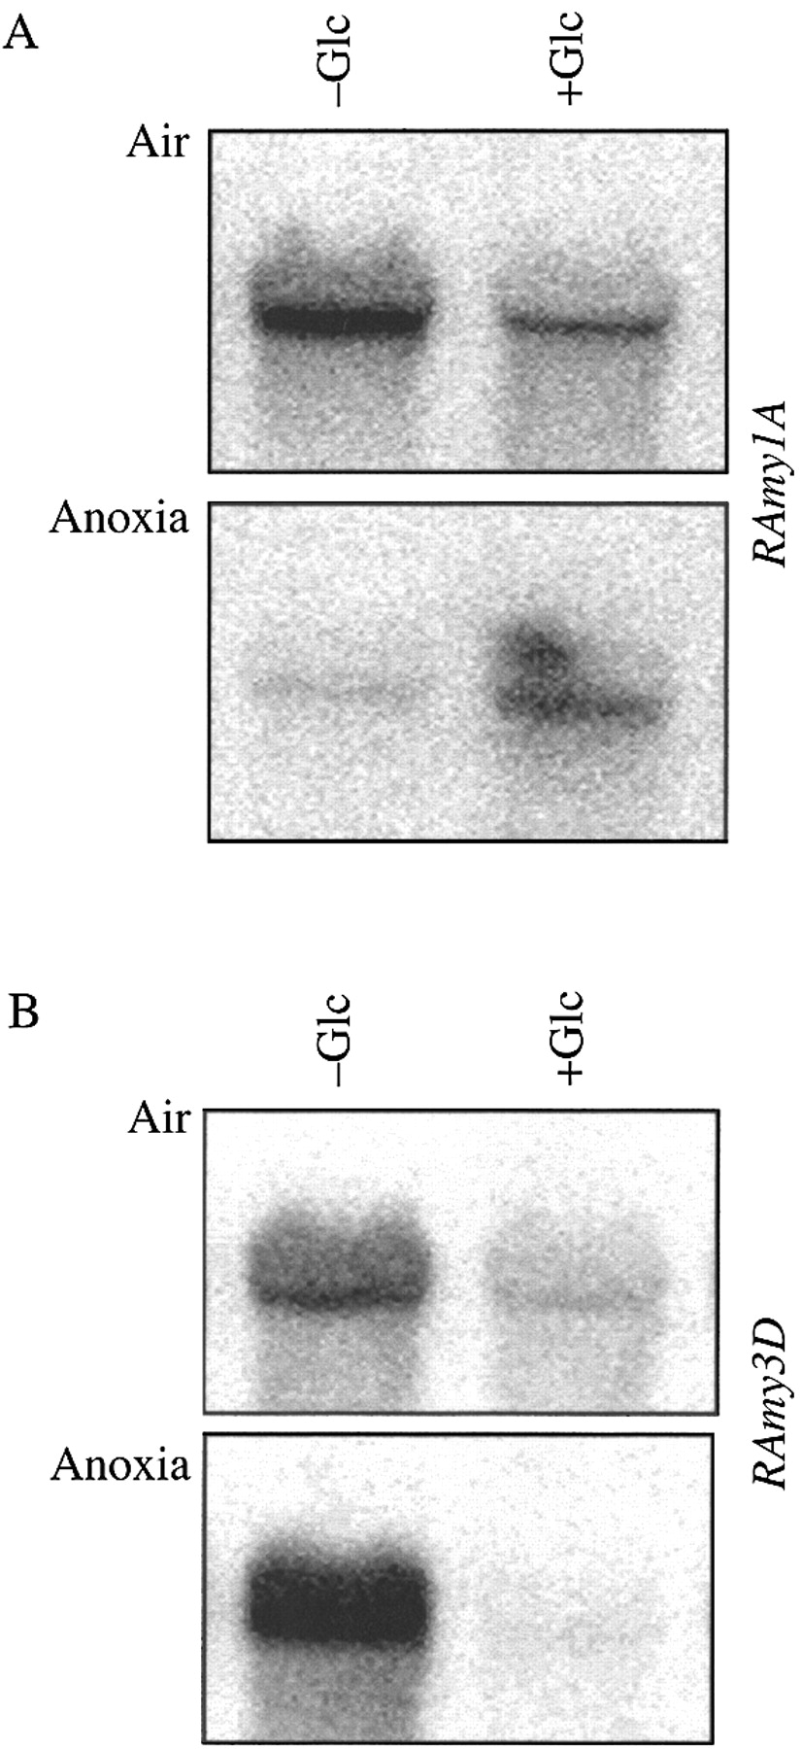
Fig. 2. Effects of anoxia and glucose on Ramy1A and Ramy3D mRNA accumulation in rice embryos. A, Northern ...
Notes:
Fig. 2. Effects of anoxia and glucose on Ramy1A and Ramy3D mRNA accumulation in rice embryos. A, Northern blot analysis of Ramy1A mRNA accumulation in embryos incubated for 2 d in presence/absence of 100 mm glucose under aerobic/anaerobic conditions. B, Northern blot analysis of Ramy3D mRNA accumulation in embryos incubated for 2 d in presence/absence of 100 mm glucose under aerobic/anaerobic conditions.
Unless provided in the caption above, the following copyright applies to the content of this slide:

Slide 3
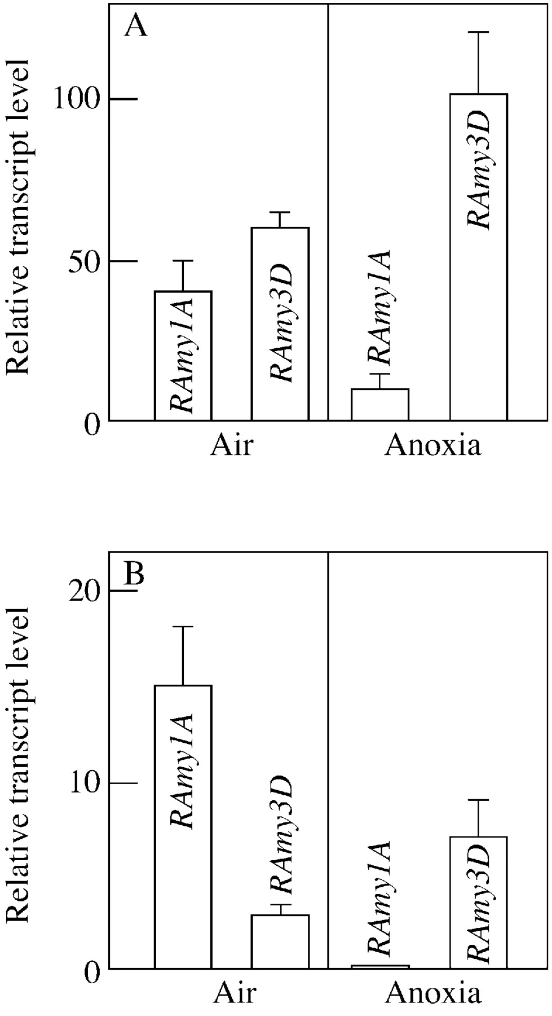
Fig. 3. Relative importance of expression of Ramy1A versus Ramy3D under aerobic and anaerobic conditions. ...
Notes:
Fig. 3. Relative importance of expression of Ramy1A versus Ramy3D under aerobic and anaerobic conditions. Quantitative data (± s.e.) from replicated (n = 3) Northern blots performed as described in Figs 1 and 2 were normalized for electrophoresis loading differences on the basis of rRNA hybridization of the same blots. A relative value of 100 is assigned to the higher level of expression detected. A, Relative accumulation of Ramy1A and Ramy3D mRNAs in aerobic and anaerobic isolated embryos incubated in the presence of 1 µm GA. B, Relative accumulation of Ramy1A and Ramy3D mRNAs in aerobic and anaerobic isolated embryoless half‐grains incubated in the presence of 1 µm GA.
Unless provided in the caption above, the following copyright applies to the content of this slide:

Slide 4
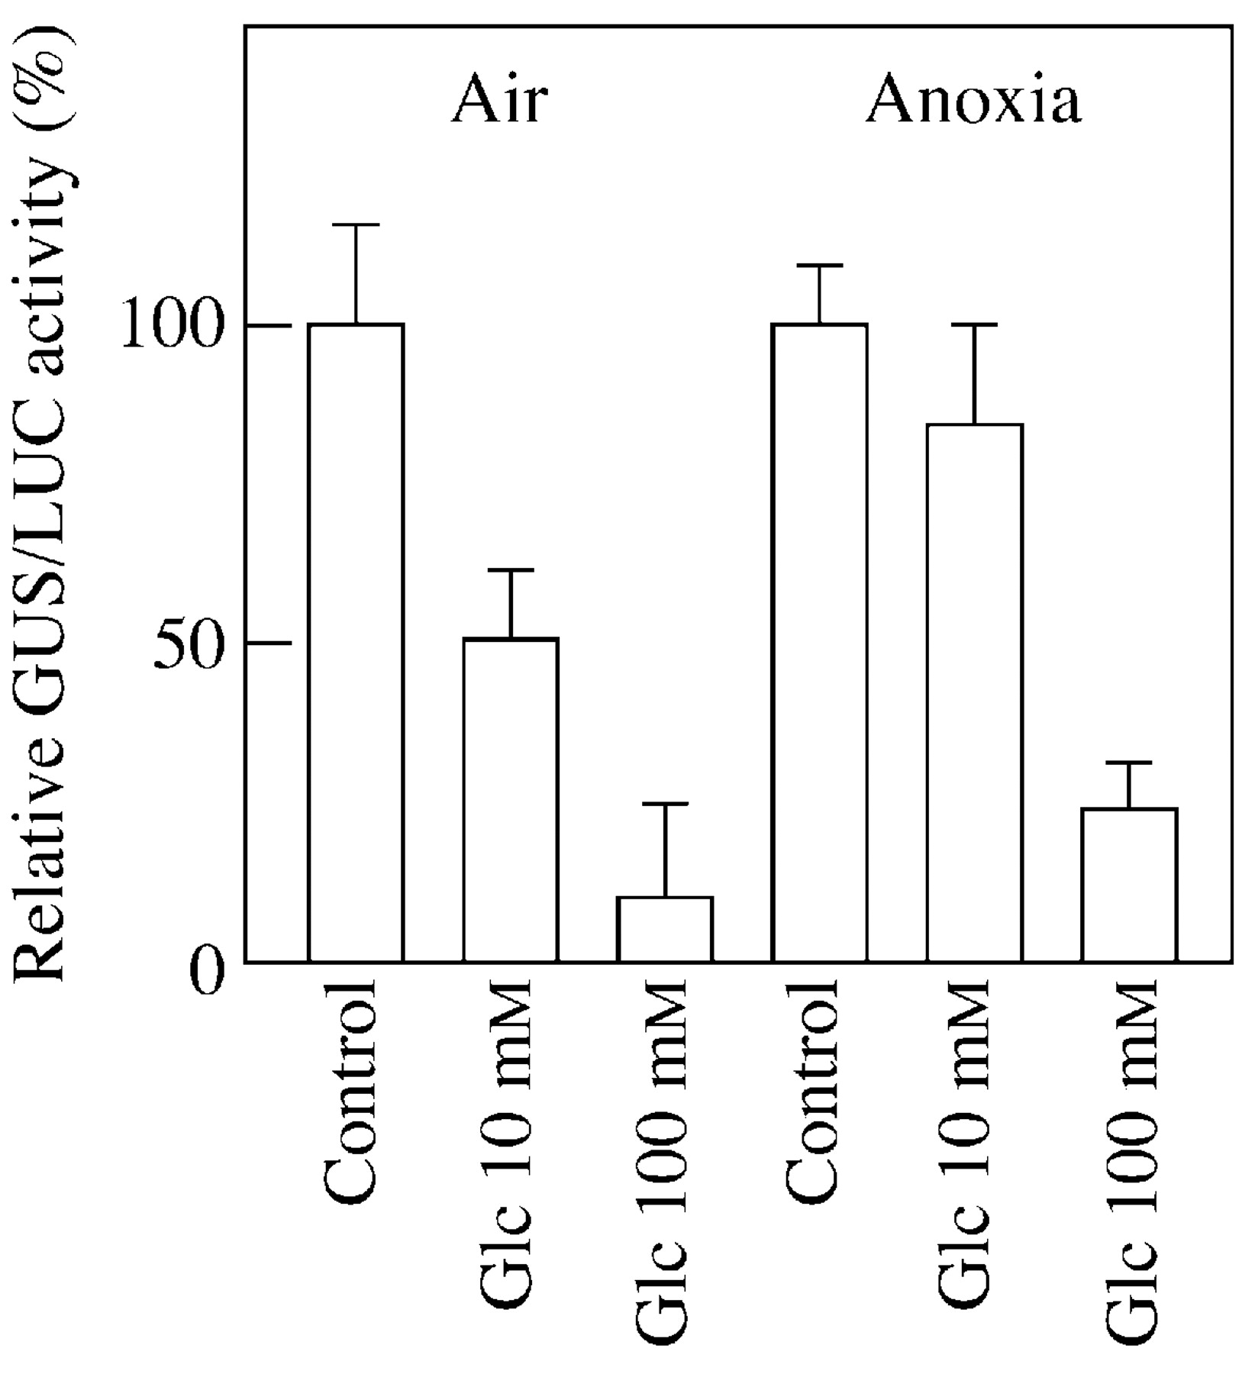
Fig. 4. Effect of glucose on the repression of RAmy3D promoter activity under aerobic and anaerobic ...
Notes:
Fig. 4. Effect of glucose on the repression of RAmy3D promoter activity under aerobic and anaerobic conditions. Transformation was performed by bombardment with Ramy3D‐GUS co‐delivered with 35S‐LUC. After trasformation the embryos were subsequently incubated for 2 d on a glucose‐free medium (Control) or a medium containing glucose (10–100 mm). Data were normalized by using the 35S‐LUC construct as internal standard. Relative GUS/LUC activity is expressed as control = 100. Data are means ± s.e. (n = 3).
Unless provided in the caption above, the following copyright applies to the content of this slide:

