Slide 1
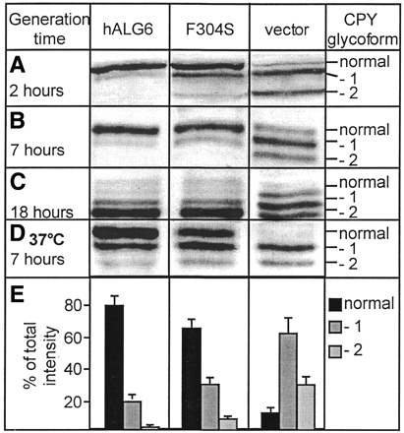
+ Figure 1. Complementation of faulty CPY glycosylation in an ALG6-deficient yeast strain with normal human ...
Notes:
+ Figure 1. Complementation of faulty CPY glycosylation in an ALG6-deficient yeast strain with normal human ALG6 (hALG6), the T911C ALG6 resulting in the F304S protein (F304S) and cells with no ALG6 (vector). Faulty glycosylation is seen as CPY glycoforms lacking one or two oligosaccharides. (A) Fast growing cells with a generation time of 1.8 ± 0.2 h. (B) Slower growing cells (generation time 7 ± 1 h). (C) Cells in early stationary growth phase (generation time 18 ± 2 h) and (D) cells growing at 37°C with a generation time of 7 ± 2 h. (E) Fractions of the total quantified intensity of the normal glycosylated CPY (black boxes), CPY lacking one oligosaccharide (dark gray) and CPY lacking two oligosaccharide chains (light gray) in four independent experiments with yeast strains carrying either normal, F304S or no ALG6 with a generation time of ∼2 h. The frequency of the ALG6 T911C Source of DNAn (subjects)Wild-type (T/T)hz (T/C)hm (C/C)Allelic frequency (q)Controls301160114270.28CDG-Ia91424450.30CDG-Ib104420.40CDG-Ia and Ib101464870.31The frequency of the T911C alteration in ALG6 resulting in amino acid change F304S. The number of subjects carrying the mutation in heterozygous (hz) and homozygous (hm) state are indicated. No clinical data are available for the homozygous controls. Table 2. Analysis of sibships of mild and moderately affected CDG-Ia patients NameNo. 1aNo. 2bMutation 1Mutation 2SeverityGenotypeFGc25V129MR141HMoFFFPcFam (4)V129MR141HMoFFWK13R239WF157SMi/MoFFWH3R239WF157SMoFFGN17T237MR141HMoFFGI20T237MR141HMiFFCFc36N216IR141HMoFFCAcFam (3)N216IR141HMoFSZMC241SR141HMiFFZFC241SR141HMiFSAB7C241SR141HMiFSAP18C241SR141HMiFSTGC5C241SR141HMiSSLLd14C241SF157SMiFFLAd9C241SF157SMiFSMi, mild; Mo, moderate; Se, severe; according to Grunewald et al. (50). aRefers to the numbering used by Grunewald et al. (50). bRefers to the numbering used by Matthijs et al. (34). cThe clinical outcome of CF, CA and FG, FP is described by Barone et al. (52). dThe clinical outcome of LL and LA is described by Drouin-Garraud et al. (51). Table 3. Frequency of T911C genotypes in PMM2-deficient patients with various clinical severities PMM2ALG6N (pts)T/T (F304)T/C (F304S)C/C (304S)Frequency (q)Mutation Clinical statusAll55252640.31Severe2781630.41aMild and moderate28171010.21aDeaths93600.33F119L/R141H33141810.30Most severe2271410.36bLess severe117400.18baχ2, P = 0.0028. bχ2, P = 0.076.
Unless provided in the caption above, the following copyright applies to the content of this slide:

