Slide 1
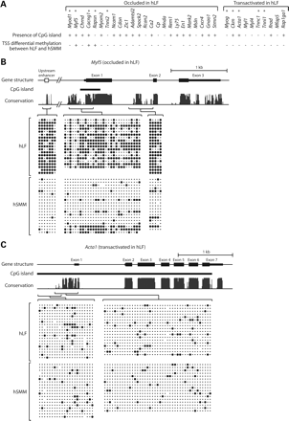
Figure 1. Bisulfite sequencing analysis of DNA methylation. (A) The 25 occluded and 10 transactivated genes in hLF that ...
Notes:
Figure 1. Bisulfite sequencing analysis of DNA methylation. (A) The 25 occluded and 10 transactivated genes in hLF that we uncovered previously (2). The presence or absence of CpG island in each gene is indicated, along with whether transcription start site (TSS) is differentially methylated between hLF and hSMM. (B) DNA methylation pattern of the occluded gene Myf5. (C) DNA methylation pattern of the transactivated gene Acta1. In the schema of gene structure, exons are shown in solid bars with thick bars indicating coding regions and thin bars indicating untranslated regions. Bioinformatically identified CpG islands are indicated. In the conservation graph, the height of peaks reflects the degree of cross-species conservation. Individual amplicons in bisulfite sequencing and their corresponding genomic regions are indicated by brackets. Within each block of bisulfite sequencing data, columns correspond to CpG sites while rows correspond to sequenced clones. Solid circles indicate methylated CpG; dots indicate unmethylated CpG.
Unless provided in the caption above, the following copyright applies to the content of this slide: © 2009 The Author(s)This is an Open Access article distributed under the terms of the Creative Commons Attribution Non-Commercial License (http://creativecommons.org/licenses/by-nc/2.0/uk/) which permits unrestricted non-commercial use, distribution, and reproduction in any medium, provided the original work is properly cited.

Slide 2
Figure 2. Effect of AdC (A) and TSA (B) treatment on occluded genes in hLF. RT–PCR analysis of gene expression is ...
Notes:
Figure 2. Effect of AdC (A) and TSA (B) treatment on occluded genes in hLF. RT–PCR analysis of gene expression is performed on drug-treated hLF without fusion and drug-treated hLF fused to mSMM. hLF, human lung fibroblasts; mSMM, mouse skeletal muscle myoblasts.
Unless provided in the caption above, the following copyright applies to the content of this slide: © 2009 The Author(s)This is an Open Access article distributed under the terms of the Creative Commons Attribution Non-Commercial License (http://creativecommons.org/licenses/by-nc/2.0/uk/) which permits unrestricted non-commercial use, distribution, and reproduction in any medium, provided the original work is properly cited.

Slide 3
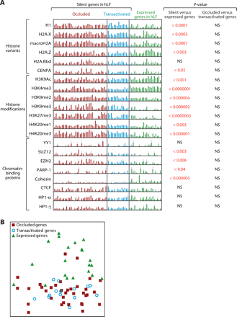
Figure 3. ChIP analysis of 20 chromatin marks in hLF. Genes targeted by the analysis can be divided into silent and ...
Notes:
Figure 3. ChIP analysis of 20 chromatin marks in hLF. Genes targeted by the analysis can be divided into silent and expressed categories, with the silent category further divided into occluded and transactivated groups. (A) PCR quantitation of ChIP for individual genes. Each bar represents a region interrogated by a PCR amplicon. The height of each bar represents fold-enrichment, relative to input, of each gene. P-values are calculated from these data using the t-test and indicate the statistical significance that two groups of genes are distinct for the chromatin mark surveyed. Error bars are based on multiple replicates of the experiment. NS, not significant; hLF, human lung fibroblasts. (B) Principal component analysis of ChIP data across the 20 chromatin marks.
Unless provided in the caption above, the following copyright applies to the content of this slide: © 2009 The Author(s)This is an Open Access article distributed under the terms of the Creative Commons Attribution Non-Commercial License (http://creativecommons.org/licenses/by-nc/2.0/uk/) which permits unrestricted non-commercial use, distribution, and reproduction in any medium, provided the original work is properly cited.

