Slide 1
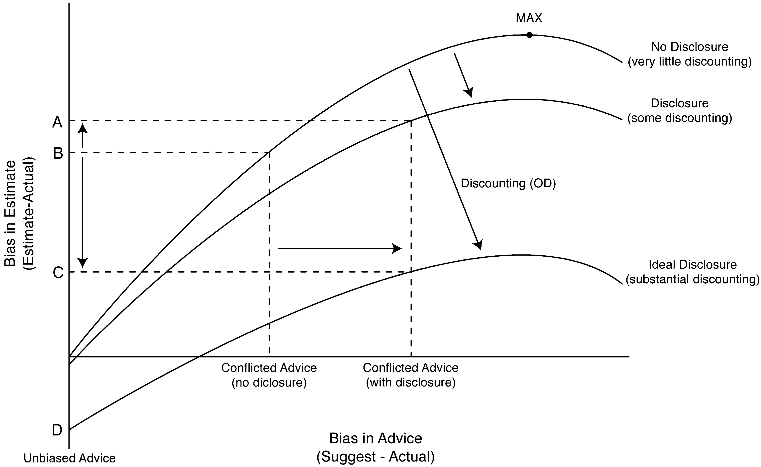
Figure 1. Main Model: The Effects of Disclosure
Notes:
Figure 1. Main Model: The Effects of Disclosure
Unless provided in the caption above, the following copyright applies to the content of this slide: © 2010 by JOURNAL OF CONSUMER RESEARCH, Inc.

Slide 2
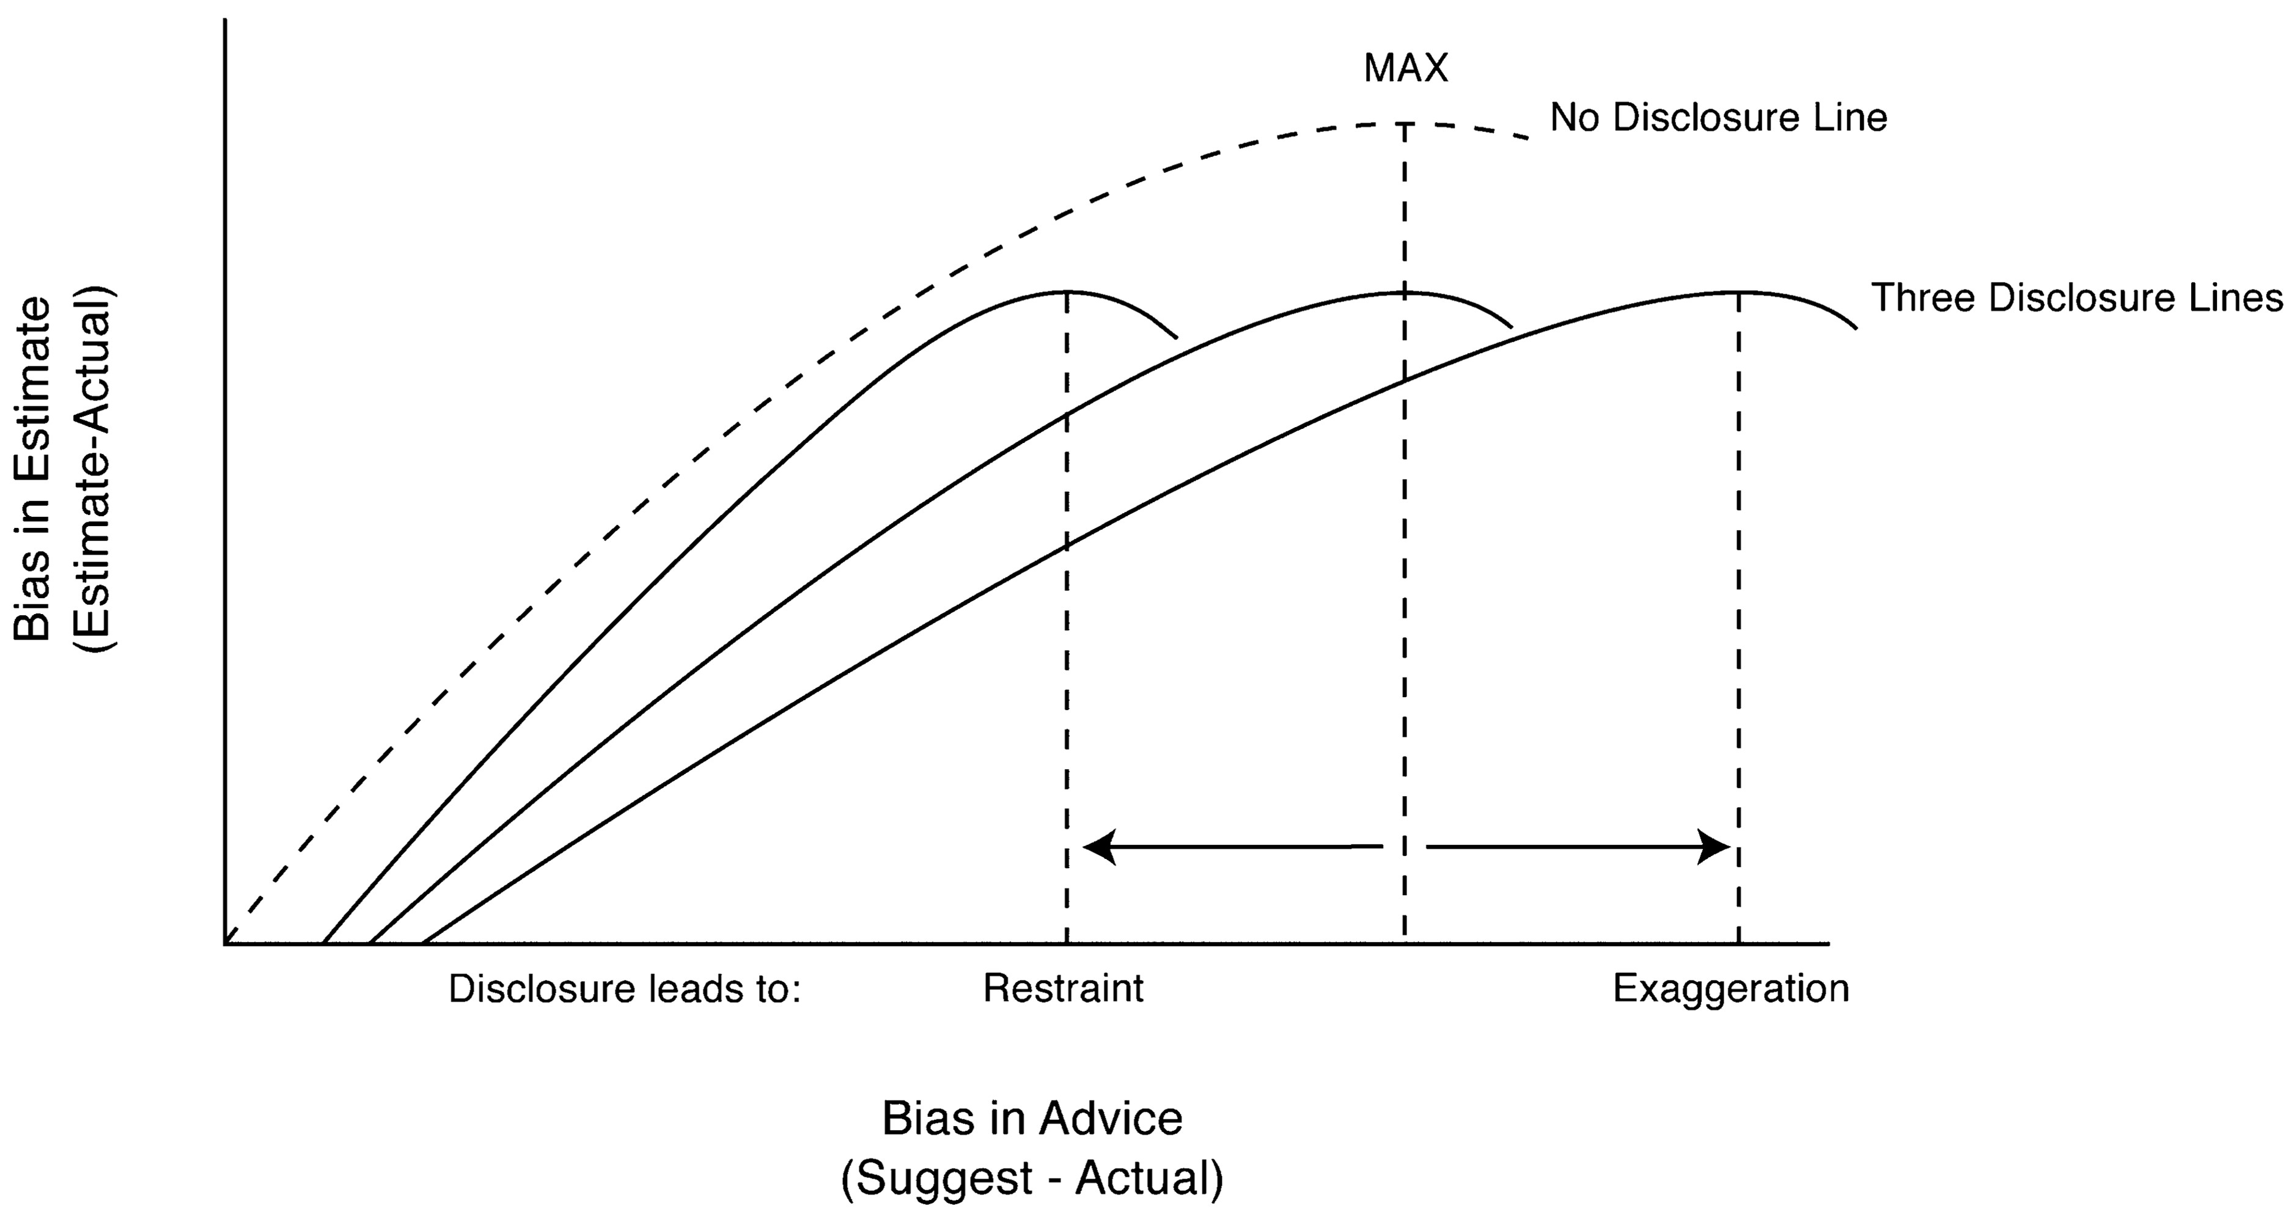
Figure 2. Strategic Restraint and Strategic Exaggeration
Notes:
Figure 2. Strategic Restraint and Strategic Exaggeration
Unless provided in the caption above, the following copyright applies to the content of this slide: © 2010 by JOURNAL OF CONSUMER RESEARCH, Inc.

Slide 3
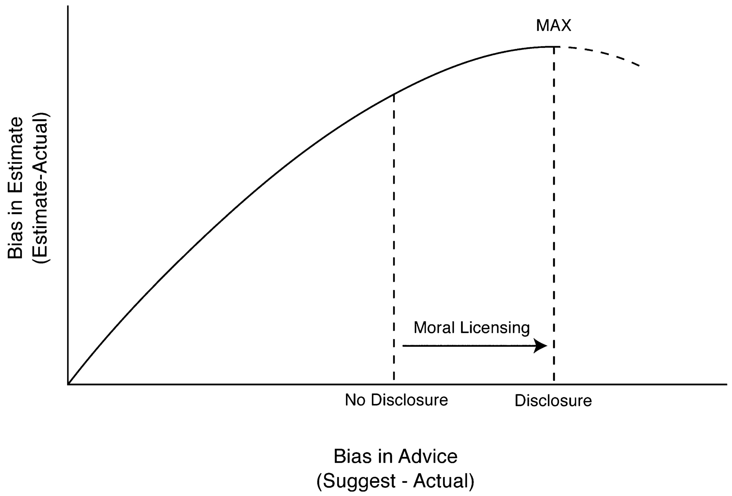
Figure 3. Moral Licensing
Notes:
Figure 3. Moral Licensing
Unless provided in the caption above, the following copyright applies to the content of this slide: © 2010 by JOURNAL OF CONSUMER RESEARCH, Inc.

Slide 4
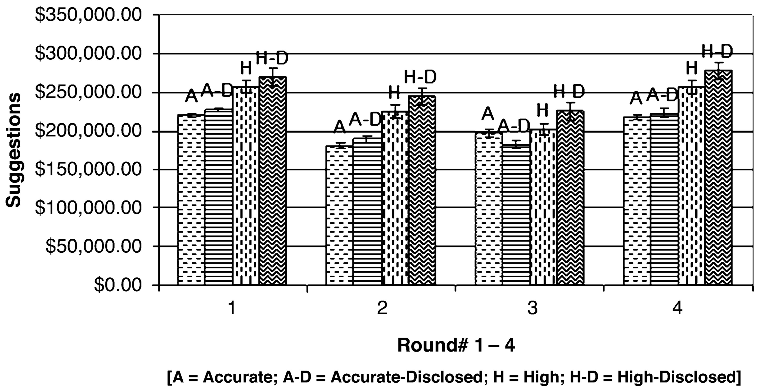
Figure 4. Study 3: Advisors’ Suggestions across Conditions and across Rounds
Notes:
Figure 4. Study 3: Advisors’ Suggestions across Conditions and across Rounds
Unless provided in the caption above, the following copyright applies to the content of this slide: © 2010 by JOURNAL OF CONSUMER RESEARCH, Inc.

Slide 5
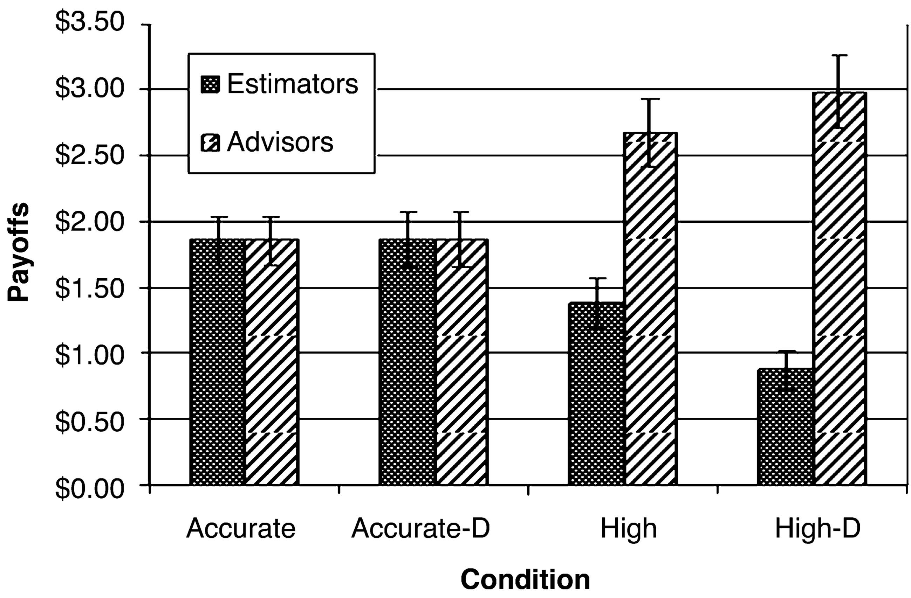
Figure 5. Study 3: Payoffs for the Two Roles in the Four Experimental Conditions
Notes:
Figure 5. Study 3: Payoffs for the Two Roles in the Four Experimental Conditions
Unless provided in the caption above, the following copyright applies to the content of this slide: © 2010 by JOURNAL OF CONSUMER RESEARCH, Inc.

Slide 6
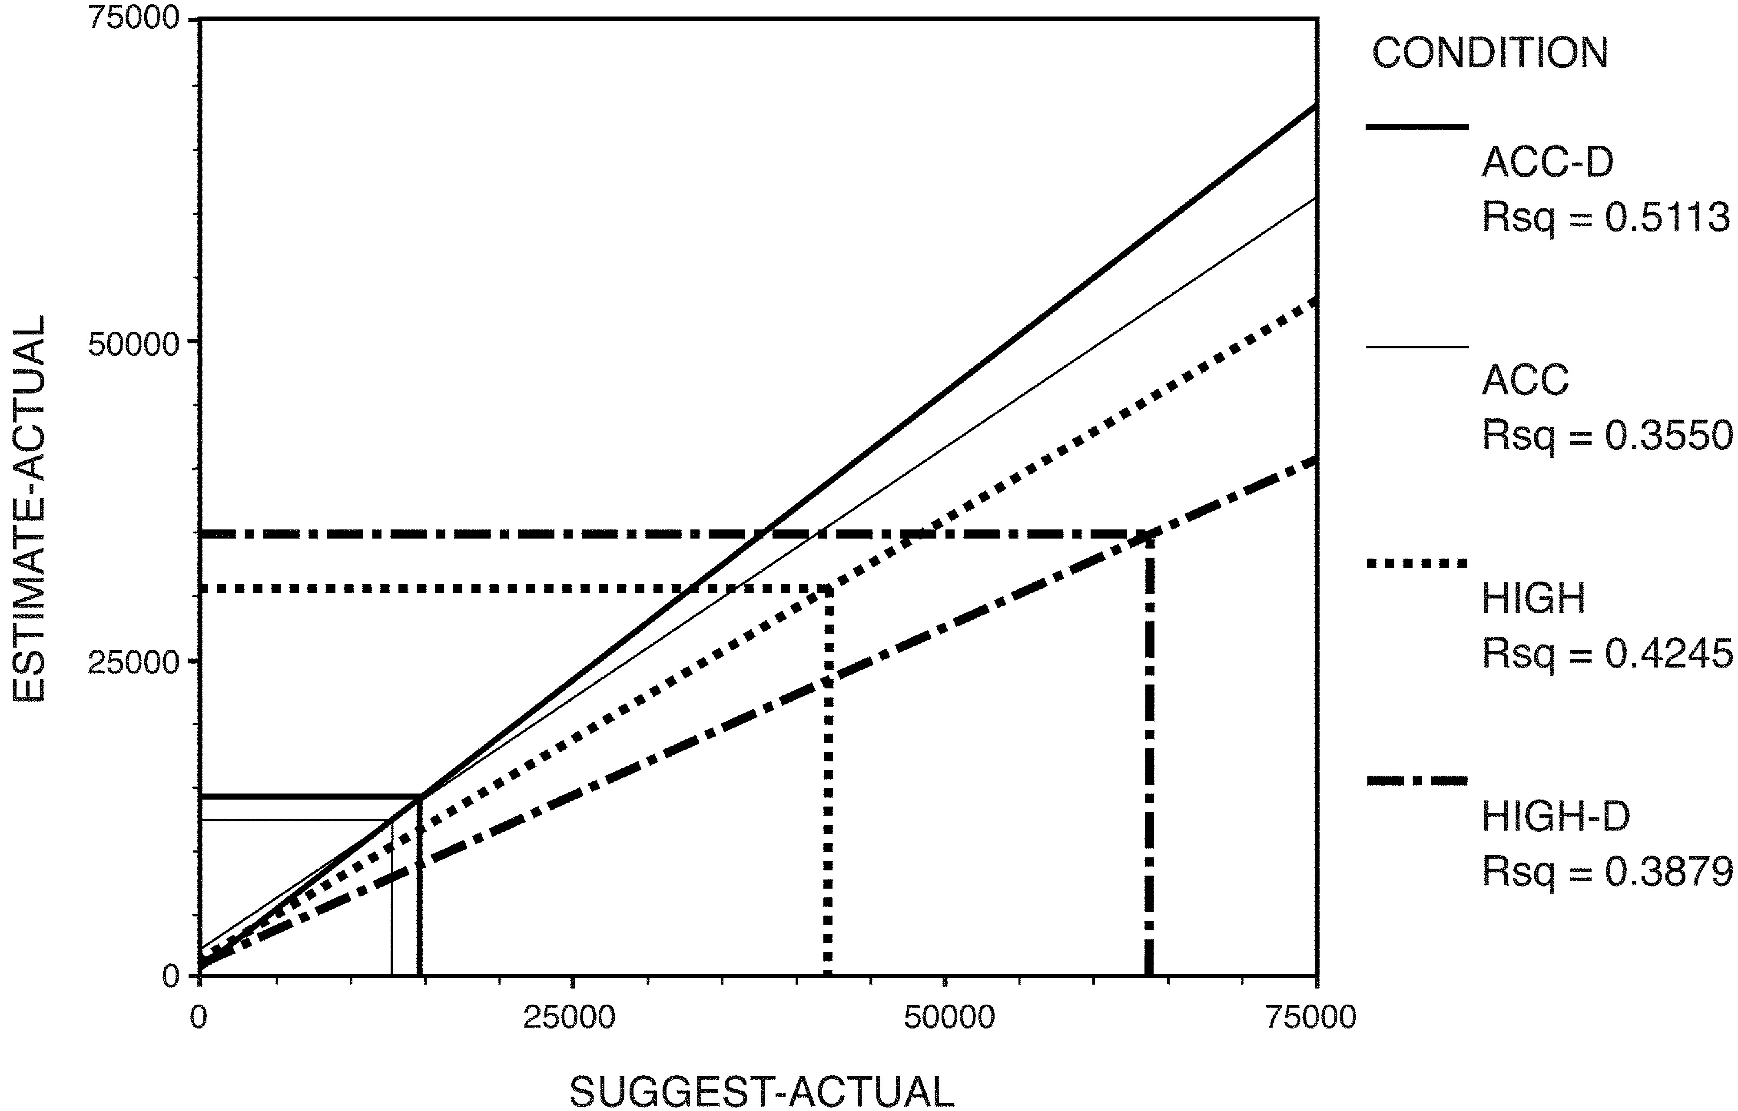
Figure 6. Study 3: Overall Summary of Findings
Notes:
Figure 6. Study 3: Overall Summary of Findings
Unless provided in the caption above, the following copyright applies to the content of this slide: © 2010 by JOURNAL OF CONSUMER RESEARCH, Inc.

Slide 7
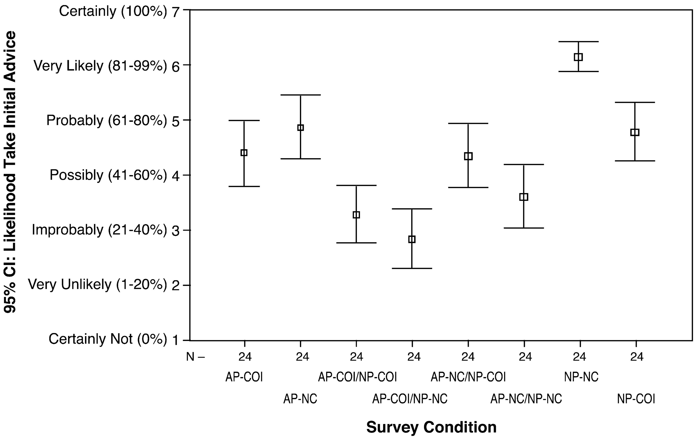
Figure 7. Study 4: Survey, Overall Findings
Notes:
Figure 7. Study 4: Survey, Overall Findings
Unless provided in the caption above, the following copyright applies to the content of this slide: © 2010 by JOURNAL OF CONSUMER RESEARCH, Inc.

Slide 8
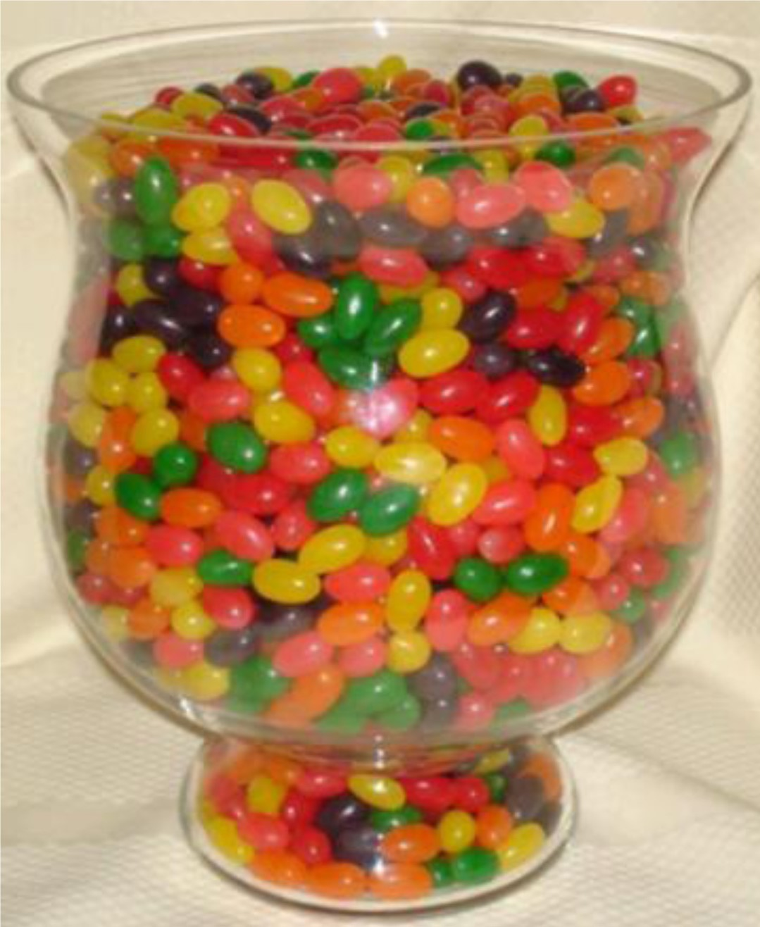
Figure A1. Image presented to the estimator in study 1
Notes:
Figure A1. Image presented to the estimator in study 1
Unless provided in the caption above, the following copyright applies to the content of this slide: © 2010 by JOURNAL OF CONSUMER RESEARCH, Inc.

Slide 9
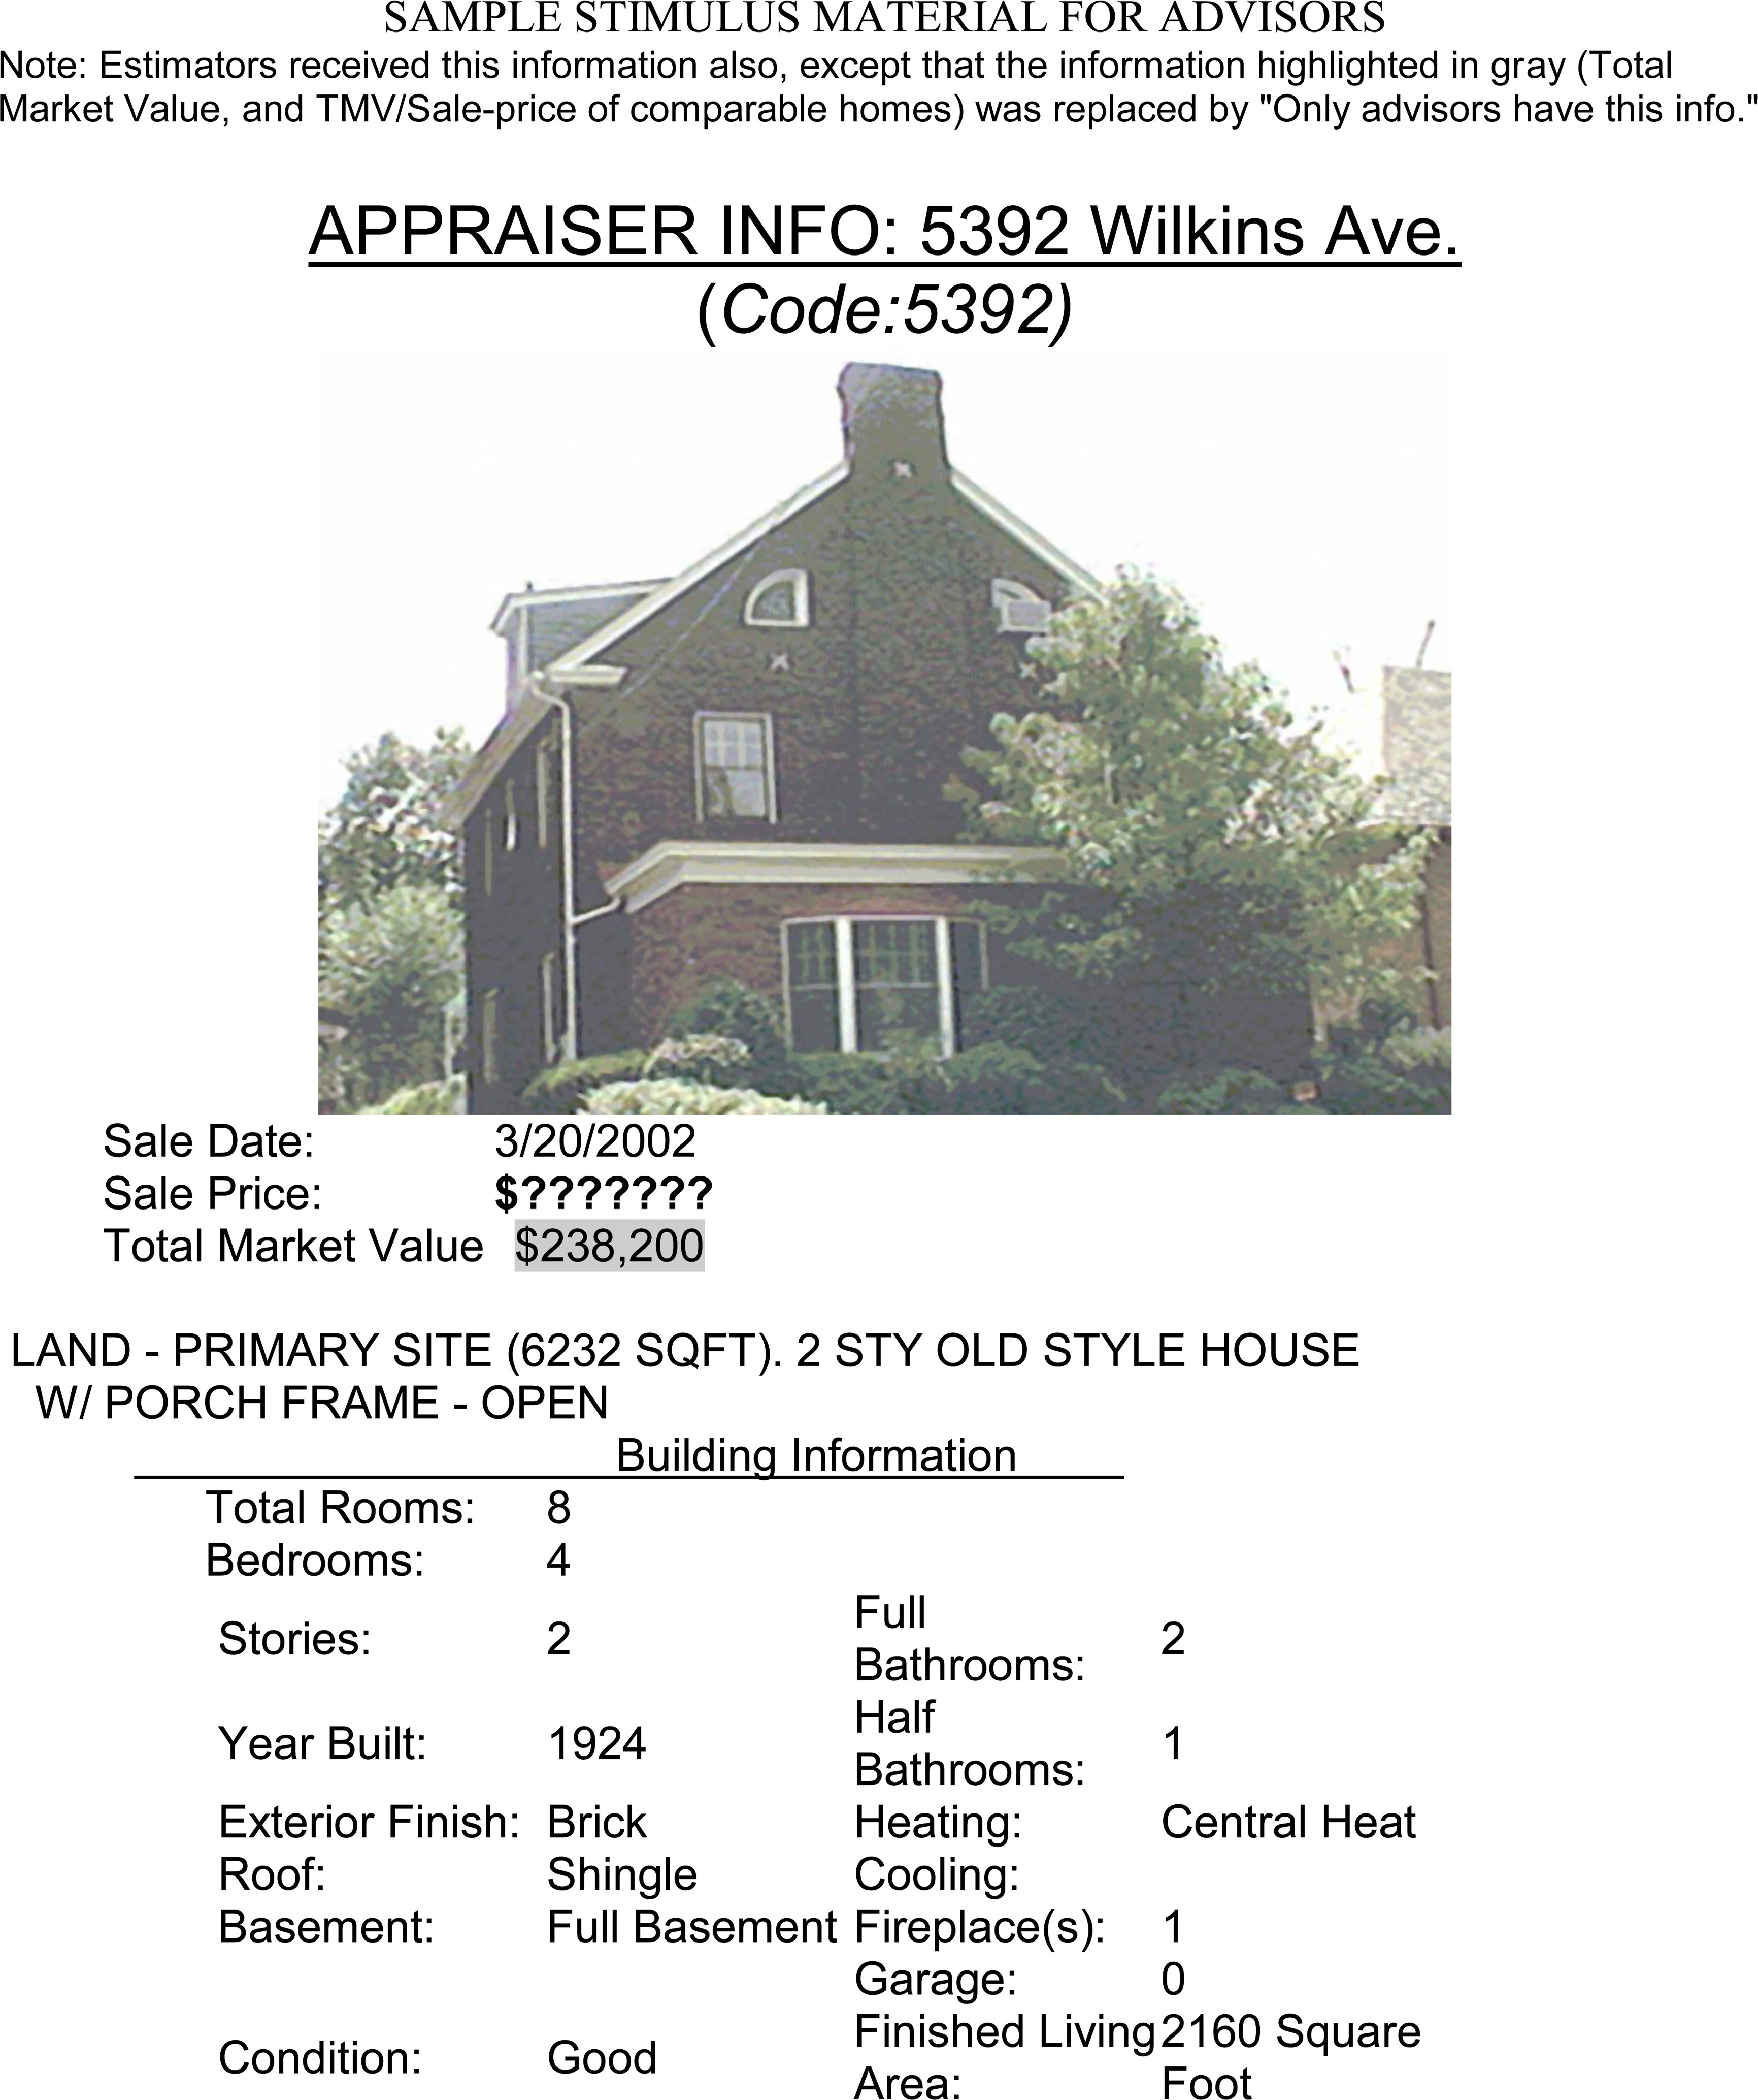
Figure B1.
Notes:
Figure B1.
Unless provided in the caption above, the following copyright applies to the content of this slide: © 2010 by JOURNAL OF CONSUMER RESEARCH, Inc.

Slide 10
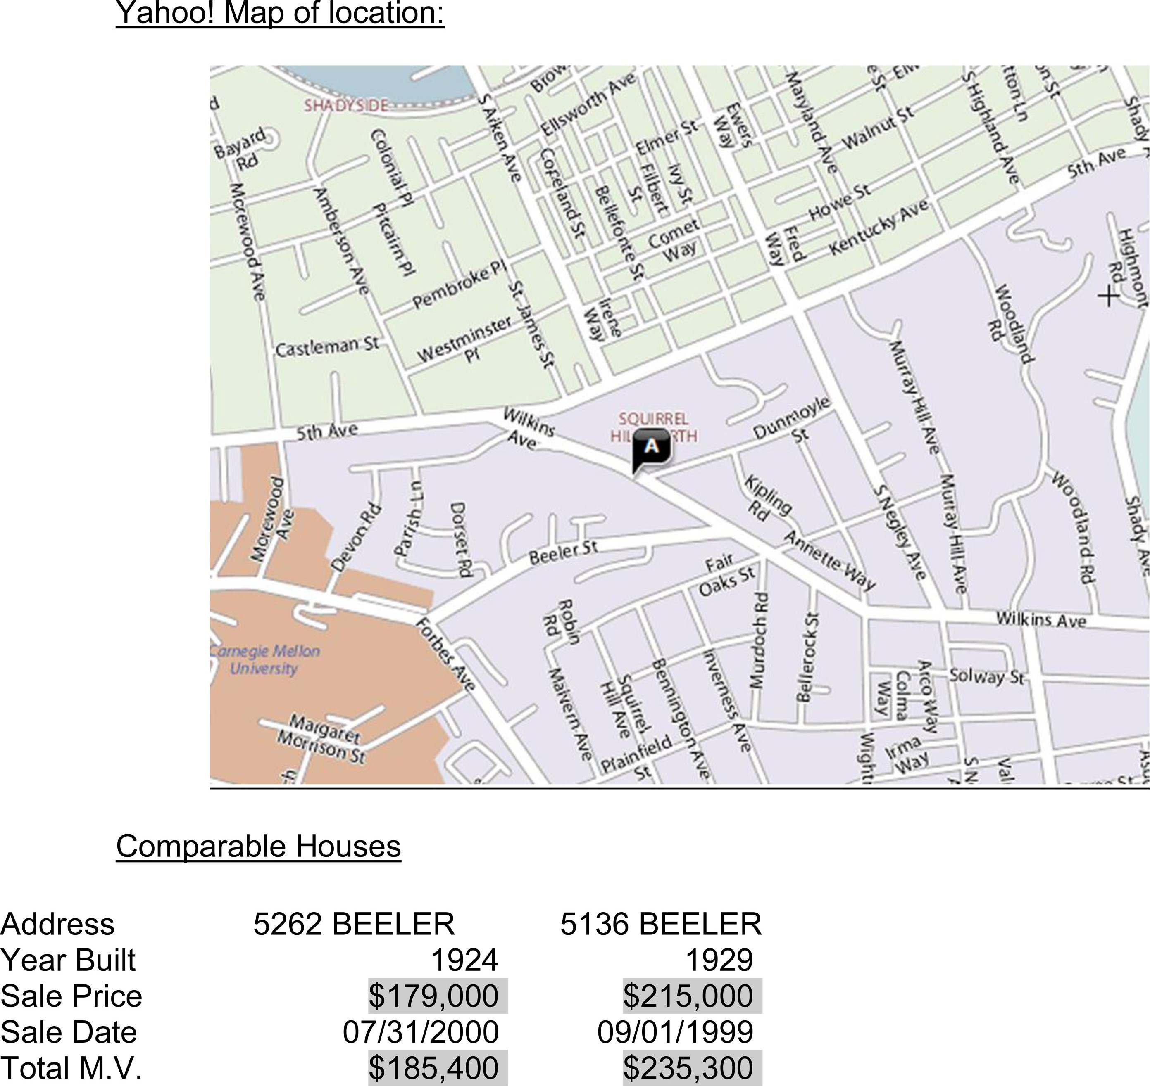
Figure B2.
Notes:
Figure B2.
Unless provided in the caption above, the following copyright applies to the content of this slide: © 2010 by JOURNAL OF CONSUMER RESEARCH, Inc.

Slide 11
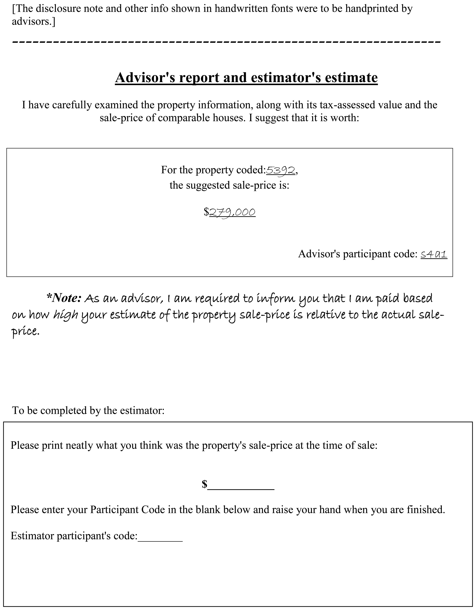
Figure C1.
Notes:
Figure C1.
Unless provided in the caption above, the following copyright applies to the content of this slide: © 2010 by JOURNAL OF CONSUMER RESEARCH, Inc.

