Slide 1
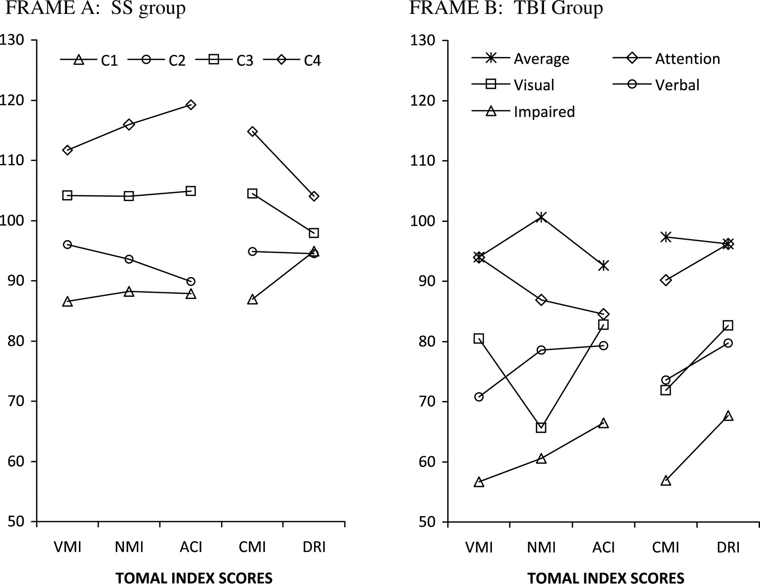
Fig. 1. Cluster profiles of TOMAL Indexes for the standardization sample group four-cluster solution (Frame A), and ...
Notes:
Fig. 1. Cluster profiles of TOMAL Indexes for the standardization sample group four-cluster solution (Frame A), and TBI group five-cluster solution (Frame B). Frame A: SS group; Frame B: TBI group. VMI = Verbal Memory Index; NMI = Non-verbal Memory Index; ACI = Attention/Concentration Index; CMI = Composite Memory Index; DRI = Delayed Memory Index.
Unless provided in the caption above, the following copyright applies to the content of this slide: © The Author 2010. Published by Oxford University Press. All rights reserved. For permissions, please e-mail: journals.permissions@oxfordjournals.org.

