Slide 1
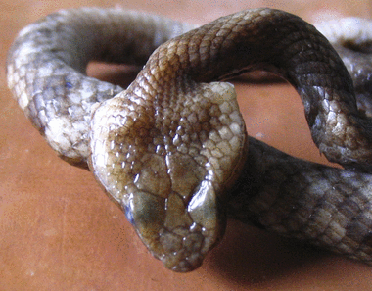
Figure 1 Specimen 4, Hypnale hypnale, showing the five large scales (plates) on the top of the head.
Notes:
Figure 1 Specimen 4, Hypnale hypnale, showing the five large scales (plates) on the top of the head.
Unless provided in the caption above, the following copyright applies to the content of this slide: © Royal Society of Tropical Medicine and Hygiene 2006

Slide 2
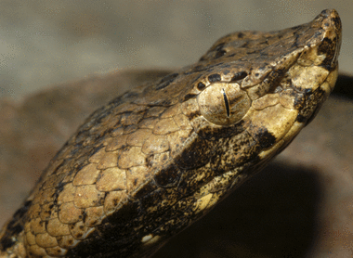
Figure 2 Hump-nosed pit viper (Hypnale hypnale), Thattekaad Bird Reserve, Periya River, Kerala, India, showing ...
Notes:
Figure 2 Hump-nosed pit viper (Hypnale hypnale), Thattekaad Bird Reserve, Periya River, Kerala, India, showing upturned snout and loreal pit between eye and nostril.
Unless provided in the caption above, the following copyright applies to the content of this slide: © Royal Society of Tropical Medicine and Hygiene 2006

Slide 3
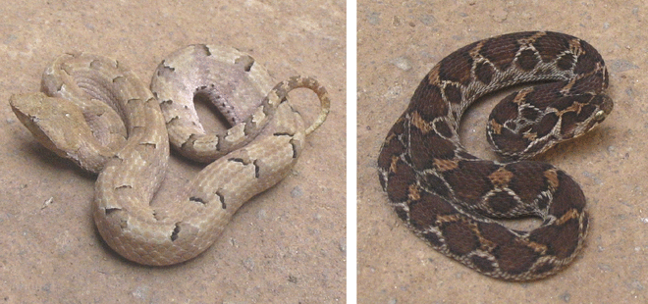
Figure 3 Hypnale hypnale (left) and Echis carinatus (right).
Notes:
Figure 3 Hypnale hypnale (left) and Echis carinatus (right).
Unless provided in the caption above, the following copyright applies to the content of this slide: © Royal Society of Tropical Medicine and Hygiene 2006

Slide 4
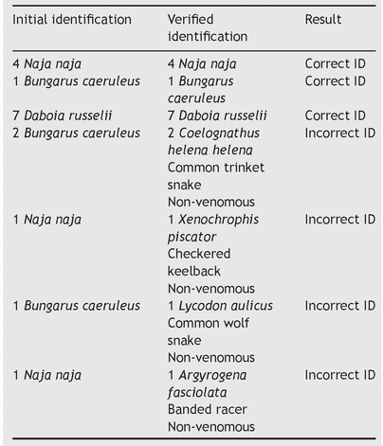
Table 1 Little Flower Hospital, Angamaly: other snakes brought by snake-bitten patients
Notes:
Table 1 Little Flower Hospital, Angamaly: other snakes brought by snake-bitten patients
Unless provided in the caption above, the following copyright applies to the content of this slide: © Royal Society of Tropical Medicine and Hygiene 2006

Slide 5
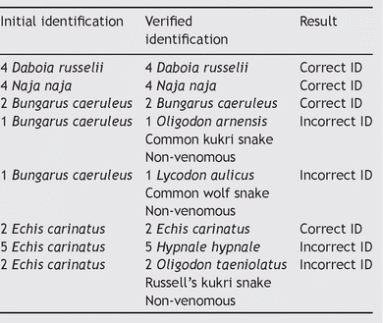
Table 2 Jubilee Mission Hospital, Thrissur: venomous species brought by snake-bitten patients
Notes:
Table 2 Jubilee Mission Hospital, Thrissur: venomous species brought by snake-bitten patients
Unless provided in the caption above, the following copyright applies to the content of this slide: © Royal Society of Tropical Medicine and Hygiene 2006

Slide 6
Table 3 Little Flower Hospital, Angamaly: details of unknown vipers finally verified to be hump-nosed pit vipers ...
Notes:
Table 3 Little Flower Hospital, Angamaly: details of unknown vipers finally verified to be hump-nosed pit vipers (Hypnale hypnale)
Unless provided in the caption above, the following copyright applies to the content of this slide: © Royal Society of Tropical Medicine and Hygiene 2006

