Slide 1
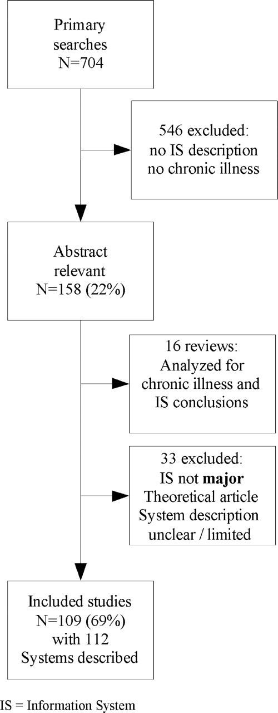
Figure 1 Article selection process.
Notes:
Figure 1 Article selection process.
Unless provided in the caption above, the following copyright applies to the content of this slide: American Medical Informatics Association

Slide 2
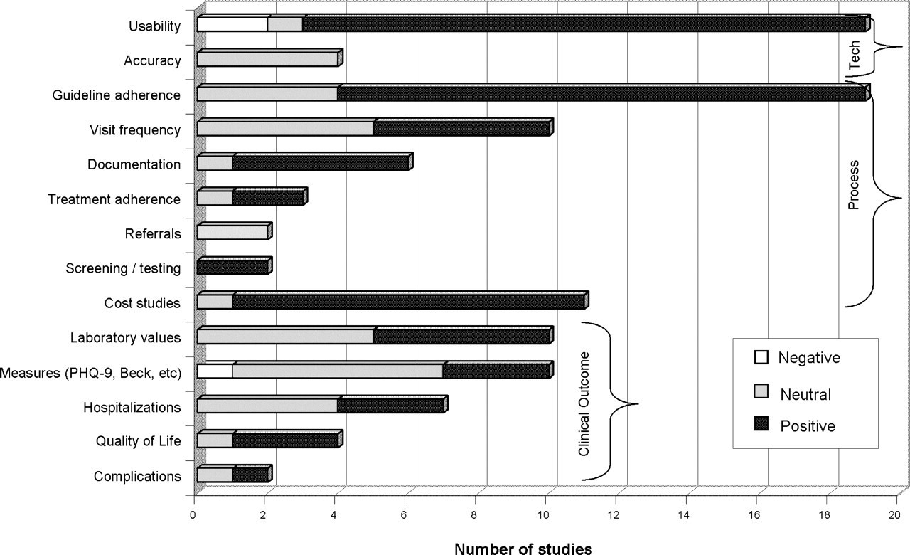
Figure 2 Results of technological, process, and clinical outcomes measures in 50 experimental studies of information ...
Notes:
Figure 2 Results of technological, process, and clinical outcomes measures in 50 experimental studies of information technology used for care of chronic disease.
Unless provided in the caption above, the following copyright applies to the content of this slide: American Medical Informatics Association

Slide 3
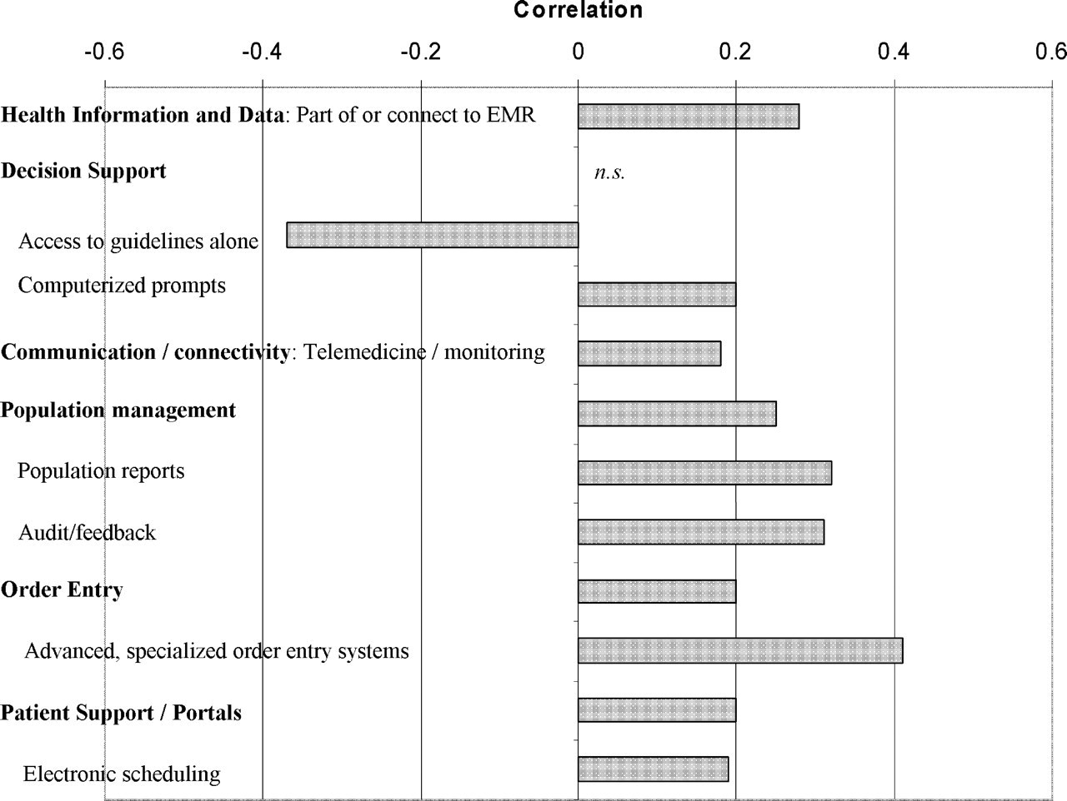
Figure 3 Correlation between presence of information system components and process and outcome measure changes (Base = ...
Notes:
Figure 3 Correlation between presence of information system components and process and outcome measure changes (Base = 112 system descriptions). n.s. = not significant.
Unless provided in the caption above, the following copyright applies to the content of this slide: American Medical Informatics Association

