Slide 1
Figure 1. Schematic diagram of the Risky-Gains task.
Notes:
Figure 1. Schematic diagram of the Risky-Gains task.
Unless provided in the caption above, the following copyright applies to the content of this slide: © 2008 The AuthorsThis is an Open Access article distributed under the terms of the Creative Commons Attribution Non-Commercial License (http://creativecommons.org/licenses/by-nc/2.0/uk/) which permits unrestricted non-commercial use, distribution, and reproduction in any medium, provided the original work is properly cited.

Slide 2
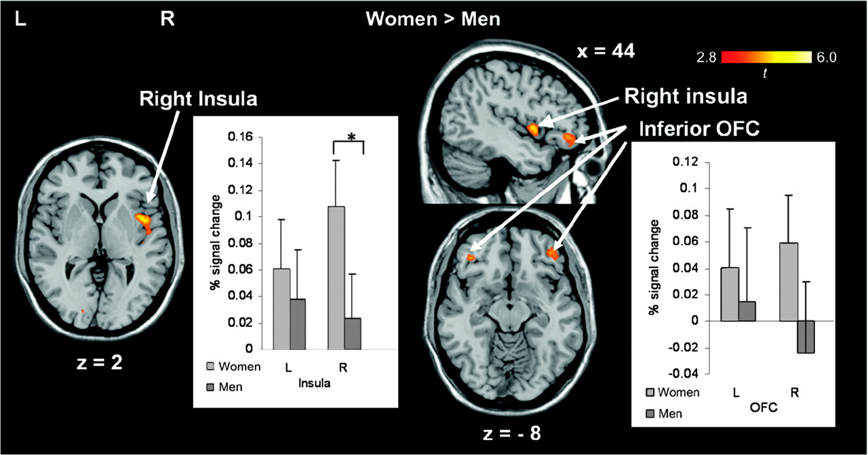
Figure 2. Results of the ROI analyses. The activation map shows the activation in the predefined regions, the insula ...
Notes:
Figure 2. Results of the ROI analyses. The activation map shows the activation in the predefined regions, the insula and the OFC, on a standard template, and the bar charts show the plot of percent signal change for the risky versus safe-response contrast in female and male participants. No significantly stronger activation was revealed for the male participants than for the female participants. Right (R) is right. L = left hemisphere; R = right hemisphere; x, y, z in Montreal Neurological Institute coordinates. Error bars show standard error of means.
Unless provided in the caption above, the following copyright applies to the content of this slide: © 2008 The AuthorsThis is an Open Access article distributed under the terms of the Creative Commons Attribution Non-Commercial License (http://creativecommons.org/licenses/by-nc/2.0/uk/) which permits unrestricted non-commercial use, distribution, and reproduction in any medium, provided the original work is properly cited.

Slide 3
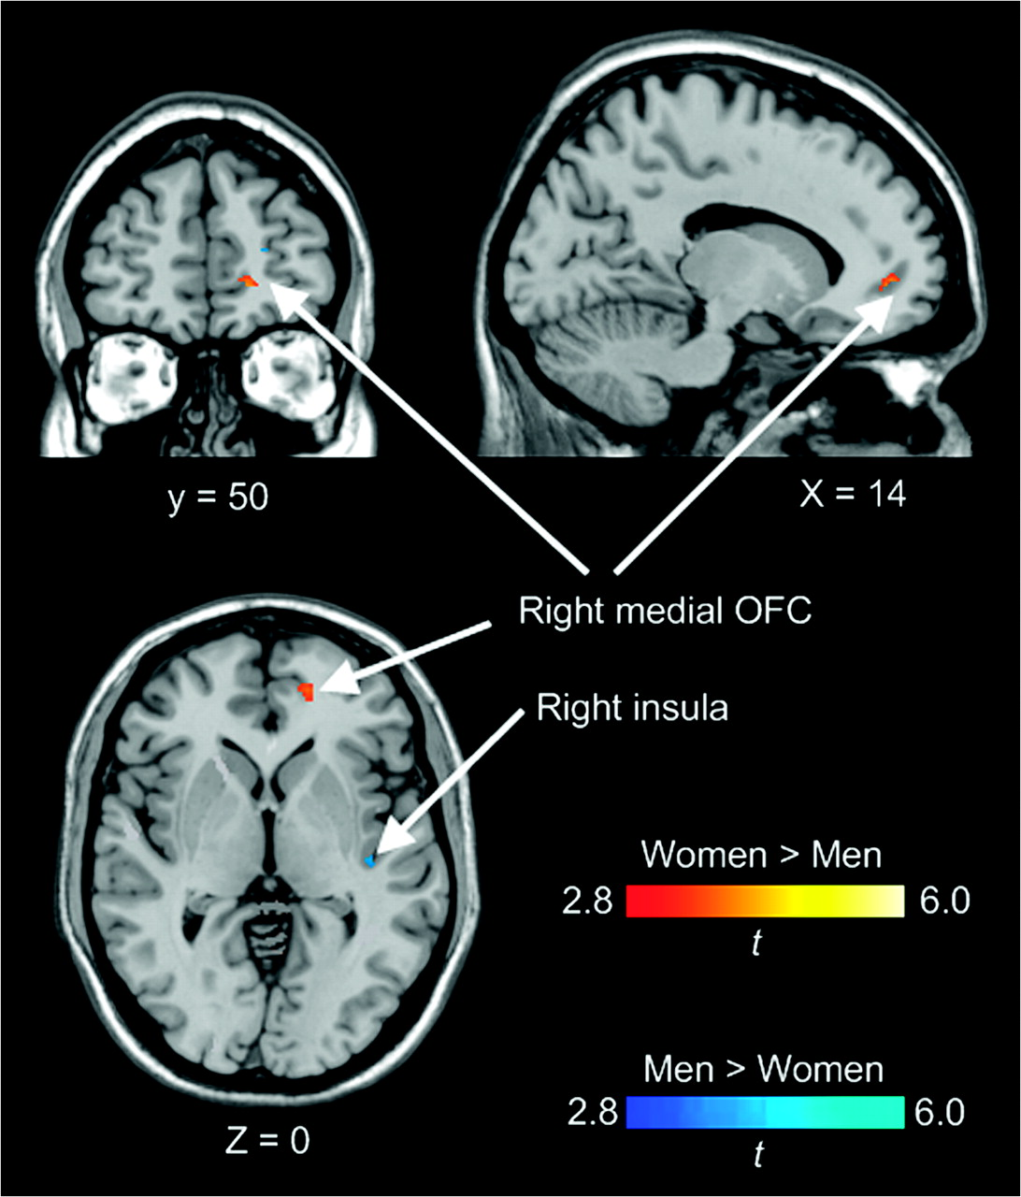
Figure 3. Results of the ROI analyses comparing activations in the insula and the OFC between female and male ...
Notes:
Figure 3. Results of the ROI analyses comparing activations in the insula and the OFC between female and male participants. x, y, z in Montreal Neurological Institute coordinates.
Unless provided in the caption above, the following copyright applies to the content of this slide: © 2008 The AuthorsThis is an Open Access article distributed under the terms of the Creative Commons Attribution Non-Commercial License (http://creativecommons.org/licenses/by-nc/2.0/uk/) which permits unrestricted non-commercial use, distribution, and reproduction in any medium, provided the original work is properly cited.

Slide 4
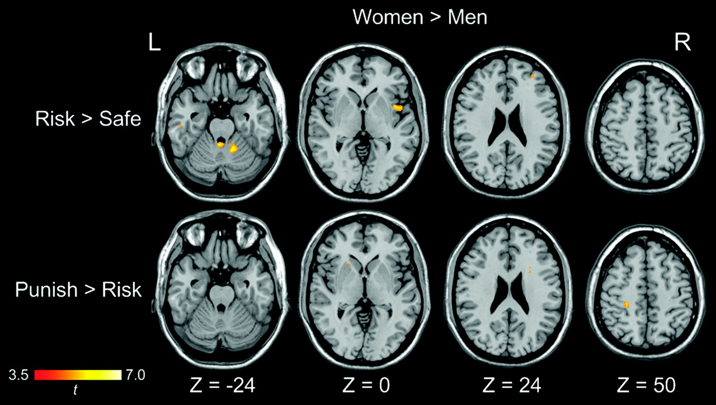
Figure 4. Whole-brain analysis comparing sex effects on risky versus safe-response contrast and punishment feedback ...
Notes:
Figure 4. Whole-brain analysis comparing sex effects on risky versus safe-response contrast and punishment feedback versus risky-response contrast at a voxel-wise intensity threshold of P < 0.001 corrected at a cluster level of 10 voxels. No significantly stronger activation was revealed for the male participants than for the female participants. L = left hemisphere; R = right hemisphere; x, y, z in Montreal Neurological Institute coordinates.
Unless provided in the caption above, the following copyright applies to the content of this slide: © 2008 The AuthorsThis is an Open Access article distributed under the terms of the Creative Commons Attribution Non-Commercial License (http://creativecommons.org/licenses/by-nc/2.0/uk/) which permits unrestricted non-commercial use, distribution, and reproduction in any medium, provided the original work is properly cited.

Slide 5
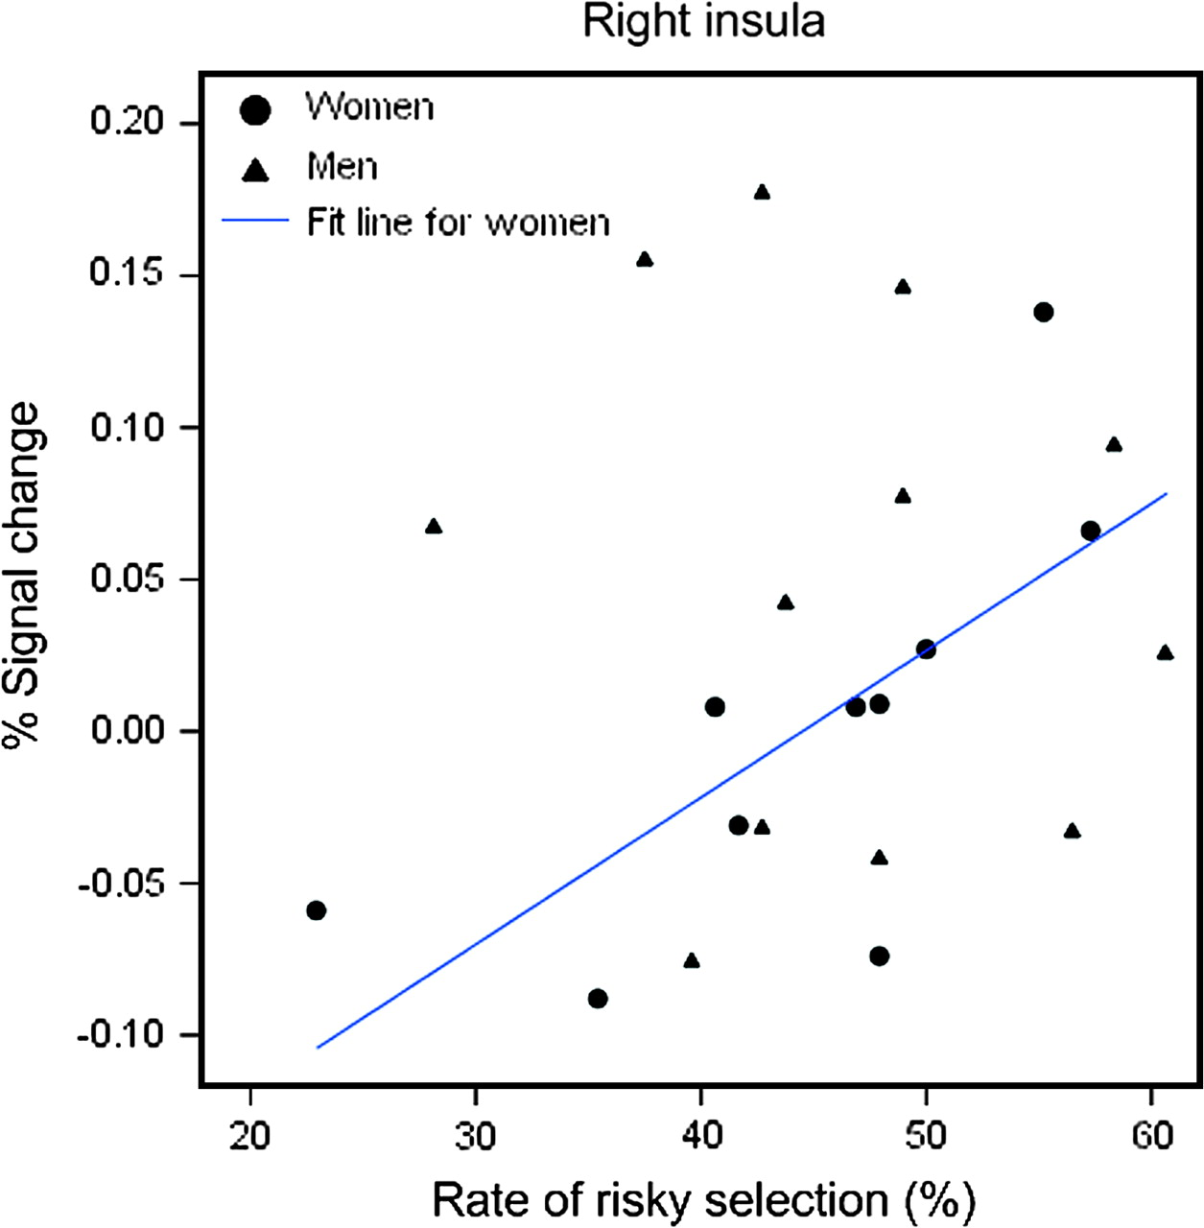
Figure 5. Scatter plot between the rate of risky responses and percent signal change in the right insula.
Notes:
Figure 5. Scatter plot between the rate of risky responses and percent signal change in the right insula.
Unless provided in the caption above, the following copyright applies to the content of this slide: © 2008 The AuthorsThis is an Open Access article distributed under the terms of the Creative Commons Attribution Non-Commercial License (http://creativecommons.org/licenses/by-nc/2.0/uk/) which permits unrestricted non-commercial use, distribution, and reproduction in any medium, provided the original work is properly cited.

Slide 6
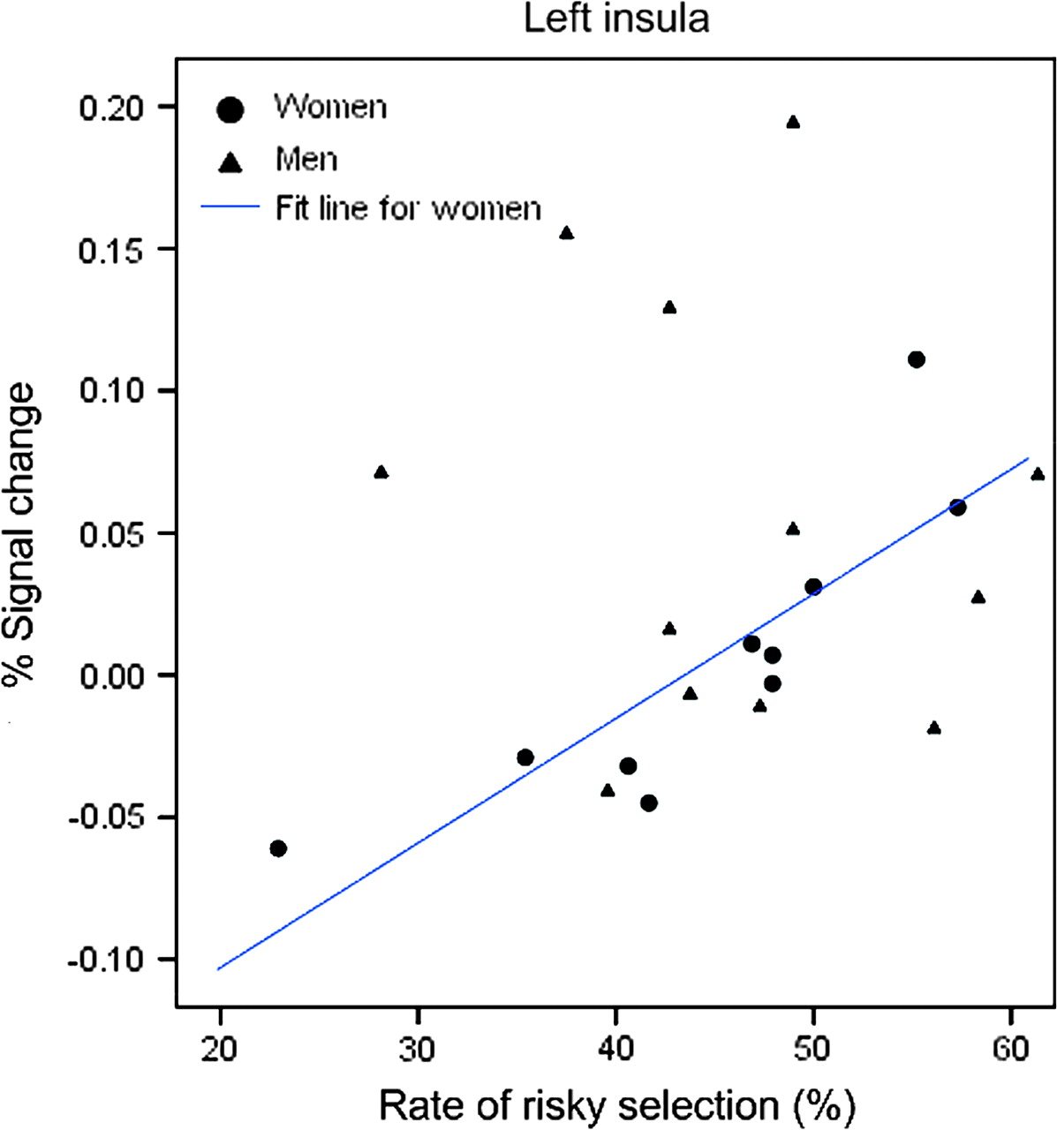
Figure 6. Scatter plot between the rate of risky responses and percent signal change in the left insula.
Notes:
Figure 6. Scatter plot between the rate of risky responses and percent signal change in the left insula.
Unless provided in the caption above, the following copyright applies to the content of this slide: © 2008 The AuthorsThis is an Open Access article distributed under the terms of the Creative Commons Attribution Non-Commercial License (http://creativecommons.org/licenses/by-nc/2.0/uk/) which permits unrestricted non-commercial use, distribution, and reproduction in any medium, provided the original work is properly cited.

Slide 7
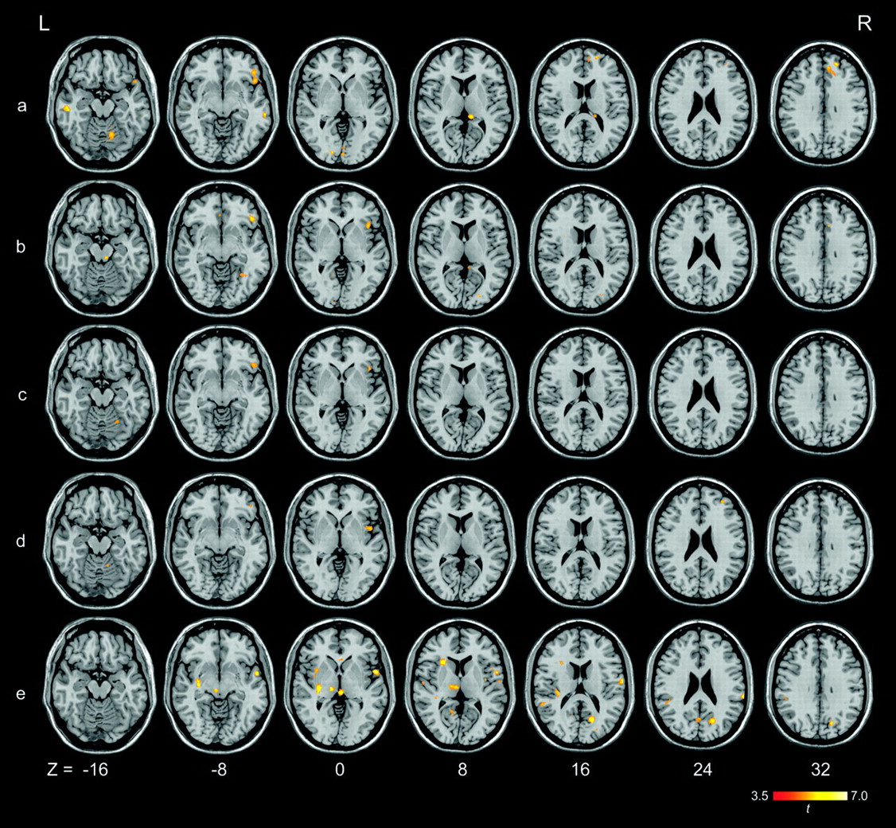
Figure 7. Whole-brain analysis showing stronger brain activation in the female participants than in the male ...
Notes:
Figure 7. Whole-brain analysis showing stronger brain activation in the female participants than in the male participants on a) punished-then-risky versus safe responses; b) punished-then-risky versus safe-then-risky responses; c) punished-then-risky versus risky-then-risky responses; d) risky-then-risky versus safe responses; and e) risky-then-risky versus safe-then-risky responses at a voxel-wise intensity threshold of P < 0.001 corrected at a cluster level of 10 voxels. L = left hemisphere; R = right hemisphere; x, y, z in Montreal Neurological Institute coordinates.
Unless provided in the caption above, the following copyright applies to the content of this slide: © 2008 The AuthorsThis is an Open Access article distributed under the terms of the Creative Commons Attribution Non-Commercial License (http://creativecommons.org/licenses/by-nc/2.0/uk/) which permits unrestricted non-commercial use, distribution, and reproduction in any medium, provided the original work is properly cited.

Slide 8
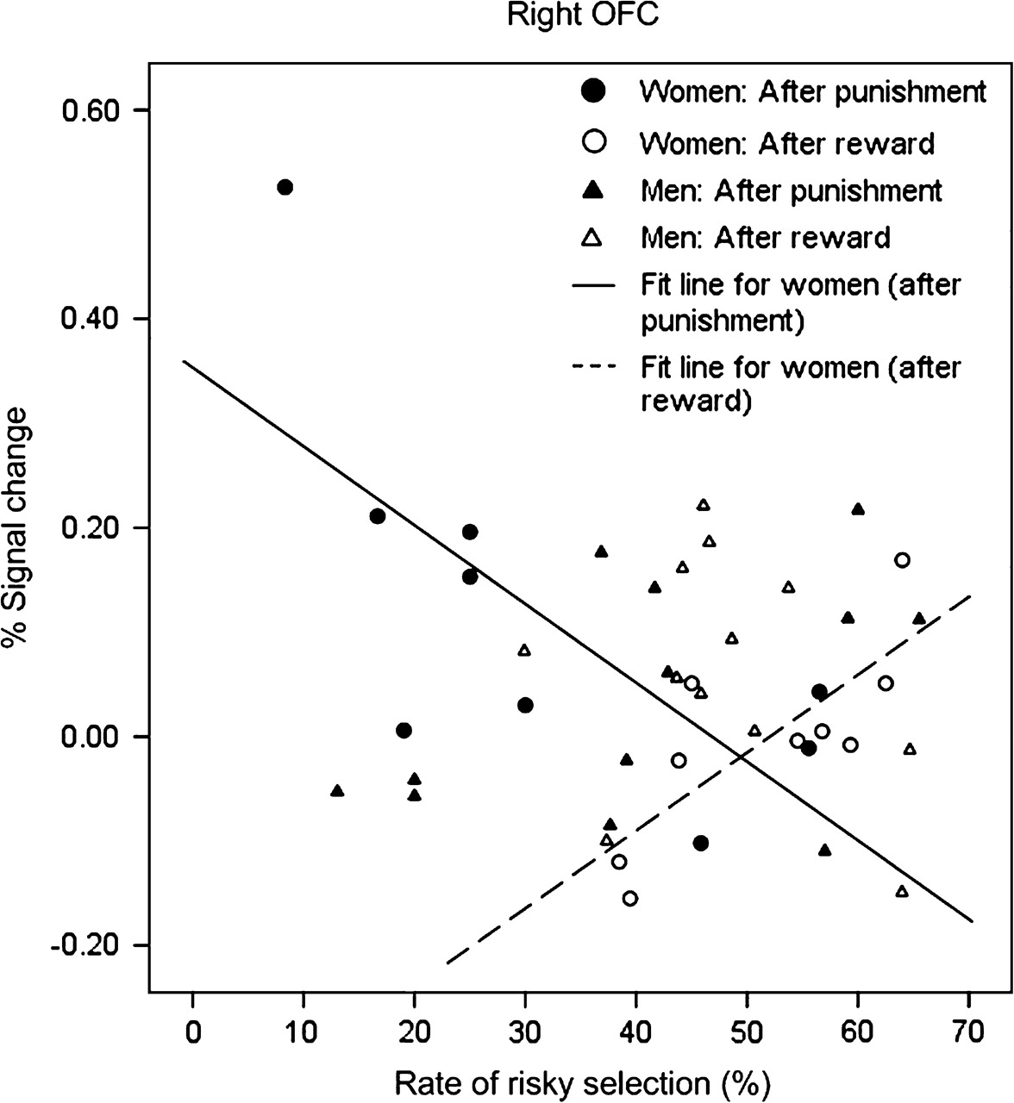
Figure 8. Scatter plot between the rate of risky responses after receiving punishment feedback (i.e., ...
Notes:
Figure 8. Scatter plot between the rate of risky responses after receiving punishment feedback (i.e., punished-then-risky response) and its percent signal change in the right OFC.
Unless provided in the caption above, the following copyright applies to the content of this slide: © 2008 The AuthorsThis is an Open Access article distributed under the terms of the Creative Commons Attribution Non-Commercial License (http://creativecommons.org/licenses/by-nc/2.0/uk/) which permits unrestricted non-commercial use, distribution, and reproduction in any medium, provided the original work is properly cited.

Slide 9
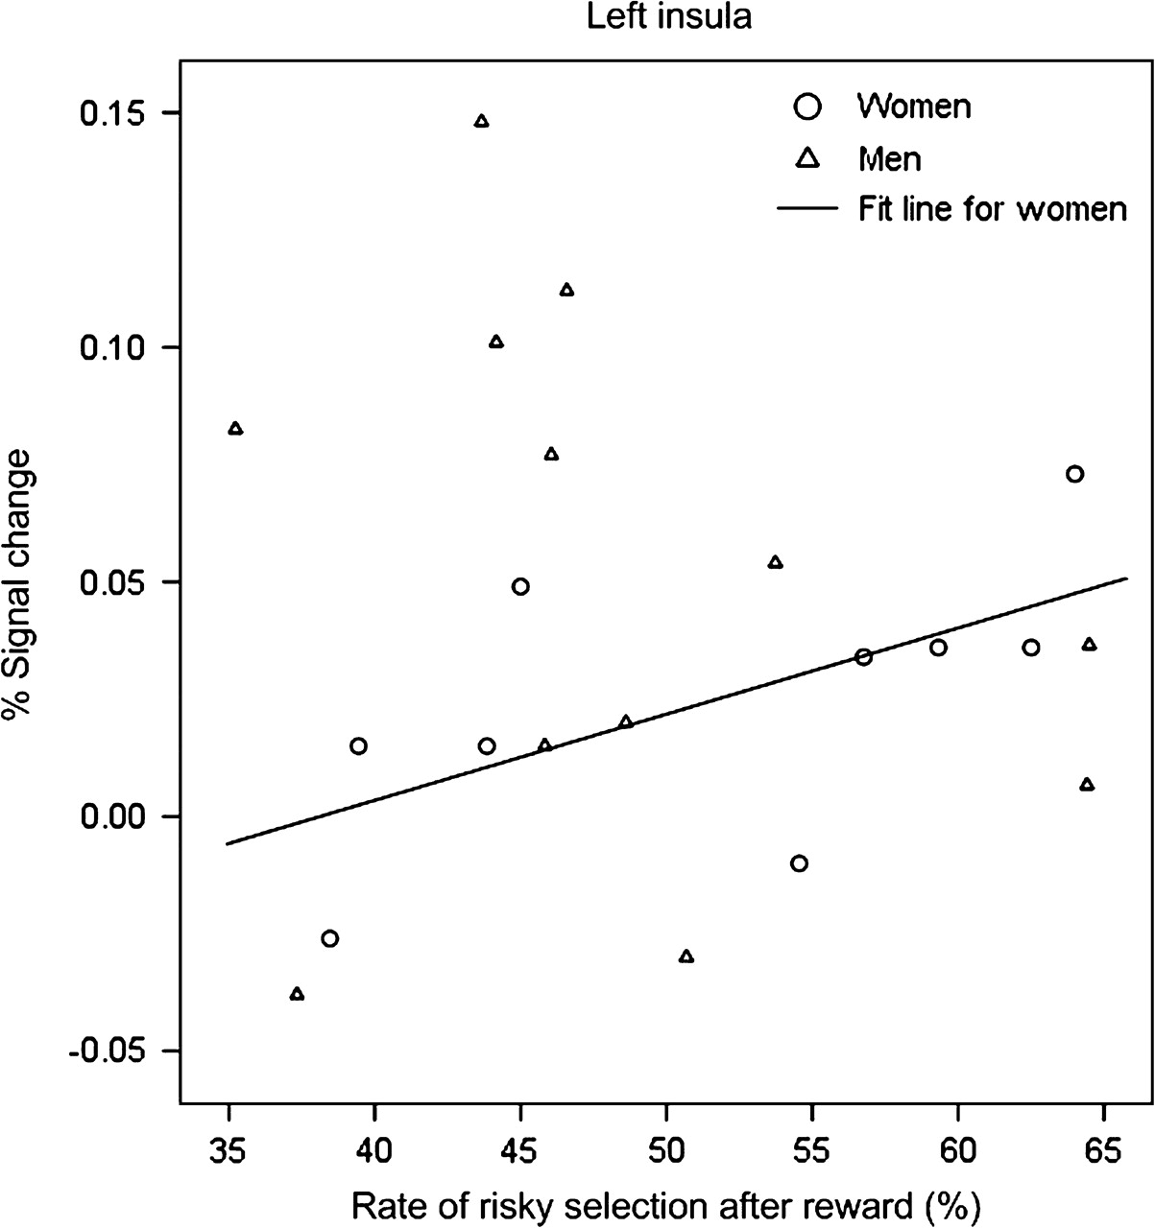
Figure 9. Scatter plot between the rate of risky responses after making a risky response (i.e., risky-then-risky ...
Notes:
Figure 9. Scatter plot between the rate of risky responses after making a risky response (i.e., risky-then-risky response) and its percent signal change in the left insula.
Unless provided in the caption above, the following copyright applies to the content of this slide: © 2008 The AuthorsThis is an Open Access article distributed under the terms of the Creative Commons Attribution Non-Commercial License (http://creativecommons.org/licenses/by-nc/2.0/uk/) which permits unrestricted non-commercial use, distribution, and reproduction in any medium, provided the original work is properly cited.

