Slide 1
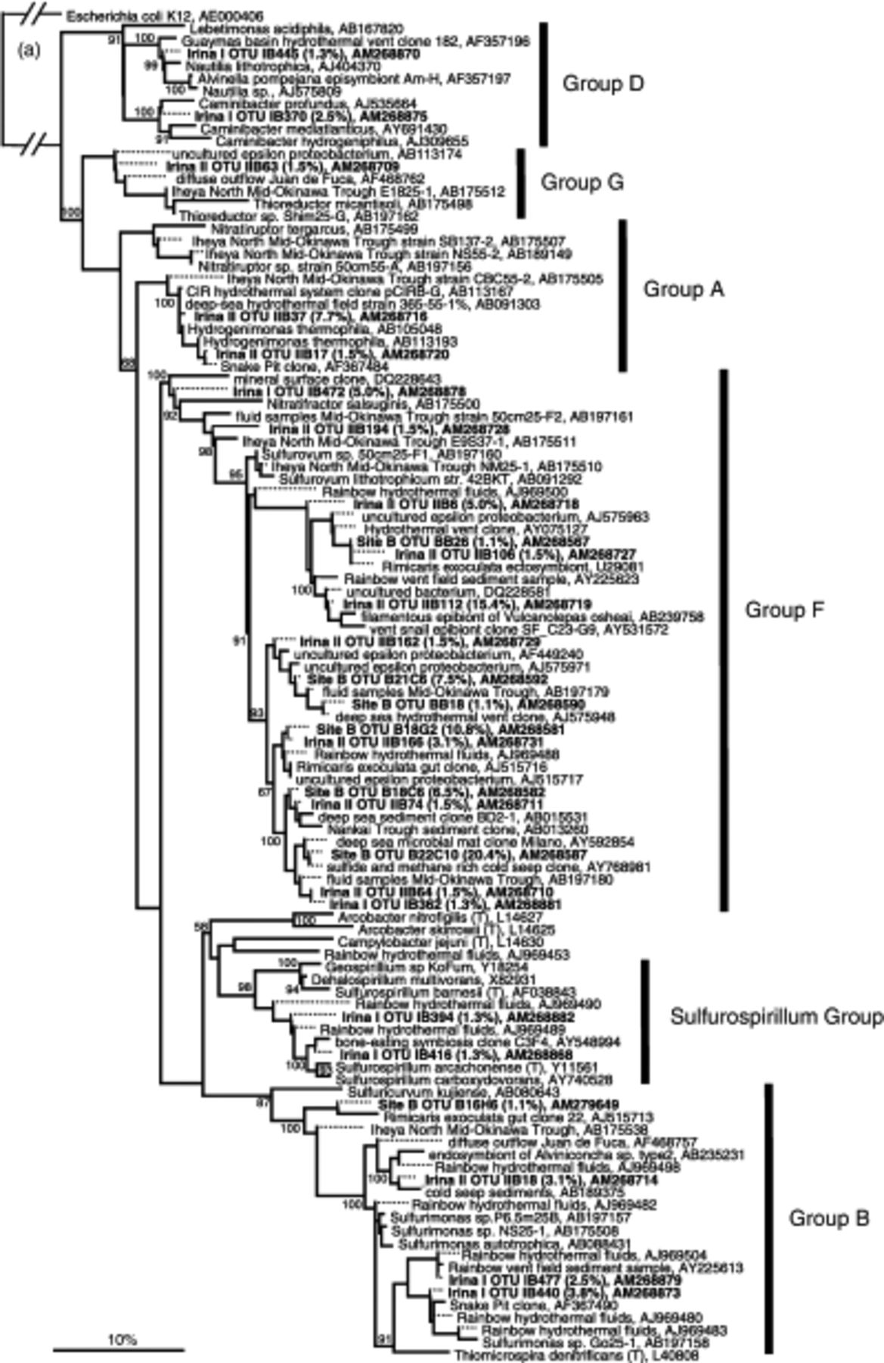
1 Phylogenetic relationships of 16S rRNA gene sequences of (a) Epsilonproteobacteria, (b) deeply rooted ...
Notes:
1 Phylogenetic relationships of 16S rRNA gene sequences of (a) Epsilonproteobacteria, (b) deeply rooted bacterial lineages, (c) Deltaproteobacteria (Desulfobulbaceae) and (d) Archaea as determined by maximum likelihood (ML) analysis of (a) 1200, (b) 1300, (c) 1400 and (d) 1300 nucleotides. Additionally, for sequences of deeply rooted lineages (b), maximum parsimony (MP) analysis was conducted. The percentage of bootstrap resamplings above 50% is indicated. Bootstrap probabilities estimated by ML and MP analyses (b) are displayed as ML/MP. Tree topologies not supported by MP are indicated by ‘−‘. Dotted lines mark shorter sequences added subsequently to tree. Sequences obtained from Irina I, Irina II and Site B are listed in bold. Numbers in parenthesis indicate percentage of sequences belonging to one phylotype. The scale bar represents the expected number of changes per nucleotide position.
Unless provided in the caption above, the following copyright applies to the content of this slide: © 2007 Federation of European Microbiological Societies Published by Blackwell Publishing Ltd. All rights reserved

Slide 2
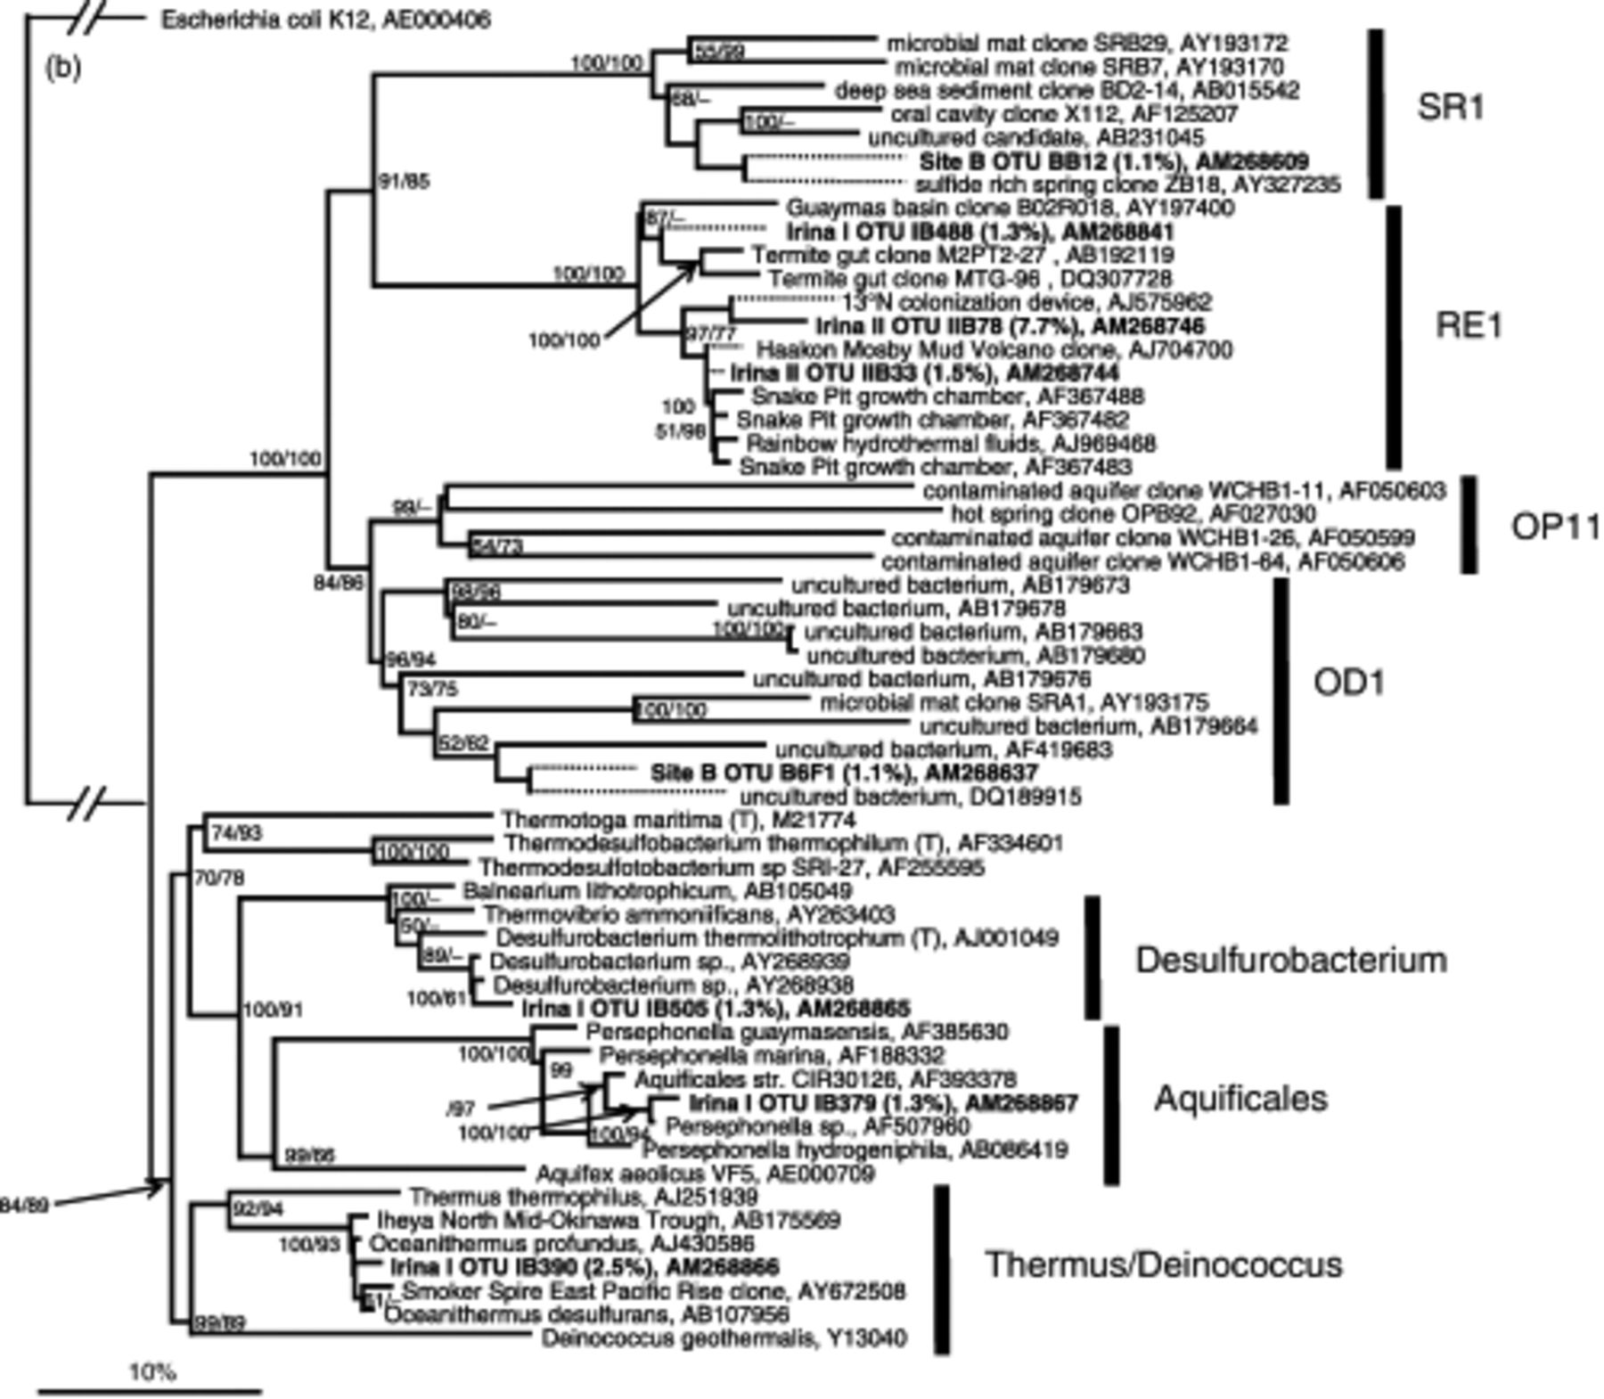
1 Phylogenetic relationships of 16S rRNA gene sequences of (a) Epsilonproteobacteria, (b) deeply rooted ...
Notes:
1 Phylogenetic relationships of 16S rRNA gene sequences of (a) Epsilonproteobacteria, (b) deeply rooted bacterial lineages, (c) Deltaproteobacteria (Desulfobulbaceae) and (d) Archaea as determined by maximum likelihood (ML) analysis of (a) 1200, (b) 1300, (c) 1400 and (d) 1300 nucleotides. Additionally, for sequences of deeply rooted lineages (b), maximum parsimony (MP) analysis was conducted. The percentage of bootstrap resamplings above 50% is indicated. Bootstrap probabilities estimated by ML and MP analyses (b) are displayed as ML/MP. Tree topologies not supported by MP are indicated by ‘−‘. Dotted lines mark shorter sequences added subsequently to tree. Sequences obtained from Irina I, Irina II and Site B are listed in bold. Numbers in parenthesis indicate percentage of sequences belonging to one phylotype. The scale bar represents the expected number of changes per nucleotide position.
Unless provided in the caption above, the following copyright applies to the content of this slide: © 2007 Federation of European Microbiological Societies Published by Blackwell Publishing Ltd. All rights reserved

Slide 3
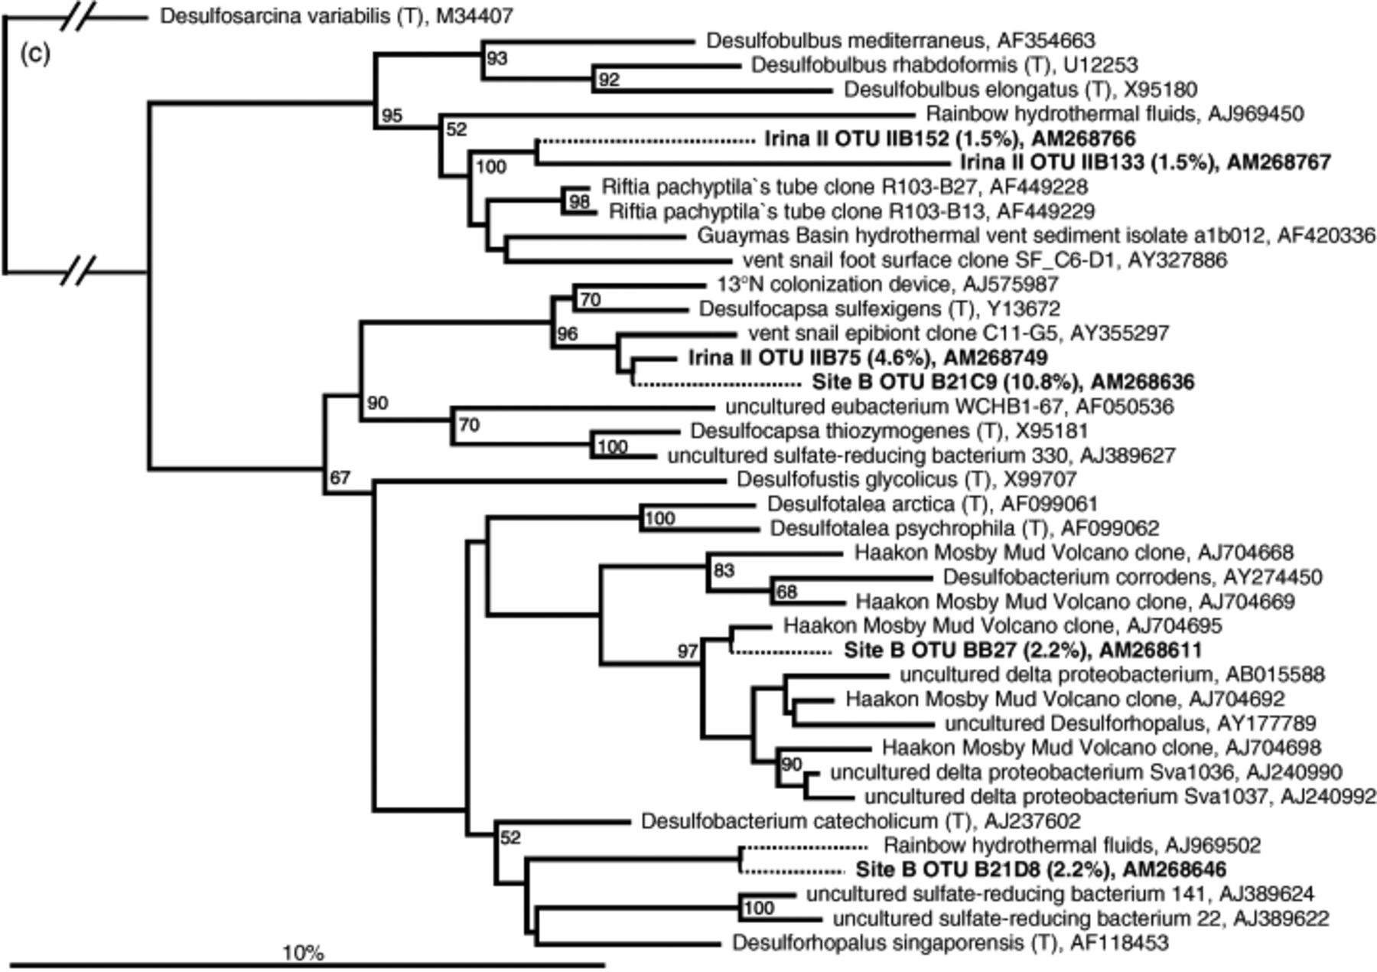
1 Phylogenetic relationships of 16S rRNA gene sequences of (a) Epsilonproteobacteria, (b) deeply rooted ...
Notes:
1 Phylogenetic relationships of 16S rRNA gene sequences of (a) Epsilonproteobacteria, (b) deeply rooted bacterial lineages, (c) Deltaproteobacteria (Desulfobulbaceae) and (d) Archaea as determined by maximum likelihood (ML) analysis of (a) 1200, (b) 1300, (c) 1400 and (d) 1300 nucleotides. Additionally, for sequences of deeply rooted lineages (b), maximum parsimony (MP) analysis was conducted. The percentage of bootstrap resamplings above 50% is indicated. Bootstrap probabilities estimated by ML and MP analyses (b) are displayed as ML/MP. Tree topologies not supported by MP are indicated by ‘−‘. Dotted lines mark shorter sequences added subsequently to tree. Sequences obtained from Irina I, Irina II and Site B are listed in bold. Numbers in parenthesis indicate percentage of sequences belonging to one phylotype. The scale bar represents the expected number of changes per nucleotide position.
Unless provided in the caption above, the following copyright applies to the content of this slide: © 2007 Federation of European Microbiological Societies Published by Blackwell Publishing Ltd. All rights reserved

Slide 4
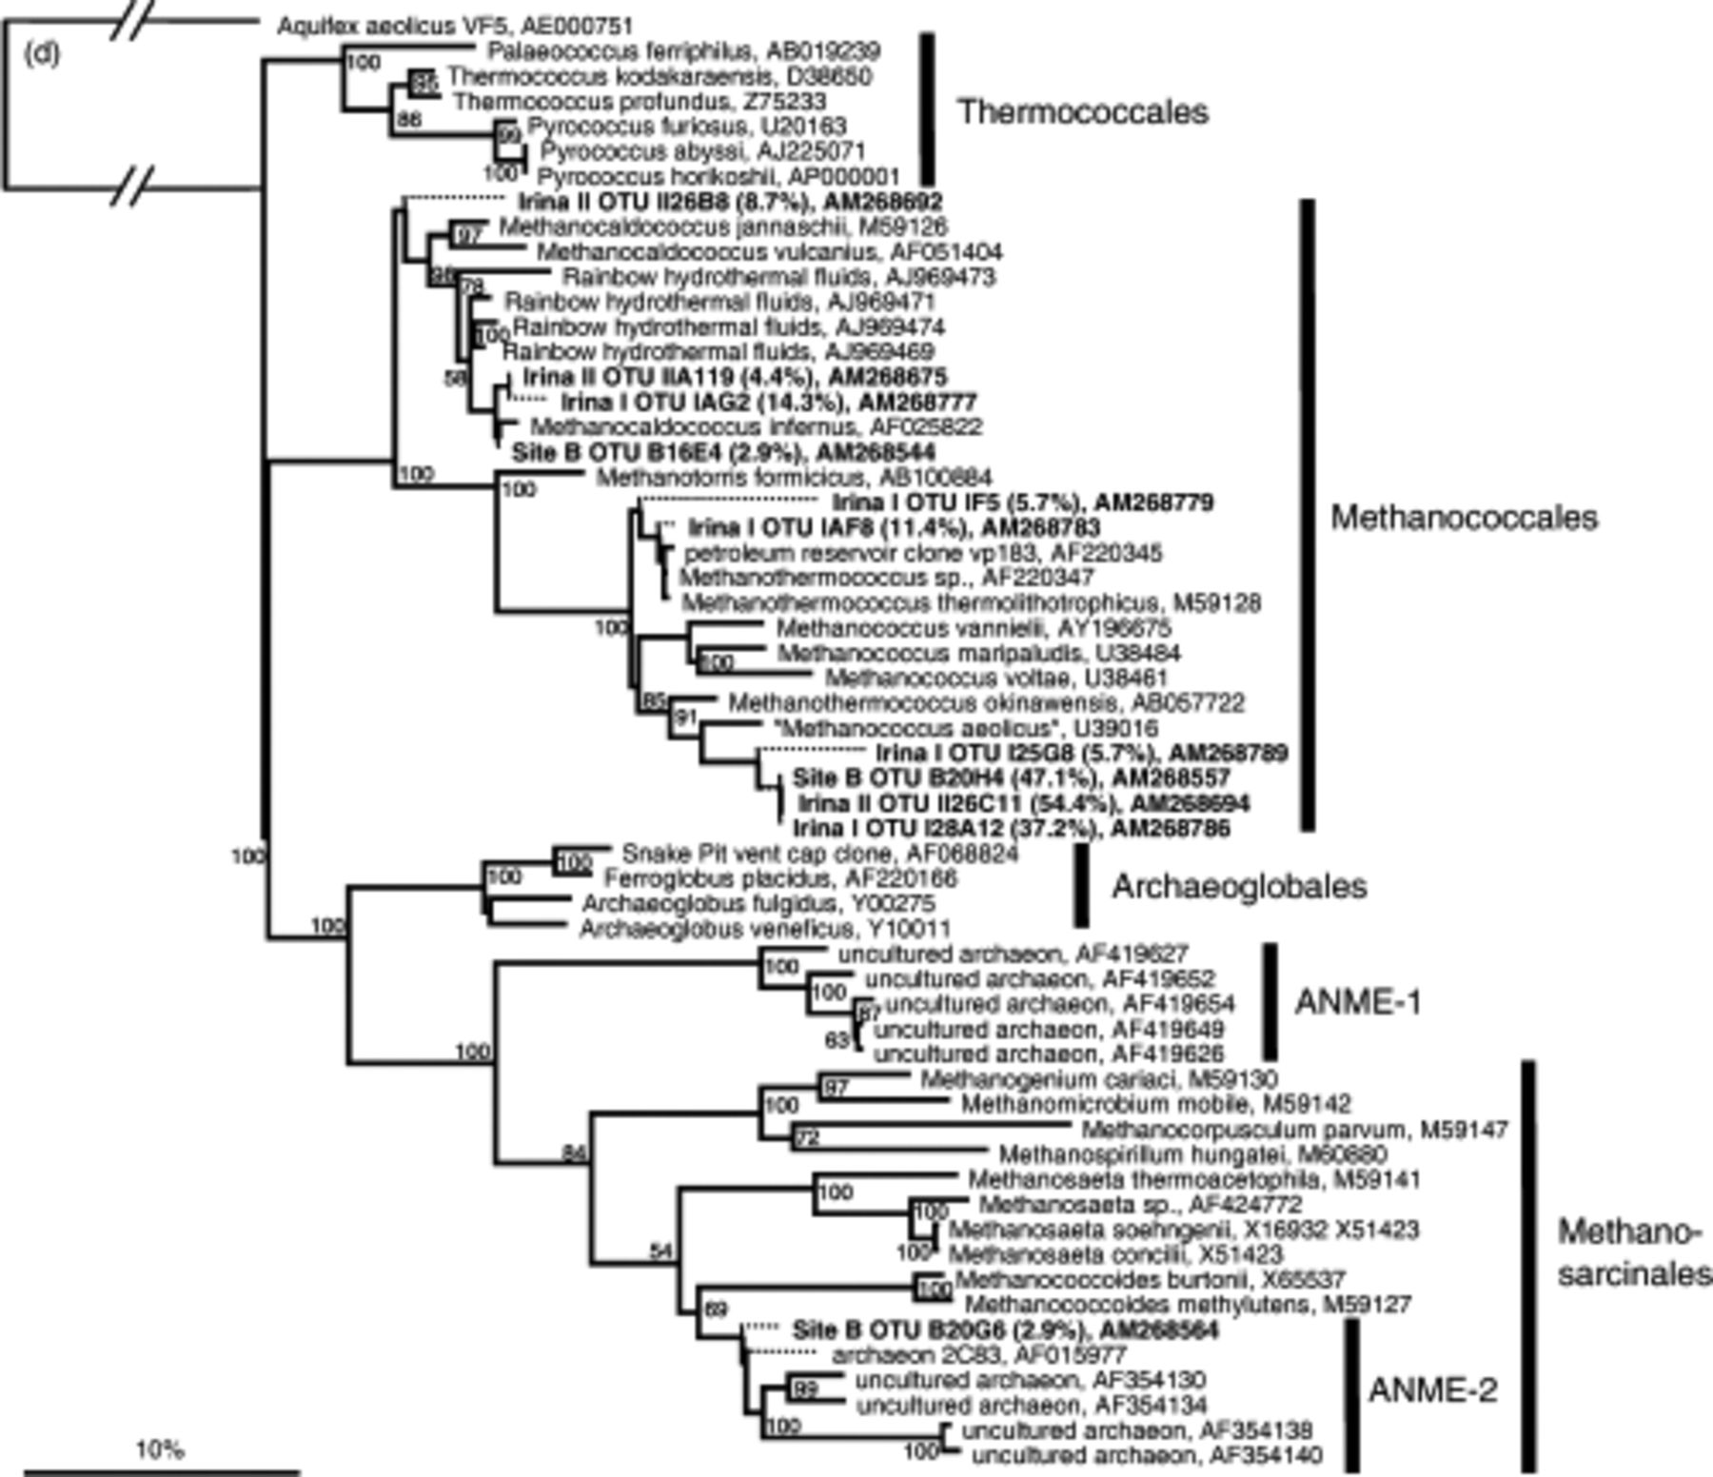
1 Phylogenetic relationships of 16S rRNA gene sequences of (a) Epsilonproteobacteria, (b) deeply rooted ...
Notes:
1 Phylogenetic relationships of 16S rRNA gene sequences of (a) Epsilonproteobacteria, (b) deeply rooted bacterial lineages, (c) Deltaproteobacteria (Desulfobulbaceae) and (d) Archaea as determined by maximum likelihood (ML) analysis of (a) 1200, (b) 1300, (c) 1400 and (d) 1300 nucleotides. Additionally, for sequences of deeply rooted lineages (b), maximum parsimony (MP) analysis was conducted. The percentage of bootstrap resamplings above 50% is indicated. Bootstrap probabilities estimated by ML and MP analyses (b) are displayed as ML/MP. Tree topologies not supported by MP are indicated by ‘−‘. Dotted lines mark shorter sequences added subsequently to tree. Sequences obtained from Irina I, Irina II and Site B are listed in bold. Numbers in parenthesis indicate percentage of sequences belonging to one phylotype. The scale bar represents the expected number of changes per nucleotide position.
Unless provided in the caption above, the following copyright applies to the content of this slide: © 2007 Federation of European Microbiological Societies Published by Blackwell Publishing Ltd. All rights reserved

