Slide 1
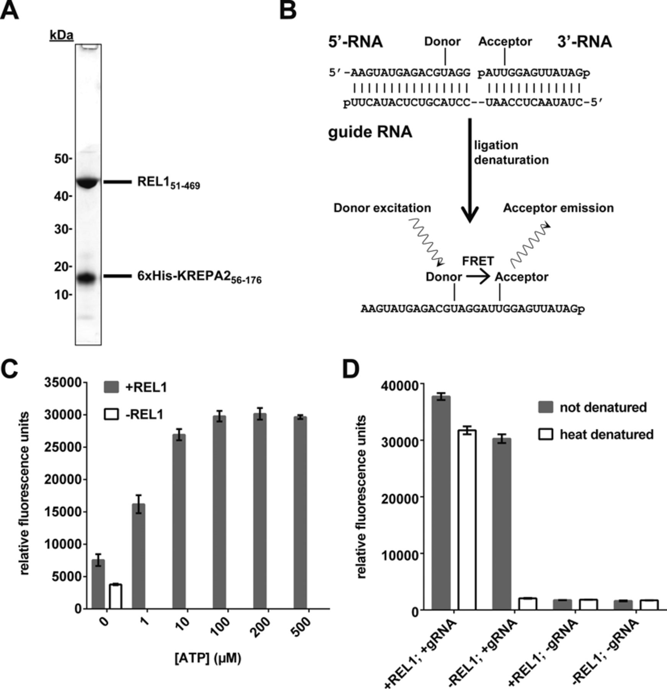
Figure 1. Purification of recombinant REL1 and initial characterization of the FRET-based assay. (A) SDS-PAGE showing ...
Notes:
Figure 1. Purification of recombinant REL1 and initial characterization of the FRET-based assay. (A) SDS-PAGE showing the purified REL151–469-KREPA251–176 complex. REL151–469 has a size of 46.9 kDa, while 6xHis-KREPA251–176 has a size of 16.5 kDa. (B) Schematic representation of the assay principle. A nicked RNA duplex consisting of guide RNA (gRNA), 5′-RNA with donor fluorophore and 3′-RNA with acceptor fluorophore serves as substrate. After incubation with REL1, ligated RNA is detected by denaturation-resistant FRET between the two fluorophores. (C) The FRET signal is dependent on ATP and REL1. The assay was carried out as described in ‘Materials and Methods’ section under ‘Initial RNA annealing and ligation conditions’, except 100 ng REL1 and the concentrations of ATP indicated were used. Means and standard deviations for three independent experiments are shown. (D) The FRET signal is dependent on gRNA. The assay was carried out as described in ‘Materials and Methods’ section under ‘Initial RNA annealing and ligation conditions’, except 200 ng REL1 were used, gRNA was added or omitted as indicated and samples were or were not denatured at 96°C before reading, as indicated. Means and standard deviations for five (+gRNA) or three (−gRNA) replicates are shown.
Unless provided in the caption above, the following copyright applies to the content of this slide: © The Author(s) 2015. Published by Oxford University Press on behalf of Nucleic Acids Research.This is an Open Access article distributed under the terms of the Creative Commons Attribution License (http://creativecommons.org/licenses/by/4.0/), which permits unrestricted reuse, distribution, and reproduction in any medium, provided the original work is properly cited.

Slide 2
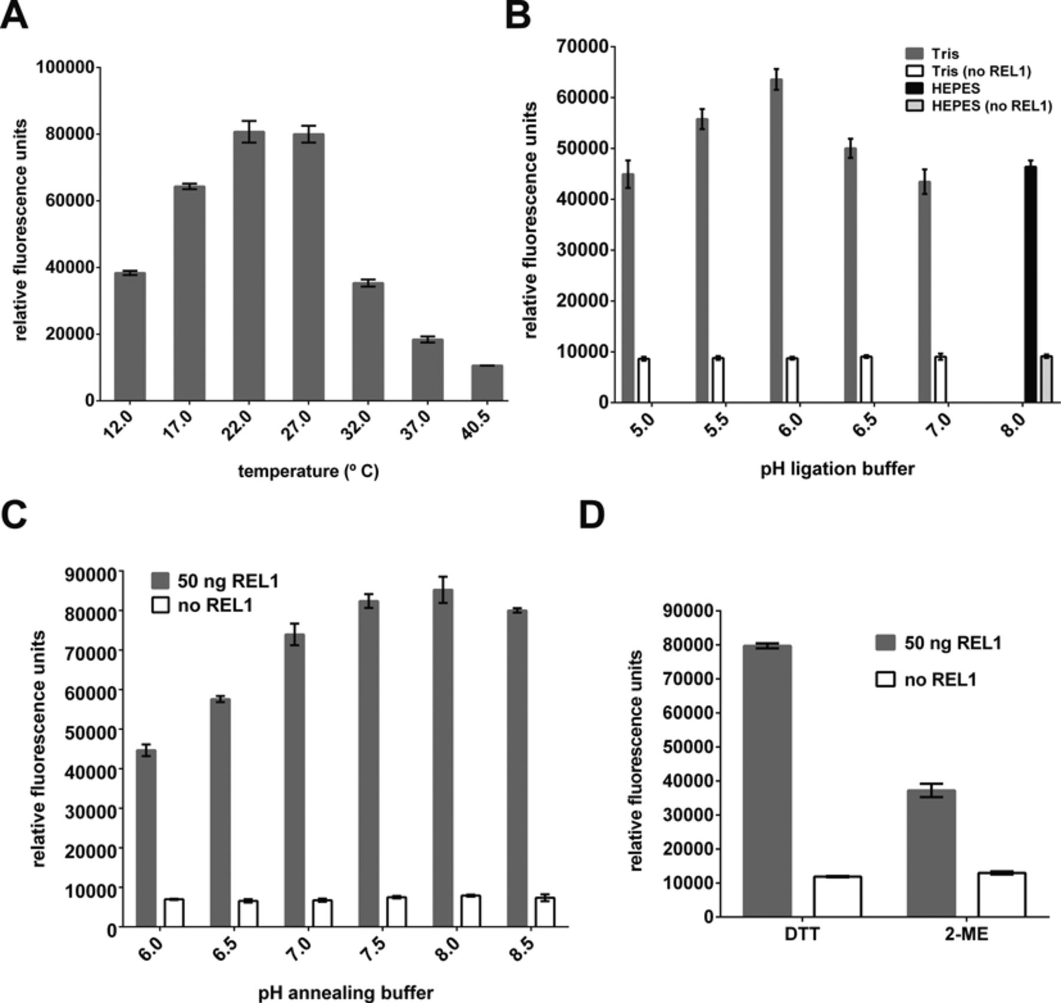
Figure 2. Optimization of assay conditions (I). Optimization of (A) incubation temperature, (B) pH of ligation buffer, ...
Notes:
Figure 2. Optimization of assay conditions (I). Optimization of (A) incubation temperature, (B) pH of ligation buffer, (C) pH of annealing buffer. (D) Assay performance with dithiothreitol (DTT) versus β-mercaptoethanol (2-ME) as reducing agent. For (B), (C) and (D), parallel assays without REL1 were carried out as controls. Except for the parameters tested, all experiments were carried out as described in ‘Materials and Methods’ section under ‘Initial RNA annealing and ligation conditions’, and means and standard deviations for three replicates are shown.
Unless provided in the caption above, the following copyright applies to the content of this slide: © The Author(s) 2015. Published by Oxford University Press on behalf of Nucleic Acids Research.This is an Open Access article distributed under the terms of the Creative Commons Attribution License (http://creativecommons.org/licenses/by/4.0/), which permits unrestricted reuse, distribution, and reproduction in any medium, provided the original work is properly cited.

Slide 3
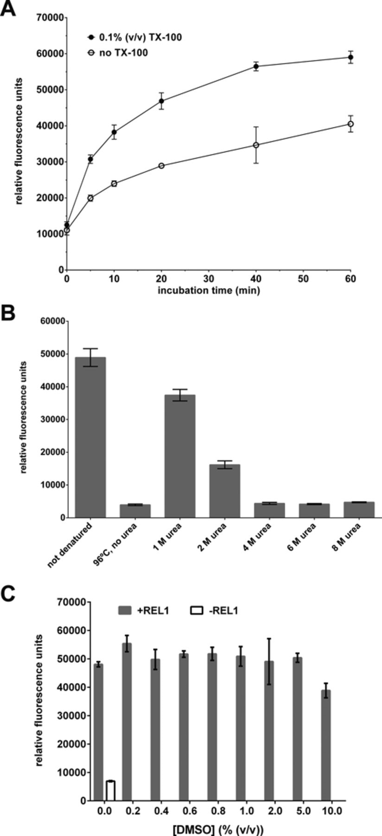
Figure 3. Optimization of assay conditions (II). (A) Comparison of ligation production formation over time in the ...
Notes:
Figure 3. Optimization of assay conditions (II). (A) Comparison of ligation production formation over time in the presence and absence of 0.1% (v/v) Triton X-100 (TX-100). (B) Comparison of different methods for disrupting the annealed (but unligated) nicked dsRNA substrate. Denaturation by 96°C heat in the presence of 200-fold excess competitor DNA oligo was compared to treatment with 1–8 M urea at room temperature. (C) Influence of 0.2–10% (v/v) DMSO on assay performance. Except for the parameters tested, all experiments were carried out as described in ‘Materials and Methods’ section under ‘Initial RNA annealing and ligation conditions’, and means and standard deviations for three replicates are shown.
Unless provided in the caption above, the following copyright applies to the content of this slide: © The Author(s) 2015. Published by Oxford University Press on behalf of Nucleic Acids Research.This is an Open Access article distributed under the terms of the Creative Commons Attribution License (http://creativecommons.org/licenses/by/4.0/), which permits unrestricted reuse, distribution, and reproduction in any medium, provided the original work is properly cited.

Slide 4
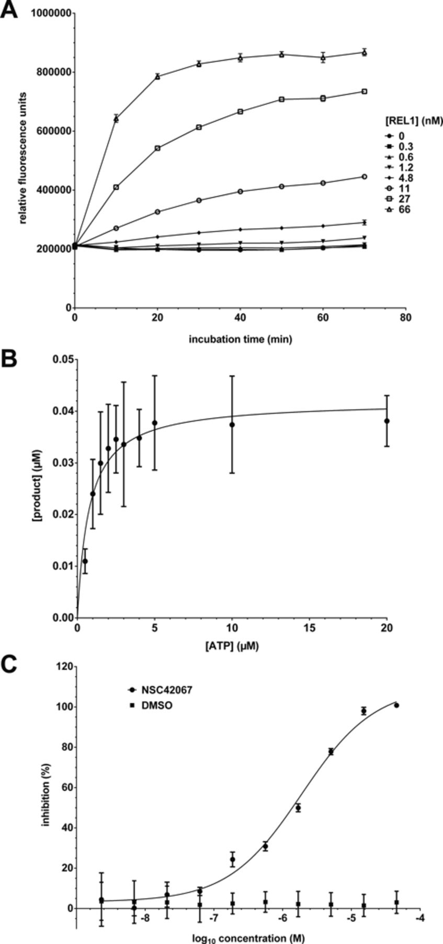
Figure 4. Kinetic characterization of REL1. (A) Product formation over time. Substrate was incubated with different ...
Notes:
Figure 4. Kinetic characterization of REL1. (A) Product formation over time. Substrate was incubated with different concentrations of REL1 and urea stop buffer was added after 0–70 min. (B) Determination of Km for ATP. The assay was carried out with varying concentrations of ATP and 50 ng REL1 in a reaction volume of 20 μl. The data were fitted to the Michaelis–Menten equation. (C) Determination of IC50 for compound NSC42067. REL1 activity was measured in the presence of increasing concentrations of compound, calculated as% inhibition compared to the control, plotted and fitted to a sigmoidal curve. All experiments were carried out under optimized conditions, and means and standard deviations for three replicates are shown.
Unless provided in the caption above, the following copyright applies to the content of this slide: © The Author(s) 2015. Published by Oxford University Press on behalf of Nucleic Acids Research.This is an Open Access article distributed under the terms of the Creative Commons Attribution License (http://creativecommons.org/licenses/by/4.0/), which permits unrestricted reuse, distribution, and reproduction in any medium, provided the original work is properly cited.

Slide 5
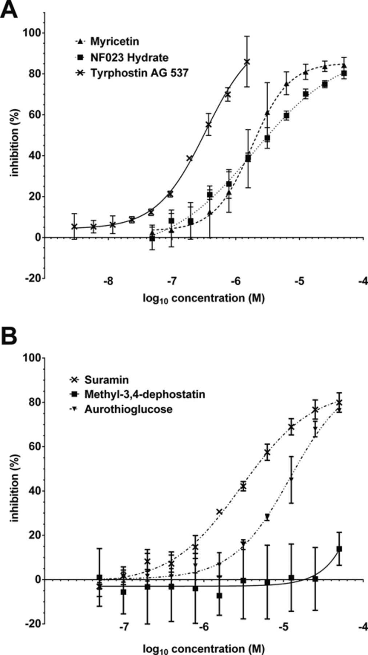
Figure 5. Dose-response curves for the top six hits from the pilot screen against the LOPAC library. Data were plotted ...
Notes:
Figure 5. Dose-response curves for the top six hits from the pilot screen against the LOPAC library. Data were plotted as% inhibition compared to controls without inhibitor and fitted to a sigmoidal curve. (A) Compounds myricetin, NF023 hydrate and tyrphostin AG537. (B) Compounds suramin, methyl-3,4-dephostatin and aurothioglucose. All experiments were carried out under optimized conditions, and means and standard deviations for three replicates are shown.
Unless provided in the caption above, the following copyright applies to the content of this slide: © The Author(s) 2015. Published by Oxford University Press on behalf of Nucleic Acids Research.This is an Open Access article distributed under the terms of the Creative Commons Attribution License (http://creativecommons.org/licenses/by/4.0/), which permits unrestricted reuse, distribution, and reproduction in any medium, provided the original work is properly cited.

Slide 6
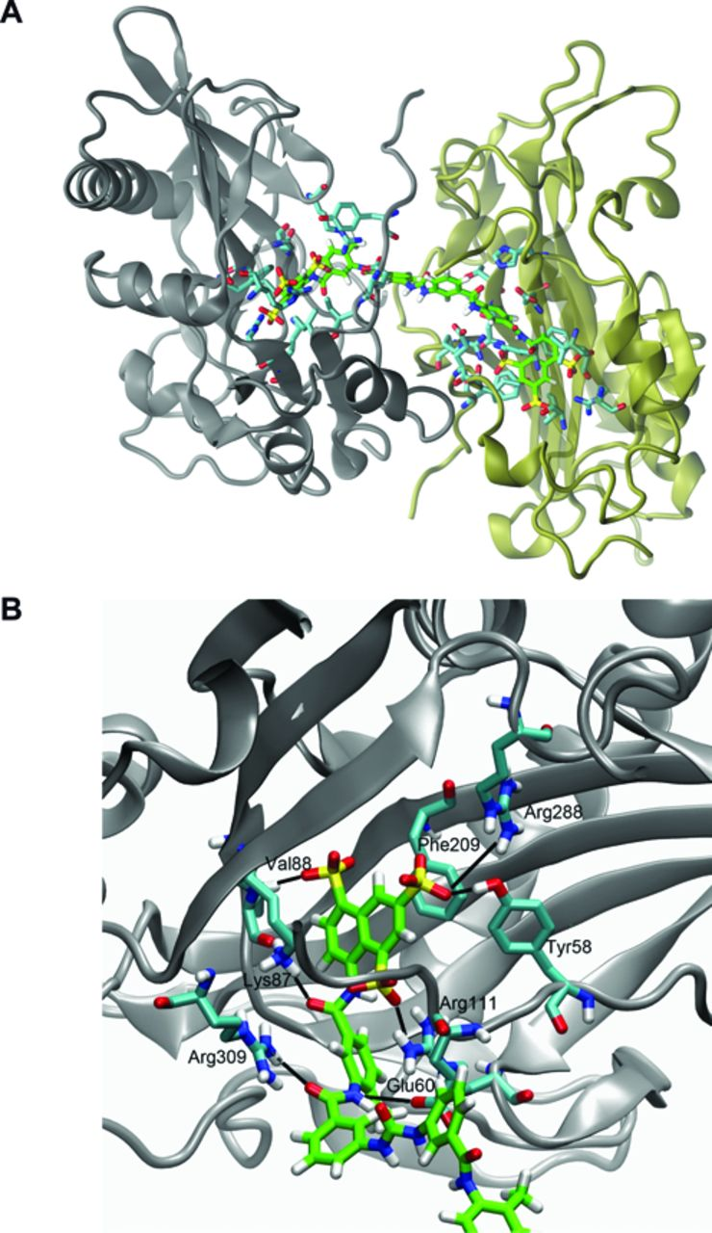
Figure 6. Proposed binding mode of suramin to REL1. (A) Predicted binding of suramin to two REL1 enzymes ...
Notes:
Figure 6. Proposed binding mode of suramin to REL1. (A) Predicted binding of suramin to two REL1 enzymes simultaneously. The two enzymes have been colored gray and tan, respectively. Suramin is shown with its carbon atoms colored green. Only side-chains of residues in the two enzymes that interact with suramin are shown for clarity (carbon atoms colored cyan). (B) Detailed view of the predicted interaction of one half of suramin with key residues in the ATP binding pocket. Suramin, shown with carbon atoms colored green, assumes the binding position of REL1's natural substrate ATP and its interactions with the enzyme. Only the side-chains of interacting residues in the enzyme are shown for clarity (in cyan).
Unless provided in the caption above, the following copyright applies to the content of this slide: © The Author(s) 2015. Published by Oxford University Press on behalf of Nucleic Acids Research.This is an Open Access article distributed under the terms of the Creative Commons Attribution License (http://creativecommons.org/licenses/by/4.0/), which permits unrestricted reuse, distribution, and reproduction in any medium, provided the original work is properly cited.

