Slide 1
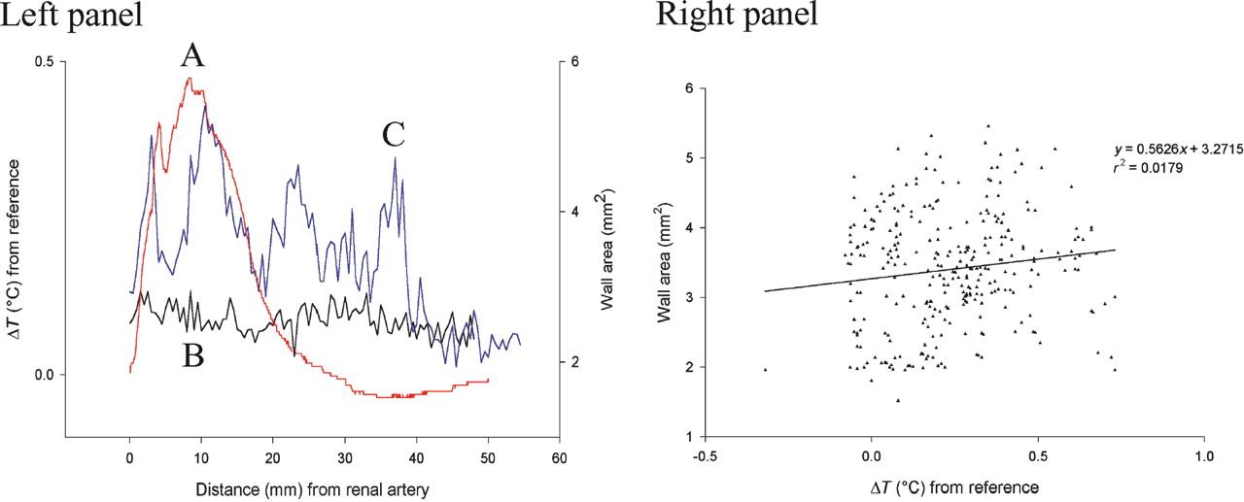
Figure 1 A representative example of an IVUS pull-back and a temperature pull-back for a single rabbit (left ...
Notes:
Figure 1 A representative example of an IVUS pull-back and a temperature pull-back for a single rabbit (left panel: A, temperature; B, wall area before injury; C, wall area after injury) and for the entire group of rabbits (right panel). Both situations show an absence of relationship between IVUS-derived wall thickness and temperature heterogeneity.
Unless provided in the caption above, the following copyright applies to the content of this slide: © The European Society of Cardiology 2005. All rights reserved. For Permissions, please e-mail: journals.permissions@oxfordjournals.org

Slide 2
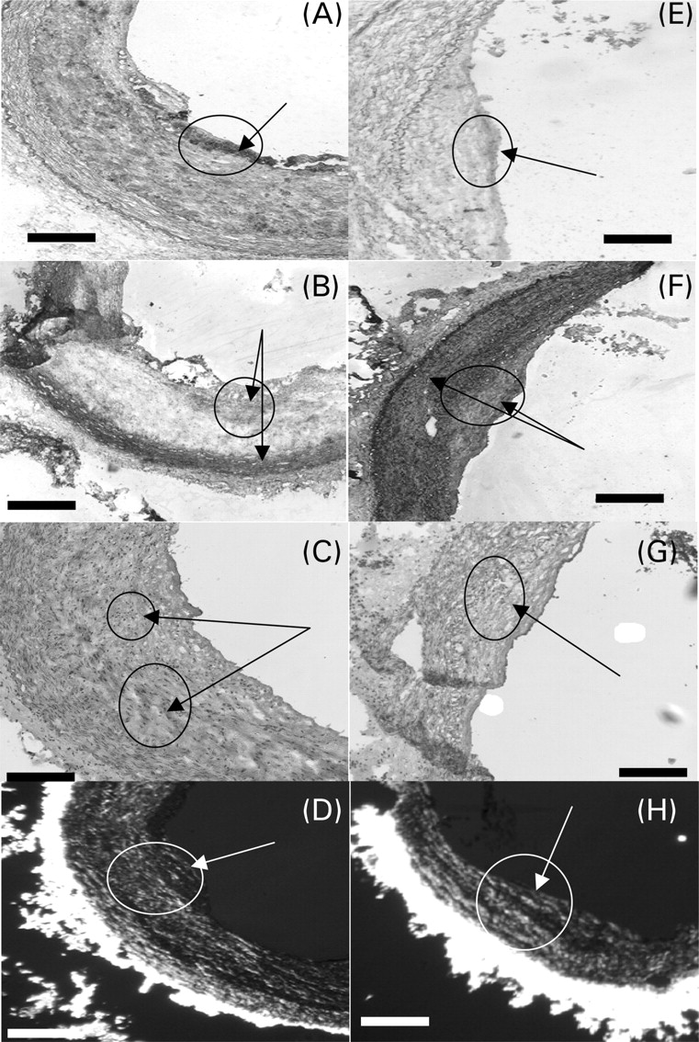
Figure 2 A representative example of the cellular composition of hot (left column) and cold regions (right ...
Notes:
Figure 2 A representative example of the cellular composition of hot (left column) and cold regions (right column). The first row shows the macrophages (RAM-11 stain; A and E), the second row the SMCs (α-actin stain; B and F), the third row the lipids (Oil-red-O stain; C and G), and the last row the collagen (Picrosirius red stain; D and H). Bar: 500 µm.
Unless provided in the caption above, the following copyright applies to the content of this slide: © The European Society of Cardiology 2005. All rights reserved. For Permissions, please e-mail: journals.permissions@oxfordjournals.org

Slide 3
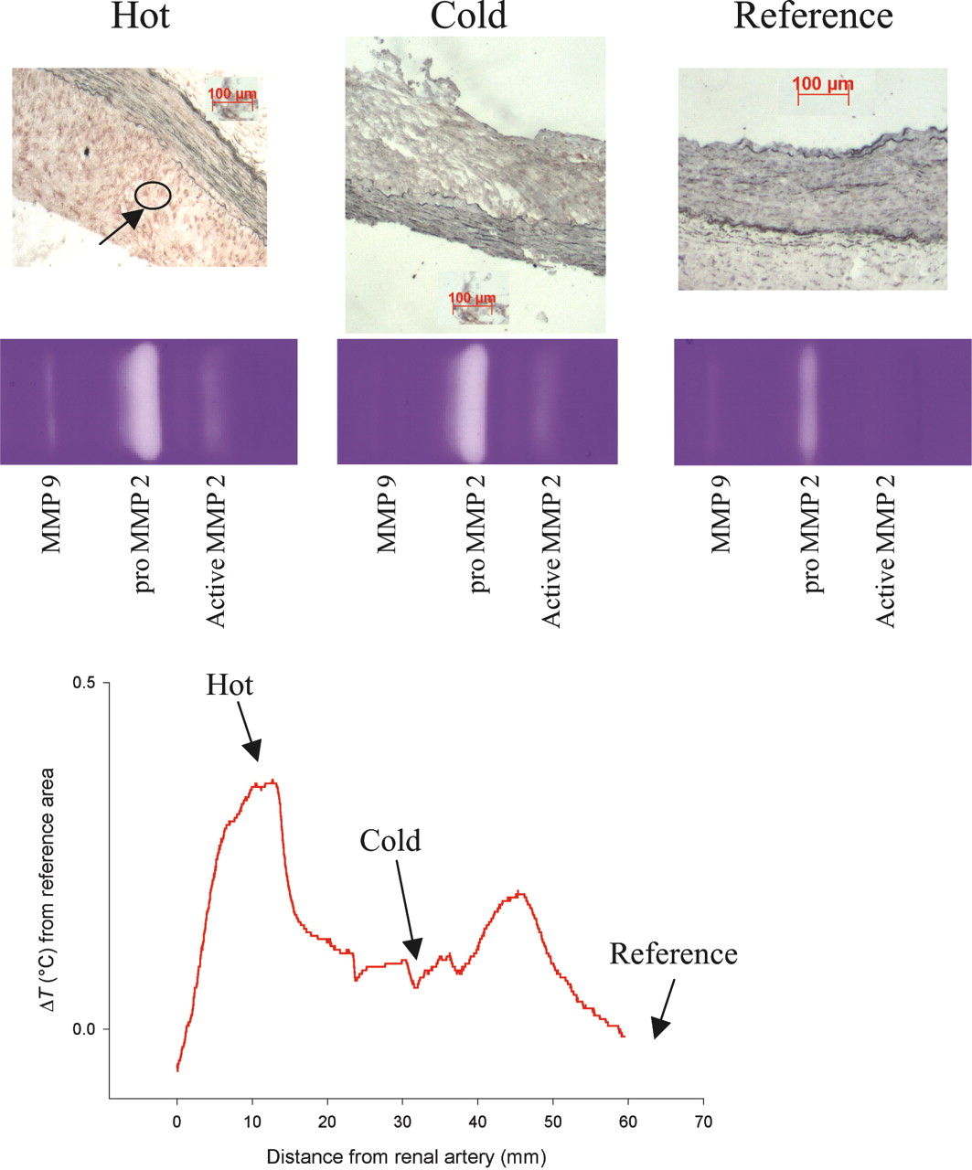
Figure 3 A representative example of hot, cold, and reference regions containing zymography results of ...
Notes:
Figure 3 A representative example of hot, cold, and reference regions containing zymography results of pro-MMP-2, MMP-2, and MMP-9 (top) and a temperature curve (bottom) of the same rabbit. In addition, immunohistochemistry of the MMP-2 staining is shown.
Unless provided in the caption above, the following copyright applies to the content of this slide: © The European Society of Cardiology 2005. All rights reserved. For Permissions, please e-mail: journals.permissions@oxfordjournals.org

Slide 4
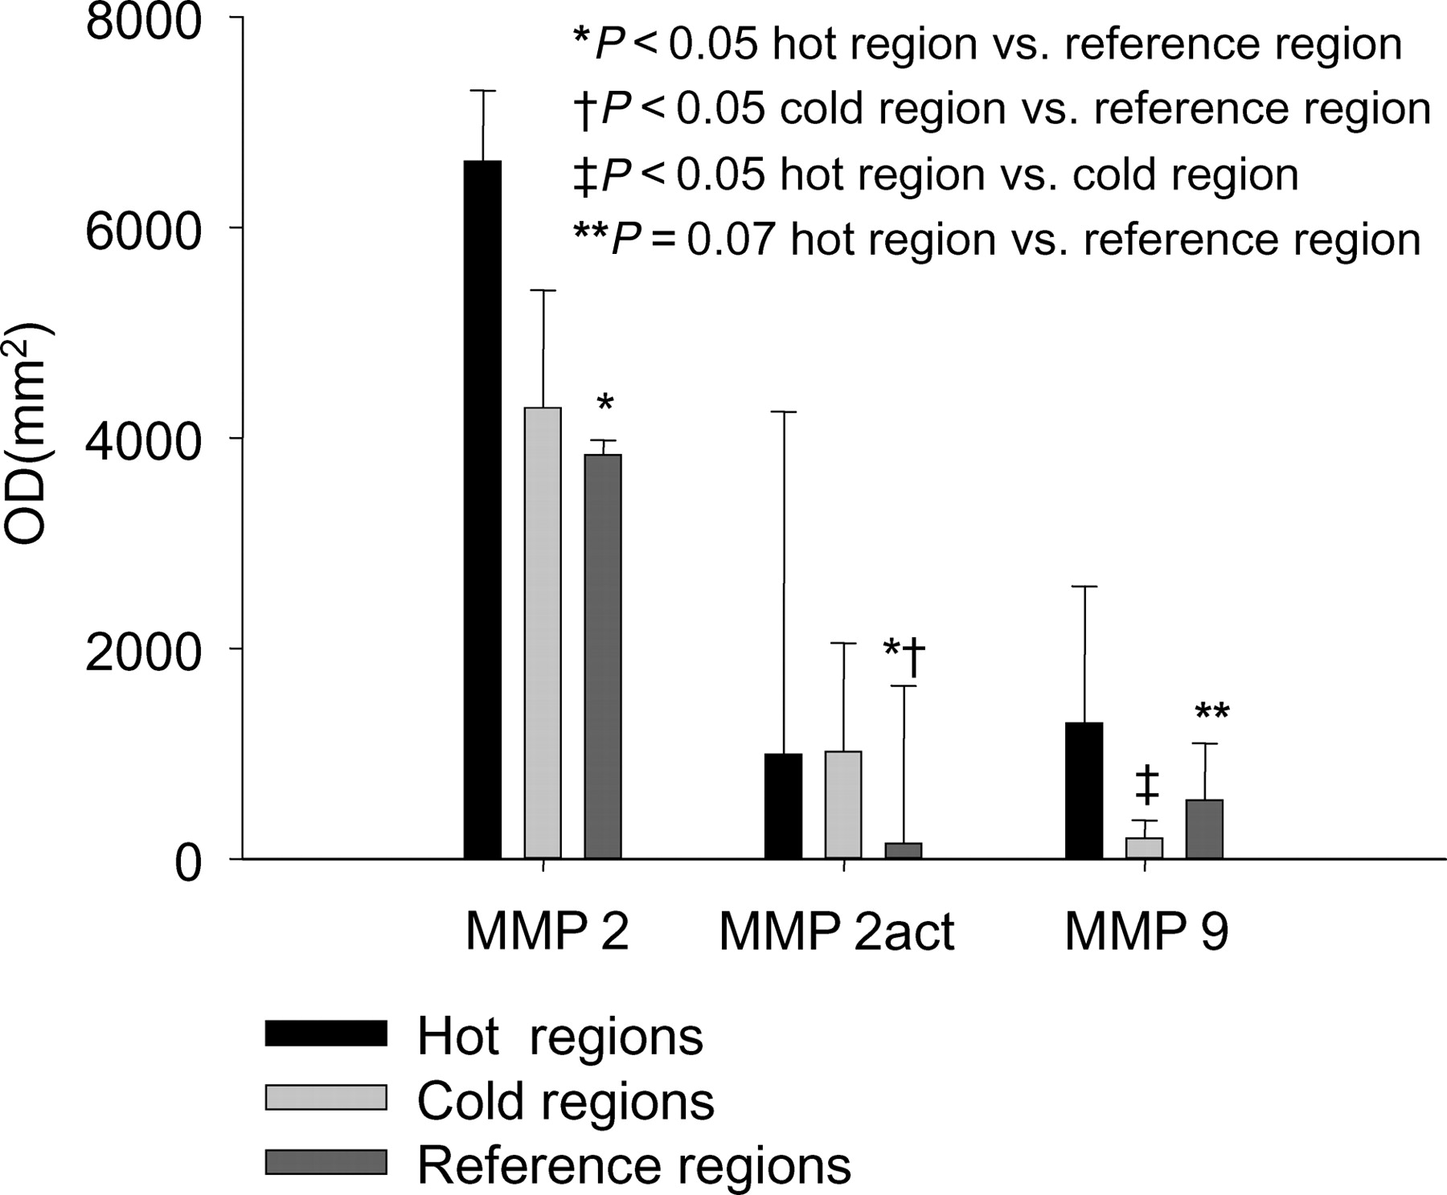
Figure 4 Metalloproteinase activity analysis (MMP-2 and MMP-9) of hot (black bars) plaques, cold (light grey ...
Notes:
Figure 4 Metalloproteinase activity analysis (MMP-2 and MMP-9) of hot (black bars) plaques, cold (light grey bars) plaques, and the reference region (dark grey bars) of the aorta of atherosclerotic rabbits (n=11).
Unless provided in the caption above, the following copyright applies to the content of this slide: © The European Society of Cardiology 2005. All rights reserved. For Permissions, please e-mail: journals.permissions@oxfordjournals.org

Slide 5
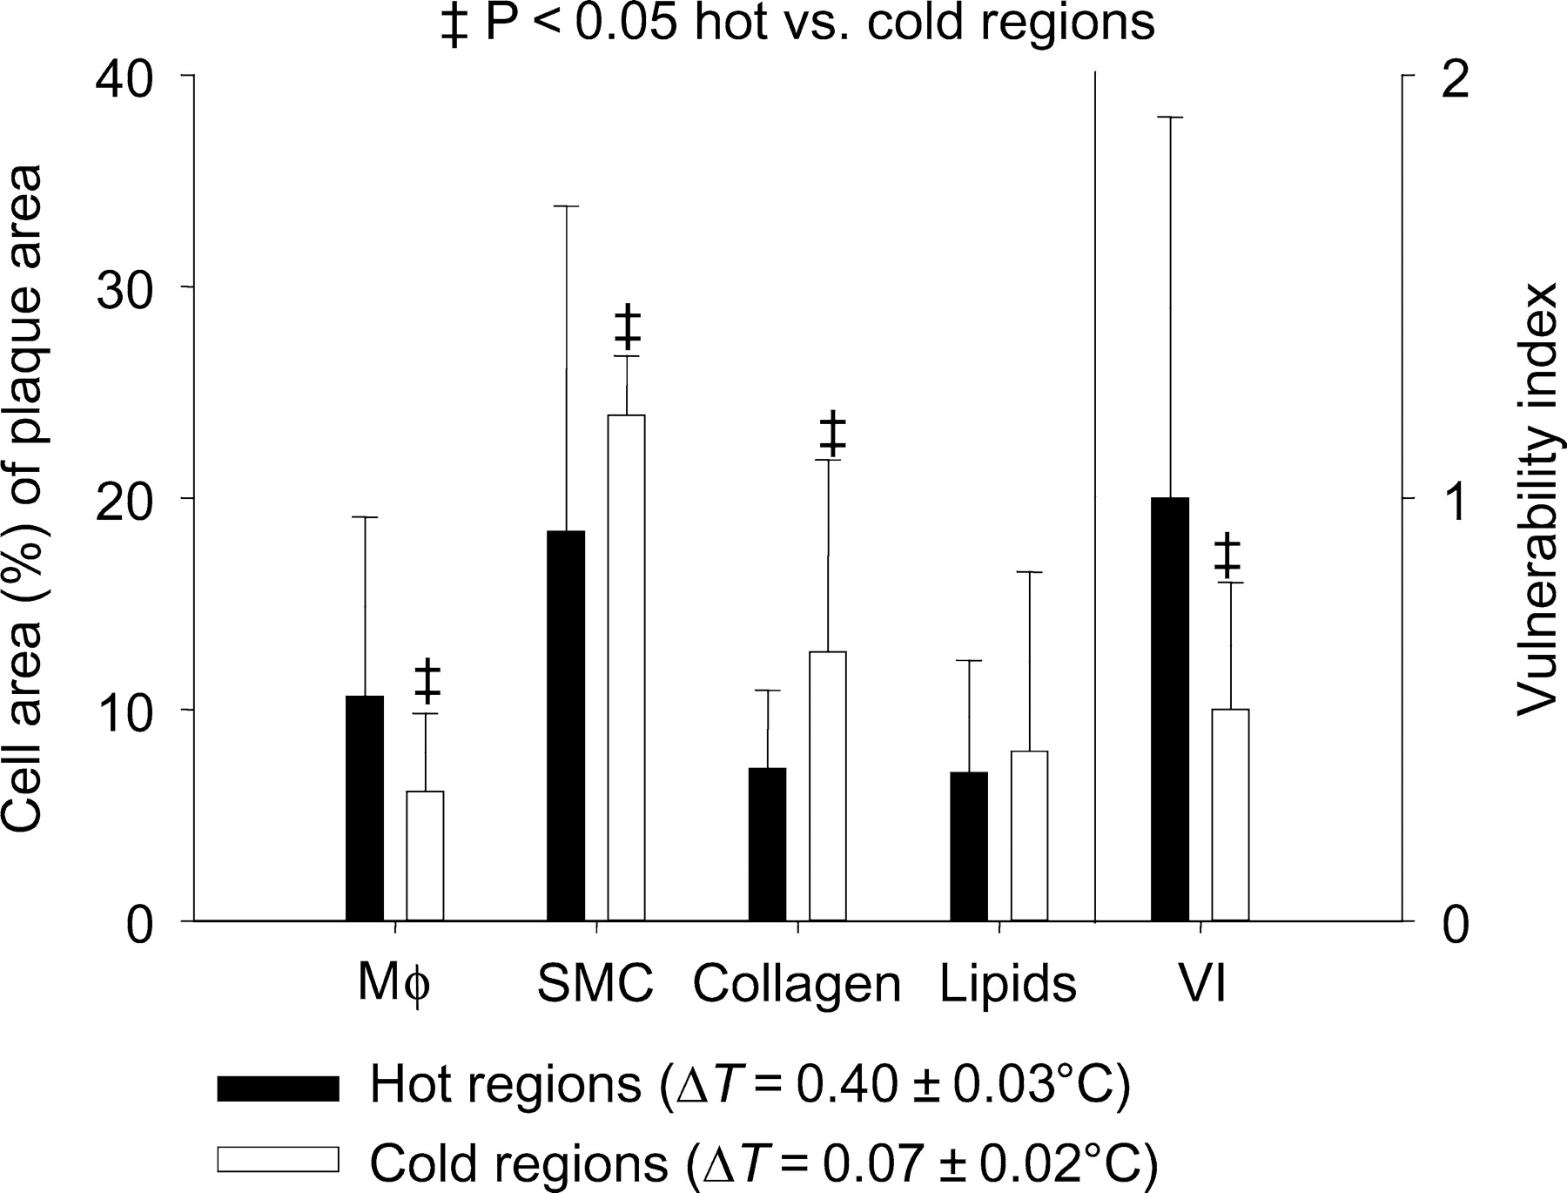
Figure 5 Cellular components of hot (filled squares) plaques and cold (open squares) plaques in the ...
Notes:
Figure 5 Cellular components of hot (filled squares) plaques and cold (open squares) plaques in the infrarenal aorta of a series of 11 atherosclerotic rabbits. In the right panel, the VI is calculated on the basis of the individual histological features. Note that the error bars are standard deviation.
Unless provided in the caption above, the following copyright applies to the content of this slide: © The European Society of Cardiology 2005. All rights reserved. For Permissions, please e-mail: journals.permissions@oxfordjournals.org

