Slide 1
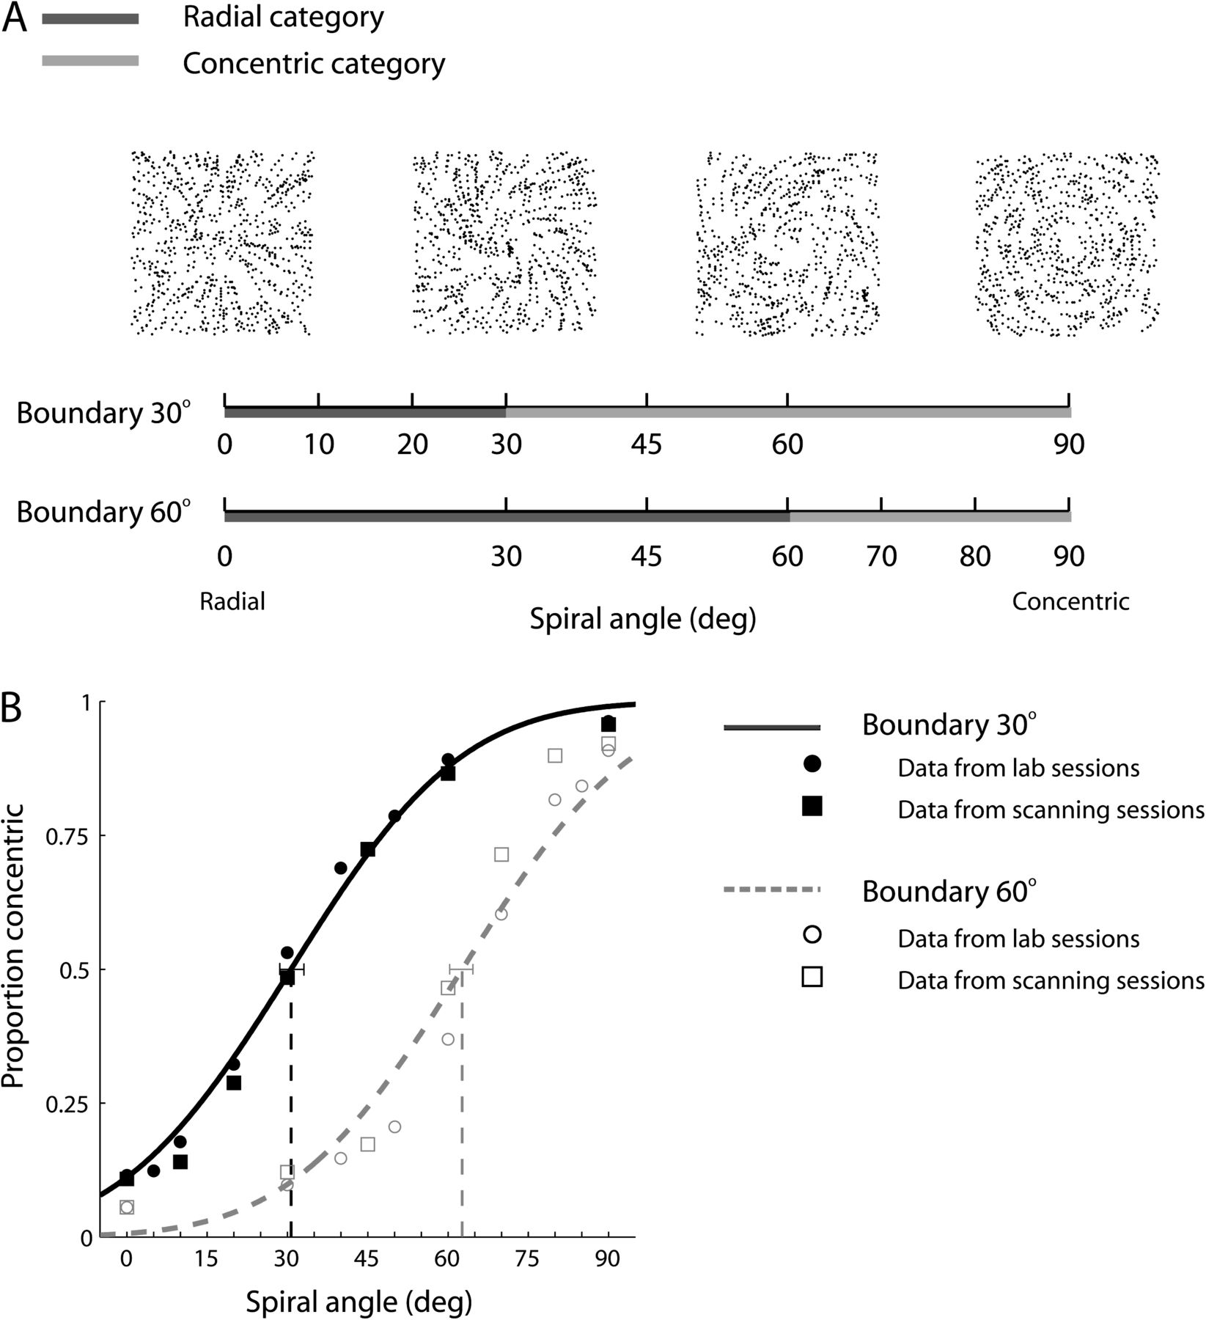
Figure 1. Stimuli and behavioral data. (A) Stimuli: example Glass pattern stimuli (100% signal) at spiral angles of 0°, ...
Notes:
Figure 1. Stimuli and behavioral data. (A) Stimuli: example Glass pattern stimuli (100% signal) at spiral angles of 0°, 30°, 60°, and 90°. The 2 boundaries and spiral angles tested are shown (black bar: stimuli that resemble radial; gray bar: stimuli that resemble concentric) indicating the categorical membership of the stimuli for each boundary. (B) Behavioral data for the categorization task collected in the lab (circles) and the scanner (squares) are shown for each boundary. Error bars indicate the 95% confidence interval at 50% concentric threshold.
Unless provided in the caption above, the following copyright applies to the content of this slide: © The Author 2011. Published by Oxford University Press. All rights reserved. For permissions, please e-mail: journals.permissions@oup.com

Slide 2
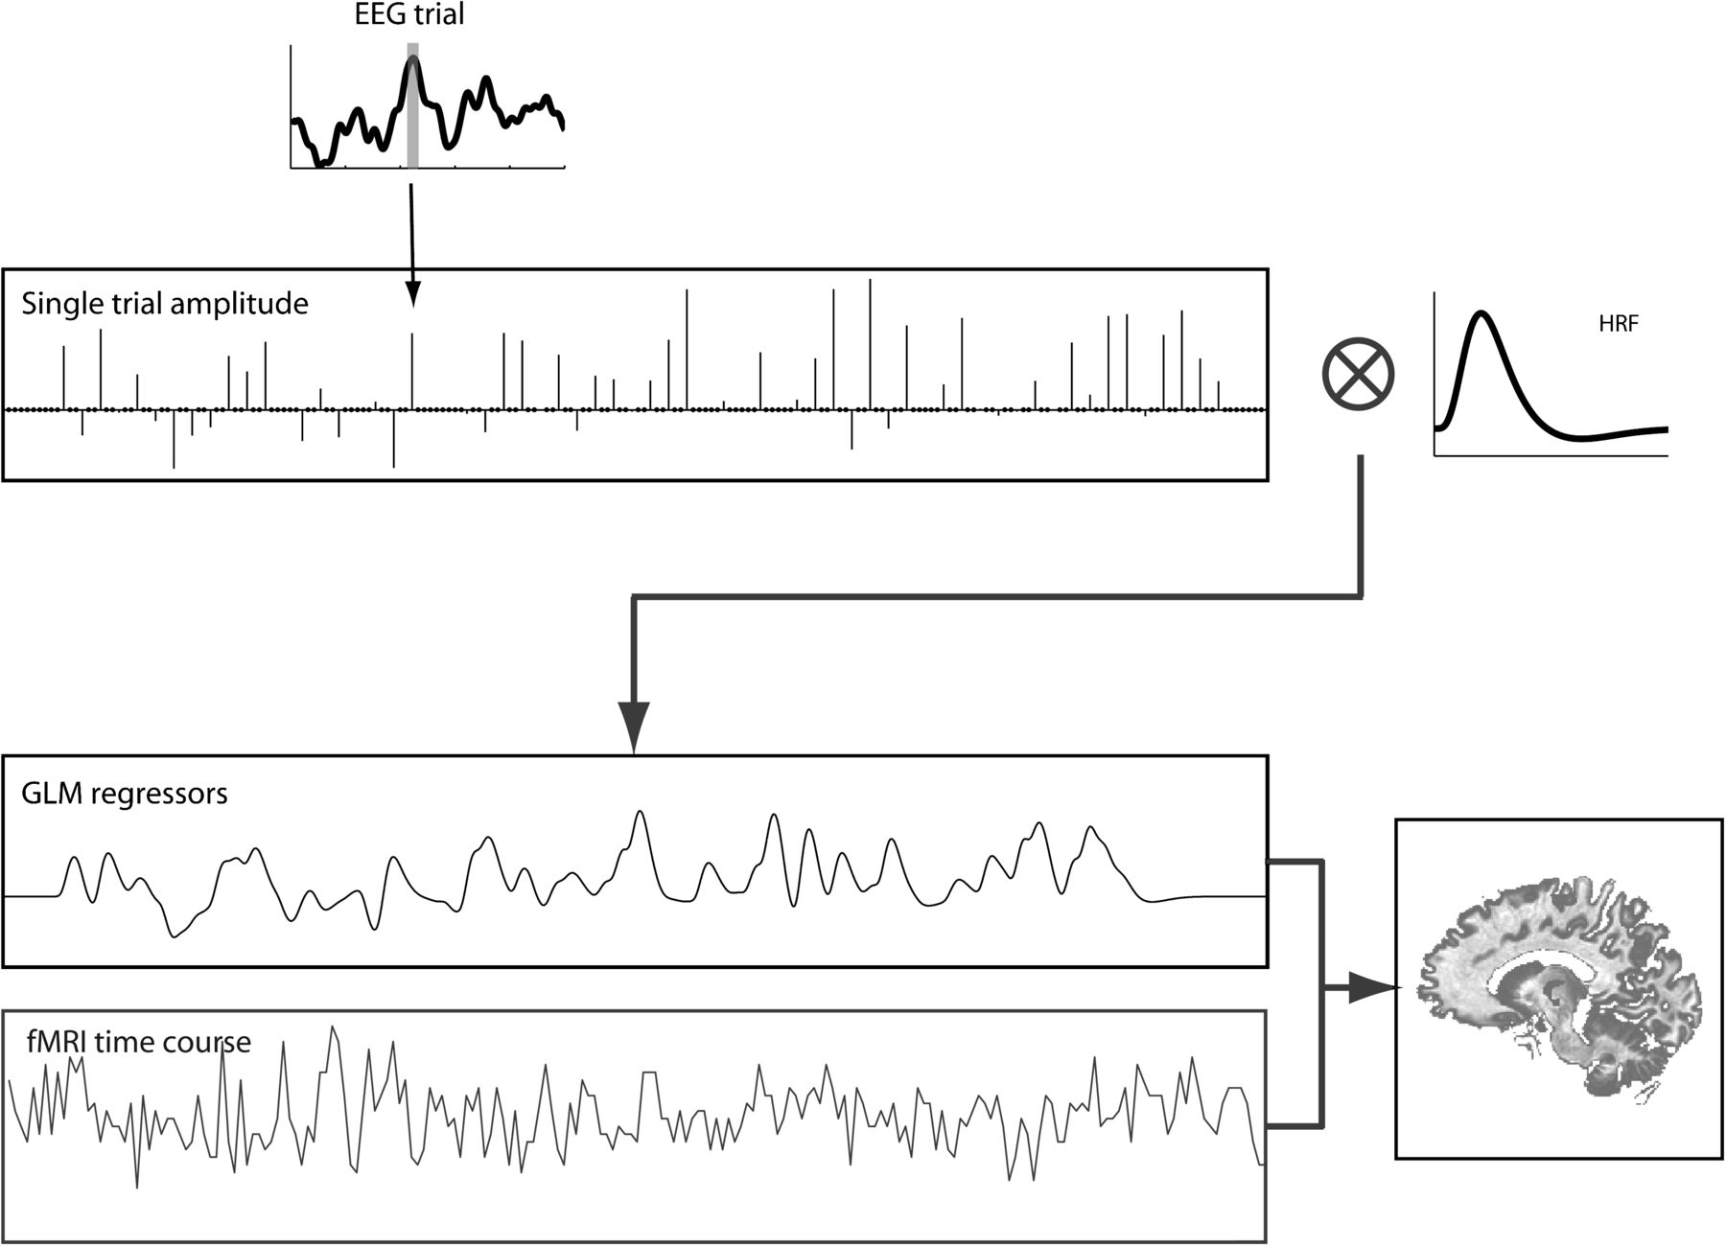
Figure 2. Schematic of single-trial EEG-informed fMRI mapping To identify brain regions associated with different ...
Notes:
Figure 2. Schematic of single-trial EEG-informed fMRI mapping To identify brain regions associated with different decision processes, we used an EEG-informed GLM analysis with separate regressors for the 2 EEG temporal components. The regressor amplitude at the time of each stimulus trial was calculated by averaging the amplitude of the EEG channel time course within a 10-ms window, centered at the component peak latency. These time series of EEG component amplitudes were used to generate 2 separate regressors and convolved with a canonical double-gamma hemodynamic response function.
Unless provided in the caption above, the following copyright applies to the content of this slide: © The Author 2011. Published by Oxford University Press. All rights reserved. For permissions, please e-mail: journals.permissions@oup.com

Slide 3
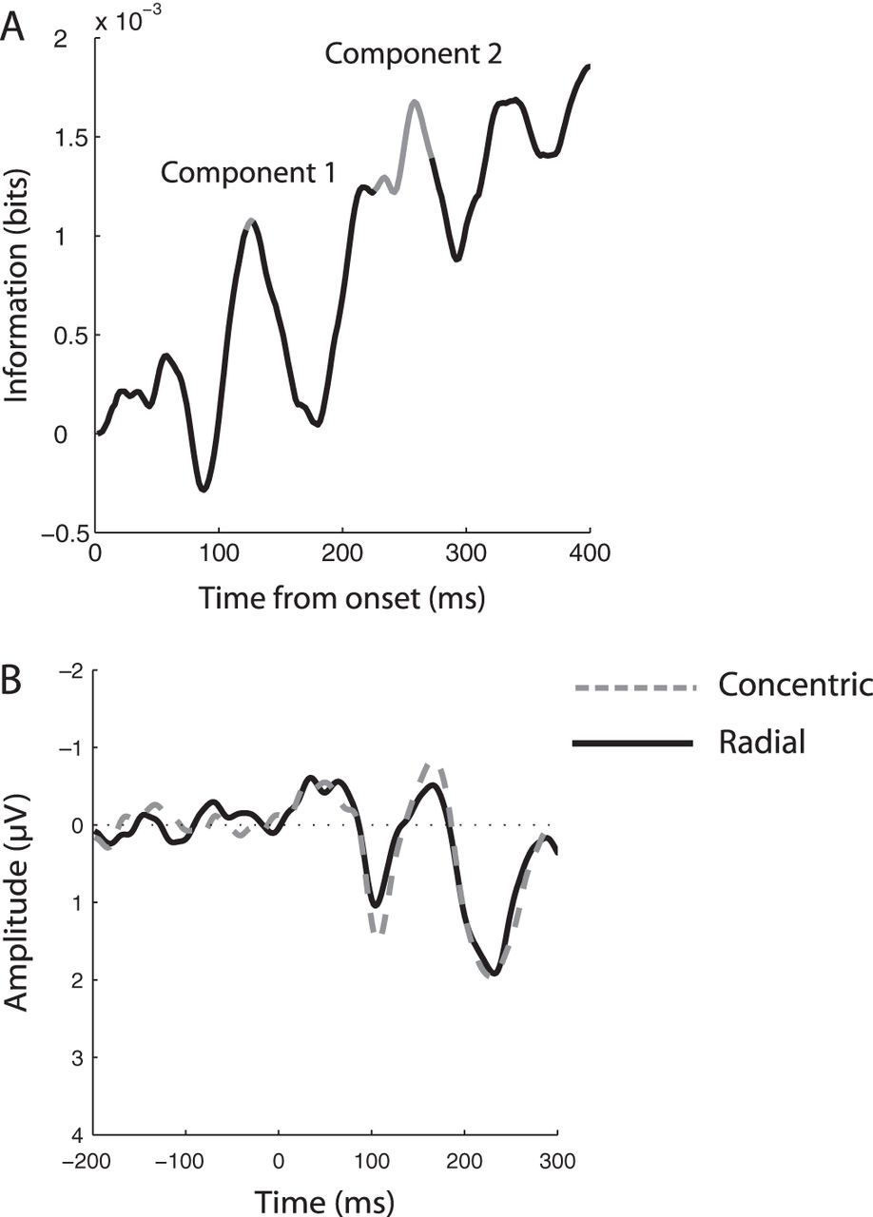
Figure 3. EEG temporal components. (A) MI time course. Information was smoothed using a 30-ms window and averaged ...
Notes:
Figure 3. EEG temporal components. (A) MI time course. Information was smoothed using a 30-ms window and averaged across all trials, channels, observers, and scanning sessions. Information values (bits) are shown after subtraction of the MI estimated using shuffled condition labels (500 iterations) and normalization to prestimulus baseline. The latencies of the 2 temporal peaks that showed the highest MI values are indicated in the plots. Shaded parts of the time course indicate significant MI values (P < 0.05). (B) Group average visual-evoked potential in response to concentric and radial Glass patterns. The waveforms are averaged across trials, the 15 channels selected for the EEG-informed fMRI analysis and all observers. This analysis showed similar peaks but lacked sufficient sensitivity to discriminate between signals related to concentric and radial patterns, in contrast to the MI-based analysis that allowed us to identify components that discriminated significantly between these signals.
Unless provided in the caption above, the following copyright applies to the content of this slide: © The Author 2011. Published by Oxford University Press. All rights reserved. For permissions, please e-mail: journals.permissions@oup.com

Slide 4
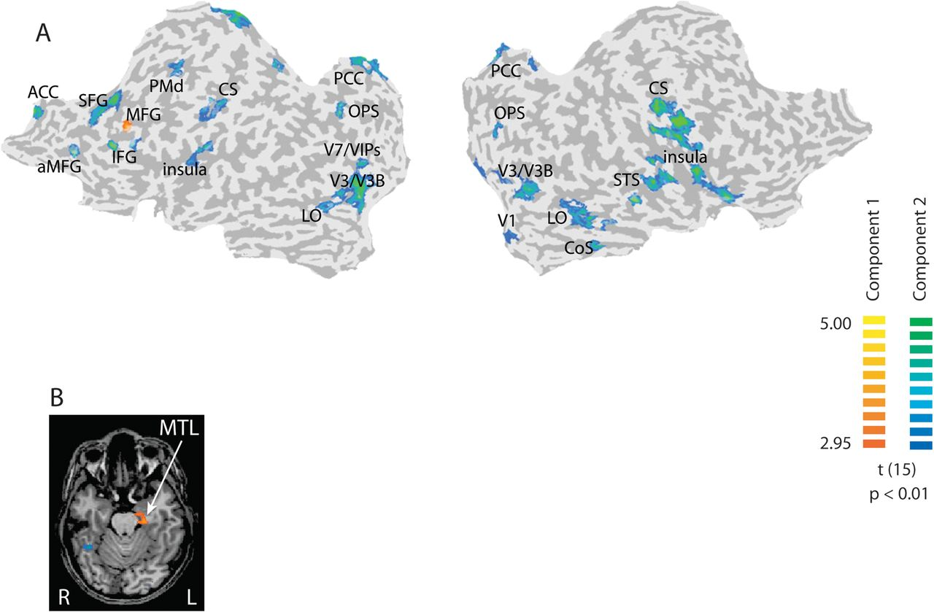
Figure 4. Single-trial EEG-informed fMRI analysis. Random effect GLM analysis (data grouped across all observers and ...
Notes:
Figure 4. Single-trial EEG-informed fMRI analysis. Random effect GLM analysis (data grouped across all observers and scanning sessions) using EEG defined regressors corresponding to the 2 temporal components. Regressors were orthogonalized by removing the common variance from the second component regressor. Activations significantly (P < 0.01, cluster threshold corrected) correlated with the first and second EEG components. (A) t-statistic maps are superimposed on flattened cortical surfaces of both hemispheres (Supplementary Table S1 for Talairach coordinates). Sulci are shown in dark gray and gyri in light gray. (B) Additional activations correlated with the first EEG component were observed in MTL.
Unless provided in the caption above, the following copyright applies to the content of this slide: © The Author 2011. Published by Oxford University Press. All rights reserved. For permissions, please e-mail: journals.permissions@oup.com

Slide 5
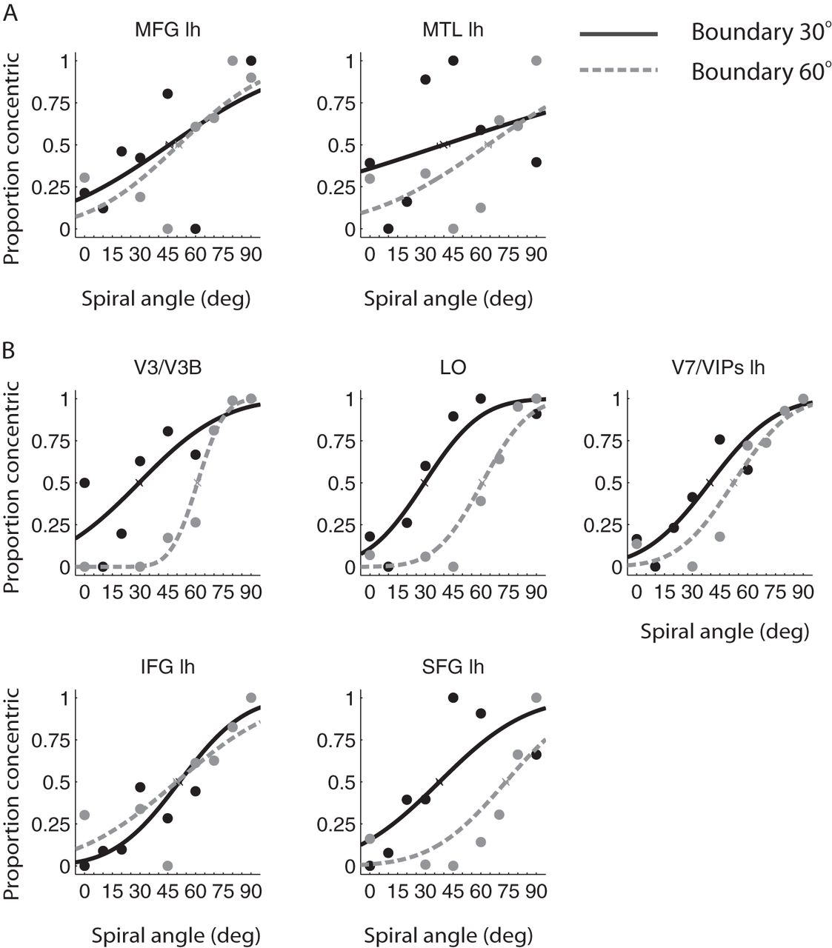
Figure 5. fMR-metric functions. fMR-metric functions based on the observers’ behavioral choice for each session (30° ...
Notes:
Figure 5. fMR-metric functions. fMR-metric functions based on the observers’ behavioral choice for each session (30° and 60° boundary) for regions significantly correlated with (A) the early and (B) later EEG component. Mean classifier performance (proportion of trials classified as concentric for each stimulus condition) across observers is plotted after linear scaling (i.e., for each fMR-metric function, we scaled each prediction by subtracting the minimum value across conditions and dividing by the difference between maximum and minimum prediction values) to allow comparison between cortical areas. Average classifier prediction data are scaled from 0 to 1 and fitted with cumulative Gaussian functions for each session: 30° (black solid lines) and 60° (gray dotted lines) boundary. Nonscaled classification values (Supplementary Fig. S2) were consistent with our previous findings (Li et al. 2009). Error bars indicate the 95% confidence interval at 50% concentric threshold. Only ROIs with significantly fitted fMR-metric functions for both sessions are shown (maximum correlation: R = 0.98, P < 0.001; minimum correlation: R = 0.78, P = 0.04). The goodness of fit (R, P) for ROIs with nonsignificantly fitted fMR-metric functions in at least 1 of the 2 scanning sessions is reported in Supplementary Table S2.
Unless provided in the caption above, the following copyright applies to the content of this slide: © The Author 2011. Published by Oxford University Press. All rights reserved. For permissions, please e-mail: journals.permissions@oup.com

Slide 6
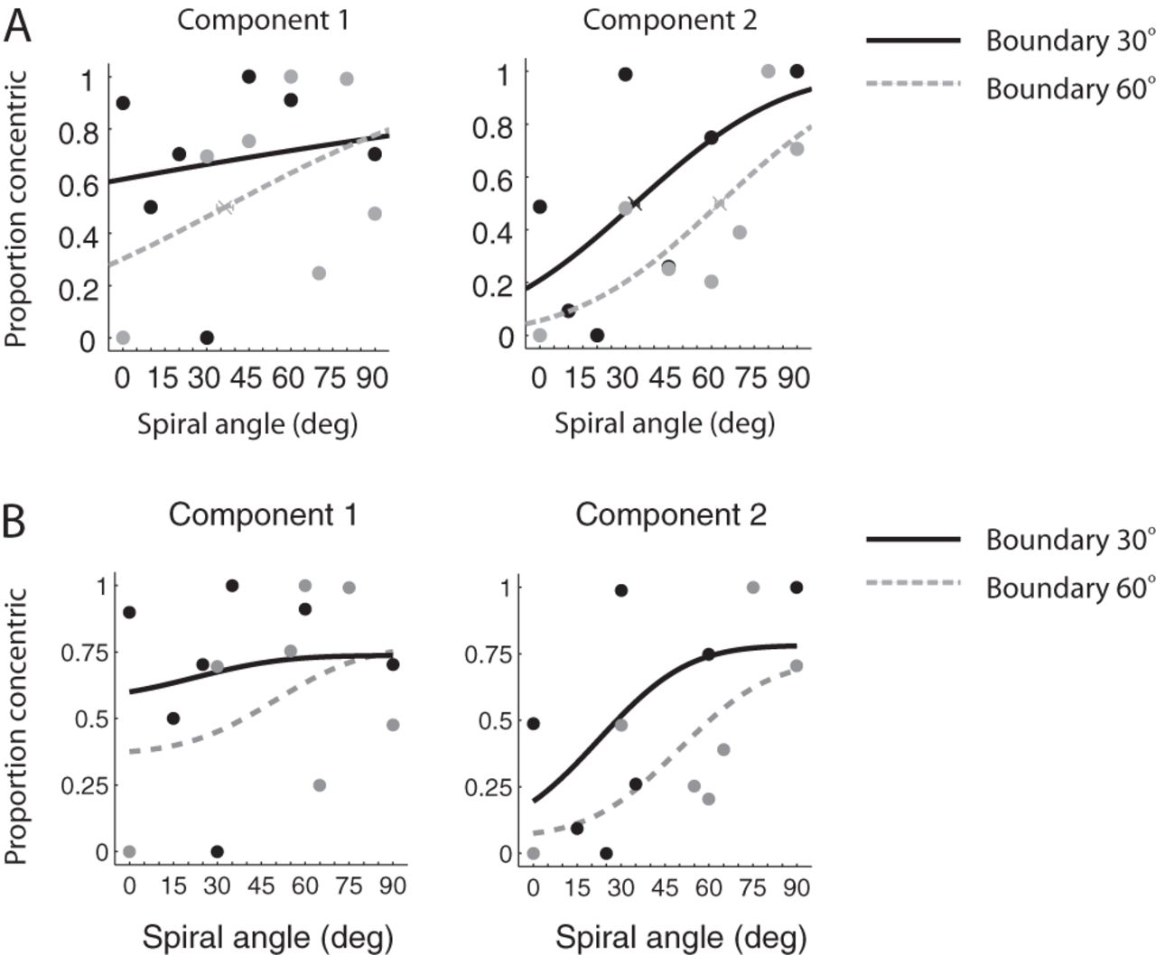
Figure 6. EEG-metric functions. (A) EEG-metric functions are shown for the first and second components for each session ...
Notes:
Figure 6. EEG-metric functions. (A) EEG-metric functions are shown for the first and second components for each session (30° and 60° boundary). The classifier performance at each condition was averaged across observers and fitted with cumulative Gaussian functions for each session. (B) Correlating psychometric and EEG-metric functions. As with the fMR-metric functions, we scaled the cumulative Gaussian model obtained from the psychophysical data to fit the classifiers predictions based on single-trial EEG data.
Unless provided in the caption above, the following copyright applies to the content of this slide: © The Author 2011. Published by Oxford University Press. All rights reserved. For permissions, please e-mail: journals.permissions@oup.com

Slide 7
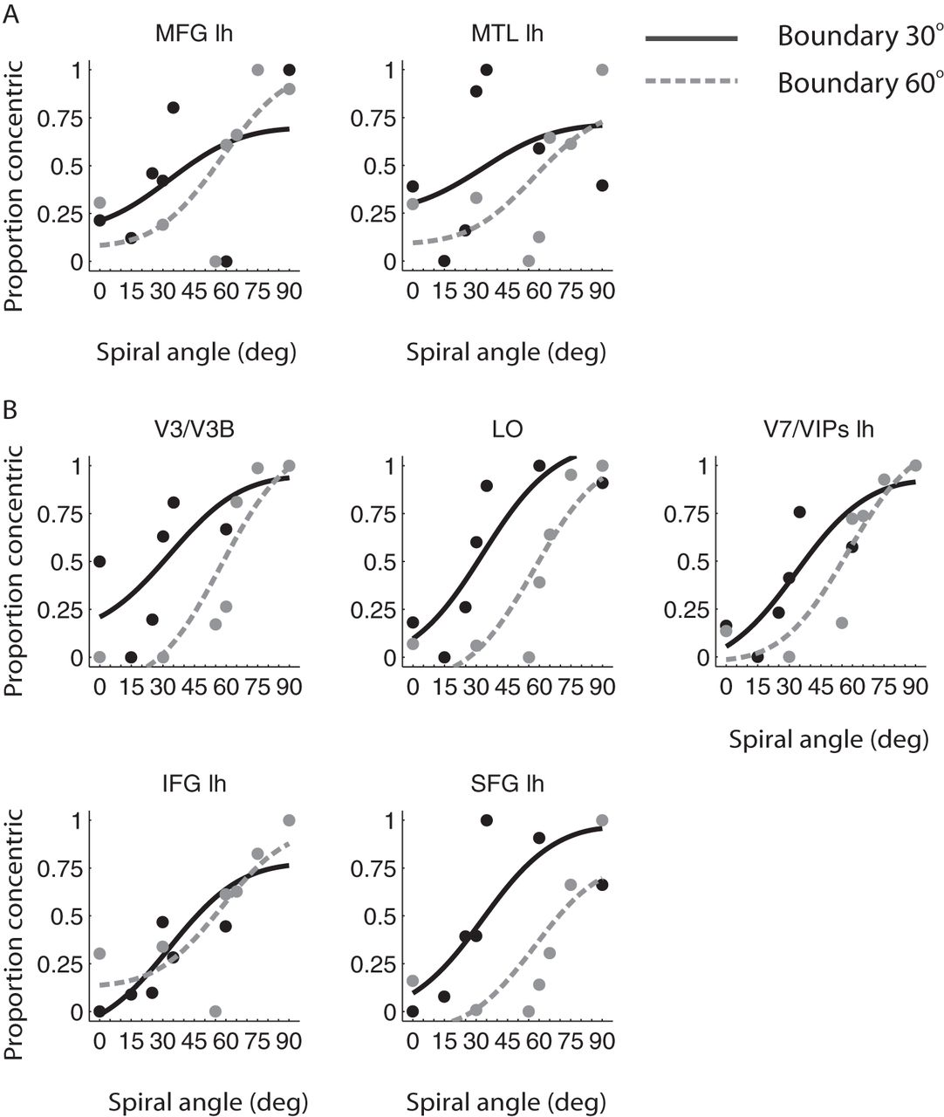
Figure 7. Correlating psychometric and fMR-metric functions. Similar to previous studies (Zenger-Landolt and Heeger ...
Notes:
Figure 7. Correlating psychometric and fMR-metric functions. Similar to previous studies (Zenger-Landolt and Heeger 2003; Chandrasekaran et al. 2007), we scaled the cumulative Gaussian model obtained from the psychophysical data to fit the fMRI data (i.e., the predictions of the pattern classifier): y=B+S1+exp(β−αx), where B is the baseline, S is the scale of the fitting, β is the intercept, and α is the slope of the cumulative Gaussian model. Data are shown for regions significantly correlated with (A) the first EEG component and (B) the second EEG component for each session: 30° (black solid lines) and 60° (gray dotted lines) boundary. Only ROIs with significantly fitted fMR-metric functions for both sessions are shown. The goodness of fit (R, P) for ROIs with nonsignificantly fitted fMR-metric functions in at least 1 of the 2 scanning sessions is reported in Supplementary Table S3.
Unless provided in the caption above, the following copyright applies to the content of this slide: © The Author 2011. Published by Oxford University Press. All rights reserved. For permissions, please e-mail: journals.permissions@oup.com

