Slide 1
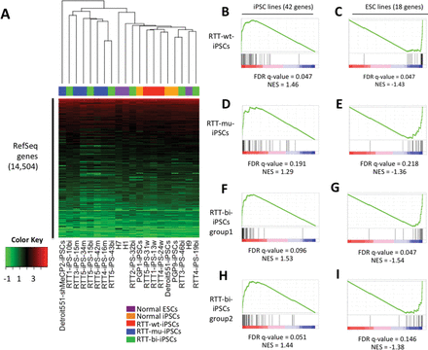
Figure 1. Global Expression similarity of hESCs, cell line-derived iPSCs and RTT-iPSCs. (A) Supervised hierarchical ...
Notes:
Figure 1. Global Expression similarity of hESCs, cell line-derived iPSCs and RTT-iPSCs. (A) Supervised hierarchical clustering analysis was performed using 14 504 expressed RefSeq genes. Log2(FPKM) values were represented by colors from green (low) to red (high). (B–I) Enrichment of iPSCs and hESCs-specific genes in RTT-iPSCs. False discovery rate (FDR) and normalized enrichment score (NES) were calculated by Gene Set Enrichment Analysis (GSEA) software at Broad institute.
Unless provided in the caption above, the following copyright applies to the content of this slide: © The Author 2013. Published by Oxford University Press. All rights reserved. For Permissions, please email: journals.permissions@oup.com

Slide 2
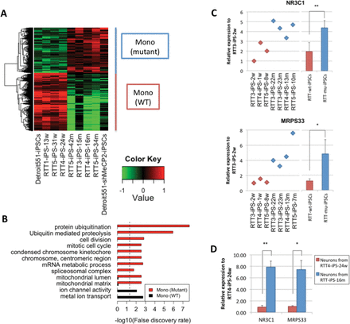
Figure 2. Differentially-expressed genes between RTT-wt-iPSCs and RTT-mu-iPSCs. (A) Heatmap represents genes, which ...
Notes:
Figure 2. Differentially-expressed genes between RTT-wt-iPSCs and RTT-mu-iPSCs. (A) Heatmap represents genes, which were highly expressed in RTT-wt-iPSCs and RTT-mu-iPSCs, respectively. Relative expression values to the average expression values across all samples were represented by colors from green to red (log2 scale). (B) Over-representation of GO terms and KEGG pathways is shown by bar plot. Dashed line represents 0.05 FDR. qPCR validation of differential expression of NR3C1 and MRPS33 in (C) RTT-iPSCs and (D) neurons derived from RTT-iPSCs (*P < 0.05 and **P < 0.01).
Unless provided in the caption above, the following copyright applies to the content of this slide: © The Author 2013. Published by Oxford University Press. All rights reserved. For Permissions, please email: journals.permissions@oup.com

Slide 3
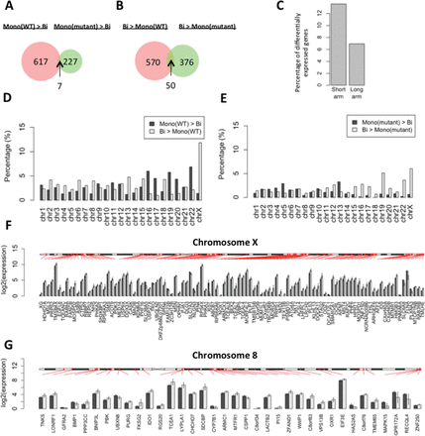
Figure 3. Differentially expressed genes between monoallelic and biallelic RTT-iPSCs. (A and B) Venn diagram represents ...
Notes:
Figure 3. Differentially expressed genes between monoallelic and biallelic RTT-iPSCs. (A and B) Venn diagram represents the number of (A) highly or (B) lowly expressed genes in RTT-wt-iPSCs and RTT-mu-iPSCs compared with RTT-bi-iPSCs (P < 0.05). Thus, the common genes in (A) were defined as monoallelic iPSC-specific and in (B) as biallelic iPSC-specific genes. (C) Comparison of the ratio of differentially expressed X-linked genes between short (60 600 kbp). (D and E) (D) The percentage of differentially expressed genes in each chromosome between RTT-wt-iPSCs and RTT-bi-iPSCs and (E) between RTT-mu-iPSCs and RTT-bi-iPSCs. The ratio was calculated by dividing the absolute amount of differentially expressed genes by the total number of genes per chromosome. (F and G) Chromosomal distribution of differentially-expressed genes in (F) chromosome X and (G) chromosome 8. Black and gray bars represent average of log2(FPKM) value in RTT-wt-iPSCs and RTT-bi-iPSCs, respectively. Error bar represents standard deviation of log2(FPKM).
Unless provided in the caption above, the following copyright applies to the content of this slide: © The Author 2013. Published by Oxford University Press. All rights reserved. For Permissions, please email: journals.permissions@oup.com

Slide 4
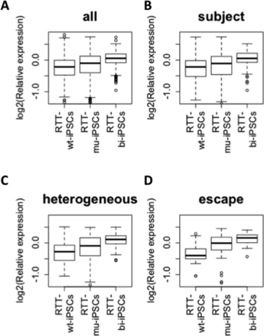
Figure 4. Expression of genes in X chromosome among mono-allelic wild type and mutant, and biallelic RTT-iPSCs. ...
Notes:
Figure 4. Expression of genes in X chromosome among mono-allelic wild type and mutant, and biallelic RTT-iPSCs. Relative expression level to average of all RTT-iPSCs are shown (log2 scale): (A) average all; (B), ‘heterogeneous’; (C), ‘subject’; (D), ‘escape’ X-linked genes which are defined by Carrel et al. (38).
Unless provided in the caption above, the following copyright applies to the content of this slide: © The Author 2013. Published by Oxford University Press. All rights reserved. For Permissions, please email: journals.permissions@oup.com

Slide 5
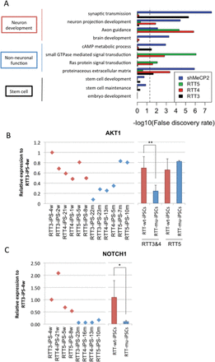
Figure 5. Differential gene expression in RTT iPSCs with distinct mutations. (A) Over-represented GO terms and KEGG ...
Notes:
Figure 5. Differential gene expression in RTT iPSCs with distinct mutations. (A) Over-represented GO terms and KEGG pathways of downregulated genes in RTT-iPSCs with different mutations and MeCP2 KD iPSCs. Pathways in non-neuronal and neuronal functions were represented. Dashed line represents 0.05 FDR. (B and C) qPCR validation of differential expression of neuronal developmental genes (AKT1 and NOTCH1) using multiple wild-type and mutant RTT-iPSCs. (*P < 0.05 and **P < 0.01)
Unless provided in the caption above, the following copyright applies to the content of this slide: © The Author 2013. Published by Oxford University Press. All rights reserved. For Permissions, please email: journals.permissions@oup.com

