Slide 1
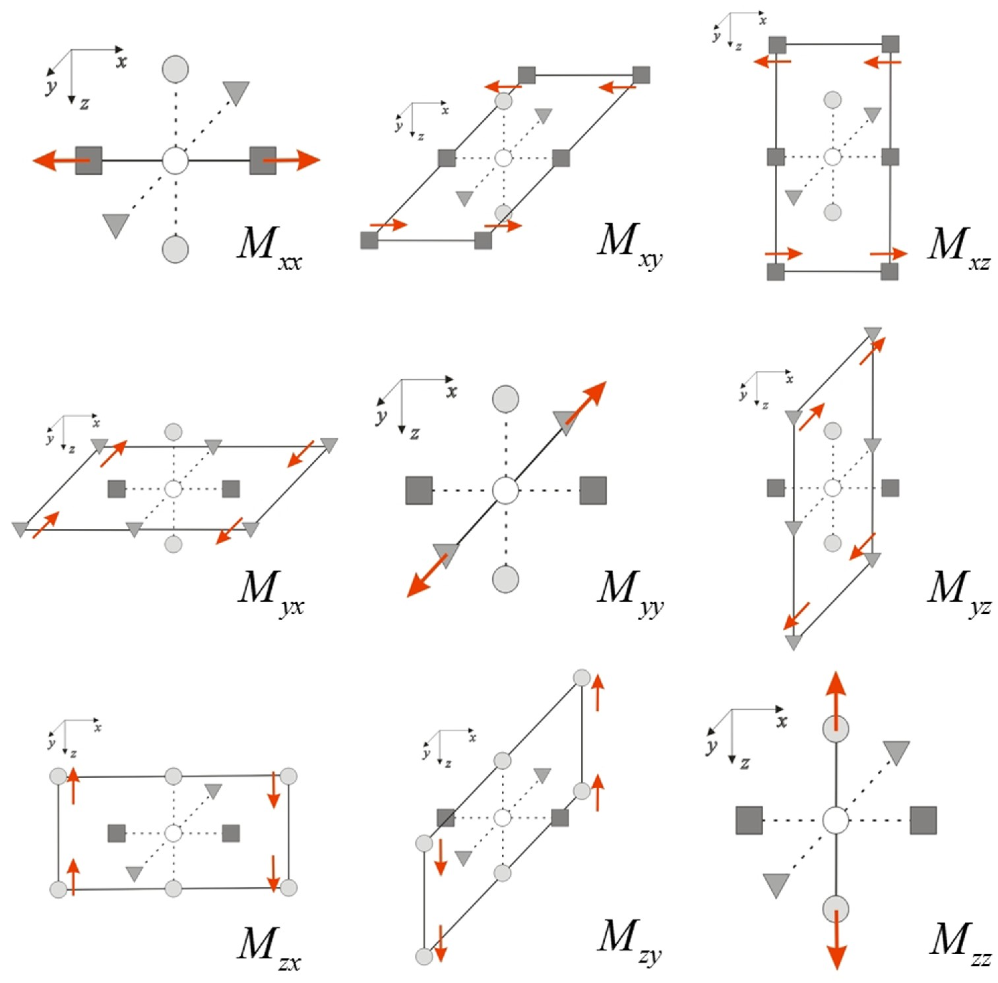
Figure 1. Schematic diagram illustrating the source mechanism of each element in the Moment tensor, M. They are ...
Notes:
Figure 1. Schematic diagram illustrating the source mechanism of each element in the Moment tensor, M. They are depicted based on 3-D elastic staggered grid (Graves 1996), which is good to express both stress and the resulting body forces. The normal stresses and nine elastic constants are defined on the white circles. The dark grey rectangle, grey inverted triangle and light grey circles indicate the displacements (or body forces) along x, y and z directions, respectively. Shear stresses, which are located between each displacement component, are not shown in this figure for the simplicity.
Unless provided in the caption above, the following copyright applies to the content of this slide: © The Authors 2016. Published by Oxford University Press on behalf of The Royal Astronomical Society.

Slide 2
Figure 2. Schematic diagrams illustrating the definition of the angles that will be used throughout the paper: (a) for ...
Notes:
Figure 2. Schematic diagrams illustrating the definition of the angles that will be used throughout the paper: (a) for incident P wave and (b) for incident S wave. The angles $\theta _i^P$ and $\theta _i^S$ denote the incidence angles of P and S waves and the angles $\theta _d^P$ and $\theta _d^S$ denote the diffracted angles of P and S waves. The four angles, $\theta _o^{PP}$, $\theta _o^{PS}$, $\theta _o^{SP}$ and $\theta _o^{SS}$, are the opening angles which are defined by the Snell's law as shown from eqs (37) to (40).
Unless provided in the caption above, the following copyright applies to the content of this slide: © The Authors 2016. Published by Oxford University Press on behalf of The Royal Astronomical Society.

Slide 3
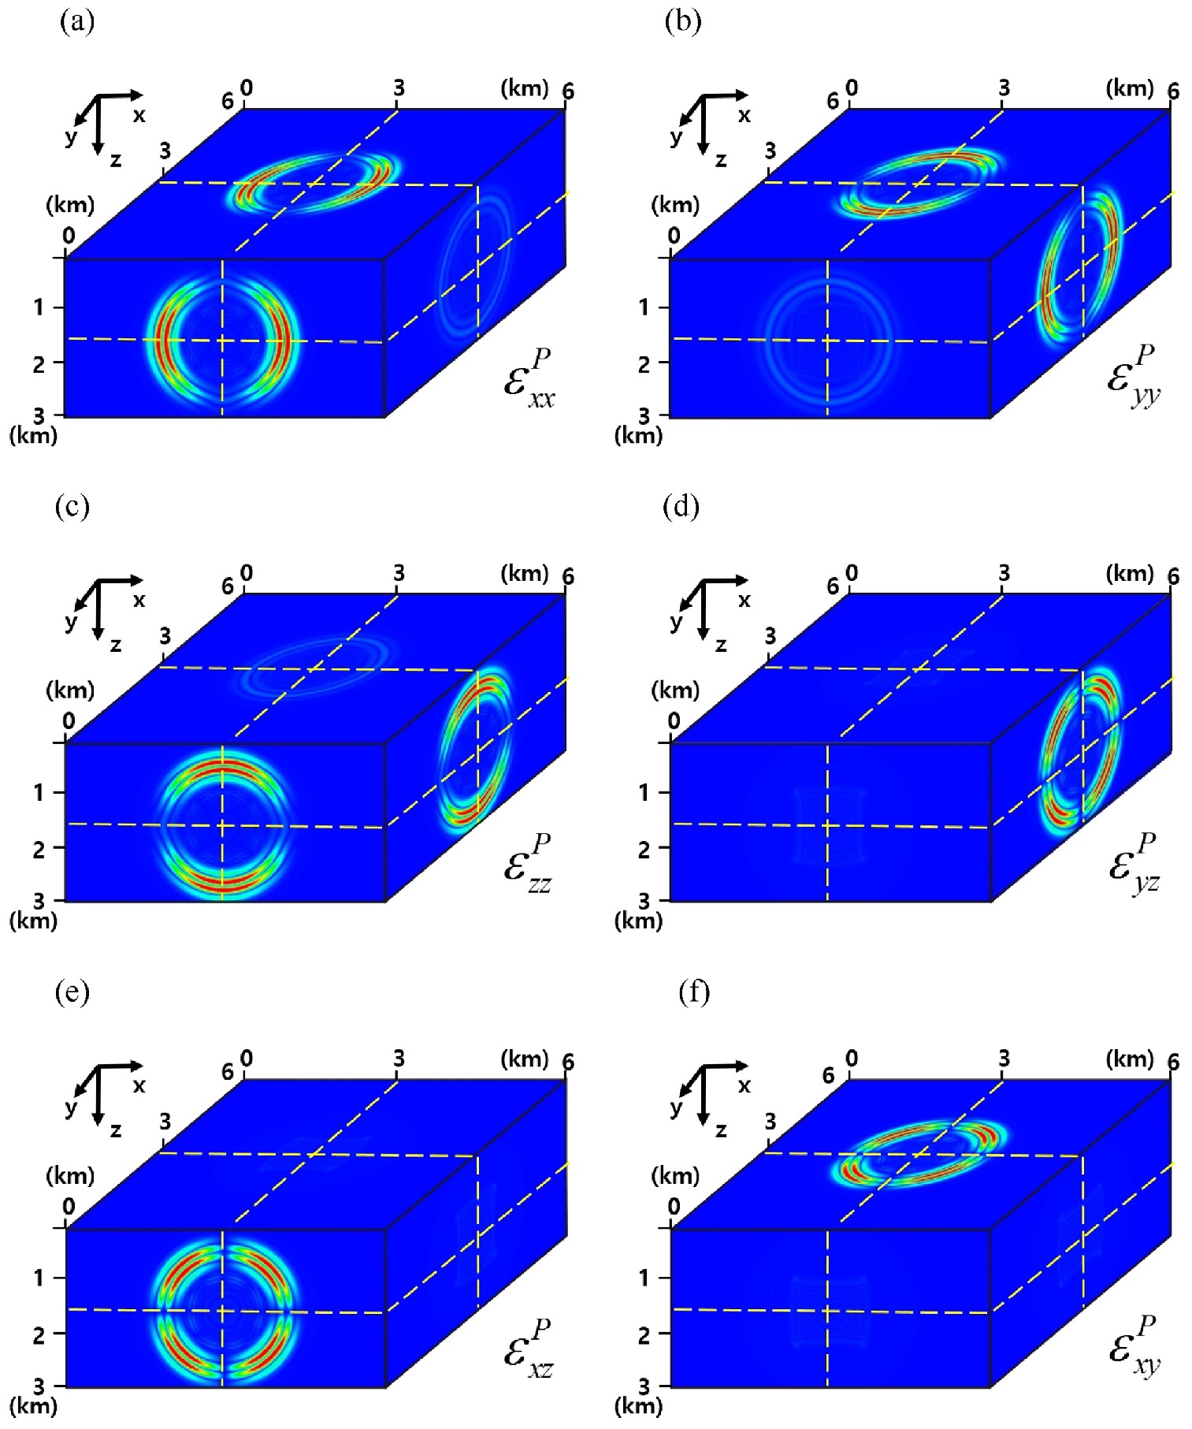
Figure 3. Snapshots of each strain fields caused by incident P wave generated from the centre of the model; (3, 3, 1.5 ...
Notes:
Figure 3. Snapshots of each strain fields caused by incident P wave generated from the centre of the model; (3, 3, 1.5 km). The results are obtained from the isotropic homogeneous background model at 1 sec along the yellow dashed lines.
Unless provided in the caption above, the following copyright applies to the content of this slide: © The Authors 2016. Published by Oxford University Press on behalf of The Royal Astronomical Society.

Slide 4
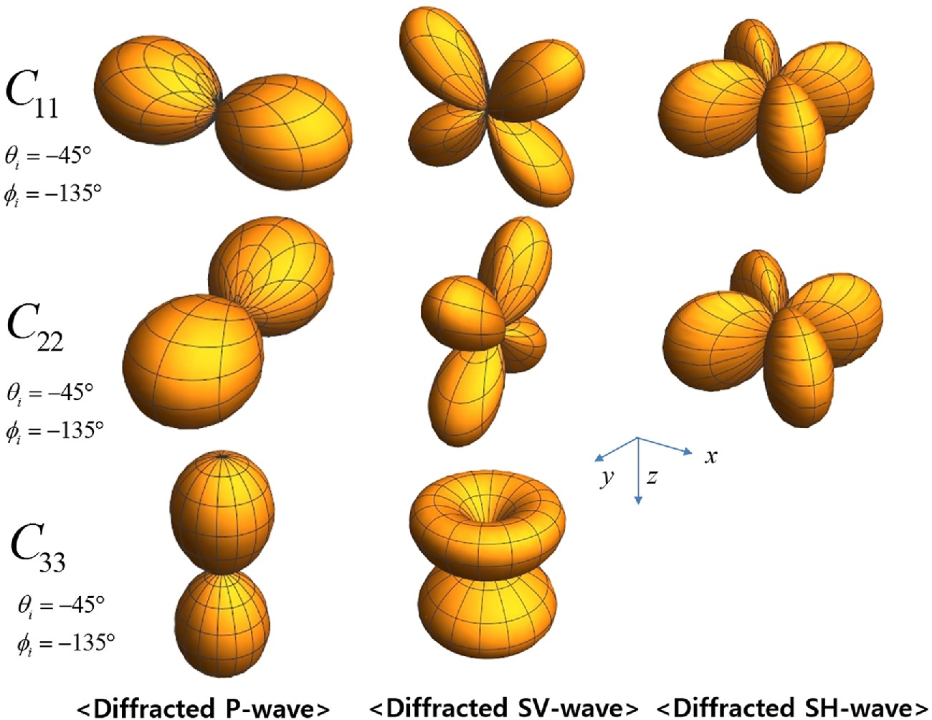
Figure 4. The diffraction-based radiation patterns of C₁₁, C₂₂ and C₃₃ for the ...
Notes:
Figure 4. The diffraction-based radiation patterns of C11, C22 and C33 for the incident P wave that is generated from the source located at −45° incidence angle and −135° azimuth angle.
Unless provided in the caption above, the following copyright applies to the content of this slide: © The Authors 2016. Published by Oxford University Press on behalf of The Royal Astronomical Society.

Slide 5
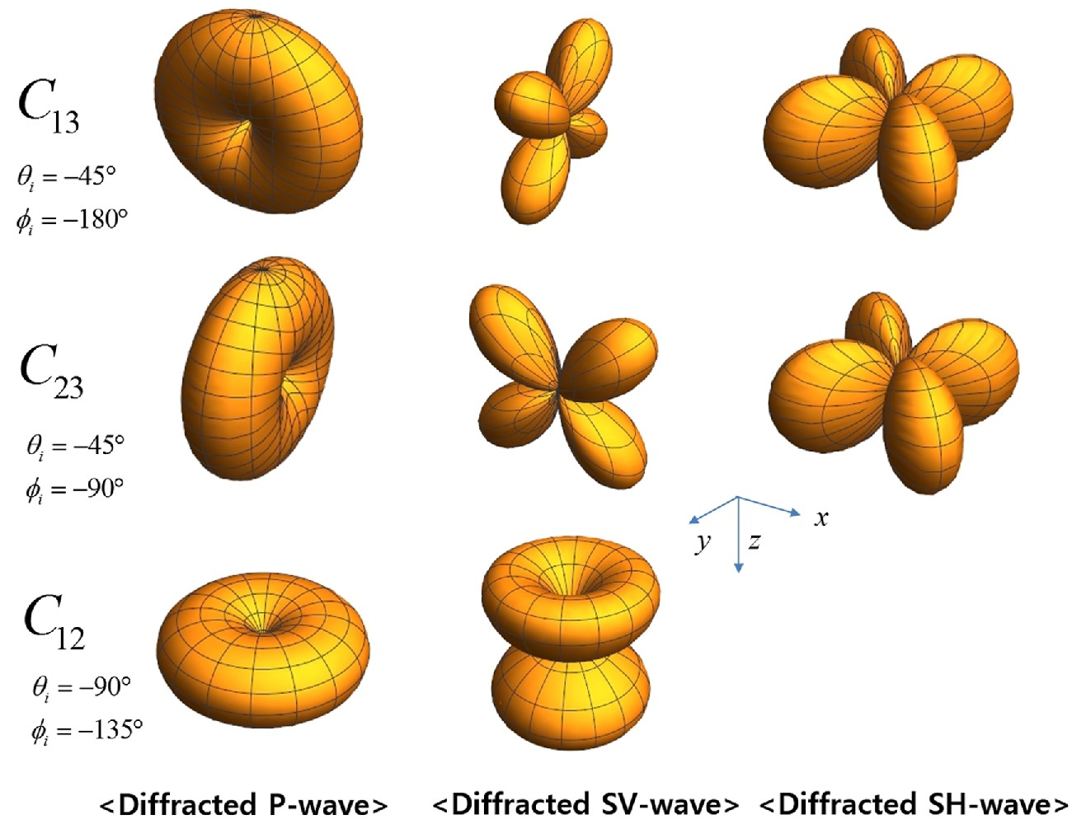
Figure 5. The diffraction-based radiation patterns of C₁₃, C₂₃ and C₁₂ for the ...
Notes:
Figure 5. The diffraction-based radiation patterns of C13, C23 and C12 for the incident P wave. Notice that each parameter is derived from different source locations.
Unless provided in the caption above, the following copyright applies to the content of this slide: © The Authors 2016. Published by Oxford University Press on behalf of The Royal Astronomical Society.

Slide 6
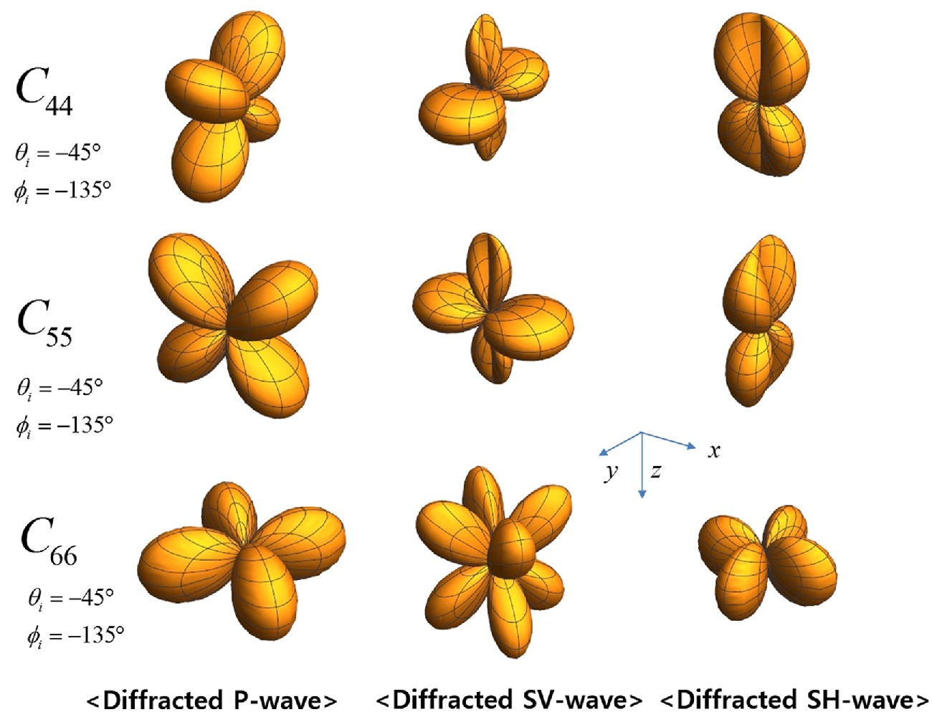
Figure 6. The diffraction-based radiation patterns of C₄₄, C₅₅ and C₆₆ for the ...
Notes:
Figure 6. The diffraction-based radiation patterns of C44, C55 and C66 for the incident P wave that is generated from the source located at −45° incidence angle and −135° azimuth angle.
Unless provided in the caption above, the following copyright applies to the content of this slide: © The Authors 2016. Published by Oxford University Press on behalf of The Royal Astronomical Society.

Slide 7
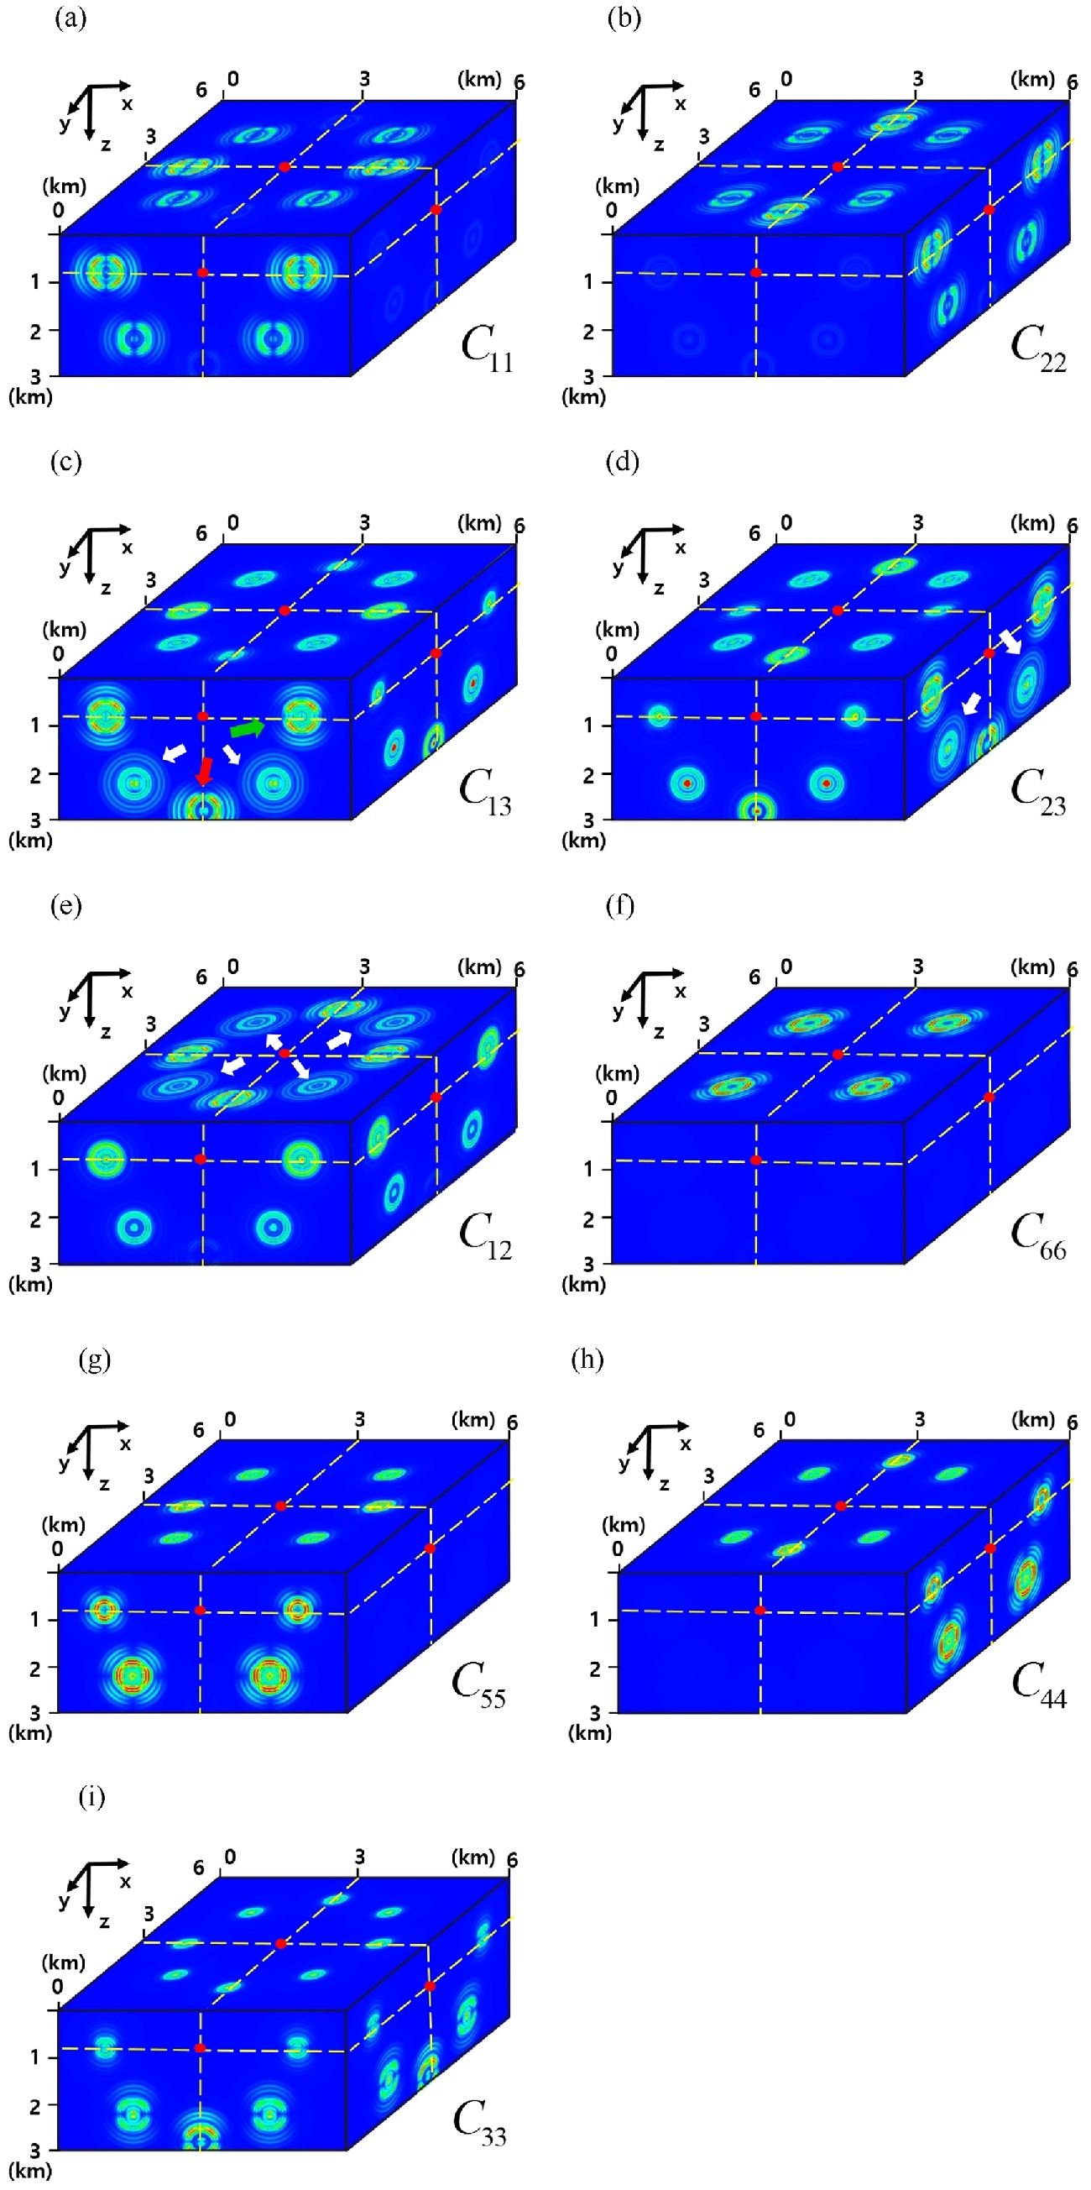
Figure 7. Snapshots of the partial derivative wavefields for 9 elastic constants. The source is located in the middle ...
Notes:
Figure 7. Snapshots of the partial derivative wavefields for 9 elastic constants. The source is located in the middle at 0.8 km depth. We assume 13 perturbations at the same time, which are far from the source with the same distance. The square loot of the displacement vector at each plane intersecting the source location on red dot (slices along yellow dashed lines) is projected onto the cube's surface.
Unless provided in the caption above, the following copyright applies to the content of this slide: © The Authors 2016. Published by Oxford University Press on behalf of The Royal Astronomical Society.

Slide 8
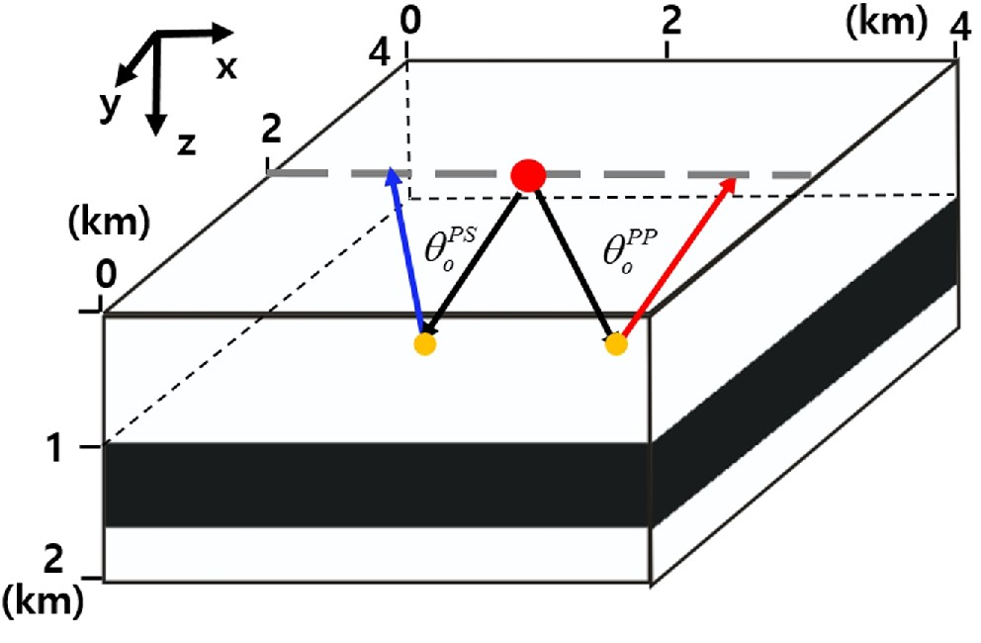
Figure 8. A simple model with one horizontal layer within a homogeneous background medium. The dashed grey line ...
Notes:
Figure 8. A simple model with one horizontal layer within a homogeneous background medium. The dashed grey line indicates the survey line (inline). The black, red and blue lines indicate the incident ray path, reflected P–P ray path and reflected P–SV ray path, respectively, that are used to calculate the reflection-based radiation pattern analytically. The red circle indicate the source location, which is assumed to calculate the gradient direction. The orange circle represents a possible reflector at the boundary of the layer, whose location can be varied depending on the opening angle and azimuth angle. The definitions of each opening angle ($\theta _o^{PP}$ and $\theta _o^{PS}$) are defined in the equations from (37) to (40).
Unless provided in the caption above, the following copyright applies to the content of this slide: © The Authors 2016. Published by Oxford University Press on behalf of The Royal Astronomical Society.

Slide 9
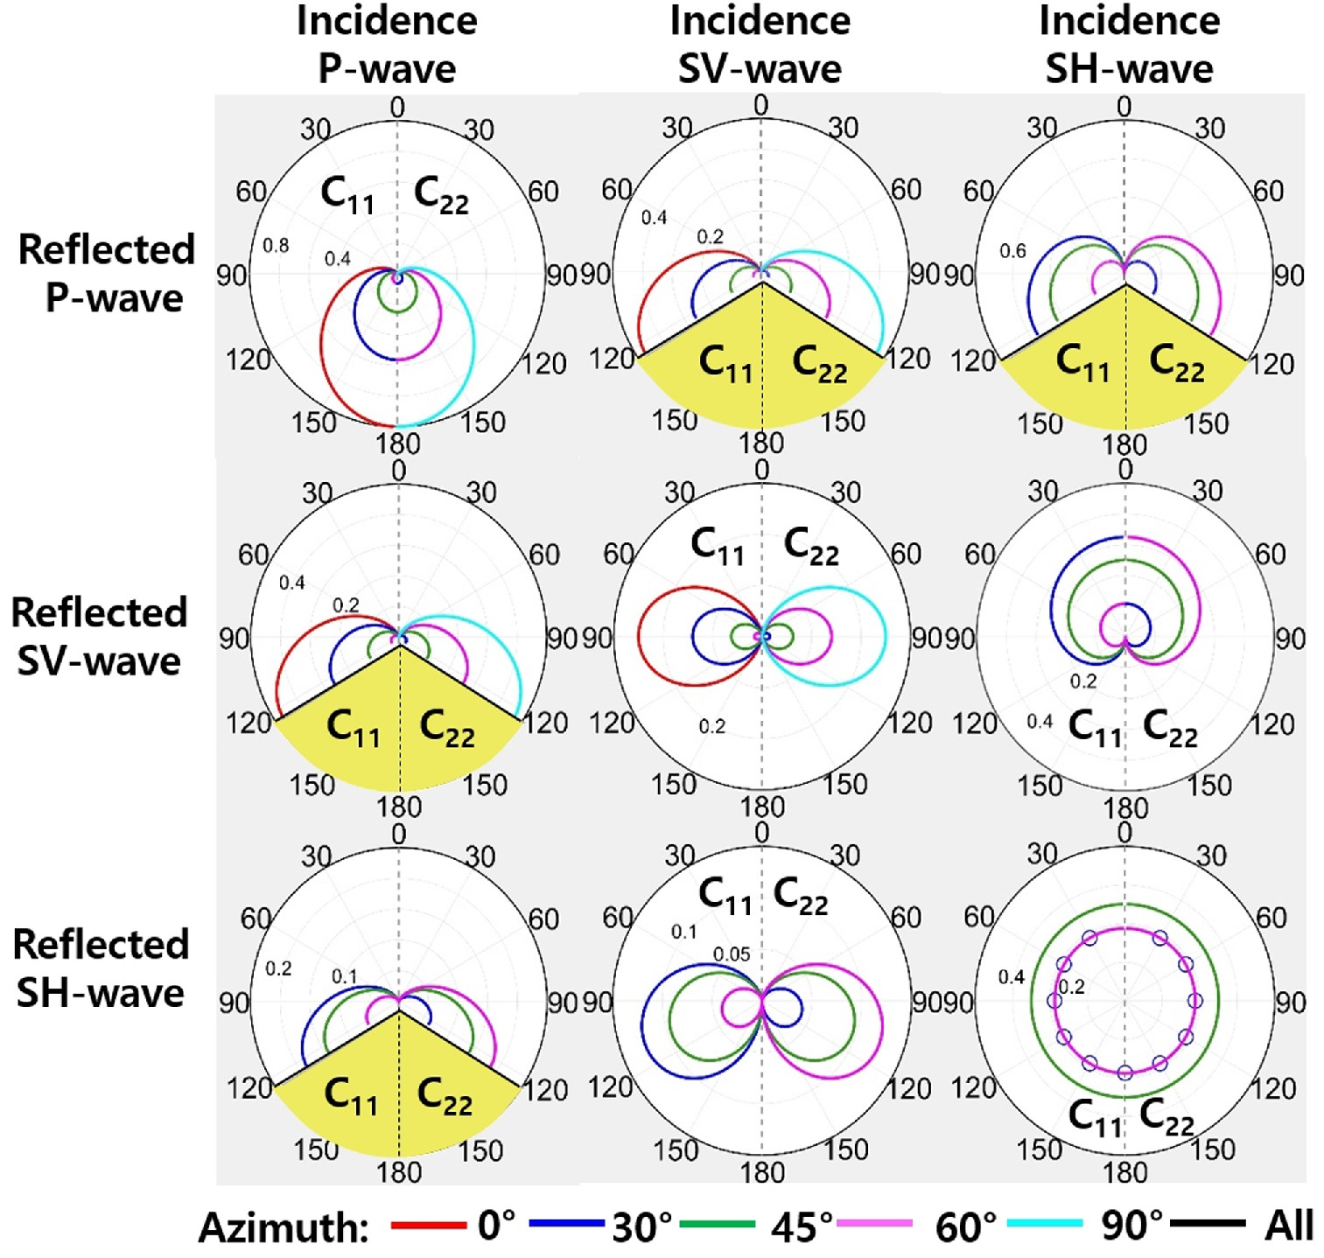
Figure 9. The reflection-based radiation pattern for C₁₁ (left hemisphere) and C₂₂ (right ...
Notes:
Figure 9. The reflection-based radiation pattern for C11 (left hemisphere) and C22 (right hemisphere) perturbations. Each column indicates the types of incident waves and each row denotes the types of reflected waves. The angle is defined as the opening angle (θ0) for each mode-conversion shown in Fig. 7. For PS and SP conversions, there are no reflection at yellow area due to the critical angle in eq. (41).
Unless provided in the caption above, the following copyright applies to the content of this slide: © The Authors 2016. Published by Oxford University Press on behalf of The Royal Astronomical Society.

Slide 10
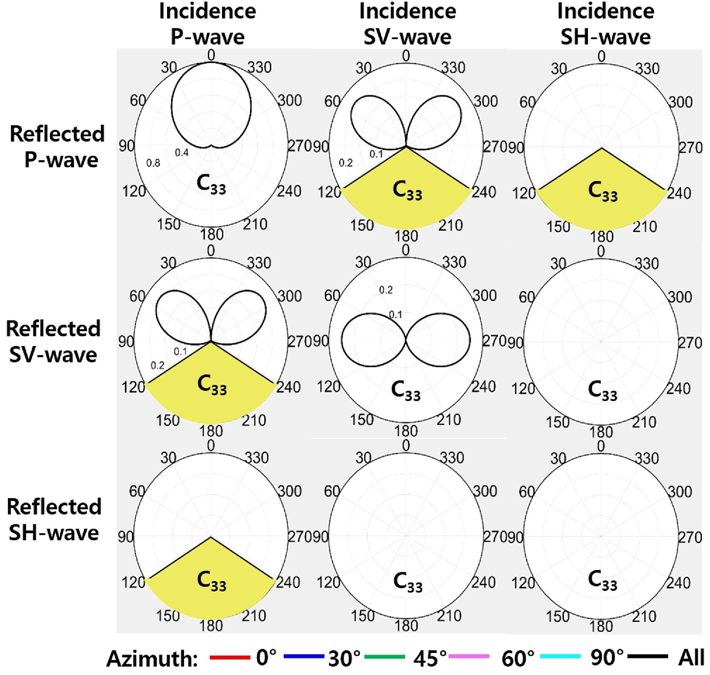
Figure 10. The reflection-based radiation pattern for C₃₃ perturbations.
Notes:
Figure 10. The reflection-based radiation pattern for C33 perturbations.
Unless provided in the caption above, the following copyright applies to the content of this slide: © The Authors 2016. Published by Oxford University Press on behalf of The Royal Astronomical Society.

Slide 11
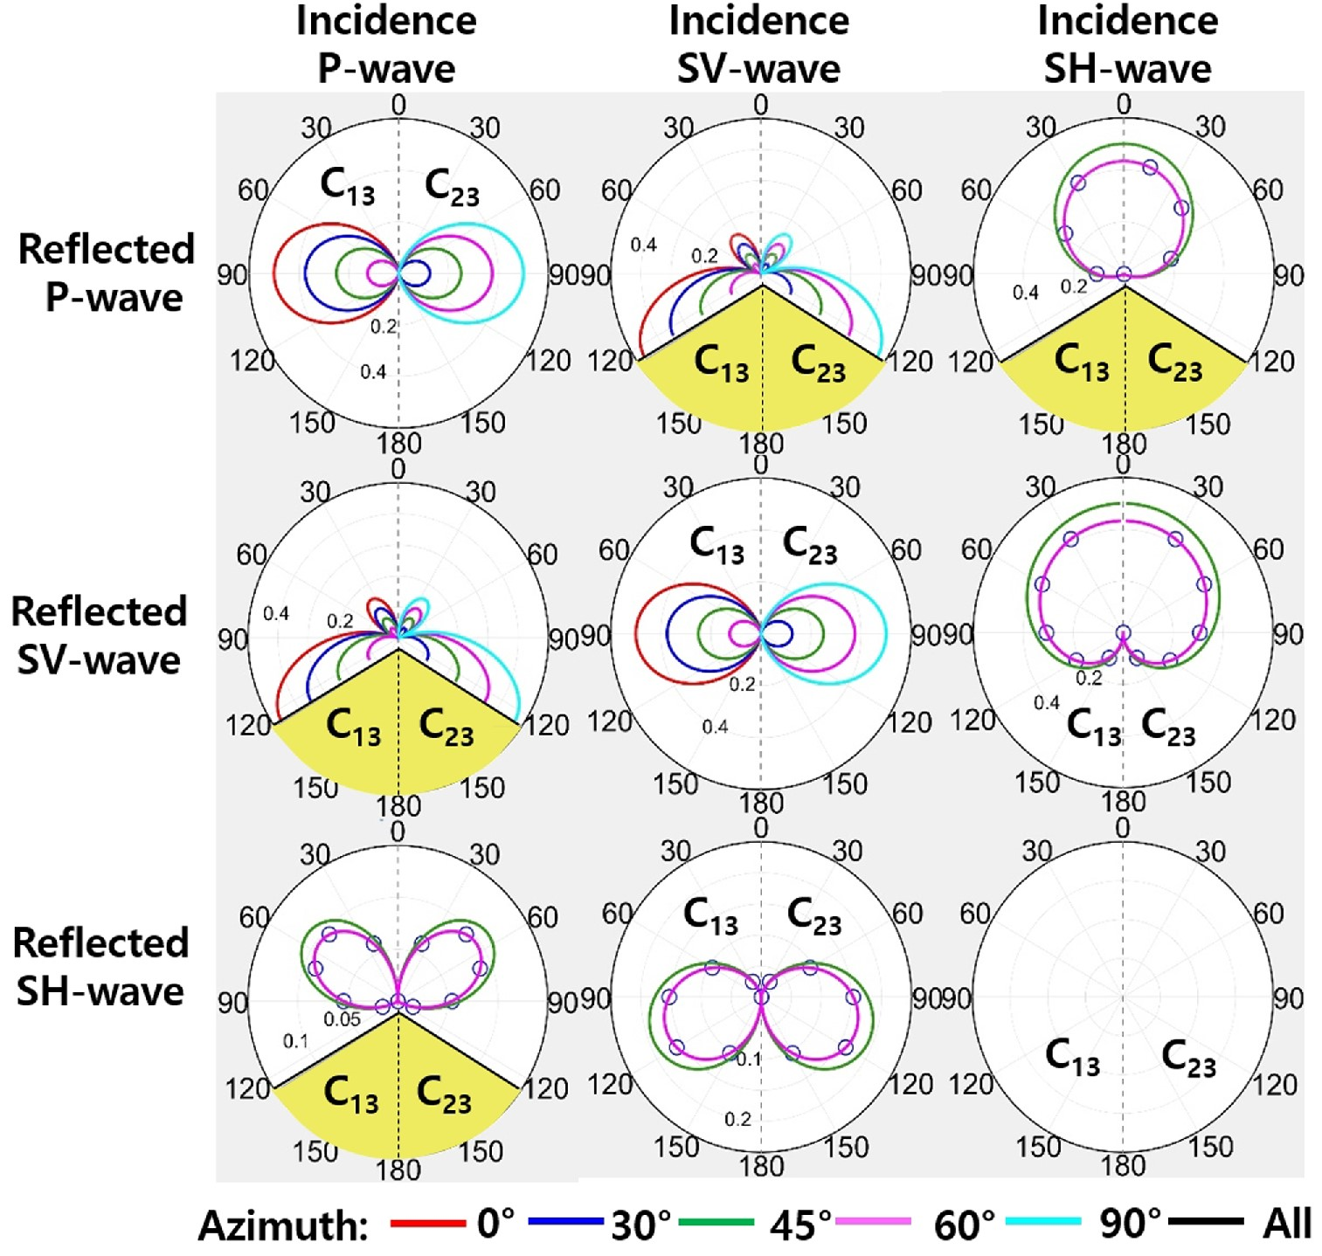
Figure 11. The reflection-based radiation pattern for C₁₃ (left hemisphere) and C₂₃ (right ...
Notes:
Figure 11. The reflection-based radiation pattern for C13 (left hemisphere) and C23 (right hemisphere) perturbation. For the SH–P reflected wave, we ignore sin θ in the denominator (eq. 36) to avoid the singularity at 0 opening angle.
Unless provided in the caption above, the following copyright applies to the content of this slide: © The Authors 2016. Published by Oxford University Press on behalf of The Royal Astronomical Society.

Slide 12
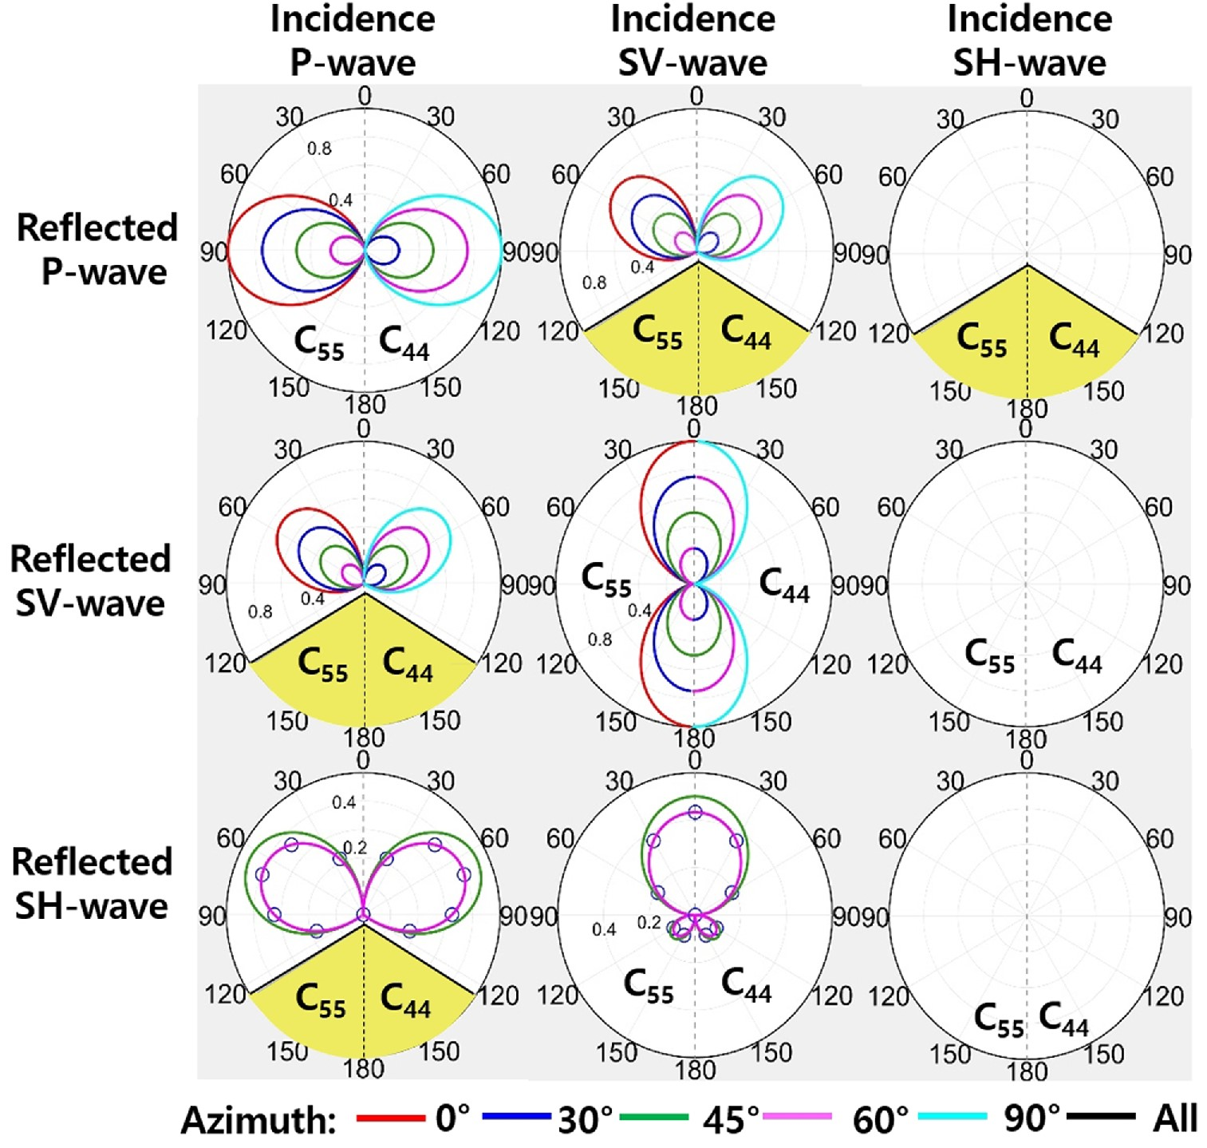
Figure 12. The reflection-based radiation pattern for C₁₂ (left hemisphere) and C₆₆ (right ...
Notes:
Figure 12. The reflection-based radiation pattern for C12 (left hemisphere) and C66 (right hemisphere) perturbation.
Unless provided in the caption above, the following copyright applies to the content of this slide: © The Authors 2016. Published by Oxford University Press on behalf of The Royal Astronomical Society.

Slide 13
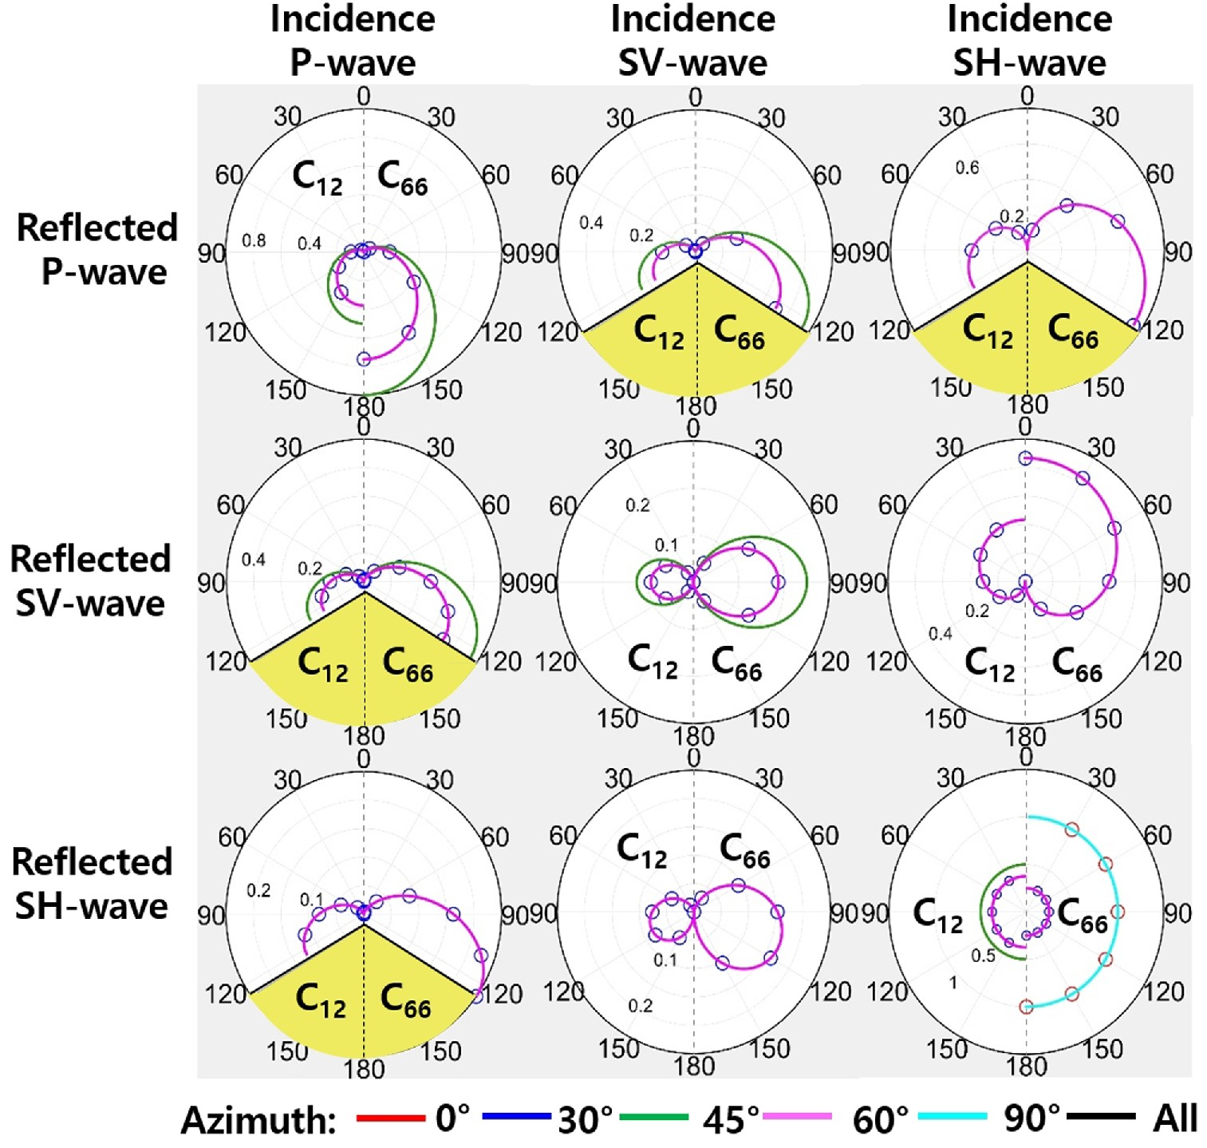
Figure 13. The reflection-based radiation pattern for C₁₂ (left hemisphere) and C₆₆ (right ...
Notes:
Figure 13. The reflection-based radiation pattern for C12 (left hemisphere) and C66 (right hemisphere) perturbation.
Unless provided in the caption above, the following copyright applies to the content of this slide: © The Authors 2016. Published by Oxford University Press on behalf of The Royal Astronomical Society.

Slide 14
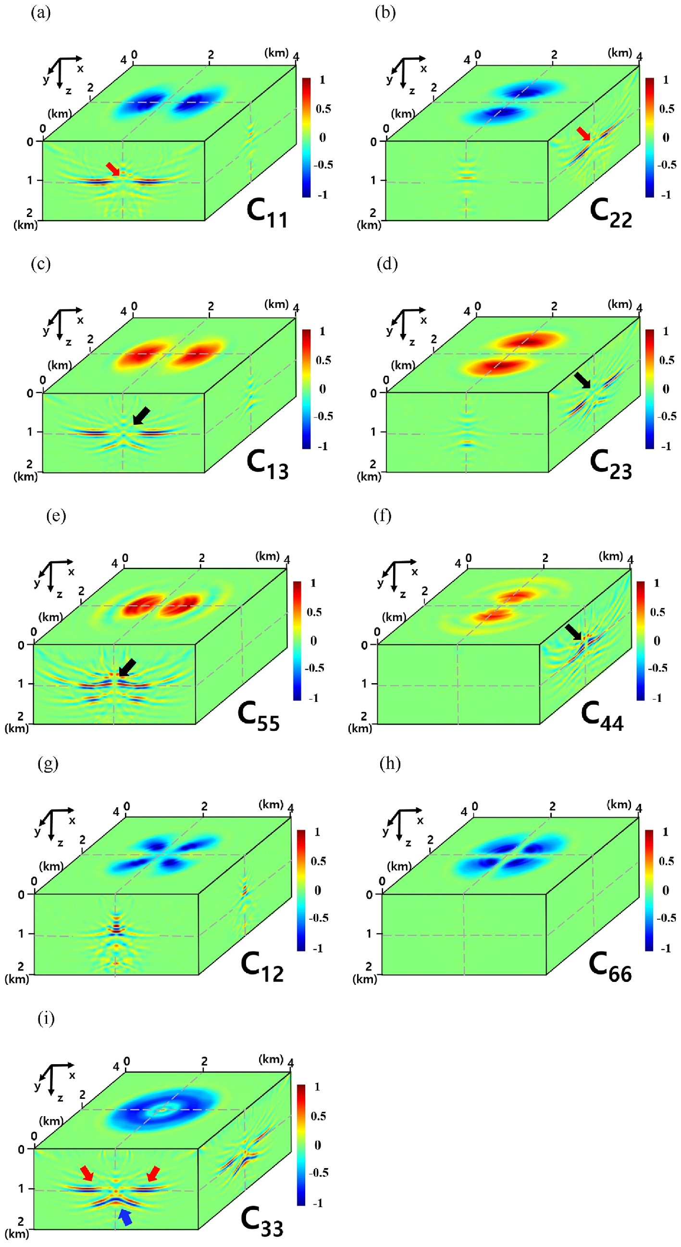
Figure 14. The gradient directions for each elastic constant obtain from a single shot on the middle of the surface. The ...
Notes:
Figure 14. The gradient directions for each elastic constant obtain from a single shot on the middle of the surface. The gradient vector at each plane (slices along grey dashed lines) is projected onto the cube's surface.
Unless provided in the caption above, the following copyright applies to the content of this slide: © The Authors 2016. Published by Oxford University Press on behalf of The Royal Astronomical Society.

