Slide 1
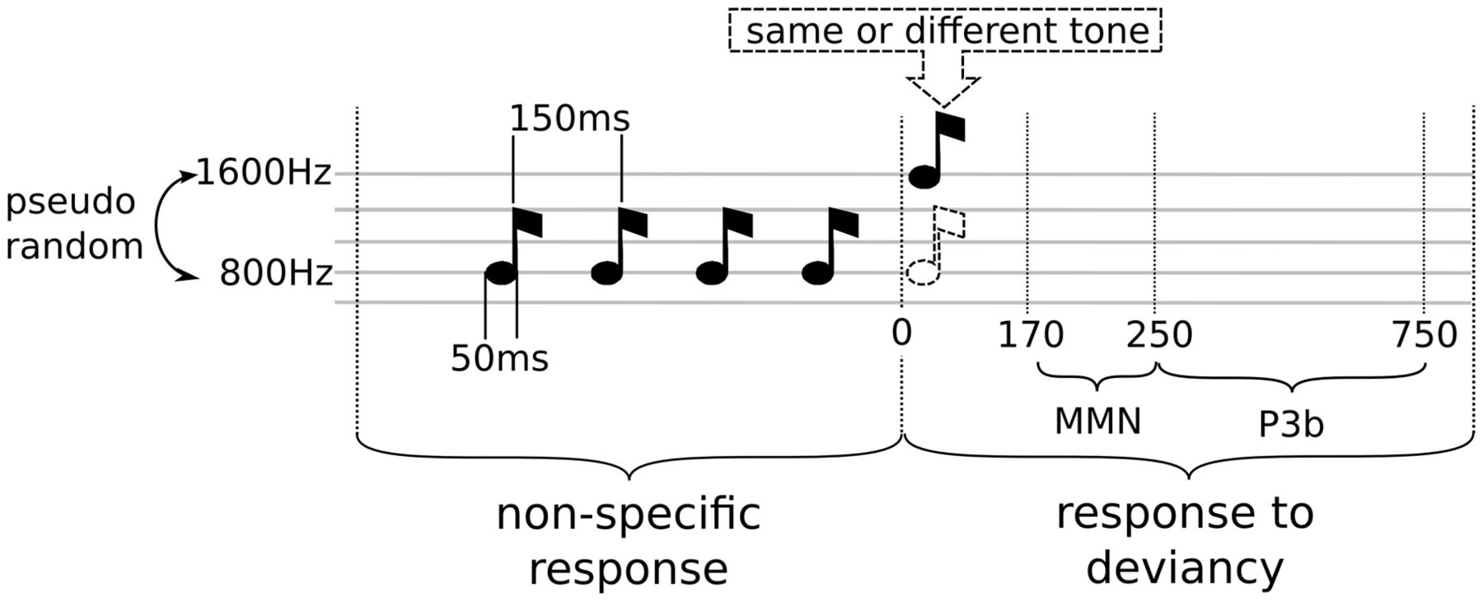
Figure 1 A multi-dimensional approach to categorize states of consciousness. Description of the experimental protocol ...
Notes:
Figure 1 A multi-dimensional approach to categorize states of consciousness. Description of the experimental protocol used for patient auditory stimulation. Spectral and information-theory measures were computed in the early time window (which is identical for all trials), whereas event-related potentials were computed on the late window (response specific to the trial condition).
Unless provided in the caption above, the following copyright applies to the content of this slide: © The Author (2014). Published by Oxford University Press on behalf of the Guarantors of Brain. All rights reserved. For Permissions, please email: journals.permissions@oup.com

Slide 2
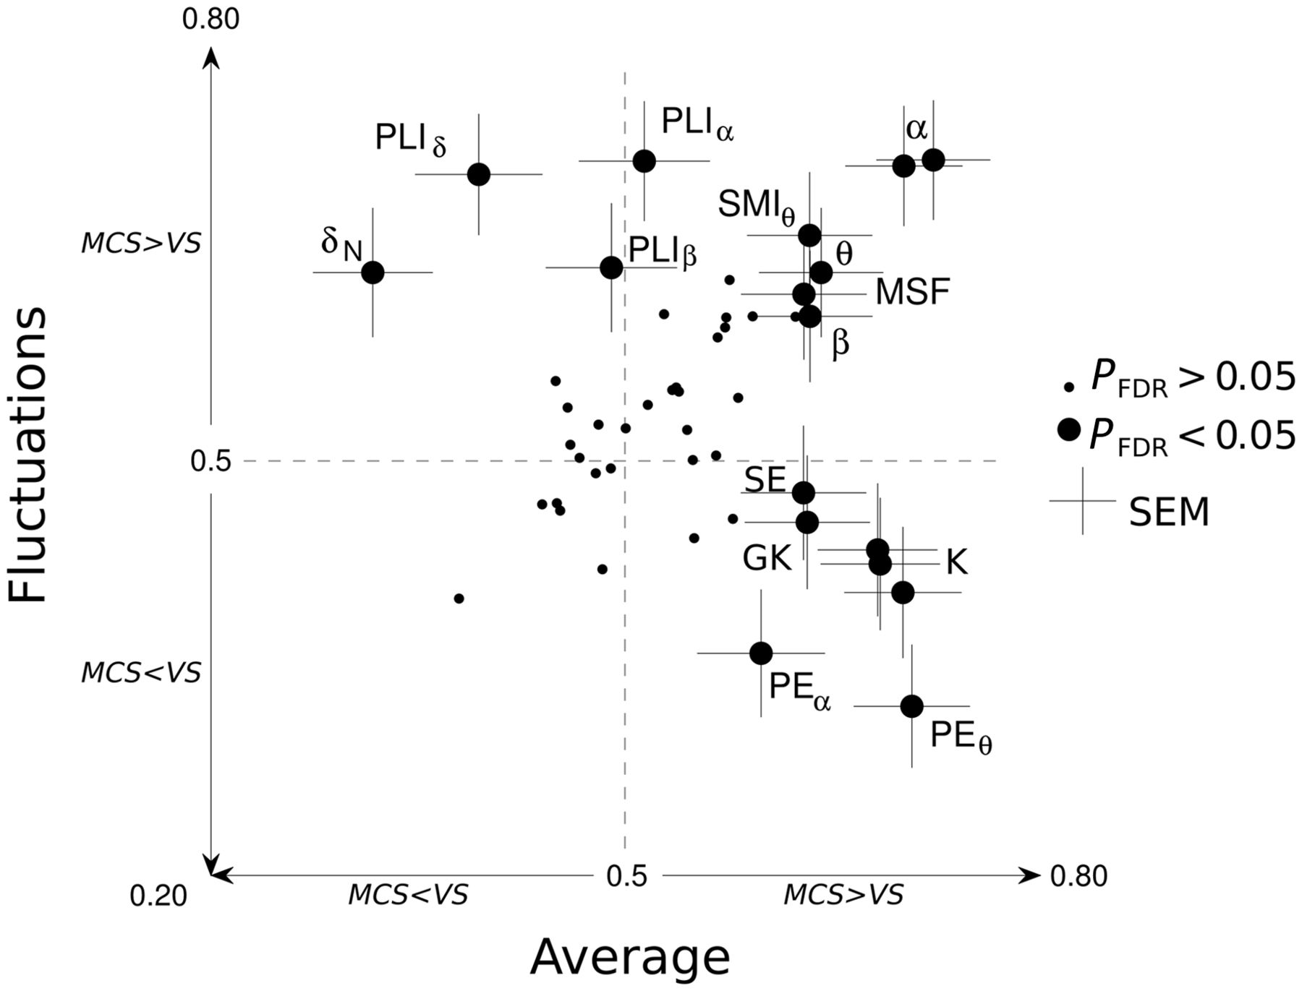
Figure 4 Summary of the measures discriminating VS and MCS patients. Each measure is plotted in a 2D graph. Acronyms ...
Notes:
Figure 4 Summary of the measures discriminating VS and MCS patients. Each measure is plotted in a 2D graph. Acronyms meanings can be found in the Supplementary material. The x-axis indicates discriminatory power for each measure’s average across trials, whereas the y-axis indicates discriminatory power for their respective fluctuations across trials. For instance, the Kolmogorov-Chaitin complexity (K) measure appears in the bottom right quadrant, suggesting that its average value is significantly higher in MCS than in VS, whereas its standard deviation, conversely, is higher in VS than in MCS. Large circles indicate significant measures (PFDR < 0.05). Non-significant measures are indicated with small dots.
Unless provided in the caption above, the following copyright applies to the content of this slide: © The Author (2014). Published by Oxford University Press on behalf of the Guarantors of Brain. All rights reserved. For Permissions, please email: journals.permissions@oup.com

Slide 3
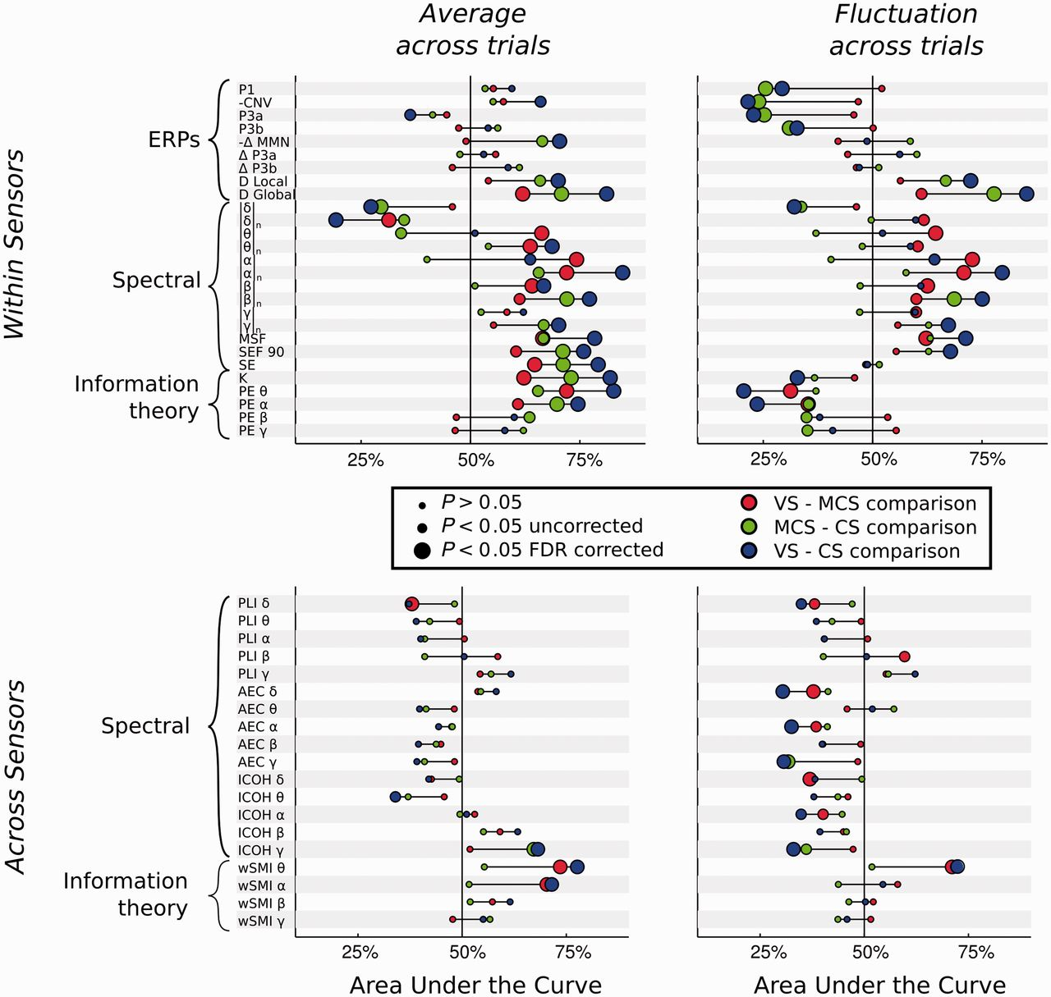
Figure 3 Discrimination power for all measures. Each line provides a summary report of its respective measure. The ...
Notes:
Figure 3 Discrimination power for all measures. Each line provides a summary report of its respective measure. The meaning of each acronym can be found in the Supplementary material. The measures are ordered according to the taxonomy presented in Table 1. The location of each dot corresponds to the AUC for a pair-wise comparison between two states of consciousness (see ‘Materials and methods’ section). Chance level corresponds to AUC = 50% (central vertical line). An AUC>50% suggests that the corresponding measure is correlated with the state of consciousness (from VS to MCS and CS). An AUC <50% suggests that the corresponding measure is anti-correlated with the state of consciousness. Dot colour and size indicate the type and significance of the comparison (see legend). The red colour highlights the minimal contrast between the MCS and VS states of consciousness. As the contingent negative variation and MMN are negative EEG components, their respective AUC was computed after changing the sign of their amplitudes.
Unless provided in the caption above, the following copyright applies to the content of this slide: © The Author (2014). Published by Oxford University Press on behalf of the Guarantors of Brain. All rights reserved. For Permissions, please email: journals.permissions@oup.com

Slide 4
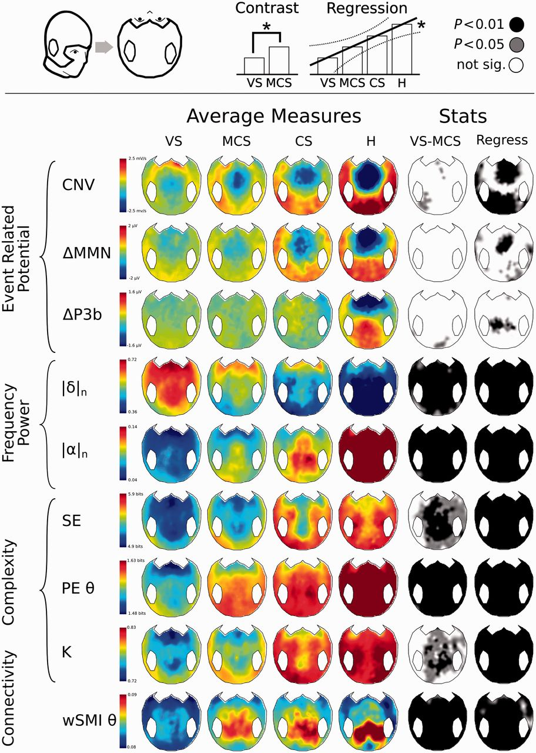
Figure 2 Scalp topography of the most discriminatory measures. The topographical 2D projection (top = front) of each ...
Notes:
Figure 2 Scalp topography of the most discriminatory measures. The topographical 2D projection (top = front) of each measure [contingent negative variation (CNV), mismatch negativity (MMN) and P300b (ΔP3b), normalized power in delta (|δ|n) and alpha (|α|n) bands, spectral entropy (SE), permutation entropy in theta band (PEθ), Komolgorov-Chaitin Complexity (K) and weighted symbolic mutual information (wSMIθ)] is plotted for each state of consciousness (columns). The fifth column indicates whether the VS and MCS patients were significantly different from one another (black = P < 0.01, light grey = P < 0.05, white = not significant, uncorrected for the number of electrodes tested). The sixth column shows the statistics of a regression analysis of the measure across the four states of consciousness (VS < MCS < CS < healthy controls (H). Black: P < 0.01, light grey: P < 0.05, white: not significant, uncorrected for the number of electrodes tested).
Unless provided in the caption above, the following copyright applies to the content of this slide: © The Author (2014). Published by Oxford University Press on behalf of the Guarantors of Brain. All rights reserved. For Permissions, please email: journals.permissions@oup.com

Slide 5
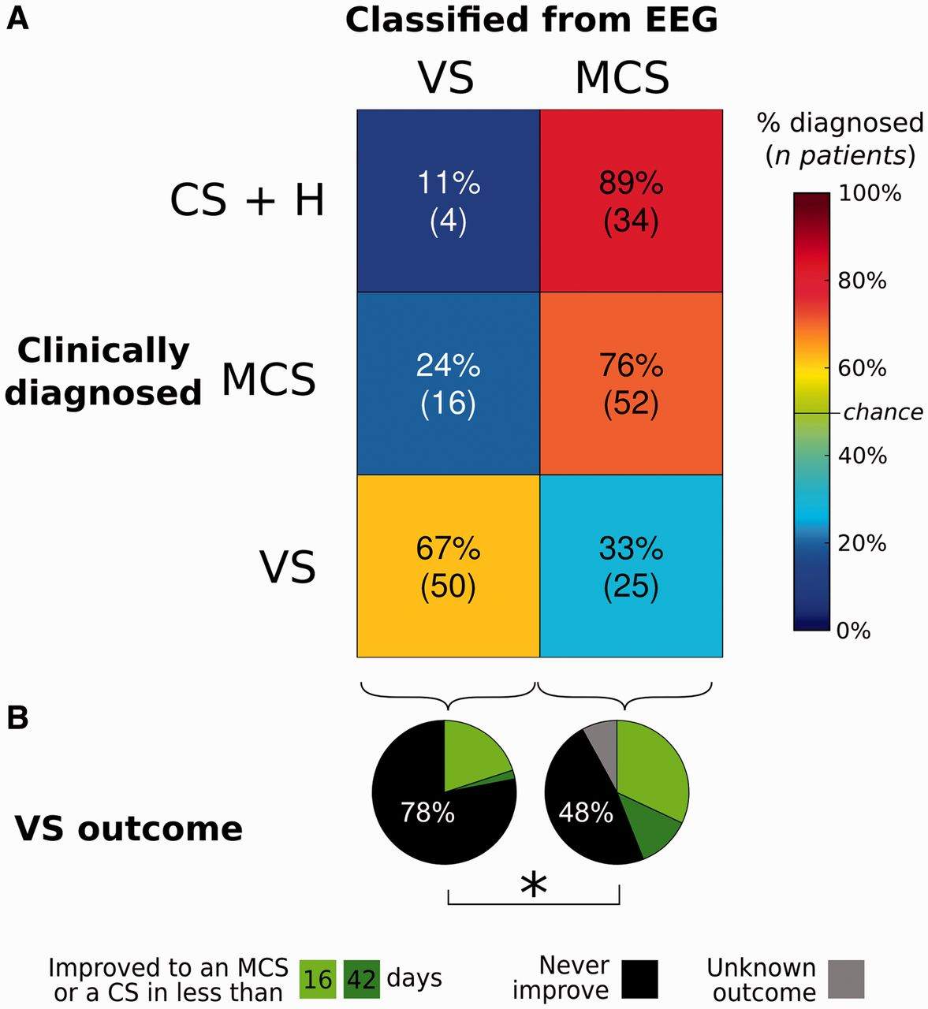
Figure 5 Comparison of EEG-based classification with clinical diagnosis and patients’ outcome. (A) Confusion matrix ...
Notes:
Figure 5 Comparison of EEG-based classification with clinical diagnosis and patients’ outcome. (A) Confusion matrix showing, on the y-axis, the clinical diagnosis (VS, MCS or CS/Healthy), and on the x-axis, the prediction using the automatic classifier based on EEG measures (VS or MCS). The number of recordings and their respective percentages within each clinical state category are reported in each cell. For VS and MCS patients EEG-based classification matches the clinical diagnosis in a majority of cases. Using the same classifier (trained to predict VS or MCS state) the top cells show the predicted condition for CS and healthy subjects. The majority of these recordings were classified as MCS. Non-matching cells can suggest inappropriate classifications, but may also indicate that EEG measures are detecting information unseen by clinicians. (B) The pie charts show the clinical outcome of the VS patients, as a function of whether EEG measures classified them as VS or in a higher state of consciousness (MCS or CS). The probability of recovery was significantly higher (P = 0.02) for patients classified into a higher state of consciousness than for patients predicted to be truly VS.
Unless provided in the caption above, the following copyright applies to the content of this slide: © The Author (2014). Published by Oxford University Press on behalf of the Guarantors of Brain. All rights reserved. For Permissions, please email: journals.permissions@oup.com

