Slide 1
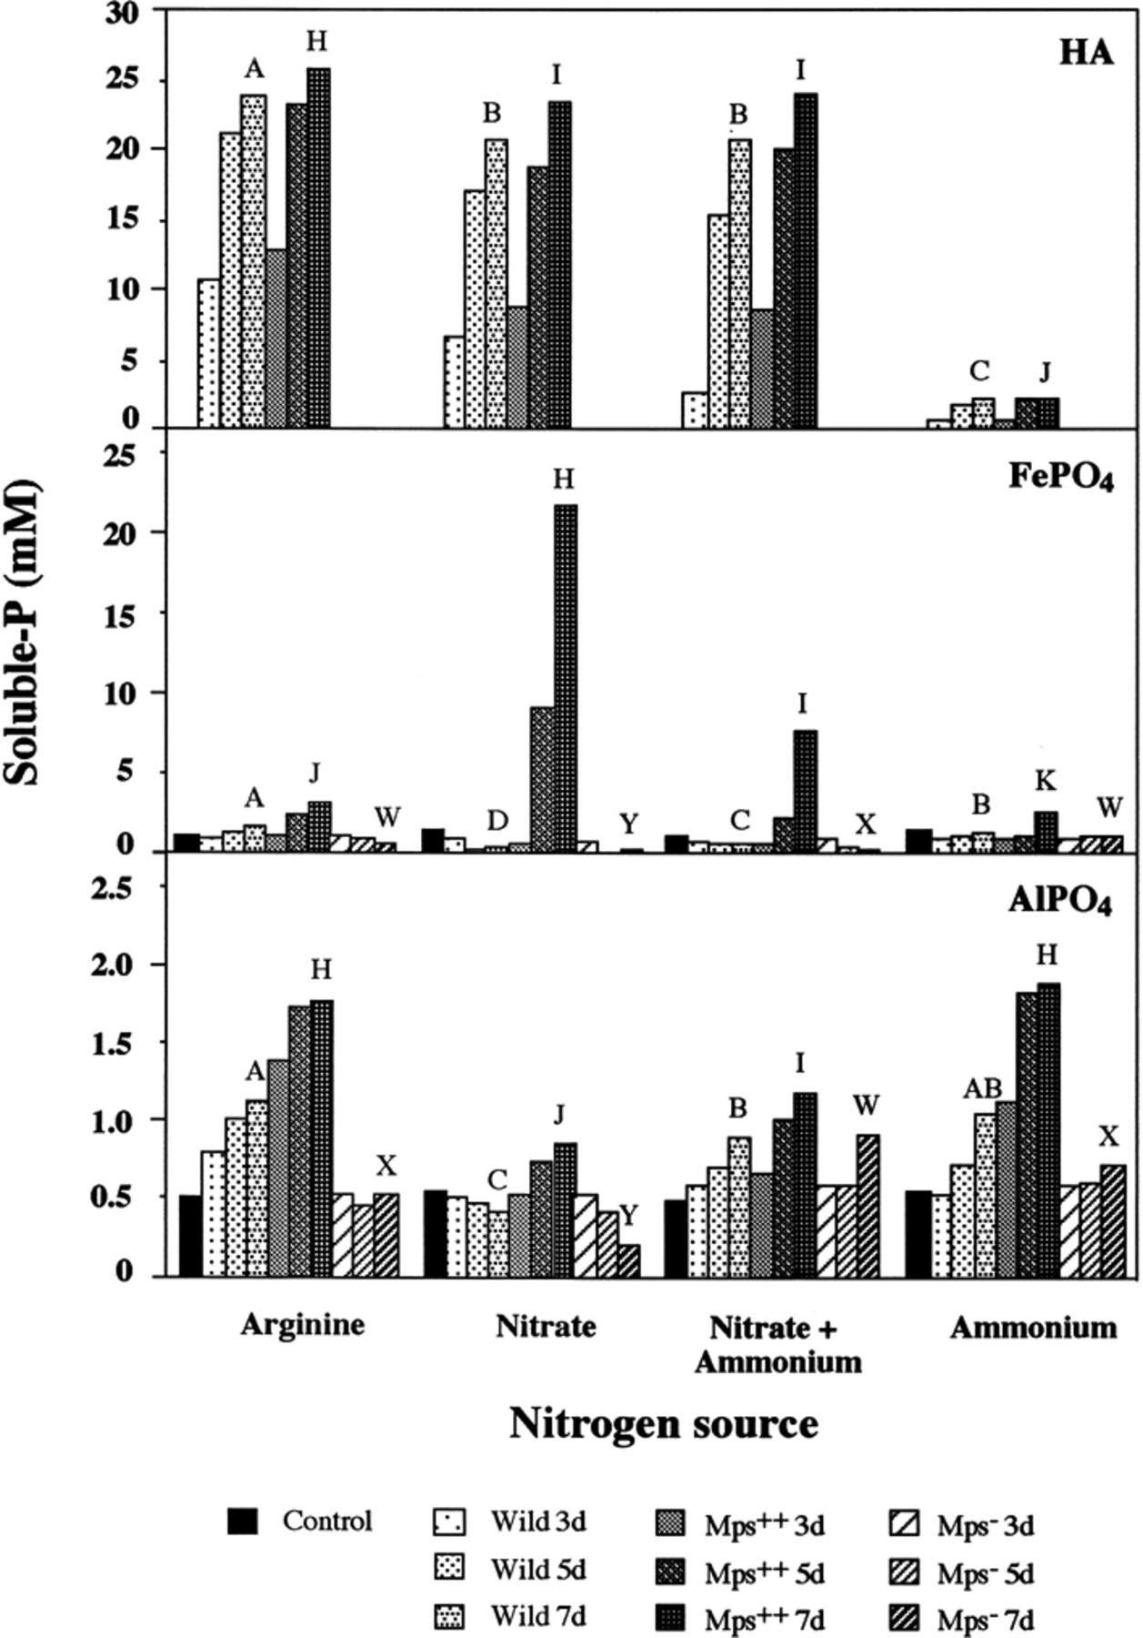
1 Solubilization of HA, FePO₄ ad AlPO₄ by P. rugulosum isolate IR-94MF1 and its ...
Notes:
1 Solubilization of HA, FePO4 ad AlPO4 by P. rugulosum isolate IR-94MF1 and its Mps++ and Mps− mutants in liquid medium using sucrose as the C source and different N sources (3.7 mM arginine, 18 mM nitrate, 18 mM nitrate+ammonium and 0.7 mM ammonium) after 3 (3d), 5 (5d) and 7 (7d) days of incubation. Values are means of three replicates. Means labeled with the same letter are not significantly (P>0.01) different according to the LSD test used with the rank procedure.
Unless provided in the caption above, the following copyright applies to the content of this slide: © 1999 Federation of European Microbiological Societies. Published by Elsevier Science B.V. All rights reserved.

Slide 2
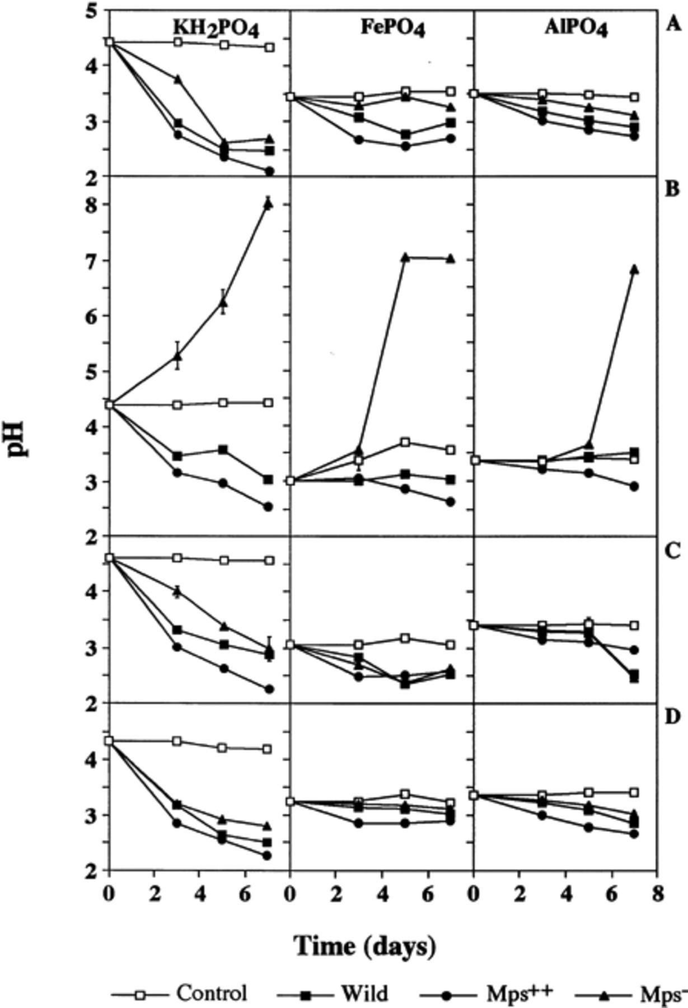
2 Changes of the pH of the culture filtrate of P. rugulosum IR-94MF1 and its Mps⁺⁺ and ...
Notes:
2 Changes of the pH of the culture filtrate of P. rugulosum IR-94MF1 and its Mps++ and Mps− mutants cultivated in liquid media containing sucrose as the sole C source and different N or P sources: (A) 3.7 mM arginine; (B) 18 mM nitrate; (C) 18 mM nitrate+ammonium; and (D) 0.7 mM ammonium. Values are means of three replicates. Error bars (±S.D.) are shown when larger than the symbol.
Unless provided in the caption above, the following copyright applies to the content of this slide: © 1999 Federation of European Microbiological Societies. Published by Elsevier Science B.V. All rights reserved.

