Slide 1
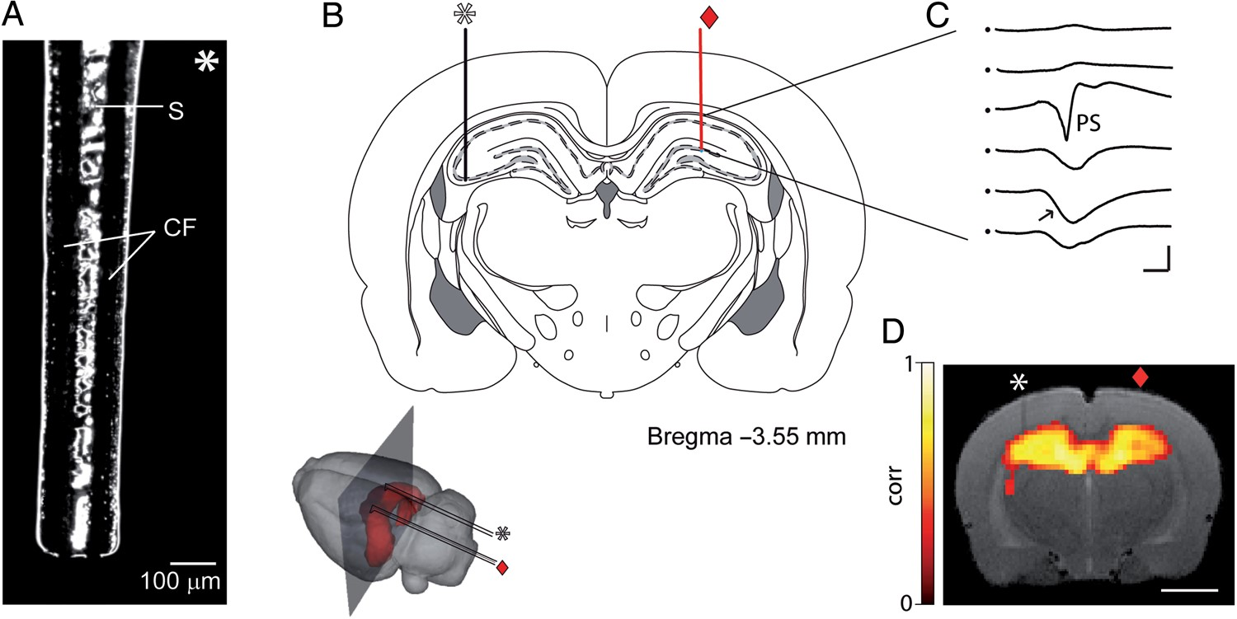
Figure 1. Experimental setup. (A) Micrograph of the tip of one of the carbon-fiber bipolar microstimulating electrodes ...
Notes:
Figure 1. Experimental setup. (A) Micrograph of the tip of one of the carbon-fiber bipolar microstimulating electrodes used in the study. CF (carbon fiber), S (septum). (B) Coronal section of Paxinos and Watson atlas (Paxinos and Watson 2007) at 3.55 mm posterior to bregma illustrating the position of the microstimulating (asterisk) and recording (diamond) electrodes. (Inset) Schematic representation of the L-shaped electrodes implanted in the rat dorsal hippocampus. The vertical plane (dark gray) depicts the approximate location of the coronal section from the atlas and the MR image in (D). (C) Electrophysiological field potentials recorded along the dorso-ventral extension of CA1 were used to optimize the effective positioning of the carbon-fiber microstimulation in the contralateral CA3 first, and then to quantify CA1 spiking activity during the experiment. Note the typical EPSP (arrow) and PS recorded in the stratum radiatum and pyramidale, respectively. (D) Representative T2-weighted MRI anatomy with overlaid functional maps evoked by CA3 stimulation. Note the very small artifact in the MR image produced by the carbon-fiber electrode (asterisk) and the virtual absence of artifacts induced by the borosilicate recording electrode (diamond). Scale bars: 100 µm (A); 2 ms, 4 mV (C); 5 mm (D).
Unless provided in the caption above, the following copyright applies to the content of this slide: © The Author 2015. Published by Oxford University Press. All rights reserved. For Permissions, please e-mail: journals.permissions@oup.com

Slide 2
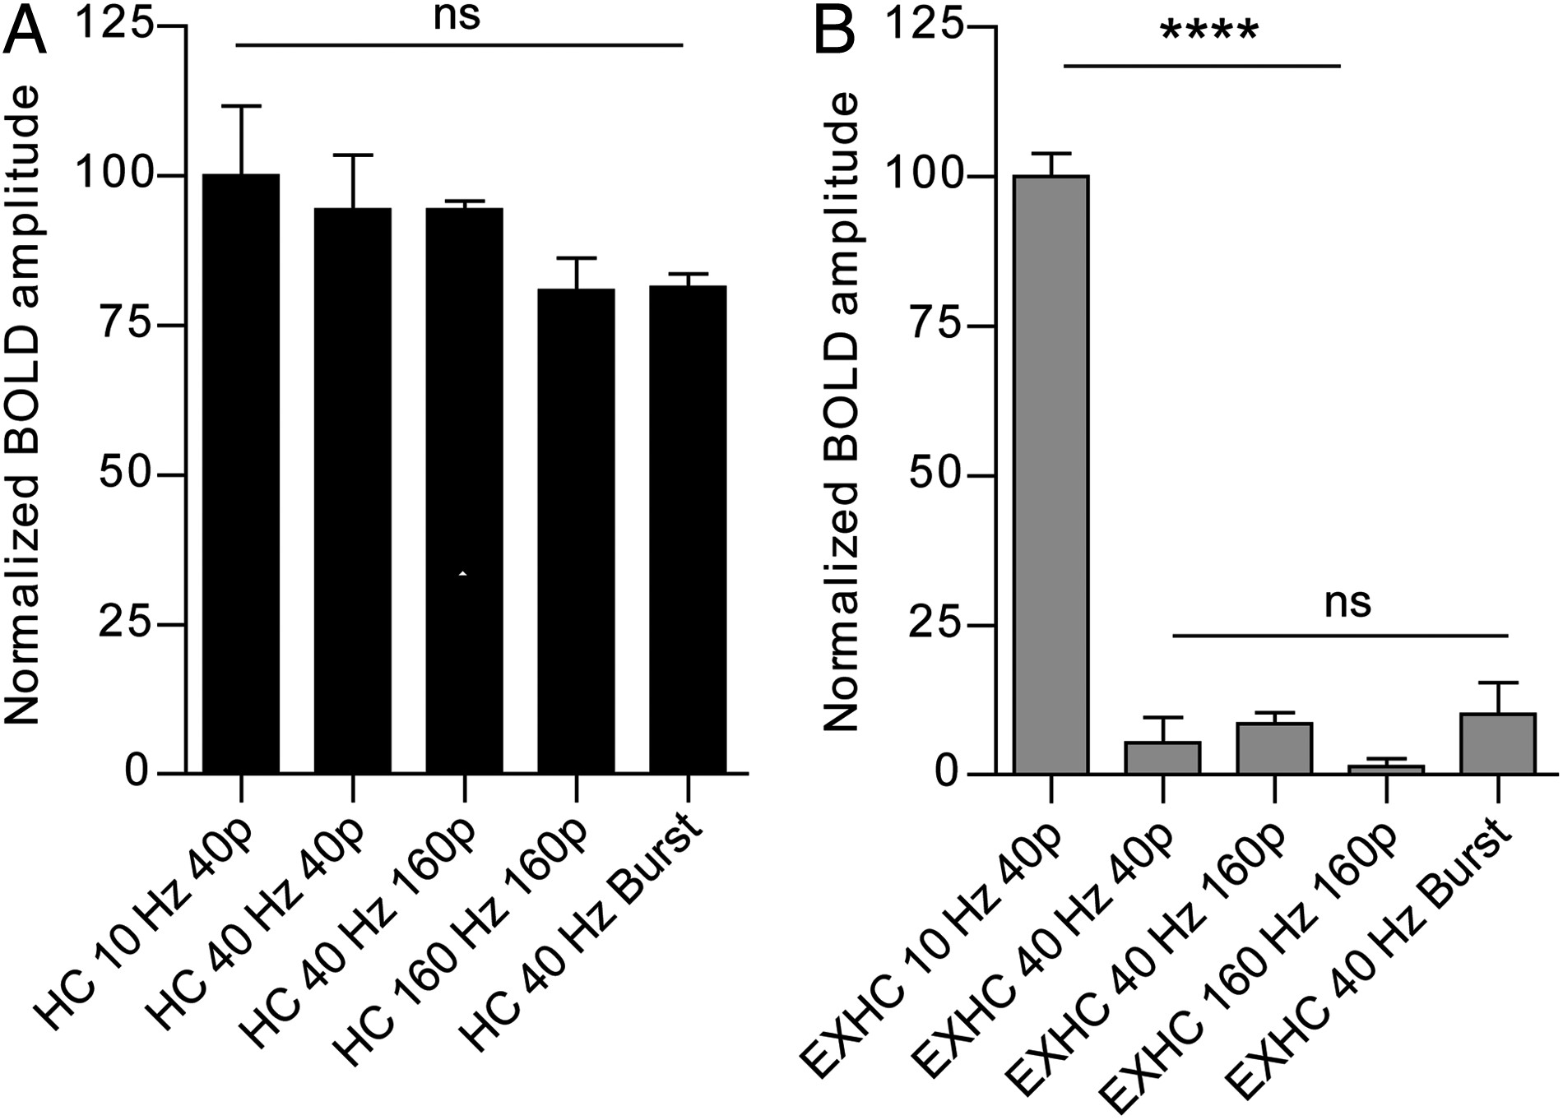
Figure 5. Frequency is the key parameter determining extrahippocampal activity propagation. (A) BOLD signal responses ...
Notes:
Figure 5. Frequency is the key parameter determining extrahippocampal activity propagation. (A) BOLD signal responses in the hippocampus and (B) PFC to different stimulation protocols varying the frequencies, number of pulses (p) and structure (bursts). Burst protocols consisted of 4 or 8 pulses separated by 250 or 600 ms, respectively. Both burst protocols produced the same result and has been pooled together for simplicity. Data points represent mean ± SEM (n = 3). Note the absence of extrahippocampal propagation at 40 Hz even if long (4 s) stimulation trains equivalent to those used at 10 Hz with 4 times the number of pulses are used. Note also the absence of propagation at higher frequencies (160 Hz) or when 40 Hz activation is patterned into theta- or delta-burst protocols. Repeated-measures One-way ANOVA for hippocampal (F4,8 = 1.9, P = 0.2) and PFC activations (F4,8 = 127.9, P < 0.0001). Multiple comparisons in all cases with Bonferroni's test: ****P 0.05).
Unless provided in the caption above, the following copyright applies to the content of this slide: © The Author 2015. Published by Oxford University Press. All rights reserved. For Permissions, please e-mail: journals.permissions@oup.com

Slide 3
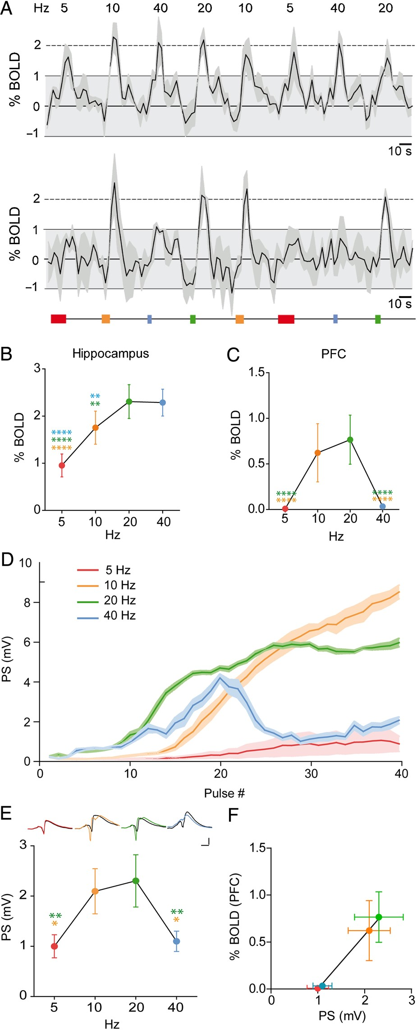
Figure 4. Short-term plasticity facilitates CA1 output and boosts system-level interactions. (A) fMRI BOLD signals ...
Notes:
Figure 4. Short-term plasticity facilitates CA1 output and boosts system-level interactions. (A) fMRI BOLD signals evoked in the hippocampus (upper panel) and PFC (lower panel) by a pseudorandom presentation of stimulation frequencies. Inset indicates the time of presentation of the different protocols. Colors in all panels represent stimulation frequencies as follows: red (5 Hz), orange (10 Hz), green (20 Hz), and blue (40 Hz). Values represent mean ± SEM. (B) BOLD signal amplitude (% from baseline, n = 9, P < 0.0001, cluster size 14) in dorsal hippocampus and (C) PFC across stimulation frequencies. PFC is composed of frontal, orbital, prelimbic, infralimbic, cingulate, and insular cortices. Note the monotonic increase in hippocampal BOLD signals amplitude (repeated-measures one-way ANOVA F3,24 = 37.05, P < 0.0001) versus the inverted U-shape response for PFC (repeated-measures one-way ANOVA F3,24 = 31.80, P < 0.0001). (D) Representative example in one animal showing the evolution of PS amplitudes in the stimulation train at frequencies ranging from 5 to 40 Hz. Data represents the mean (solid line) and SEM (shaded area) of 10 repetitions for each frequency. (E) Quantification of the output spiking activity at all tested frequencies as the PS amplitude averaged across all delivered pulses, and normalized against 5 Hz. (Inset) Representative PS evoked by the first (black) and last (colored) pulse in the train for each stimulation frequency. Note the PS facilitation at 10 and 20 HZ (repeated-measures one-way ANOVA F3,12 = 8.06, P = 0.0007). (F) Linear correlation between BOLD signals in PFC and spiking activity in CA1 (F1,34 = 10.09, P = 0.0032, r2 = 0.38). Multiple comparisons in all panels with Bonferroni's test: *P < 0.05, **P < 0.01, ***P < 0.001, ****P < 0.0001. Asterisks color denotes comparison against 10 (yellow), 20 (green), or 40 (blue) Hz. Scale bars: 5 ms, 2 mV (C).
Unless provided in the caption above, the following copyright applies to the content of this slide: © The Author 2015. Published by Oxford University Press. All rights reserved. For Permissions, please e-mail: journals.permissions@oup.com

Slide 4
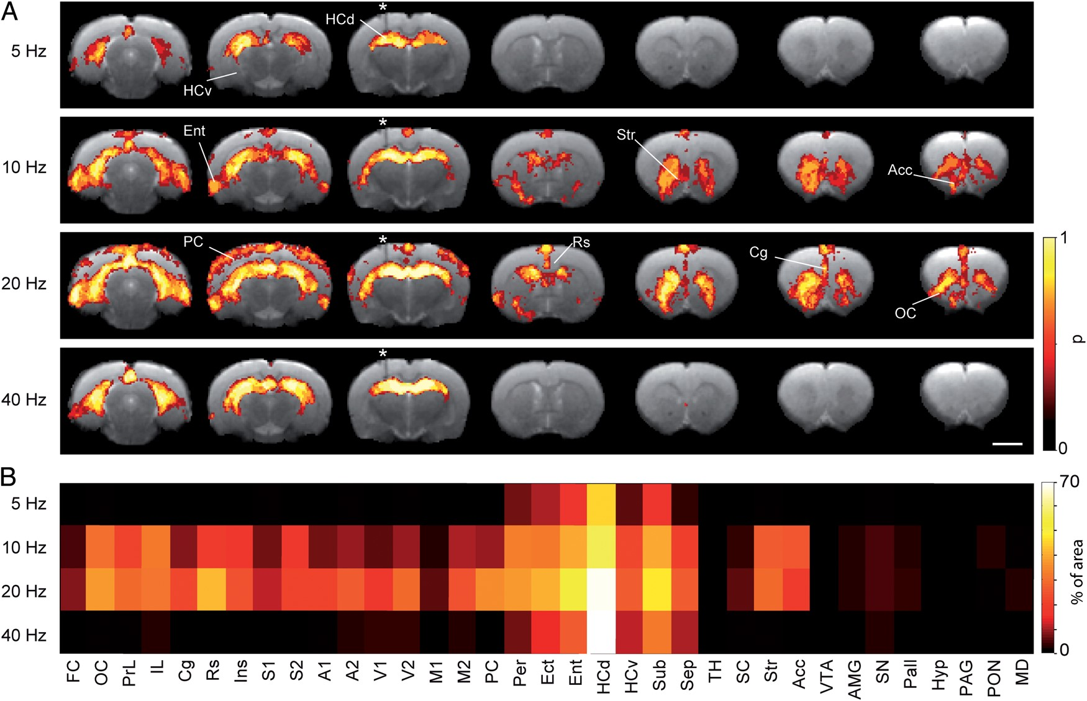
Figure 3. Brain-wide and frequency-dependent functional connectivity of dorsal CA3. (A) fMRI BOLD maps (group data, n = ...
Notes:
Figure 3. Brain-wide and frequency-dependent functional connectivity of dorsal CA3. (A) fMRI BOLD maps (group data, n = 9) overlaid on an anatomical T2-weighted images. Color-code denotes the probability of activating a region by each specific stimulation protocol (denoted on the left column). Representative individual fMRI maps (P < 0.0001, cluster size 14) used to build the probability map shown here are presented in Supplementary Figure 4. Note the extensive extrahippocampal propagation of activity to specific neocortical and subcortical regions at 10–20 Hz. Dorsal and ventral hippocampus (HCd, HCv), entorhinal cortex (Ent), striatum (Str), nucleus accumbens (Acc), retrosplenial (Rs), cingulate (Cg), prelimbic (PrL), infralimbic (IL), and orbitofrontal cortex (OC). (B) Color-coded percentage of brain ROI's activated by a particular stimulation protocol (P < 0.0001, cluster size 14). Two-way ANOVA reveals highly significant effects of frequency (F3, 840 = 189.49, P < 0.0001), ROI (F34, 280 = 21.43, P < 0.0001), and interaction (F102, 840 = 3.91, P < 0.0001). Bonferroni's multiple comparison test shown in Supplementary Table 1. Anatomical locations and abbreviations for all brain ROI's provided in Supplementary Figure 7. Scale bars: 5 mm (A).
Unless provided in the caption above, the following copyright applies to the content of this slide: © The Author 2015. Published by Oxford University Press. All rights reserved. For Permissions, please e-mail: journals.permissions@oup.com

Slide 5
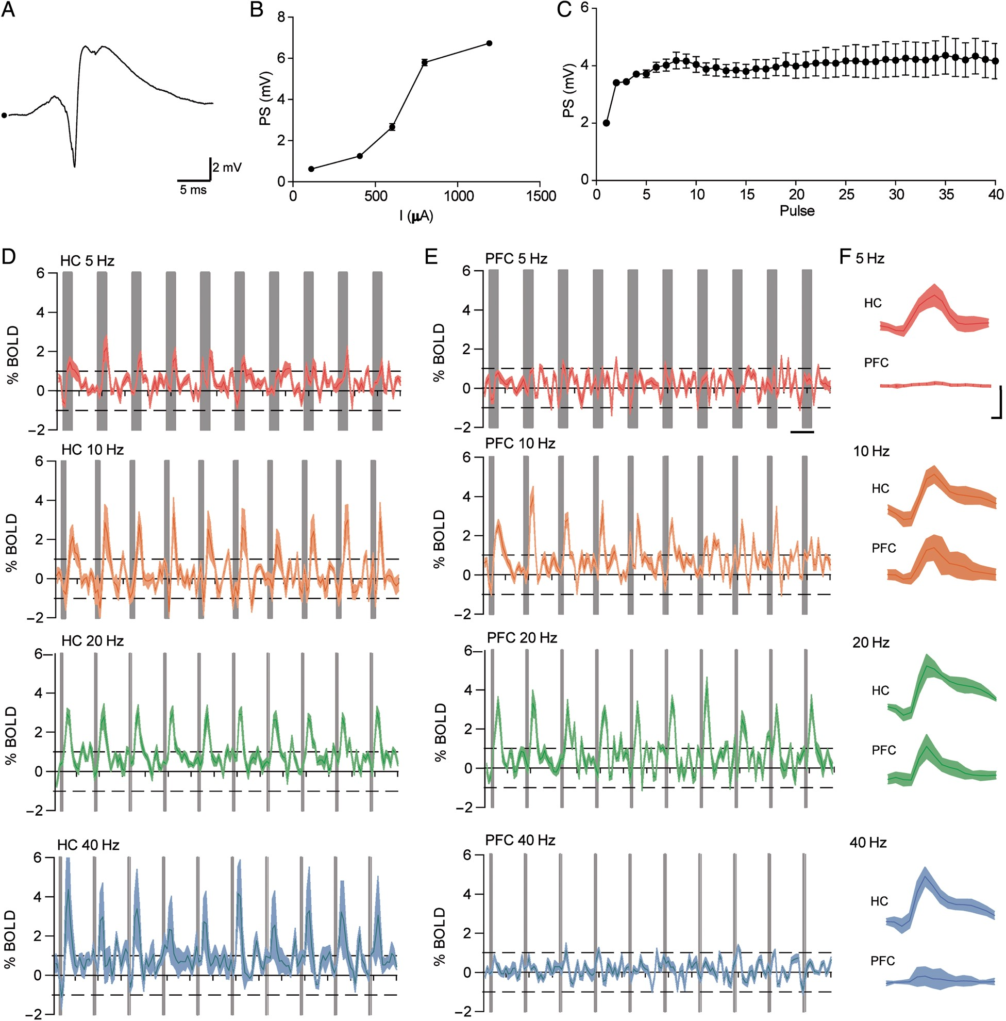
Figure 2. Frequency-dependent gating of activity propagation: electrophysiological and BOLD responses. (A) ...
Notes:
Figure 2. Frequency-dependent gating of activity propagation: electrophysiological and BOLD responses. (A) Representative PS recorded in CA1 evoked by single pulse stimulation of contralateral CA3. Data in panels (A)–(E) come from the same animal. (B) Stimulus–response curve for PS amplitude at increasing stimulation intensities. Data represent mean ± SEM of 5 repetitions of each intensity. Final intensity for train stimulation was selected as the one producing 50% of the maximal PS amplitude. (C) PS amplitude measured in the course of a 5 Hz stimulation train (40 pulses in total). Data represent mean ± SEM averaged across 10 train repetitions. (D) Representative BOLD signal time courses in the hippocampus and (E) PFC of the same animal in response to 10 trains of stimulation (indicated by vertical gray bars), delivered at 5 Hz (red), 10 Hz (orange), 20 Hz (green), or 40 Hz (blue). Each panel shows the mean ± SEM of 3 repetitions of the same protocol. (F) Average BOLD signal time courses across animals (n = 9) for the hippocampus (HC) and PFC for each of the frequencies applied. Same color code as in (A–E). Note that BOLD signal responses in the hippocampus are elicited at all stimulation frequencies, contrary to the PFC in which BOLD responses are only evoked at 10–20 Hz stimulation frequencies. Scale bars: 2 mV, 5 ms (A); 20 s (D,E); 3 s, 1% BOLD (F).
Unless provided in the caption above, the following copyright applies to the content of this slide: © The Author 2015. Published by Oxford University Press. All rights reserved. For Permissions, please e-mail: journals.permissions@oup.com

