Slide 1
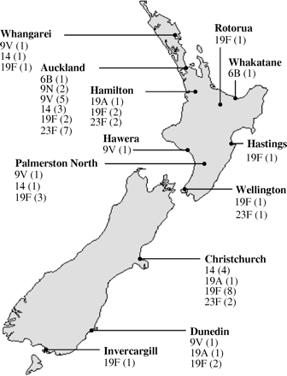
Figure 1. Distribution and serotype (number of isolates) of pneumococcal isolates throughout New Zealand.
Notes:
Figure 1. Distribution and serotype (number of isolates) of pneumococcal isolates throughout New Zealand.
Unless provided in the caption above, the following copyright applies to the content of this slide: JAC vol.55 no.3 © The British Society for Antimicrobial Chemotherapy 2005; all rights reserved

