Slide 1
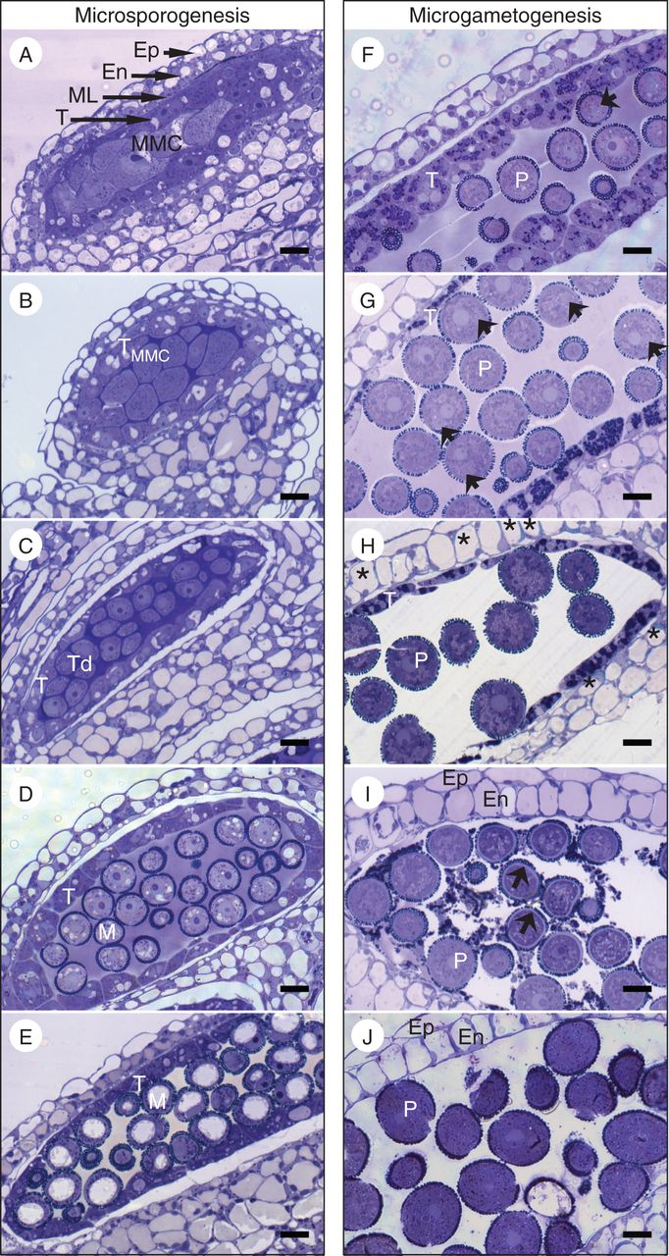
Fig. 1. Overview of pollen development in the arabidopsis anther. Development is divided into meiotic divisions (A–E) ...
Notes:
Fig. 1. Overview of pollen development in the arabidopsis anther. Development is divided into meiotic divisions (A–E) and mitotic divisions (F–J). (A) Diploid microspore mother cells. (B) Meiotic microspore mother cells surrounded by a callose wall. Two polar nuclei with lack of internal cell walls suggest that meiosis is not complete. (C) After meiosis, tetrads of haploid microspores encased in thick callose are present. (D) Early uninucleate microspores with darkly staining exine walls. (E) Uninucleate microspores in the ring-vacuolate stage. (F) Following the first mitotic division, bicellular pollen, containing one small generative cell and one large vegetative cell (arrows indicate a generative cell in F and G). Densely staining organelles are visible in the tapetum (F) and become more abundant as bicellular pollen matures (G). (H) After the second mitotic division, tapetum surrounds tricellular pollen. Thickenings in the endothecial cell walls are visible in cells, marked by asterisks. (I) Tapetum cytoplasmic contents in the locule following cell death. The intine wall surrounds each pollen grain (arrows). (J) Mature pollen grains following tapetum breakdown. En, endothecium; Ep, epidermis; M, microspore; ML, middle layer; MMC, meiotic microspore mother cell; P, pollen; T, tapetum; Td, tetrad. Scale bars = 10 μm.
Unless provided in the caption above, the following copyright applies to the content of this slide: © The Author 2014. Published by Oxford University Press on behalf of the Annals of Botany Company. All rights reserved. For Permissions, please email: journals.permissions@oup.com

Slide 2
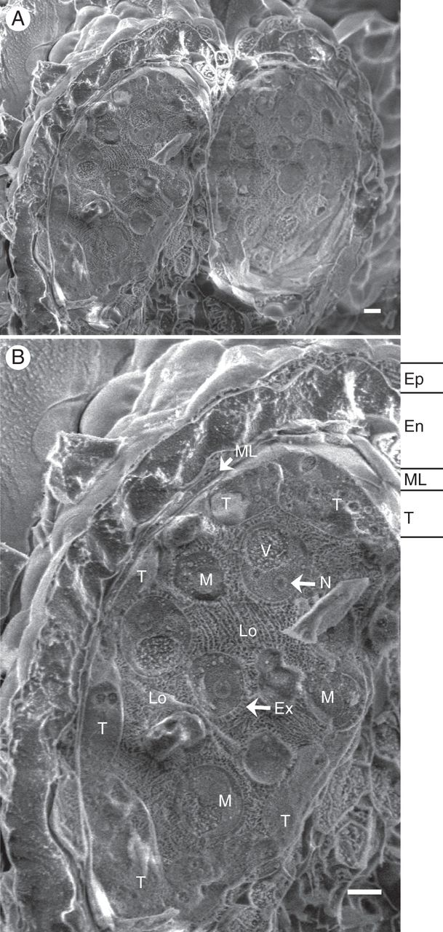
Fig. 2. Cryo-SEM of hydrated arabidopsis anther. (A) Two of the four locules filled with developing pollen grains ...
Notes:
Fig. 2. Cryo-SEM of hydrated arabidopsis anther. (A) Two of the four locules filled with developing pollen grains (microspores) exposed by fracture of the anther. (B) Magnified view of one locule and surrounding sporophytic cell layers from panel (A). Microspores are in the ring-vacuolate uninucleate stage of development. The microspores and surrounding locular fluid are encased in four cell layers of sporophytic tissues: the innermost tapetum (T), followed by a thin middle layer (ML), the endothecium (En) and outermost epidermis (Ep). Ex, exine; Lo, locule; M, microspore; N, nucleolus; T, tapetum, V, vacuole. Scale bars = 5 μm.
Unless provided in the caption above, the following copyright applies to the content of this slide: © The Author 2014. Published by Oxford University Press on behalf of the Annals of Botany Company. All rights reserved. For Permissions, please email: journals.permissions@oup.com

Slide 3
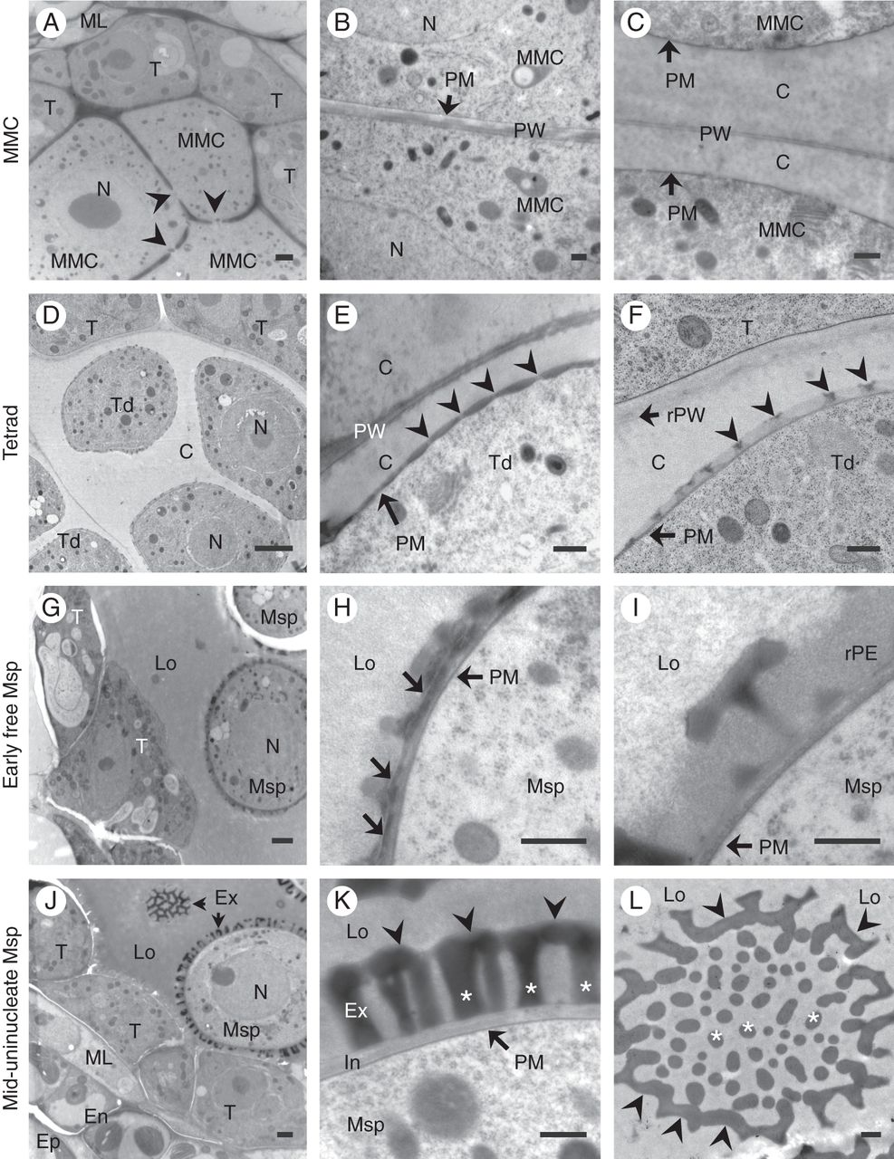
Fig. 3. Microspore exine wall development in cryo-fixed arabidopsis. High-pressure frozen/freeze-substituted anthers ...
Notes:
Fig. 3. Microspore exine wall development in cryo-fixed arabidopsis. High-pressure frozen/freeze-substituted anthers examined using TEM reveal stages of exine deposition. (A) Microspore mother cells (MMCs) with cytomictic channels (marked by arrowheads). (B) Early MMC primary cell wall displaced by an electron-lucent layer of callose between the primary wall and the MMC plasma membrane. (C) Thick callose wall on each side of the primary cell wall of a MMC. (D) Tetrads fill the locule, representing a key developmental stage in primexine formation [early and late primexine stages, as in (E) and (F), respectively]. Within the primexine matrix, spacers form in the pits created by the undulating plasma membrane. The raised portions of plasma membrane along the microspore surface [arrowheads in (E)] mark the sites of probacula and protecta formation [arrowheads in (F)]. (G) Early free uninucleate microspores in the locule. (H) Sporopollenin forms at the microspore's baculae and tecta, initially appearing lamellar (arrows). (I) As exine matures, it assumes a homogeneous appearance in baculae and tecta. Remnant primexine matrix surrounds baculae shortly after microspore release (H, I) but is not observed as uninucleate microspores mature (K, L). (J) Mid-stage uninucleate microspores in the locule. (K) Uninucleate microspores with sculptured, electron-dense baculae (marked by asterisks) and tecta (arrowheads), as well as a thin layer of early intine. (L) Tangential section of uninucleate microspore with baculae (asterisks) and tecta (arrowheads). C, callose; En, endothecium; Ep, epidermis; Ex, exine; In, intine; Lo, locule; ML, middle layer; MMC, microspore mother cell; Msp, microspore; N, nucleus; PM, plasma membrane; PW, primary wall; rPE, remnant primary exine; rPW, remnant primary wall; Td, tetrad; T, tapetum. Scale bars: (left column) = 5 μm; (middle and right columns) = 500 nm.
Unless provided in the caption above, the following copyright applies to the content of this slide: © The Author 2014. Published by Oxford University Press on behalf of the Annals of Botany Company. All rights reserved. For Permissions, please email: journals.permissions@oup.com

Slide 4
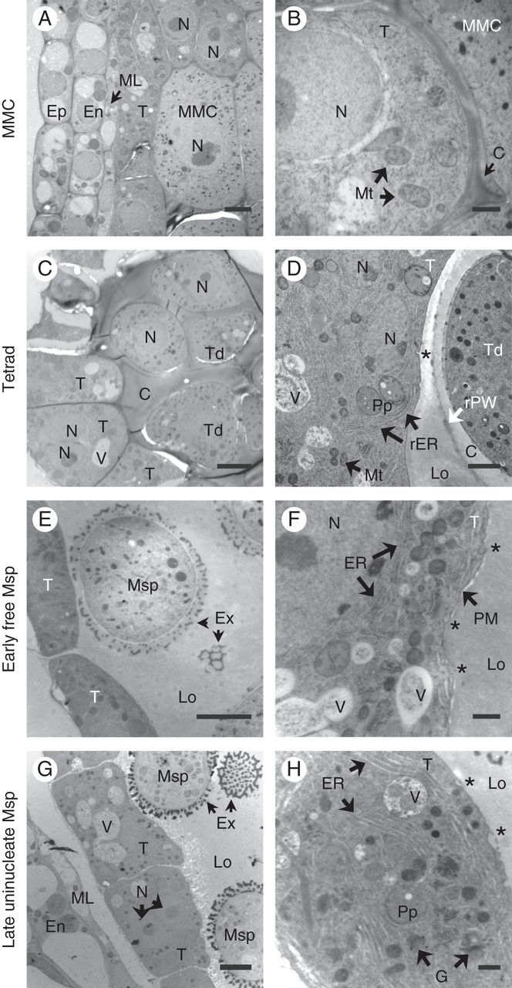
Fig. 4. Tapetum development during exine formation in cryo-fixed arabidopsis anthers. High-pressure ...
Notes:
Fig. 4. Tapetum development during exine formation in cryo-fixed arabidopsis anthers. High-pressure frozen/freeze-substituted anthers examined using TEM reveal tapetum ultrastructure in stages associated with microsporogenesis. (A) Tapetal cells form the innermost layer of the anther wall, adjacent to microspore mother cells. (B) Higher magnification view of tapetum adjacent to MMC, with tapetal cell wall present. (C) Tapetum around callose-encased tetrads. (D) Higher magnification view of tapetum lacking visible cell wall on locule-facing plasma membrane. (E) In the early uninucleate microspore stage, a developing microspore is shown in close proximity to the plasma membrane (PM) of tapetum during exine deposition. (F) Higher magnification view of tapetum. The tapetum PM exhibits occasional invaginations (asterisks in D, F and H). (G) Late uninucleate microspore stage of development with well-developed exine on microspores, which are adjacent to the tapetum. (H) Higher magnification view of tapetal developmental stage shown in (G) with abundant ER and organelles beginning next stage of differentiation. C, callose; En, endothecium; Ep, epidermis; ER, endoplasmic reticulum; Ex, exine; G, Golgi body; Lo, locule; ML, middle layer; MMC, microspore mother cell; Mt, mitochondrion; Msp, microspore; N, nucleus; Pp, proplastid; PM, plasma membrane; rER, rough endoplasmic reticulum; rPW, remnant primary wall; Td, tetrad; T, tapetum; V, vacuole. Scale bars: (left column) = 5 μm; (right column) = 1 μm.
Unless provided in the caption above, the following copyright applies to the content of this slide: © The Author 2014. Published by Oxford University Press on behalf of the Annals of Botany Company. All rights reserved. For Permissions, please email: journals.permissions@oup.com

Slide 5
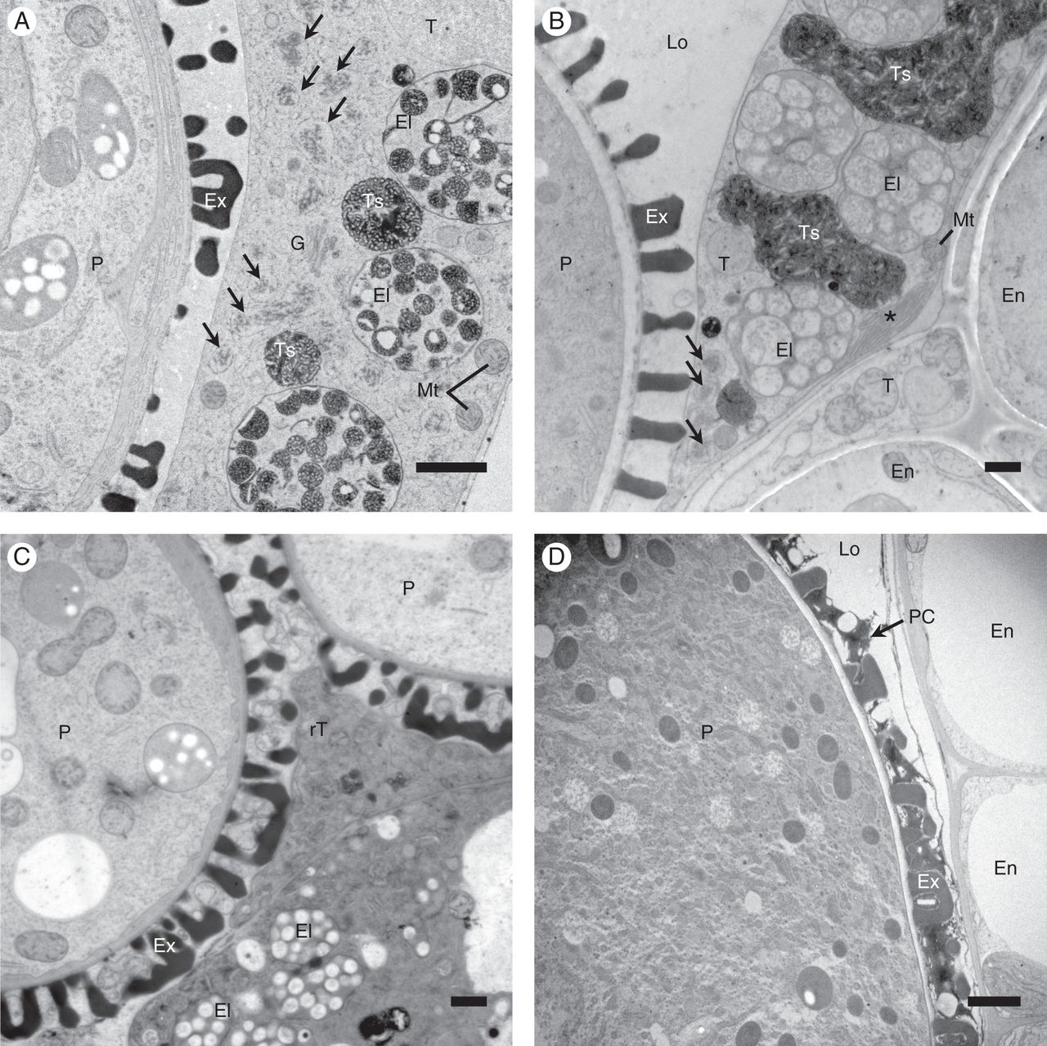
Fig. 5. Tapetum development during pollen coat formation in cryo-fixed arabidopsis anthers. High-pressure ...
Notes:
Fig. 5. Tapetum development during pollen coat formation in cryo-fixed arabidopsis anthers. High-pressure frozen/freeze-substituted anthers examined using TEM reveal tapetum ultrastructure in stages associated with microgametogenesis. (A) During the bicellular pollen stage, the tapetal cells contained differentiating elaioplasts and tapetosomes as well as dilations of rough ER, with fibrillar material in their lumen (arrows). (B) In the tricellular pollen stage, most tapetal cell space is consumed by elaioplasts and tapetosomes, with smooth ER (asterisk) and rough ER (arrows) in a peripheral position. (C) Immediately following tapetum programmed cell death, tapetum contents are scattered in the locule and within the spaces created by the sculptured exine. (D) The tapetum is absent from the locule, but tapetum-derived pollen coat (PC) constituents fill the cavities of the sporopollenin-based exine framework on tricellular pollen, completing pollen wall formation. El, elaioplast; En, endothecium; Ex, exine; Lo, locule; Mt, mitochondrion; P, pollen grain; rT, remnant tapetum; T, tapetum; Ts, tapetosome. Scale bars = 1 μm.
Unless provided in the caption above, the following copyright applies to the content of this slide: © The Author 2014. Published by Oxford University Press on behalf of the Annals of Botany Company. All rights reserved. For Permissions, please email: journals.permissions@oup.com

Slide 6
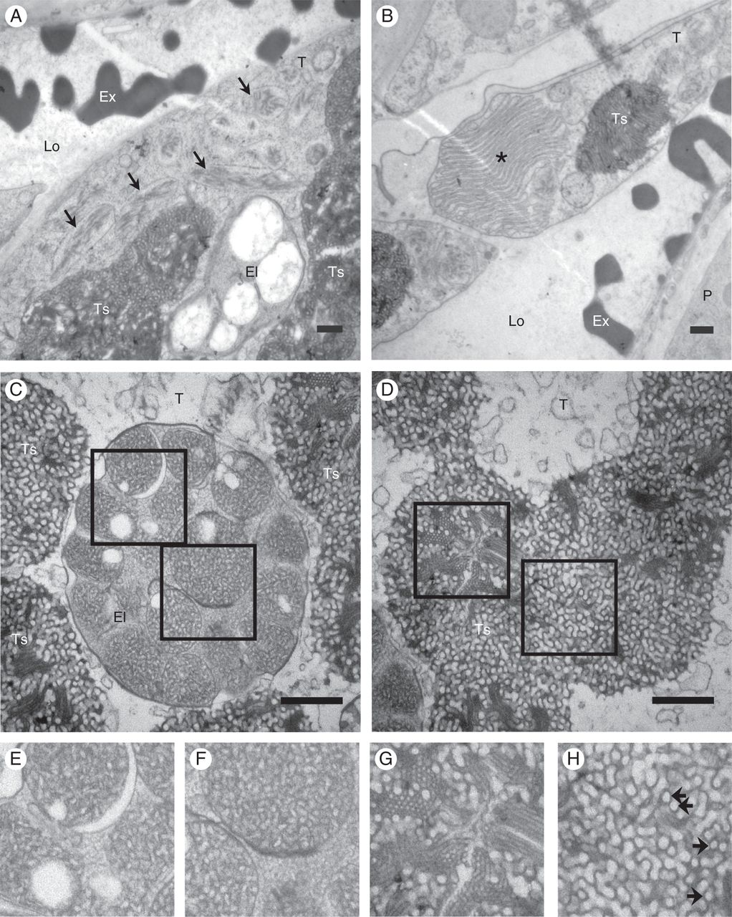
Fig. 6. Late tapetum organelle ultrastructure. High-pressure frozen/freeze-substituted anthers examined using TEM. ...
Notes:
Fig. 6. Late tapetum organelle ultrastructure. High-pressure frozen/freeze-substituted anthers examined using TEM. (A) Rough ER (arrows) contain electron-dense fibrous material. (B) Smooth ER (asterisk) is extensive and abundant in the periphery of late-stage tapetal cells. (C) Elaioplast ultrastructure. These specialized plastids contain circular globuli in their stroma, magnified in (E) and (F). The elaioplast globuli contain electron-translucent oil bodies (E) and an electron-dense meshwork (F), and are contained in a membrane. (D) Tapetosome ultrastructure, showing bundles of tightly associated linear tubes (magnified in G) and an intricate matrix of coiled fibrils (H) that make up the majority of each tapetosome. Arrows in (H) indicate circular electron-translucent regions. El, elaioplast; Ex, exine; Lo, locule; P, pollen grain; T, tapetum; Ts, tapetosome. Scale bars = 500 nm.
Unless provided in the caption above, the following copyright applies to the content of this slide: © The Author 2014. Published by Oxford University Press on behalf of the Annals of Botany Company. All rights reserved. For Permissions, please email: journals.permissions@oup.com

Slide 7
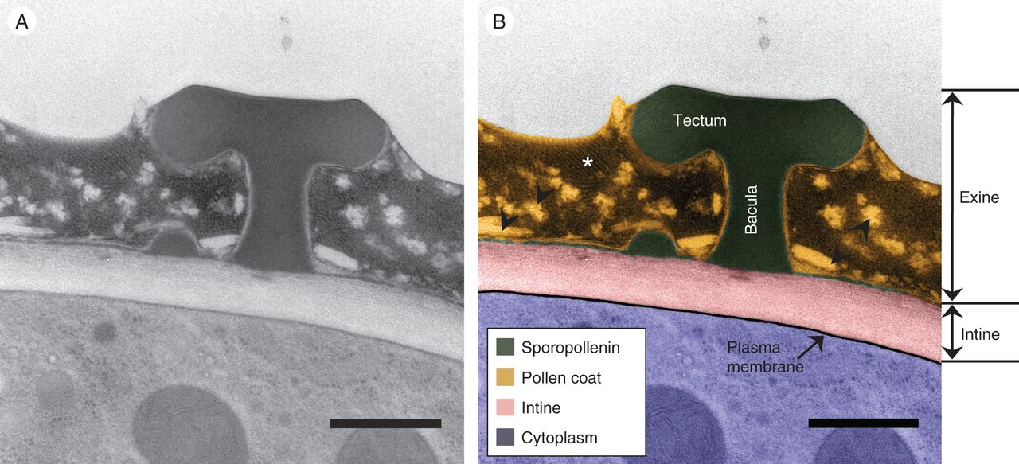
Fig. 7. The mature arabidopsis pollen wall. (A) Transmission electron micrograph of a wild-type pollen grain in ...
Notes:
Fig. 7. The mature arabidopsis pollen wall. (A) Transmission electron micrograph of a wild-type pollen grain in cross-section, revealing the stratified pollen wall outside the pollen grain plasma membrane and underlying cytoplasmic contents. (B) Coloured overlay of the micrograph from panel (A), highlighting and differentiating the sporopollenin (green) and pollen coat (orange) constituents of the pollen exine from the intine (pink), plasma membrane (black) and pollen cytoplasm (blue). Two structural features of the sporopollenin wall, known as the bacula and tectum, are labelled. Scale bars = 500 nm.
Unless provided in the caption above, the following copyright applies to the content of this slide: © The Author 2014. Published by Oxford University Press on behalf of the Annals of Botany Company. All rights reserved. For Permissions, please email: journals.permissions@oup.com

