Slide 1
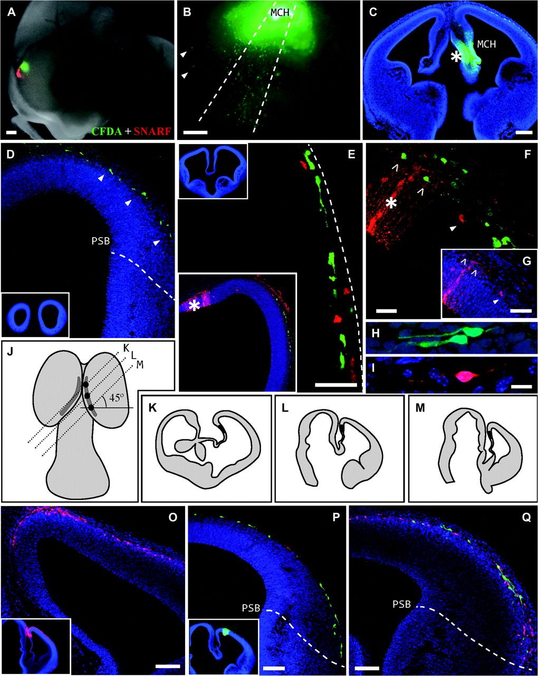
Figure 1. Tangential migration of cell populations generated in adjacent domains of the CH in E11 mice embryos cultured ...
Notes:
Figure 1. Tangential migration of cell populations generated in adjacent domains of the CH in E11 mice embryos cultured in toto for 24 h. (A) Mouse head in which 2 different fluorescent tracers, SNARF (red) and CFDA (green), were injected into the RCH and MCH, respectively. Dorsal is to the left and rostral is below. (B) Site of CFDA injection into the MCH. Labeled cells migrate obliquely toward more rostral areas by dispersal in a discrete fan shape (bounded by dashed lines). A few cells leave their migratory pathway to reach the rostral domain (arrowheads). (C) Coronal section showing the injection site (asterisk) in the MCH. (D) Cell populations generated in the MCH run tangentially through the preplate following oblique caudorostral pathways (arrowheads). These cells do not transgress the PSB. (E) In coronal sections, at rostral levels, there is a mixture of cell populations generated in the MCH (green) and RCH (red). (F, G) There is no contamination between the 2 tracers. Thus, green cells (CFDA labeled) generated in the MCH cross the adjacent (rostral) injection site area (F, asterisk) without incorporating the second tracer (SNARF, red). (G) shows the same field as that shown in (F) under the red filter. (H, I) In all cases examined, the migratory cells adopt a fusiform morphology and emit one or two opposite processes of variable length. (J) Schematic representation of the brain of an E11 mouse embryo as seen from the top. The shaded area corresponds to the extension of the CH delimited by the expression of wnt3a. The 3 black dots in the right hem indicate the divisions of the CH: RCH, MCH, and CCH. The parallel and oblique dotted lines indicate the plane of the section through each of these regions, corresponding to 45° sections (K–M). The drawings of each slice were made from real vibratome sections. (O–Q) In the sections obtained at an inclination of 45° that were used to follow the routes of migration, the overlapping routes of migration were always in rostral sections and at more distal (lateral) levels. Scale bars—(A–D): 200 μm; (O–Q): 100 μm; (E–G): 50 μm, and (H–I): 10 μm.
Unless provided in the caption above, the following copyright applies to the content of this slide: © The Author 2010. Published by Oxford University Press. All rights reserved. For permissions, please e-mail: journals.permissions@oxfordjournals.org

Slide 2
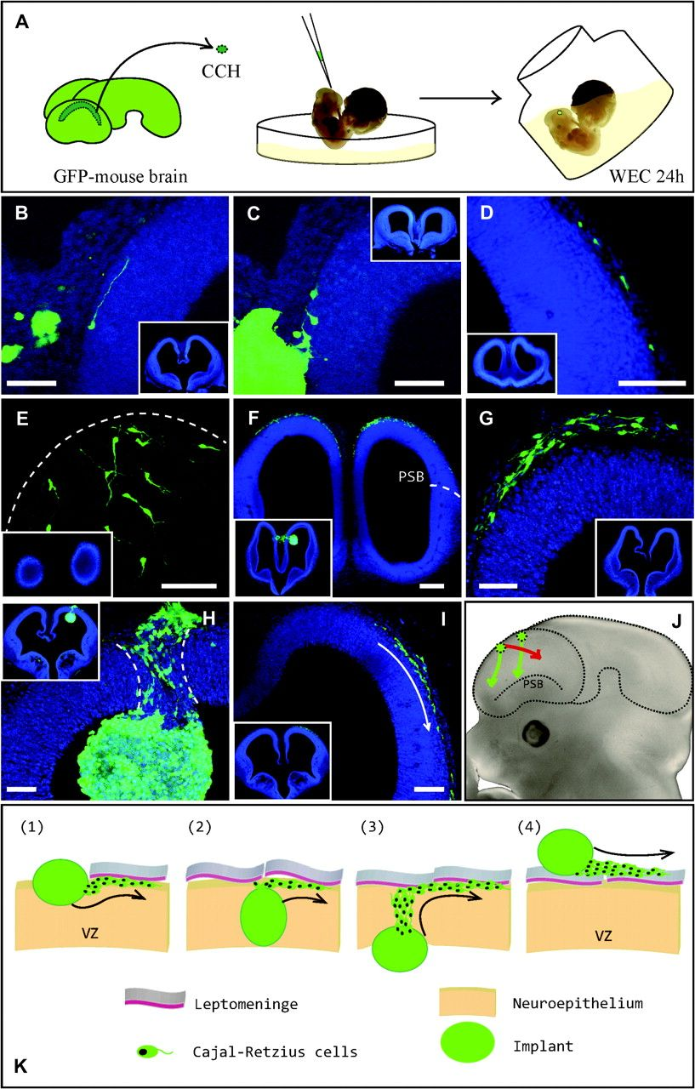
Figure 2. Four experiments involving the implantation of solid tissue from the CCH of GFP⁺ transgenic mice ...
Notes:
Figure 2. Four experiments involving the implantation of solid tissue from the CCH of GFP+ transgenic mice into different CH domains of wt mice. (A) Cartoon showing the experimental technique utilized. A tiny piece of the CCH was extracted and implanted exo utero (in petri dish) into the hem of another embryo of the same age, which was then cultured for 24 h in roller bottles as a whole embryo (whole embryo culture [WEC]). (B–D, first experiment): partial view of coronal sections (see insets) to illustrate the implants of GFP+-CCH into the MCH of wt mice. Cells generated in the implants reach the marginal layer (preplate) and then migrate tangentially, aided by a leading process. (E, F, second experiment): an implant into the RCH domain that remains in the lateral ventricle, attached to the ventricular zone of the neuroepithelium (inset in F). Cells generated in the CCH reach the preplate by radial migration, and they move rostrally as if they were born in the rostral domain (E and inset). (G, third experiment): sometimes, the implants remained on the surface of the telencephalon, and they apparently did not break through the pial membrane. In those cases, the GFP+ cells generated did not enter the cortical neuroepithelium, and they migrated along the leptomeninges, taking a wrong direction toward more caudal regions with respect to the implantation site. (H, I, fourth experiment): in this case, the implant was located in the dorsal telencephalon, close to the CH. In all these experiments (with the exception shown in G), the implanted cells adopted a new migratory route, which coincided with that of the site of implant, always moving toward more rostral cortical areas. Although migration through the preplate is tangential from the initial medial location to another more lateral site (I, arrow), the implanted cells reach the upper strata by radial migration through a very narrow corridor (H, dashed lines). (J) Diagram showing the normal migratory behavior of the cells generated in the implants (green arrows), adopting new routes in a rostrolateral direction. Some cells lose contact with the neuroepithelium and therefore with their local molecular cues, migrating erroneously in a caudal direction (red arrow). (K) Diagram showing the 4 possibilities for the integration of implants into the host neuroepithelium shown in the earlier experiments. (1) A portion of the implant embeds into the host tissue by breaking the pial membrane while the ventricular zone (vz) is preserved. The cells generated in the implant reach the preplate without migrating into the deep layers. (2) The implant occupies the entire thickness of the neuroepithelium, which rarely occurred. (3) The implant is associated with the ventricular zone (vz) at the site of injection and completely introduced into the ventricular cavity. (4) The implant lies above the neuroepithelium, and it is in contact with the leptomeninges, usually without breaking through the pial membrane. Cells generated in the unintegrated implants do not penetrate the neuroepithelium, and they migrate randomly and tangentially through the leptomeninges. Scale bars—(B, C, H, G): 50 μm; (D, E, I): 100 μm; and (F): 200 μm.
Unless provided in the caption above, the following copyright applies to the content of this slide: © The Author 2010. Published by Oxford University Press. All rights reserved. For permissions, please e-mail: journals.permissions@oxfordjournals.org

Slide 3
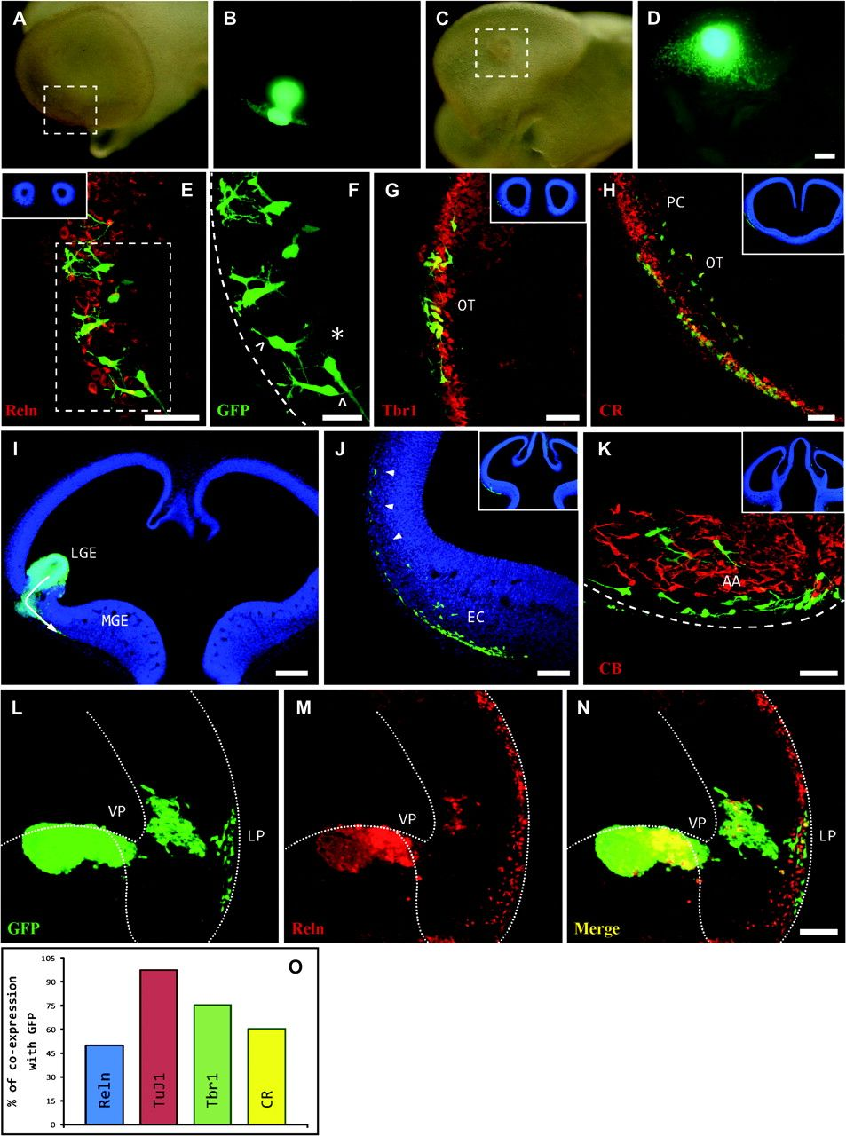
Figure 3. Implant of CCH tissue from a GFP⁺ mouse embryo (E11) into the LGE (I) of a wt mouse at the same ...
Notes:
Figure 3. Implant of CCH tissue from a GFP+ mouse embryo (E11) into the LGE (I) of a wt mouse at the same developmental stage, which was then cultured for 24 h in toto. The images in this plate are from more rostral (E) toward more caudal (K) levels along the anteroposterior brain axis. (A, B): lateral view of the telencephalon with the GFP+ implant. (C, D): ventrolateral view showing the anterior and posterior routes, taken by migratory cells generated in the implant throughout the ventral telencephalon. The boxes in (A) and (C) mark the exact site where the implant was deposited. Cells generated in the CCH implant migrate using new but established routes, in this case, through the subpallial structure into which they were integrated (I, arrow). These cells migrate radially to reach the marginal zone, where they change direction to move forward and backward subpially, some of them separating from the superficial layer to colonize other more caudal structures such as the olfactory tubercle (OT; G, H), the entorhinal cortex (EC; J), or the amygdaloid area (AA; K). These cells do not colonize the PC (G, H). At the rostral level (anterior telencephalic pole), the cells are more differentiated (F, asterisk) than those found at the caudal level, where they had a fusiform morphology and fewer branches (K). The implanted cells express the typical markers of C-R cells, including Reelin (E), Tbr1 (G), and CR (F), and they were negative for CB (K). (L–M): implant of CCH tissue from a GFP+ mouse embryo (E11) into the VP. The cells fail to reach the preplate of dorsal pallium and migrate to the outmost layer of LP. The strong expression of the C-R markers is represented in a bar chart (O). Scale bars: (A–D, I): 200 μm; (E, G, K): 50 μm; (F): 25 μm; (I, J, L–N): 100 μm.
Unless provided in the caption above, the following copyright applies to the content of this slide: © The Author 2010. Published by Oxford University Press. All rights reserved. For permissions, please e-mail: journals.permissions@oxfordjournals.org

Slide 4
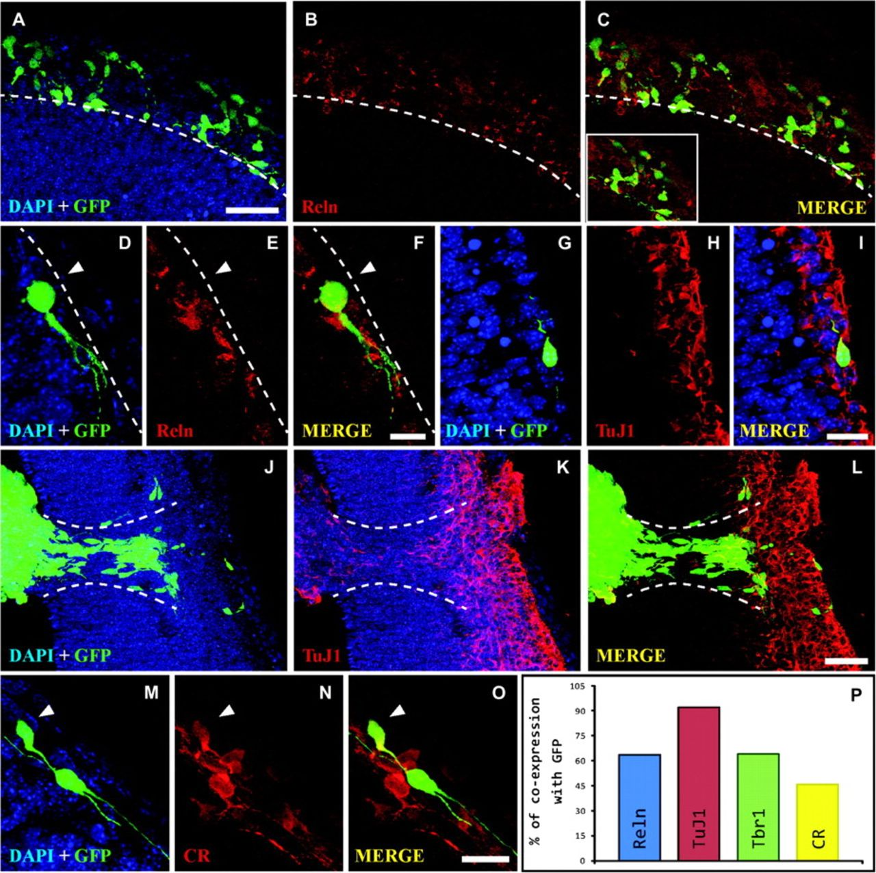
Figure 4. Immunohistochemical analysis of the cells generated by the implants. The bar chart (P) shows the percentage ...
Notes:
Figure 4. Immunohistochemical analysis of the cells generated by the implants. The bar chart (P) shows the percentage of GFP+ cells that express Reelin (Reln; B, C, E, F), β tubulin-III (TuJ1; H, I, K, L), and CR (N, O). Arrowheads in (D–F) and (M–O) indicate individual cells co-expressing 2 different markers. Scale bars—(A–C, J–L): 50 μm; (D–F): 10 μm; (G–I, M–O): 20 μm.
Unless provided in the caption above, the following copyright applies to the content of this slide: © The Author 2010. Published by Oxford University Press. All rights reserved. For permissions, please e-mail: journals.permissions@oxfordjournals.org

Slide 5
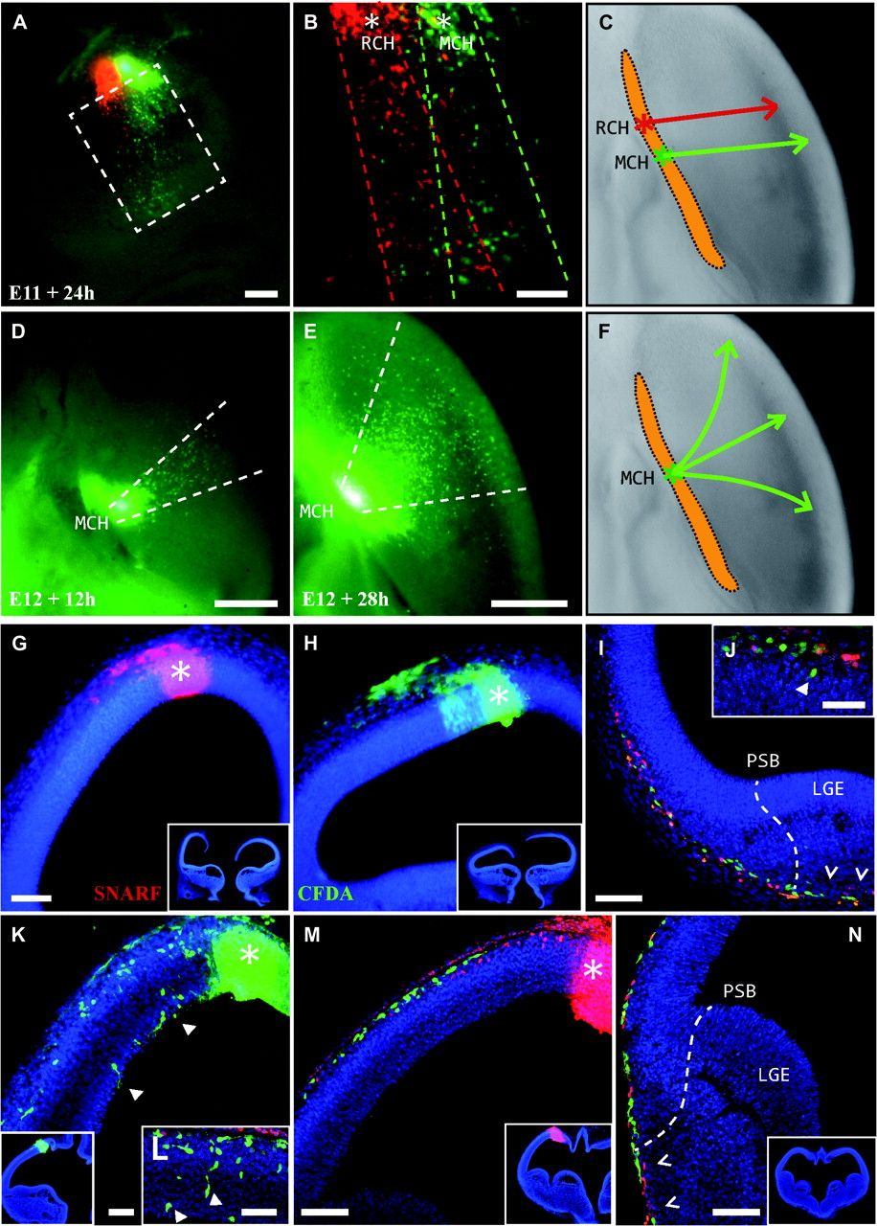
Figure 5. Dual injection of fluorescent tracers (CFDA/SNARF) into the RCH and MCH of Sey mutant mice at E11 (A–C, G–J) ...
Notes:
Figure 5. Dual injection of fluorescent tracers (CFDA/SNARF) into the RCH and MCH of Sey mutant mice at E11 (A–C, G–J) and E12 (D–F, K–N). The dark yellow area defined in (C) and (F) represents the Wnt3a expression that labels the entire extension of the CH. In these mutant mice, the cells generated in the RCH and MCH migrate along strictly lateral routes rather than along their normal migratory pathways from the caudal to rostral areas. Furthermore, cells from different adjacent domains may intermingle during the first 24 h in culture (A–C). In (A and B), rostral is to the left and dorsal is toward the top. However, 1 day later (at E12), massive migration occurs from the CH, firstly in a very limited manner (D) and some hours later, cells spread throughout the rostral and caudal areas in a fan-like fashion (E, F). (D) and (E) is a view from the top. The asterisks in (G, H, K, and M) mark the injection site with the selected tracers in coronal sections: SNARF, red and CFDA, green. Labeled cells generated in the most caudal domain of the CH invade the adjacent anterior domain and migrate through the preplate, extending beyond the PSB. This is more evident at E12 (I, M, N; open arrowheads). In the mutants, migrating cells that do not lie in a subpial position are commonly observed, and they appear as debris from the preplate (J, arrowhead) or even in the deepest neuroepithelial strata (K, L; solid arrowheads). Scale bars—(A): 250 μm; (B, G–J, M, N): 100 μm; (D, E): 500 μm; (K, L): 50 μm.
Unless provided in the caption above, the following copyright applies to the content of this slide: © The Author 2010. Published by Oxford University Press. All rights reserved. For permissions, please e-mail: journals.permissions@oxfordjournals.org

