Slide 1
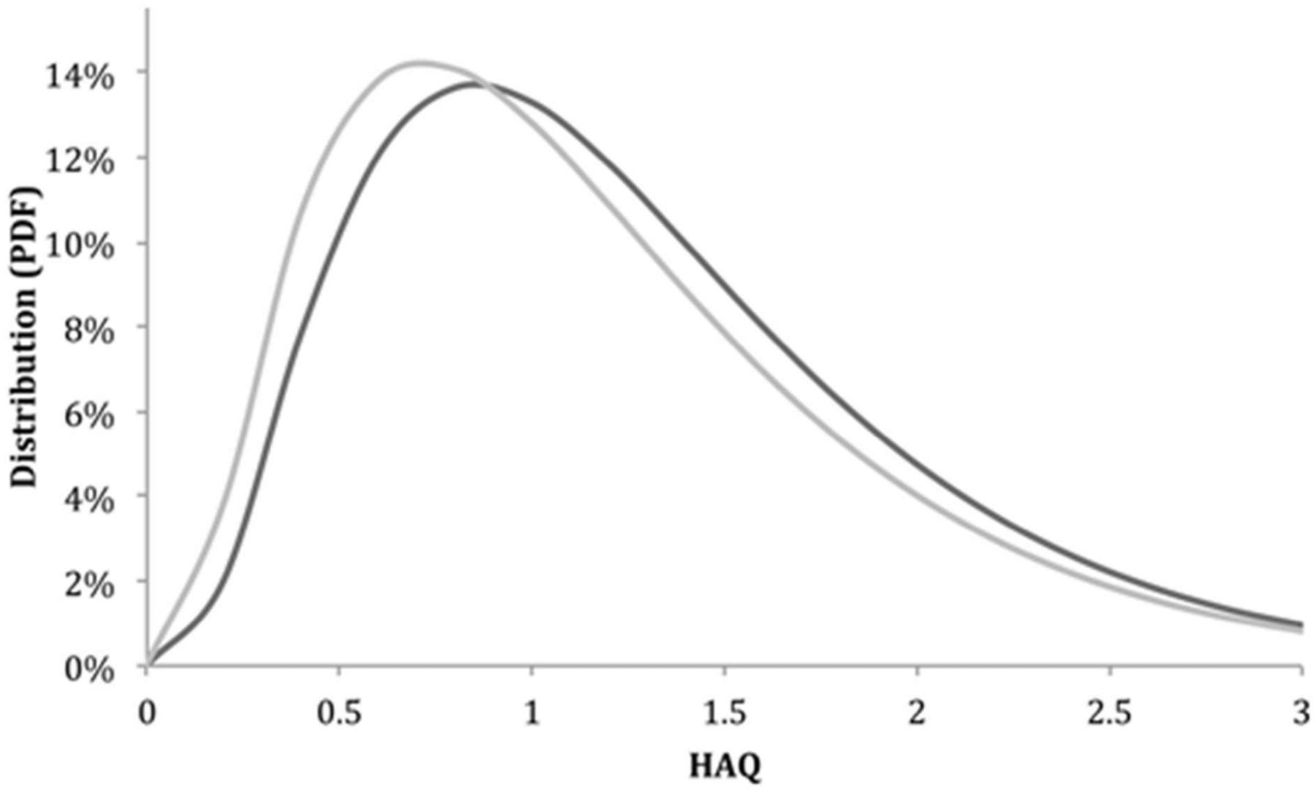
Fig. 1 HAQ distribution: current clinical practice vs MBDA at year 1 Dark grey: current clinical practice; light ...
Notes:
Fig. 1 HAQ distribution: current clinical practice vs MBDA at year 1 Dark grey: current clinical practice; light grey: with Vectra DA. Shift of the curve, to the left, denotes improvement in the mean HAQ score with the use of the MBDA test (year 1). MBDA: multibiomarker disease activity; PDF: probability density function.
Unless provided in the caption above, the following copyright applies to the content of this slide: © The Author 2015. Published by Oxford University Press on behalf of the British Society for RheumatologyThis is an Open Access article distributed under the terms of the Creative Commons Attribution Non-Commercial License (http://creativecommons.org/licenses/by-nc/4.0/), which permits non-commercial re-use, distribution, and reproduction in any medium, provided the original work is properly cited. For commercial re-use, please contact journals.permissions@oup.com

Slide 2
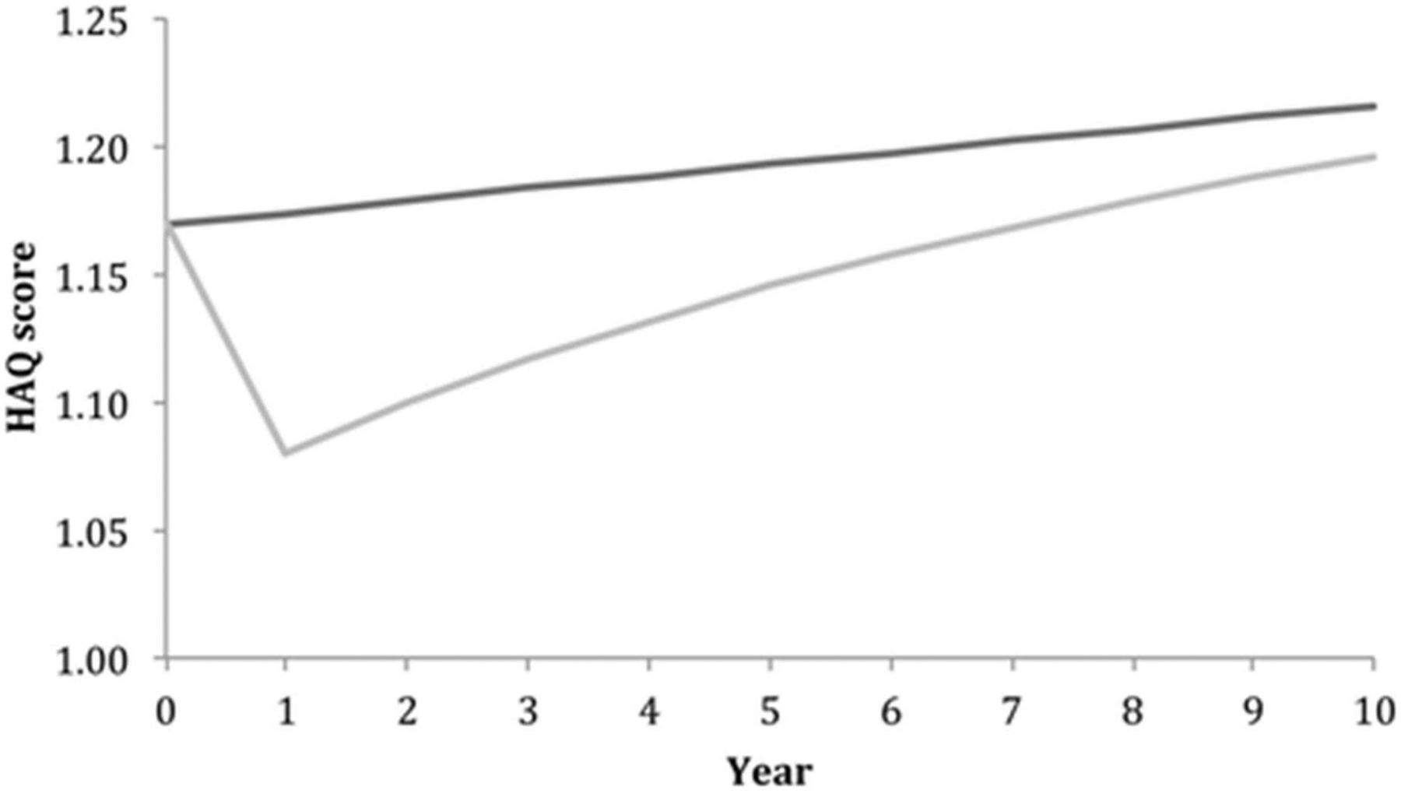
Fig. 2 Mean HAQ progression over a 10-year time horizon with and without MBDA test adjunct Dark grey: current ...
Notes:
Fig. 2 Mean HAQ progression over a 10-year time horizon with and without MBDA test adjunct Dark grey: current clinical practice; light grey: with Vectra DA. MBDA: multibiomarker disease activity.
Unless provided in the caption above, the following copyright applies to the content of this slide: © The Author 2015. Published by Oxford University Press on behalf of the British Society for RheumatologyThis is an Open Access article distributed under the terms of the Creative Commons Attribution Non-Commercial License (http://creativecommons.org/licenses/by-nc/4.0/), which permits non-commercial re-use, distribution, and reproduction in any medium, provided the original work is properly cited. For commercial re-use, please contact journals.permissions@oup.com

Slide 3
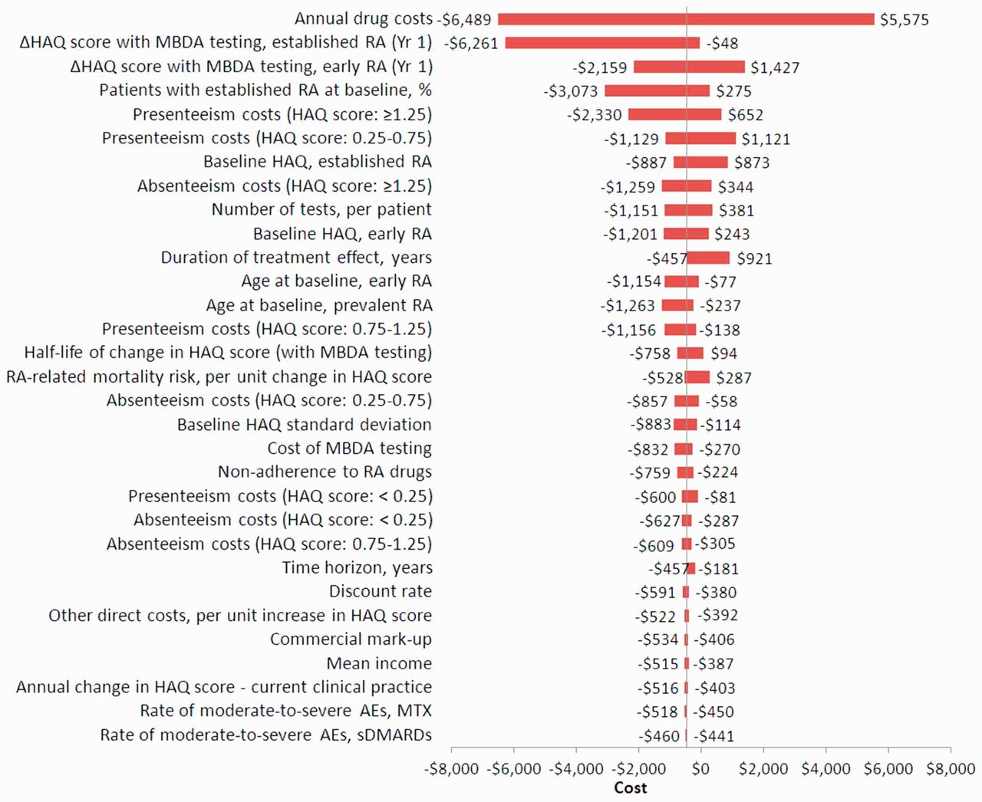
Fig. 3 One-way sensitivity analysis (effect on costs) Lower and upper bounds for parameters presented in the ...
Notes:
Fig. 3 One-way sensitivity analysis (effect on costs) Lower and upper bounds for parameters presented in the supplementary data, available at Rheumatology Online. All variables were analysed in the one-way sensitivity analysis, however, only those showing a difference >US$10 (between the upper and lower bound) were included in the figure. All costs reported in 2014 US dollars. AEs: adverse events; MBDA: multibiomarker disease activity; sDMARDs: synthetic DMARDs.
Unless provided in the caption above, the following copyright applies to the content of this slide: © The Author 2015. Published by Oxford University Press on behalf of the British Society for RheumatologyThis is an Open Access article distributed under the terms of the Creative Commons Attribution Non-Commercial License (http://creativecommons.org/licenses/by-nc/4.0/), which permits non-commercial re-use, distribution, and reproduction in any medium, provided the original work is properly cited. For commercial re-use, please contact journals.permissions@oup.com

Slide 4
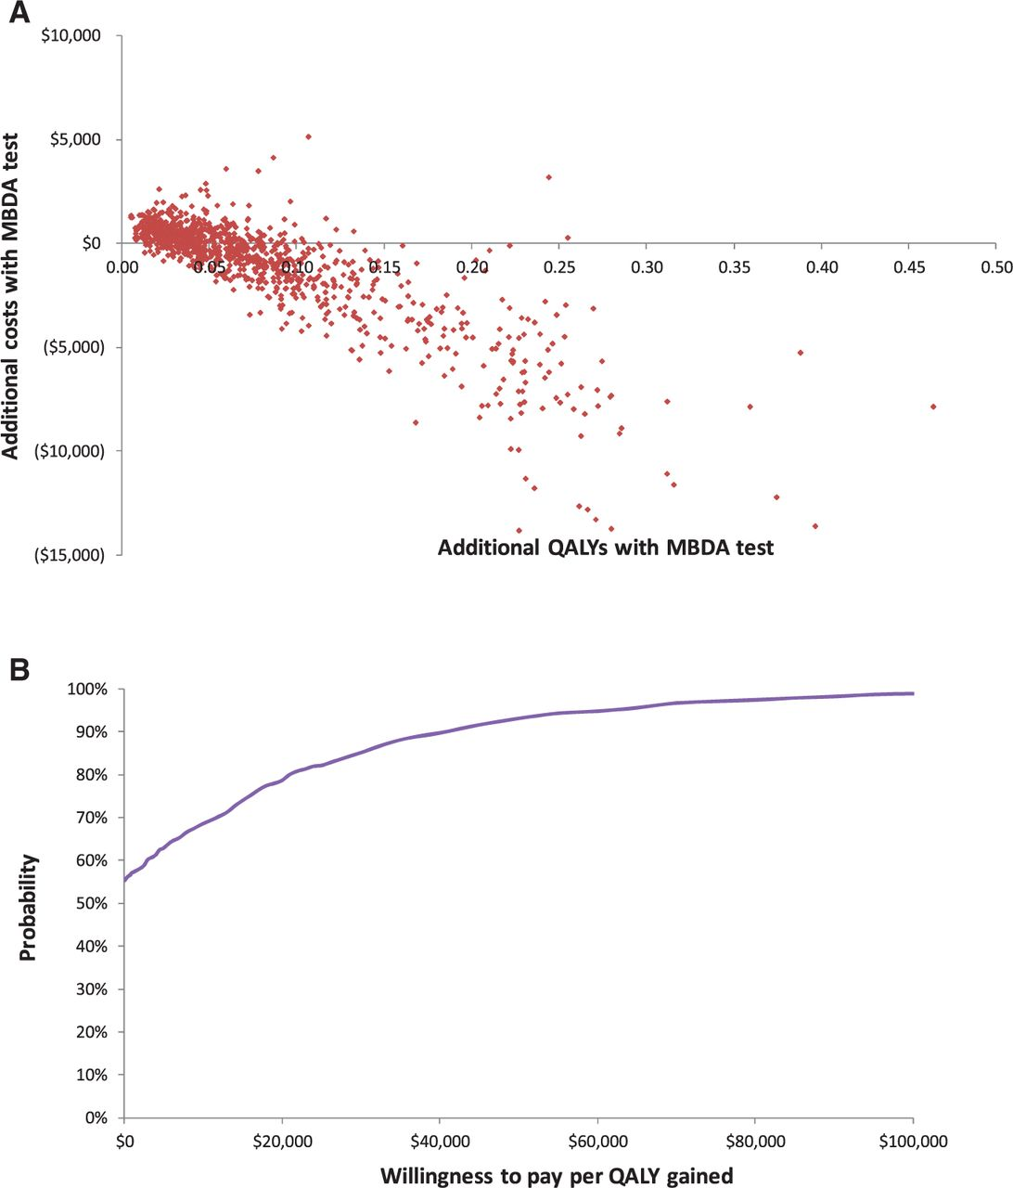
Fig. 4 Probabilistic sensitivity analysis (A) Incremental costs vs incremental QALYs. (B) Probability that cost per ...
Notes:
Fig. 4 Probabilistic sensitivity analysis (A) Incremental costs vs incremental QALYs. (B) Probability that cost per QALY gained is less than or equal to the willingness-to-pay threshold per QALY gained. MBDA: multibiomarker disease activity; QALY: quality-adjusted life years.
Unless provided in the caption above, the following copyright applies to the content of this slide: © The Author 2015. Published by Oxford University Press on behalf of the British Society for RheumatologyThis is an Open Access article distributed under the terms of the Creative Commons Attribution Non-Commercial License (http://creativecommons.org/licenses/by-nc/4.0/), which permits non-commercial re-use, distribution, and reproduction in any medium, provided the original work is properly cited. For commercial re-use, please contact journals.permissions@oup.com

