Slide 1
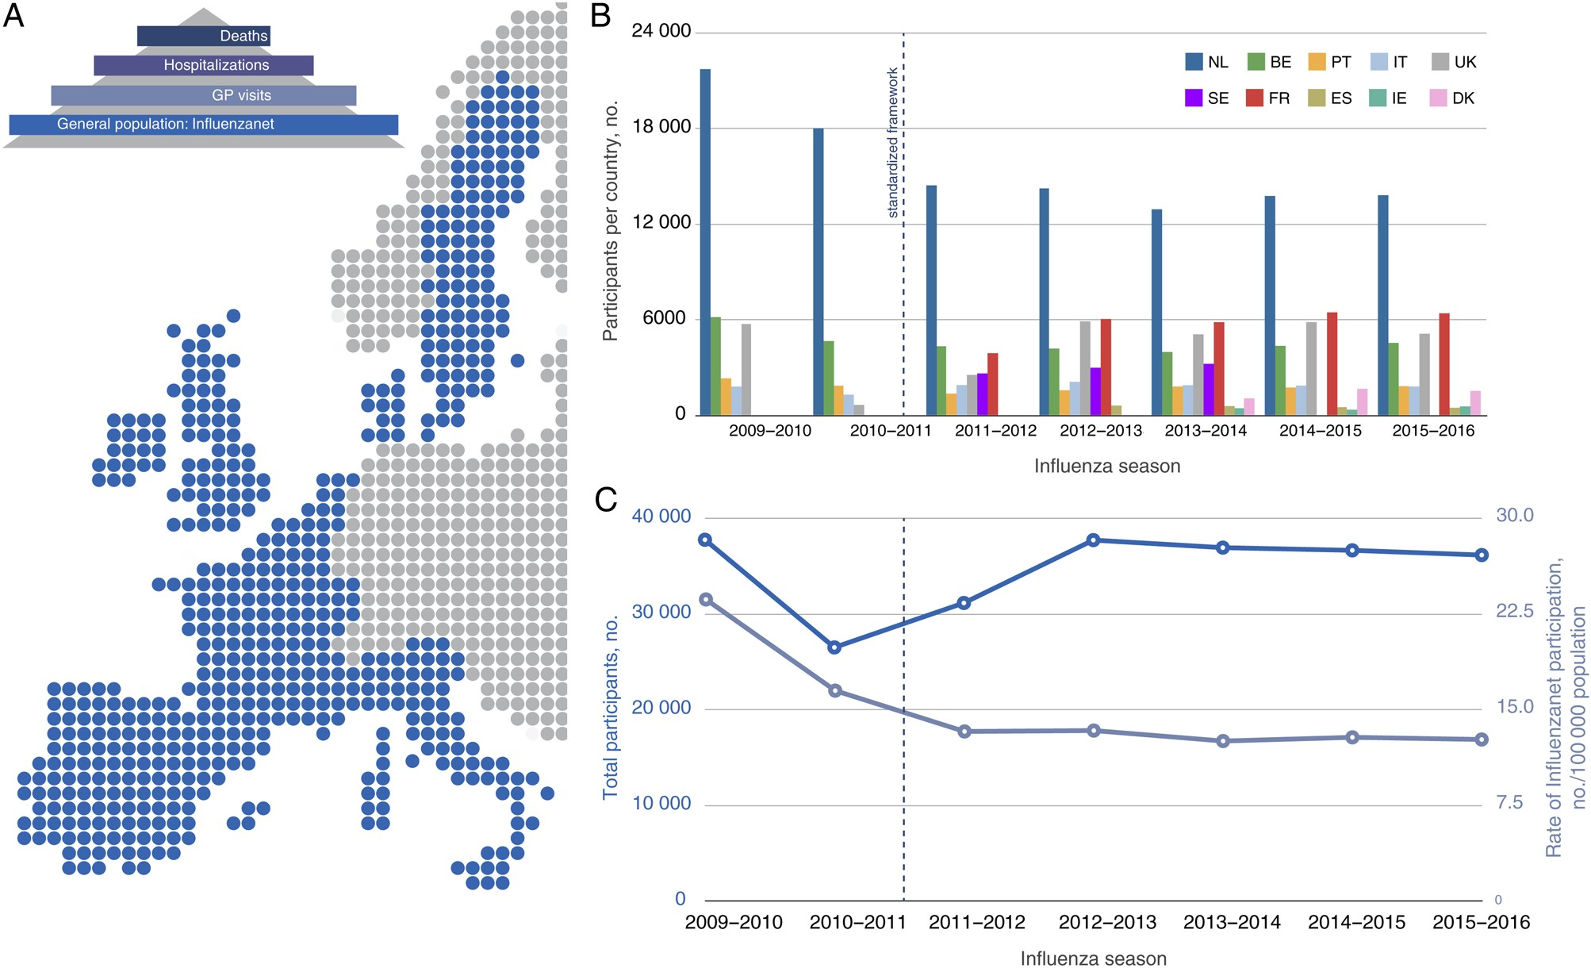
Figure 1. Influenzanet participatory surveillance system for influenza-like illness (ILI). A, ILI monitoring scheme ...
Notes:
Figure 1. Influenzanet participatory surveillance system for influenza-like illness (ILI). A, ILI monitoring scheme illustrating different layers of surveillance used by public health authorities, including (depending on the country) sentinel general practitioner (GP) networks counting ILI visits, ILI-associated hospitalization data, and ILI-associated mortality data. Influenzanet represents an additional layer for ILI monitoring, through syndromic surveillance in the general population by means of a web-based participatory system. It includes the following 10 countries schematically represented in the map: the Netherlands (NL; available at: http://www.degrotegriepmeting.nl), Belgium (BE; http://www.degrotegriepmeting.be), Portugal (PT; http://www.gripenet.pt), Italy (IT; http://www.influweb.it), the United Kingdom (UK; http://flusurvey.org.uk), Sweden (SE; http://www.halsorapport.se), France (FR; http://www.grippenet.fr), Spain (ES; http://www.gripenet.es), Ireland (IE; http://flusurvey.ie), and Denmark (DK; http://influmeter.dk). B, Number of Influenzanet participants per country per season since its launch in 2009–2010 influenza season. The dashed vertical line indicates the standardized framework introduced from the 2011–2012 season. C, Total number of Influenzanet participants per season (left axis) and rate of Influenzanet participation per season (right axis) expressed as the number of participants per 100 000 individuals of the total population of Influenzanet countries.
Unless provided in the caption above, the following copyright applies to the content of this slide: © The Author 2016. Published by Oxford University Press for the Infectious Diseases Society of America. All rights reserved. For permissions, e-mail journals.permissions@oup.com.

